Slide 1
Factorial ANOVA
Chapter 14

Slide 2
‘People can be divided into two classes: Those who go ahead and do something, and those who sit still and inquire, 'Why wasn't it done the other way?’’
Oliver Wendell Holmes
American Physician, Writer, Humorist, Harvard Professor
1809-1894

Slide 3
Dr. Petrov is interested in
conducting an experiment where:
30 high school students are randomly assigned to a new computer simulation tool for learning geometry and
30 other students are randomly assigned to the standard lecture and paper/pencil problem solving format.
However, Dr. Petrov is also interested in the effect of sex differences on learning outcomes.
r = # rows
c = # columns
r x c
1-way ANOVA:
GROUPING FACTOR
“Teaching method”
k = 2
2-way ANOVA:
COLUMN FACTOR
“Teaching method”
c = 2
•
2-way ANOVA:
ROW FACTOR
“Sex”
r = 3

Slide 4
Analysis of Variance
r = # rows
c = # columns
r x c
The # levels of each factor determines ANOVA design
Independent ANOVA types…
1-Way ANOVA = 1 factor (previously covered)
2-Way ANOVA = 2 factors (focus of lecture)
3-Way ANOVA = 3 factors
4-Way ANOVA = 4 factors
Row factor = 2 levels
Column factor = 3 levels
2-way ANOVA
with a 2X3 factorial design
Row factor = 4 levels
Column factor = 2 levels
2-way ANOVA
with a 4X2 factorial design

Slide 5
Means table
Summary of data

Slide 6
Means Table:
r = 3 rows
c = 2 columns
3 x 2
 | computer simulation tool | lecture and paper/pencil problem | Margin
Male
Female
Other
Margin |  |  | M_{G}
2-way ANOVA:
ROW FACTOR
“Sex”
r = 3
Grand Mean
Mean of ENTIRE sample’s Outcome (DV)
2-way ANOVA:
COLUMN FACTOR
“Teaching method”
c = 2

Slide 7
Means Table:
r = # rows
c = # columns
3 x 2
 | computer simulation tool | lecture and paper/pencil problem | Margin
Male |  |  | M_{1•}
Female |  |  | M_{2•}
Other |  |  | M_{3•}
Margin |  |  | M_{G}
2-way ANOVA:
ROW FACTOR
“Sex”
r = 3
Row Means
Marginal Means for Rows
Grand Mean
Mean of ENTIRE sample’s Outcome (DV)
2-way ANOVA:
COLUMN FACTOR
“Teaching method”
c = 2

Slide 8
Means Table:
r = # rows
c = # columns
3 x 2
 | computer simulation tool | lecture and paper/pencil problem | Margin
Male |  |  | M_{1•}
Female |  |  | M_{2•}
Other |  |  | M_{3•}
Margin | Μ_{•1} | Μ_{•2} | M_{G}
2-way ANOVA:
ROW FACTOR
“Sex”
r = 3
Row Means
Marginal Means for Rows
Grand Mean
Mean of ENTIRE sample’s Outcome (DV)
2-way ANOVA:
COLUMN FACTOR
“Teaching method”
c = 2
Column Means
Marginal Means for Coumns

Slide 9
Means Table:
r = # rows
c = # columns
3 x 2
 | computer simulation tool | lecture and paper/pencil problem | Margin
Male | Μ₁₁ | Μ₁₂ | M_{1•}
Female | Μ₂₁ | Μ₂₂ | M_{2•}
Other | M₃₁ | Μ₃₂ | M_{3•}
Margin | Μ_{•1} | Μ_{•2} | M_{G}
2-way ANOVA:
ROW FACTOR
“Sex”
r = 3
Row Means
Marginal Means for Rows
Grand Mean
Mean of ENTIRE sample’s Outcome (DV)
2-way ANOVA:
COLUMN FACTOR
“Teaching method”
c = 2
Column Means
Marginal Means for Coumns
Cell Means
Interior Means for Each Cell

Slide 10
The basics
Statistical significance of effects

Slide 11
Factorial 2-Way ANOVA
r = # rows
c = # columns
r x c
Simultaneously evaluate effect of 2 or more factors’ effects on a continuous outcome
AND
investigate a potential 3rd effect: an interaction between the two factors.
Cross-classification:
Participants only belong to 1 mutually exclusive ‘cell’
Belong to 1 level of row factor
Belong to 1 level of columns factor
Typical 2-way ANOVA
3x2 design
Row factor (“A”): 3 levels
Column factor (“B”): 2 levels

Slide 12
Test of Row Main Effect
r = # rows
c = # columns
r x c
Do row marginal means differ?
Do population means differ across levels of row factor, averaging across levels of column factor?
H₀: μ_{1•} = μ_{2•} = … = μ_{r•}
H₁: Not H₀
B
B1
B2
Marginals
A1
M
M
M
11
12
A1
A
A2
M
M
M
21
22
A2
A3
M
M
M
31
32
A3
Marginals
M
M
B1
B2

Slide 13
Test of Column Main Effect
r = # rows
c = # columns
r x c
Do column marginal means differ?
Do population means differ across levels of column factor, averaging across levels of row factor?
H₀: μ_{•1} = μ_{•2} = … = μ_{•c}
H₁: Not H₀
B
B1
B2
Marginals
A1
M
M
M
11
12
A1
A
A2
M
M
M
21
22
A2
A3
M
M
M
31
32
A3
Marginals
M
M
B1
B2

Slide 14
Test of Interaction Effect
Does pattern of cell means differ?
Are differences among population means across row factor similar across all levels of column factor (and vice versa)?
H₀: Differences among levels for 1 factor do not vary across levels of other factor
H₁: Not H₀

Slide 15
Possible Outcomes: order to investigate
Significant Interaction and…
Always check for FIRST
Always interpret FIRST
Exercise EXTREME caution interpreting significance and effect of main effects
No significant interaction, but…
Significant main effects for both rows and columns
Significant of only main effect for rows, but not for columns
Significant of only main effect for columns, but not for rows
No significance… main effects or interaction(s)

Slide 16
Ignoring Factorial Design
Treat each cell as a separate group (e.g., M/Rep, M/Dem, F/Rep, F/Dem) and run analysis as 1-Way ANOVA with R*C groups?
Results in same SS_{Between} as factorial design (SS_{R} + SS_{C} + SS_{RC} ; when study is balanced)
Cannot see patterns in data, as all levels of all factors are blended together in each group
Cannot as easily observe interaction effects
Limits identification of characteristics that uniquely differentiate participants
More cumbersome when many factors included
Less powerful

Slide 17
Reduced Error
Adding factors that
explain subject-to-subject variability
in outcome
reduces MS_{W} & increases power
Variance within (and thus across) individual cells
is reduced
as cases become more homogeneous
in terms of their characteristics
Subject-to-subject variability contributes to
increased MS_{W}
=> Less power
Factors that do not have this effect may slightly decrease power
df_{W} =N – rc
decreases as # cells increases,
increasing MS_{W} & decreasing F-ratios
Alternatives:
Restriction (subjects from 1-level only – reduced generalizability)
Repeated-measures (matched) designs

Slide 18
Assumptions
Can NOT test or “fix” this
You can only can PLAN well
Look at the PLOT
{histogram, QQ plot, boxplot}
of the OUTCOME,
for each cell’s subsample
Similar to 1-Way ANOVA…
Independence (observations)
Outcome is normally distributed in EACH population
Homogeneity of variance in EACH population
Run Levene’s Test of HOV
for all cell’s subsample

Slide 19
OMNIBUS F-Tests
Statistical significance of effects

Slide 20

ANOVA Summary Table:
4-Sum of Squares
1-Way ANOVA
2-Way ANOVA
Source | SS | df | MS | F | p
Group
Within
Total
Source | SS | df | MS | F | p
Row
Column
R x C
Within
Total

Slide 21
Partitioning Total Variance (SS_{total})
For balanced designs (all cells are the same size)…
GROUPING Effect
k = # groups
SS_{Total} = SS_{Between-Groups} + SS_{Within-Groups}
1-Way ANOVA
2-Way ANOVA
SS_{Total} = SS_{(R)ows} + SS_{(C)olumns} + SS_{RC} + SS_{Within-Cell}
ROW Main Effect
r = # rows
COLUMN Main Effect
c = # columns
INTERACTION Effect
r x c = # cells

Slide 22
SS_{R}
Computed with row means:
all scores in a given row are averaged,
regardless of column
n_{row} = # participants per row
Grand Mean
Mean of ENTIRE sample’s Outcome (DV)
Row Means
Marginal Means for Rows
2 Alternative Forms, Give the same value

Slide 23
SS_{C}
Computed with column means:
all scores in a given column are averaged
regardless of row
n_{col} = # participants per column
Grand Mean
Mean of ENTIRE sample’s Outcome (DV)
Column Means
Marginal Means for Columns
2 Alternative Forms, Give the same value

Slide 24
SS_{RC}
Variability among cell means
AFTER REMOVING variability due to
individual row and column effects
n_{cell} = # participants per cell
Grand Mean
Mean of ENTIRE sample’s Outcome (DV)
Cell Means
Interior Means for Each Cell
2 Alternative Forms, Give the same value

Slide 25
SS_{W}
For each cell, all scores within that cell are subtracted from cell mean, squared, and summed
SS within each cell added together
SS_{W} = SS₁₁ + SS₁₂ +…+ SS_{rc}
3 Alternative Forms, Give the same value

Slide 26
ANOVA Summary Table:
Degrees of Freedom
1-Way ANOVA
2-Way ANOVA
Source | SS | df | MS | F | p
Group
Within
Total
Source | SS | df | MS | F | p
Row
Column
R x C
Within
Total

Slide 27
Degrees of Freedom: “df”
2-way or factorial (Ch 14)
n = # obs per cell
r = # rows
c = # columns
n_{T} = total # observations
1-way or independent groups (Ch 12)
n = # obs per group
k = # groups
n_{T} = total # observations

Slide 28
ANOVA Summary Table:
VarianCe Estimates
1-Way ANOVA
2-Way ANOVA
Source | SS | df | MS | F | p
Group
Within
Total
Source | SS | df | MS | F | p
Row
Column
R x C
Within
Total

Slide 29
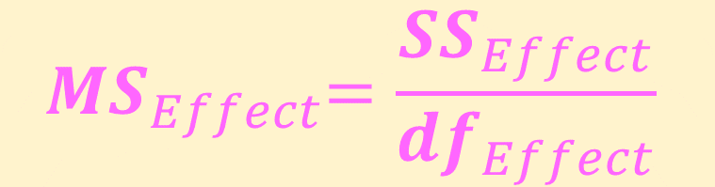
4x Variance Estimates: “MS”
$${ MS}_{Effect}=\frac{{SS}_{Effect}}{{df}_{Effect}}$$
Variance Estimate | Effect of … | Sensitive to effect of…
MS_{R} | Row’s Factor Name | Row-wise Factor
MS_{C} | Column’s Factor Name | Column-wise Factor
MS_{RxC} | Interaction | Interaction between the Row-wise & Column-wise Factors
MS_{W} | Within-Cell, Residual, or Error | None of the Factors (noise)
Note MS_{Within} is also called MS_{W} , MS_{Error} , MS_{Residual} , or “MSE”

Slide 30
ANOVA Summary Table:
Omnibus f-tests
1-Way ANOVA
2-Way ANOVA
Source | SS | df | MS | F | p
Group
Within
Total
Source | SS | df | MS | F | p
Row
Column
R x C
Within
Total

Slide 31
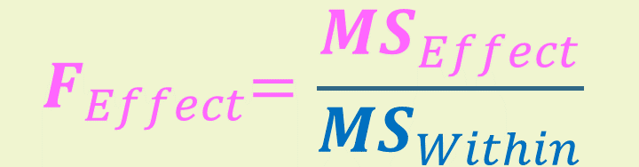
3x F-Statistics (F-ratio or F-test) → p-values
$${ F}_{Effect}=\frac{{MS}_{Effect}}{{MS}_{Within}}$$
The Denominator (bottom) of each F-ratio and df’s are the same for all 3 F-tests
F-stats | Effect of … | Degrees of Freedom
 |  | numerator | denominator
F_{R} | Row’s Factor Name | df_{R} = r - 1 | df_{Within} = n_{T} – (r x c)
F_{C} | Column’s Factor Name | df_{C} = c - 1 | df_{Within} = n_{T} – (r x c)
F_{RxC} | Interaction | df_{R x C} = (r – 1) x (c - 1) | df_{Within} = n_{T} – (r x c)
NOTE Since each F-test CAN have a different numerator df,
the critical values (F_{CV}) may all be different

Slide 32
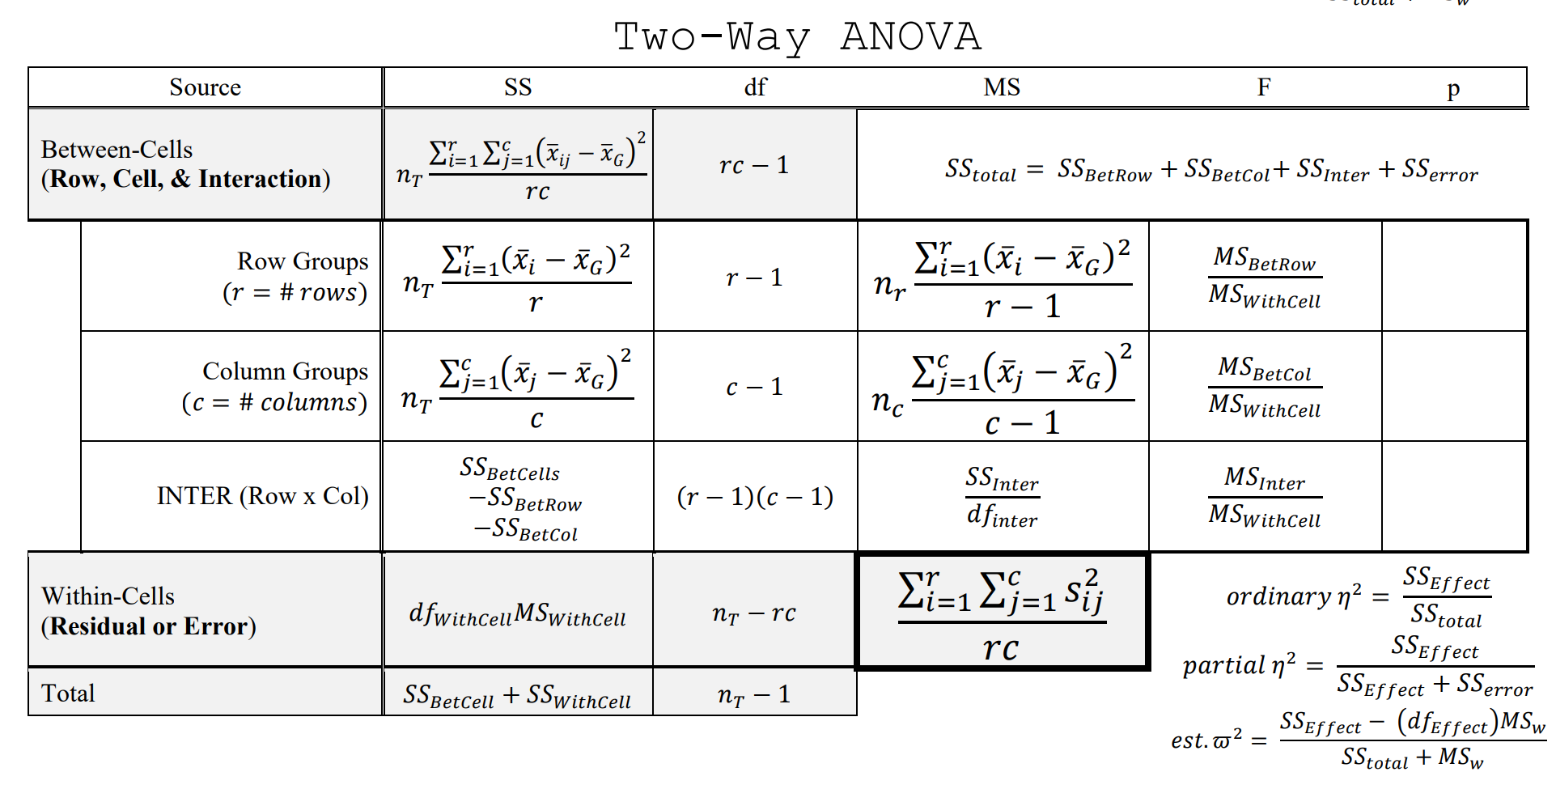
Formula sheet

Slide 33
Effect Size
How big is the effect?

Slide 34
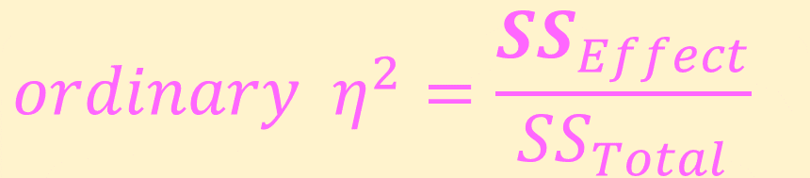
Effect Size
Proportion of variation in outcome accounted for by a particular factor or interaction term
$$ordinary { η}^{2}=\frac{{SS}_{Effect}}{{SS}_{Total}}$$
Interpretation:
Range: 0 to 1
Small: .01 to .06
Medium: .06 to .14
Large: > .14
Eta-squared (η²)
1-way ANOVA
SS_{Between} / SS_{Total}
2-way ANOVA
Row factor: SS_{R} / SS_{Total}
Column factor: SS_{C} / SS_{Total}
Interaction: SS_{RC} / SS_{Total}

Slide 35
Effect Size – “should” but people don’t
η² are biased parameter estimates
Should estimate omega squared (ω²)
Substitute SS and df values
Same interpretation as η²

Slide 36
Effect Size – partial
When all factors are experimental or when many factors are included in analysis, SS due to a factor or interaction will be small relative to SS_{Total}
Partial effect size estimates are often reported
Proportion of variation in outcome accounted for by a particular factor or interaction term, excluding other main effects or interaction sources of variation

Slide 37
Interactions
Moderation of effects

Slide 38
Interactions: aka “Moderation
Interaction between …
2 factors is called a “2-way interaction”
3 factors is called a “3-way interaction”
Quite rare, be skeptical BUT I have found/published them ;)
Significance indicates that the effect of 1 factor is not same at all levels of another factor
i.e. the effect of 1 factor depends on the level of the other
Effect of variables combined is different than would be predicted by either variable alone
Most interesting results, but more difficult to explain or interpret than main effects

Slide 39
Interactions
Ordinal
Direction or order of effects is similar for different subgroups
Disordinal
Direction or order of effects is reversed for different subgroups

Slide 40
Interactions
Significance of interaction always evaluated 1st
If significant, interpret interaction, not main effects
If non-significant, interpret main effects
Once we know effects of 1 factor are tempered by or contingent on levels of another factor (as in an interaction), interpretation of either factor (main effect) alone is problematic
Best interpreted through visualization
Cell means plot
Interactions exist if lines cross or will cross (non-parallel)
Design graph to best illustrate
Outcome on y-axis
Select one factor for x-axis
Other factor(s) represented by separate lines, colors, panels, ect.
Selection guides interpretation, can dictate whether plot is ordinal/disordinal

Slide 41
Interactions
It is Recommend to only interpreting significant main effects (Keppel & Wickens, 2004) IF…
there is NO significant interaction
there is a significant interaction WITH EXTREME CAUTION, IF…
interaction effect size is small relative to that of main effects and
there is an ordinal pattern to the means
However, must report all main and interaction effects regardless of statistical significance

Slide 42
Need for Testing Interactions
Results may be distorted if additional factors are not included in analysis so that interactions are not tested
E.g., If experimental effects of a drug had opposite effects in men and women, the variable representing drug effects may appear to be ineffective (non-significant main effect) without including the variable for sex differences
If interaction terms are non-significant, increased confidence that effect of key factor (e.g., drug treatment) is generalizable to all levels of other factors (e.g., sex)

Slide 43
Follow-up Tests
Prob Interactions, Post Hoc, a prior’

Slide 44
Multiple Comparisons – follow “iT” up
Factorial ANOVA produces omnibus results
It does NOT indication of specific level (group) differences within or across factor(s)
Multiple comparisons elucidate differences within significant main effects or interactions
Pattern of results dictates approach (eg. Significant main effects, but no interaction)
Each of the 3 F-tests in a 2-Way ANOVA represents a ‘planned comparison’
No adjustment to α_{EW} necessary
However, within each main-effect and interaction a separate family of possible multiple comparisons may be conducted (α_{EW} must be controlled within each ‘family’)

Slide 45
Significant Interaction
Simple main effects generally tested within each level of stratifying factor
2-levels
Simple, pairwise comparisons: Tukey HSD or t-tests with Bonferroni correction
> 2 levels
Modified 1-way ANOVA followed by simple or complex comparisons

Slide 46
Significant Interaction
Modified 1-Way ANOVA tests of simple main effects often done ‘by hand’
Obtain MS_{Between} from standard 1-Way ANOVA
Comparing means across 1 level of 1 factor within 1 level of another factor
Obtain MS_{Within} from original 2-Way ANOVA
Ensure homogeneity of variance assumption is reasonably satisfied

Slide 47
Interaction Contrasts
An alternative is to perform ‘interaction contrasts’, rather than immediately testing simple effects
With a 2x2 design, only tests of simple main effects are possible
With a 2x3 design, 3 separate 2x2 ANOVAs may be conducted
Interaction magnitude (and significance) can differ from one subset to another
Simple effects can be used following significant interaction subsets
MS_{B} for overall interaction = ‘average’ of MS_{Interactions} for separate interaction subsets
Notes:
I HAVE NEVER SEEN ANYONE DO THIS.

Slide 48
Non-Significant Interaction
The you may evaluate possible significant main effect…
Factors with 2 levels
No multiple comparisons required
Factors with > 2 levels
2-way ANOVA is reduced to two 1-Way ANOVAs
Simple (pairwise) or complex (linear) contrasts are computed within individual significant main-effect(s) (ignoring others)

Slide 49
Non-Significant Interaction
Significant main-effects
Simple or complex comparisons among marginal means (levels)
No further tests if F-test of main-effect indicates difference

Slide 50
Results
How to present findings, APA style

Slide 51
Reporting Results
Marginal Ms for main effects, cell Ms for interactions and their SDs (or SEs) and CIs
No need to report MS_{W}
For each significant effect
F(df_{Effect}, df_{Within}) = F_{stat}, p-value, effect size (η² or ω²)
Results of post-hoc or planned comparisons
Figures are *extremely* helpful!

Slide 52
Conclusions
With a non-significant interaction
# of follow-up tests on main-effects needs to be kept low so as to not inflate α_{EW}, where each main-effect can contain a family of tests
With a significant interaction
# of tests of simple effects or interaction contrasts should not exceed df_{Interaction}
For 2x2 ANOVA: # ≤ (r-1)*(c-1)
In Conformity data example = 2*1 = 2 tests
Some forgo tests of simple main effects and compute all possible pairwise comparisons at cell level
Results in many, many tests
Following a significant interaction and significant simple main effects
Not necessary to conduct all possible pairwise comparisons
Planned comparisons should be derived from theory or previous research and flow from research questions
Significant unplanned interactions that do not conform to theory should be swallowed with a HIGH DEGREE OF SKEPTICISM

Slide 53
Unbalanced
Sub-sample sizes are not equal

Slide 54
Unbalanced Designs
Equal ns in each cell = Orthogonal design
Factors are independent/uncorrelated so that significance of any effect is independent of significance of other effects (including interaction)
Most research consists of unbalanced data
As ns across cells become more unequal, factors become more dependent/correlated
Unbalanced: SS_{Between} ≠ SS_{R} + SS_{C} + SS_{RC}
More difficult to determine independent effects of each factor
Previous equations and R commands will not work correctly for unbalanced designs

Slide 55
Unbalanced Designs
Unbalanced
Sum of areas where factors
overlap with DV ≠ SS_{B}
Some areas counted twice
Remaining portion of DV = SS_{W}
Balanced
Sum of areas where factors
overlap with DV = SS_{B}
Remaining portion of DV = SS_{W}
F1
DV
DV
F1
F2
F2
F1xF2
F1xF2

Slide 56
Unbalanced Designs
Reason for unequal ns should be random, not related to factor(s) themselves (more difficult with non-experimental studies)
If not so, validity of results is questionable when regular ANOVA procedures are employed
Adjustments made to ANOVA to correct for unequal ns
Analysis of weighted means: Non-recommended, but common, approach where imbalance is slight and imbalance is random
Harmonic mean of cell ns is used in computation of various MS
Total N is adjusted = Harmonic mean of all cell sizes x # cells
MS_{Within} = Weighted average of cell variances
Each row and column mean computed = Simple (non-weighted) average of cell means in a given row or column
Alternate SS calculations to handle overlapping variation accounted for in outcome (next 2 slides)
Regression analysis (Take EDUC/PSY 7610! And think about PSY 7650 “MLM”)

Slide 57
Alternative SS Calculations
Several methods for partitioning or allocating variation between outcome and factor(s) to account for unbalanced designs
Commonly used
Type I SS: Sequential or Hierarchical
Type II SS: Partially Sequential
Type III SS: Simultaneous or Regression
Specialized and less commonly used
Type IV SS: Don’t use
Type V SS: Used for fractional factorial designs
Type VI SS: Effective hypothesis tests though sigma-restricted coding

Slide 58
Alternative SS Recommendations
Type II or III SS recommended in most cases
Results should be fairly consistent
Type III is most commonly used
Nothing wrong with Type II
Considered by some to be more powerful, especially when testing main effects
Uncertainty of results when n are vastly unbalanced
Not an issue when design is balanced
Type I-III yield same results
Even when unbalanced, interaction result same

