Slide 1
Chapter 8 Power & Effect Size
For EDUC/PSY 6600

Slide 2
“
Cohen (1994): “Next, I have learned and taught that the primary product of research inquiry is one or more measures of effect size, not p values.” (p. 1310).
Abelson (1995): “However, as social scientists move gradually away from reliance on single studies and obsession with null hypothesis testing, effect size measures will become more and more popular” (p. 47).
”

Slide 3
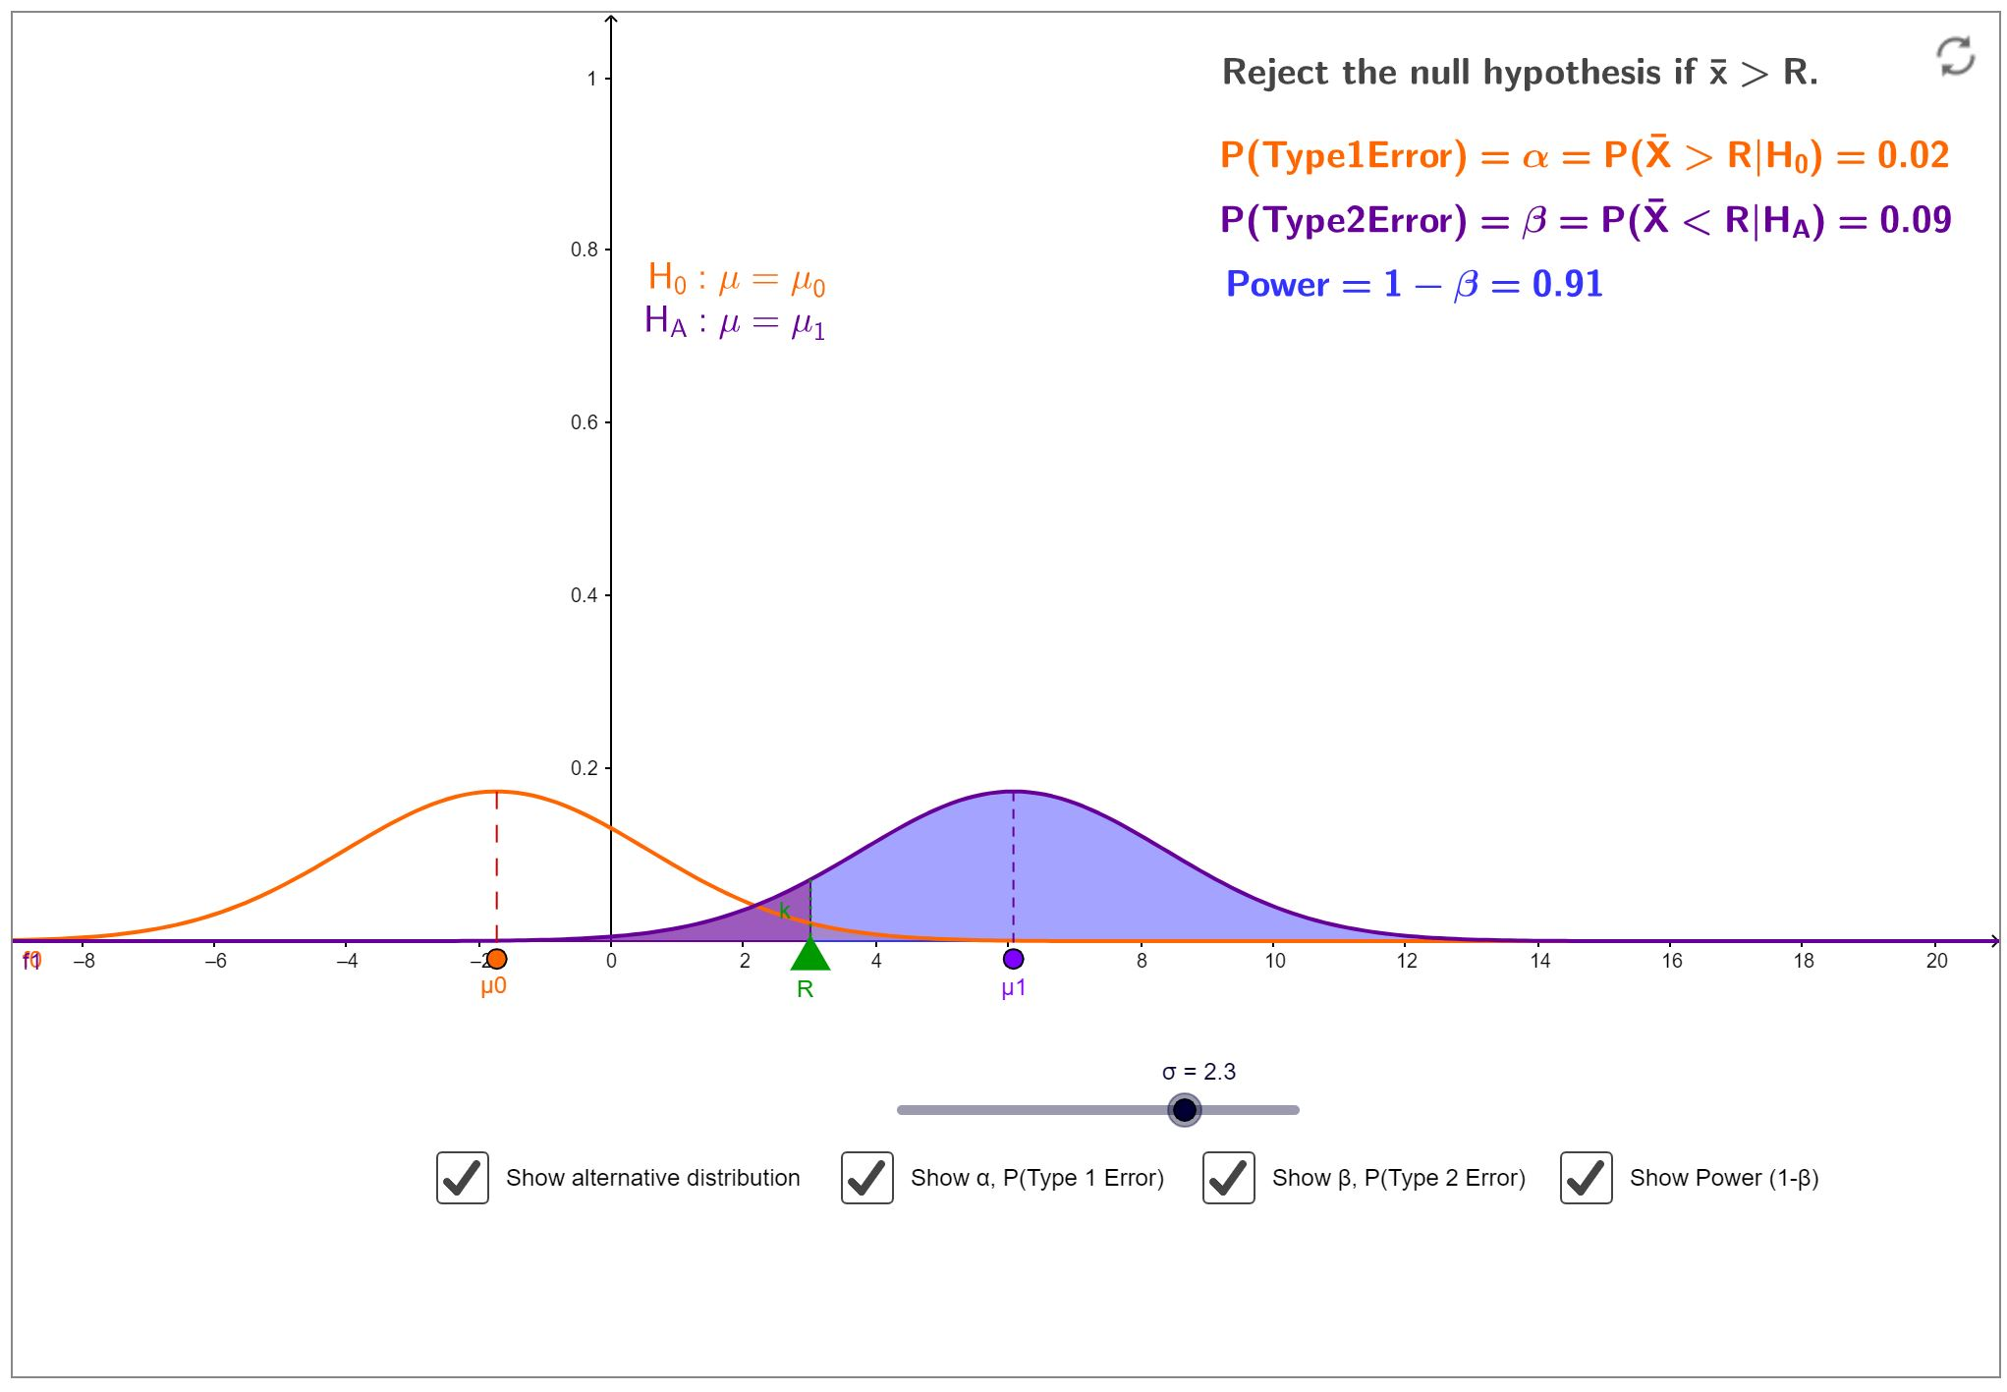
https://math.usu.edu/~schneit/CTIS/HTErrors/HTErrors.html

Slide 4
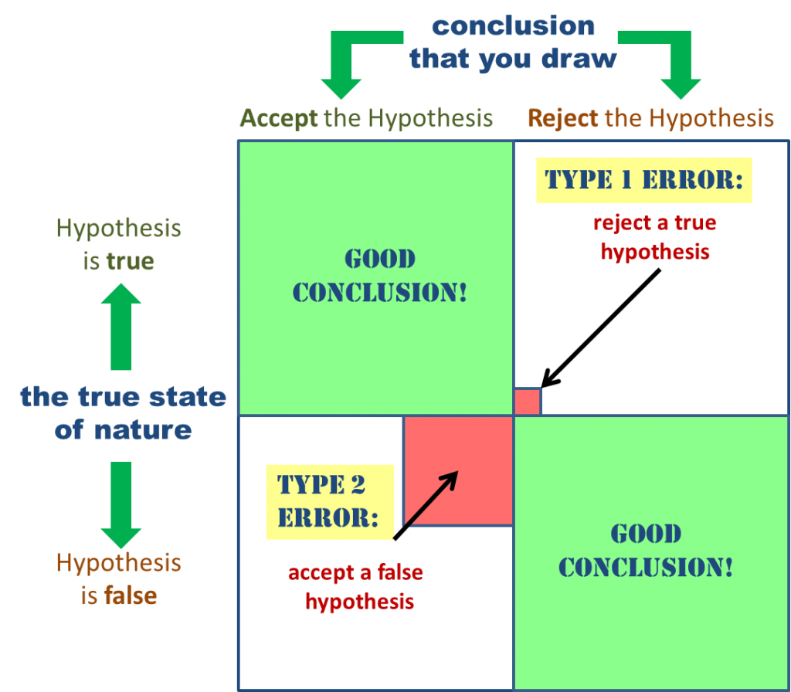


Types of Errors
When we conduct a hypothesis test,
we wither reject or fail to reject the Null Hypothesis.
Our decision usually causes four outcomes:
$$α$$
$$β$$

Slide 5
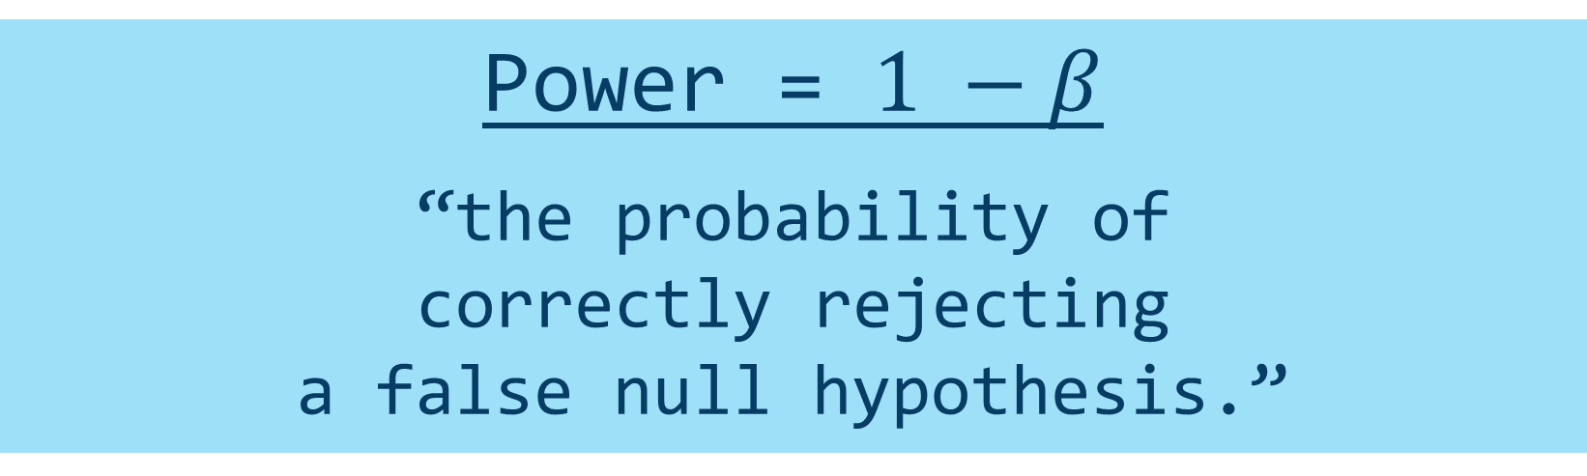
Types of Errors
Power = $1 −β$
“the probability of
correctly rejecting
a false null hypothesis.”

Slide 6
Some background on power, effect size, p-values, and test statistics:
Calculated
Observed
Before collecting data
After collecting and analyzing data
Power
(given expected effect
size, alpha, n)
Power
(did you get significance?)
P-value
(the alpha level,
usually .05)
P-value
(the observed
p-value)
Effect Size
(how big you expect
the effect to be)
Effect Size
(how big the effect
was in your sample)
Test Statistic
(the observed test
statistic from
data)
Test Statistic
(the cut-off point)

Slide 7
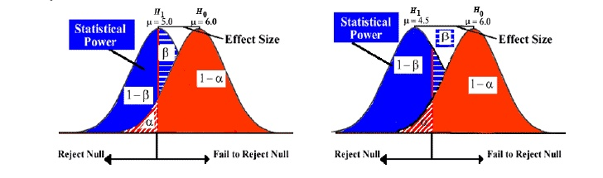
Effect Sizes
Notes:
$η^{2}$and $r_{pb}^{2}$
association between grouping variable (IV) and continuous DV
Ranges from 0 to 1
With only 2 groups,
results are same

Slide 8
Effect Sizes
Cohen’s d | Interpretation
.2 | Small
.5 | Moderate
.8 | Large
Notes:
In standard deviation units

Slide 9

Effect Sizes
$η^{2}$ (eta squared) and $r_{pb}^{2}$
association between grouping variable (IV) and continuous DV
Ranges from 0 to 1
With only 2 groups, results are same

Slide 10
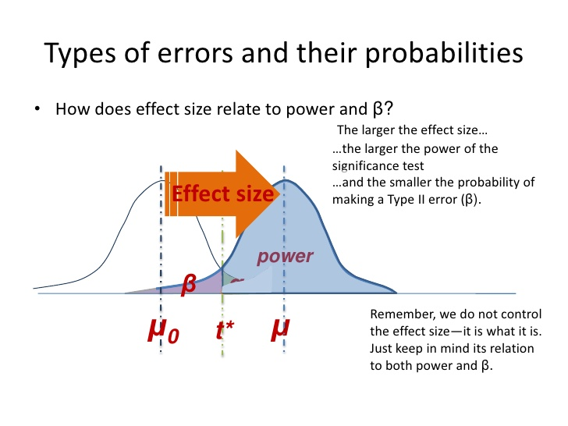
What affects power?
Sample Size
Larger sample = more power
Effect Size
Larger Effect size = more power
Alpha Level
Higher Alphas = more power
Directionality
One tail = more power

Slide 11
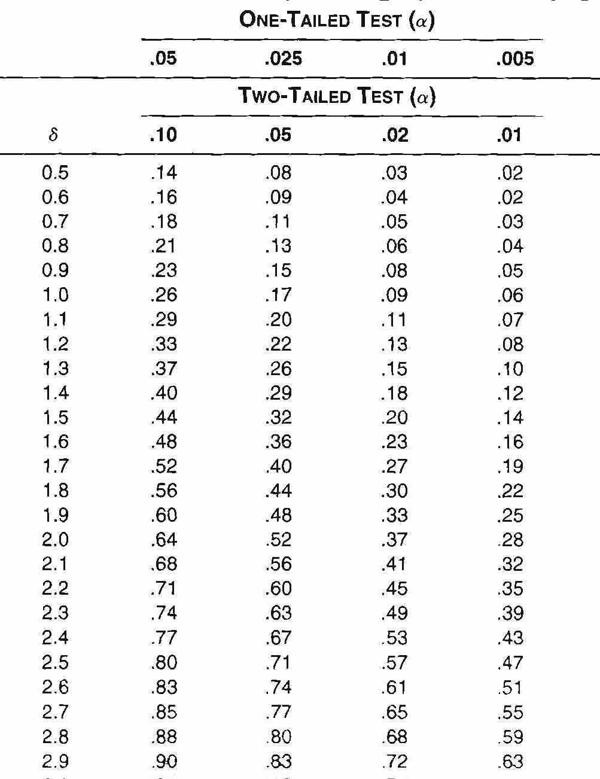
Power Analysis
Non-centrality parameter is calculated by:
Since it’s assumed that the…
Variances are same in 2 groups
N’s are same in 2 groups
...and since σ is often assumed to be 1…
…the equation is simplified…

Slide 12

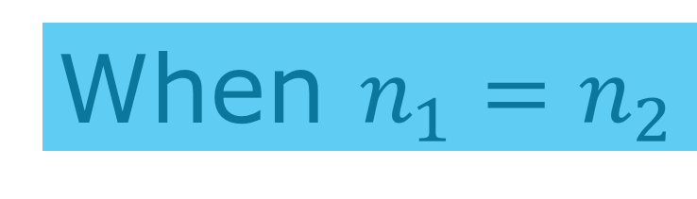
When $n_{1}=n_{2}$
When $n_{1}≠n_{2}$
Notes:
When $n_{1}=n_{2}$
Post hoc
δ → Power via Table A.3
n = # cases in any one group
a priori
n per group necessary for specified power
When $n_{1}≠n_{2}$
Post hoc
Conservative approach: use smaller n in previous formulae
Ineffective if ns vastly different or small
Liberal approach: compute
harmonic (not arithmetic) mean (the top equation)
Then, use the second.
a priori
Always plan for equal n’s
Never throw out data just to make your n’s equal!

Slide 13
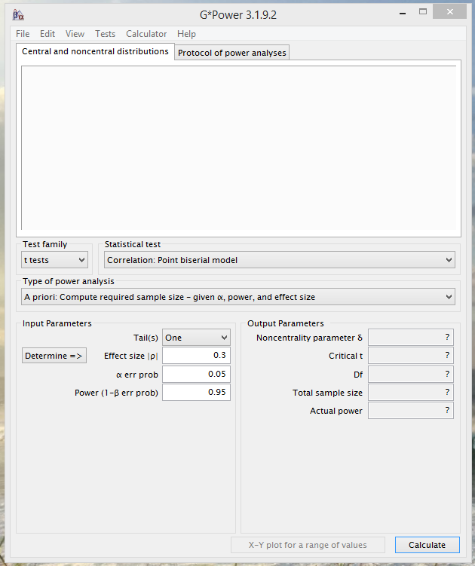
G-Power
Download at: http://www.gpower.hhu.de/

Slide 14
Chap 8: section A
d is just the number of standard deviations that separate two population means
g is the number of standard deviations (based on pooling the sample variances and taking the square-root) separating the sample means.
connection between a calculated t and delta;
large t’s are usually associated with large deltas
small t’s usually with small deltas.
Of course, the alternate hypothesis distribution shows that t can occasionally come out very differently from delta

Slide 15
An estimate of power
is only as good as
the estimate of effect size upon which it
is based
…BUT determining the effect size is usually
the purpose (or should be) of the experiment.

