Slide 1
T-test for 2 Independent Sample Means
For EDUC/PSY 6600

Slide 2
We cannot solve problems by using the same kind of thinking that we used when we created them.
Albert Einstein

Slide 3
Intro
Same continuous DV compared across 2 independent (random) samples
Is there a significant difference between the 2 group means?
Do 2 samples come from different normal distributions with the same mean?
aka…
Independent-groups design
Between-subjects design
Between-groups design
Randomized-groups design

Slide 4
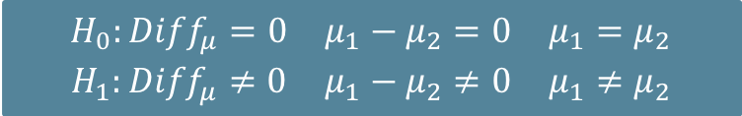

Steps of a Hypothesis test
$$\begin{matrix}H_{0}:{Diff}_{μ}=0 & μ_{1}−μ_{2}=0 & μ_{1}=μ_{2} \\ H_{1}:{Diff}_{μ}≠0 & μ_{1}−μ_{2}≠0 & μ_{1}≠μ_{2}\end{matrix}$$
“T-Test Statistic”$: t= \frac{est −hyp}{{SE}_{est}}$
State the Hypotheses (Null & Alternative)
Select the Statistical Test & Significance Level
α level
One vs. Two tails
Select random samples and collect data
Find the region of Rejection
Based on α & # of tails
Calculate the Test Statistic
Examples include: z, t, F, χ²
Make the Statistical Decision
*even use z, if N > 100’ish

Slide 5

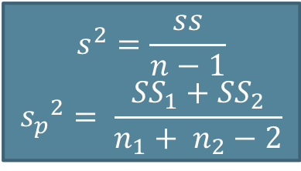
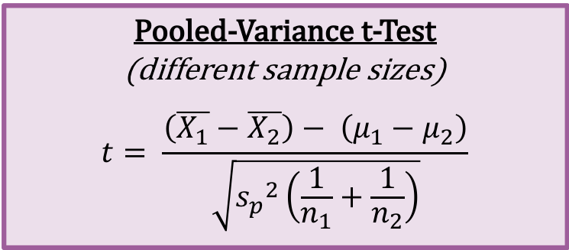
Steps of a Hypothesis test
Separate Variance t-Test
(need HOV)
$$t= \frac{\left(\overline{X_{1}}−\overline{X_{2}}\right) − \left(μ_{1}−μ_{2}\right) }{\sqrt{\frac{{s_{1}}^{2}}{n_{1}} + \frac{{s_{2}}^{2}}{n_{2}}}}$$
State the Hypotheses (Null & Alternative)
Select the Statistical Test & Significance Level
α level
One vs. Two tails
Select random samples and collect data
Find the region of Rejection
Based on α & # of tails
Calculate the Test Statistic
Examples include: z, t, F, χ²
Make the Statistical Decision
$$min\left(n_{1}, n_{2}\right)−1< df< n_{1}+ n_{2}−2$$
Pooled-Variance t-Test
(different sample sizes)
$$t= \frac{\left(\overline{X_{1}}−\overline{X_{2}}\right)− \left(μ_{1}−μ_{2}\right)}{\sqrt{{s_{p}}^{2}\left(\frac{1}{n_{1}}+\frac{1}{n_{2}}\right)}}$$
$$df= n_{1}+ n_{2}−2$$
$$s^{2}=\frac{ss}{n−1}$$
$${s_{p}}^{2}= \frac{{SS}_{1}+{SS}_{2}}{n_{1}+ n_{2}−2}$$

Slide 6
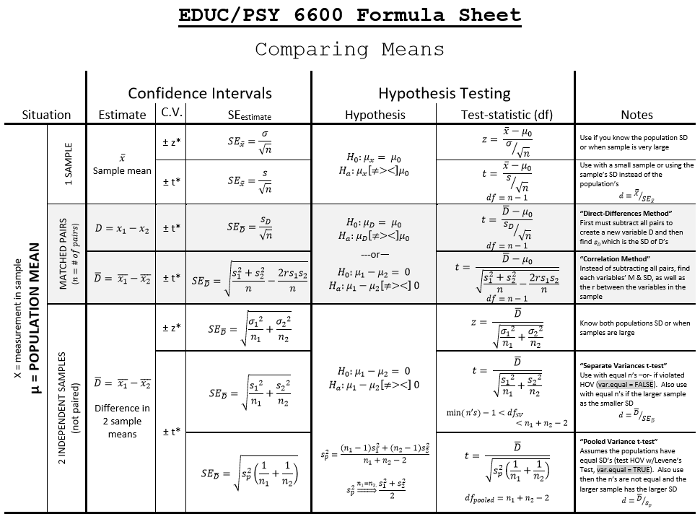

Slide 7
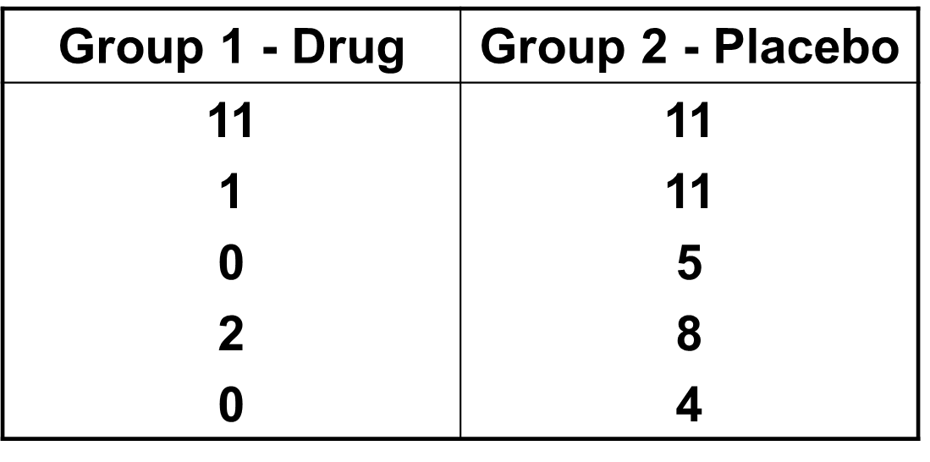
Example 1
In order to assess the efficacy of a new antidepressant drug, 10 clinically depressed participants are randomly assigned to one of two groups. Five participants are assigned to Group 1, which is administered the antidepressant drug for 6 months. The other 5 participants are assigned to Group 2, which is administered a placebo during the same 6 month period
Assume that prior to introducing the treatments, the experimenter confirmed that the level of depression in the 2 groups was equal
After 6 months, all participants are rated by a psychiatrist (blind to participant assignment) on their level of depression

Slide 8


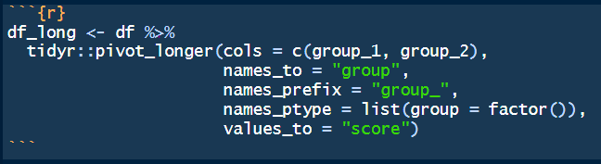
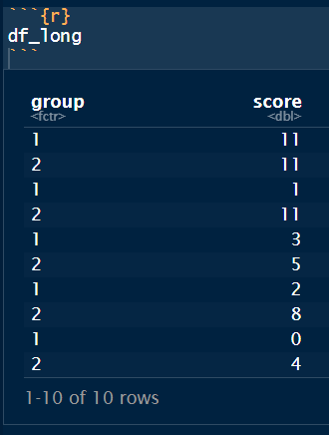
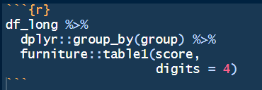
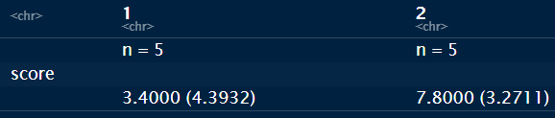
Example 1

Slide 9
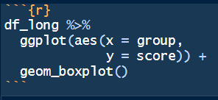
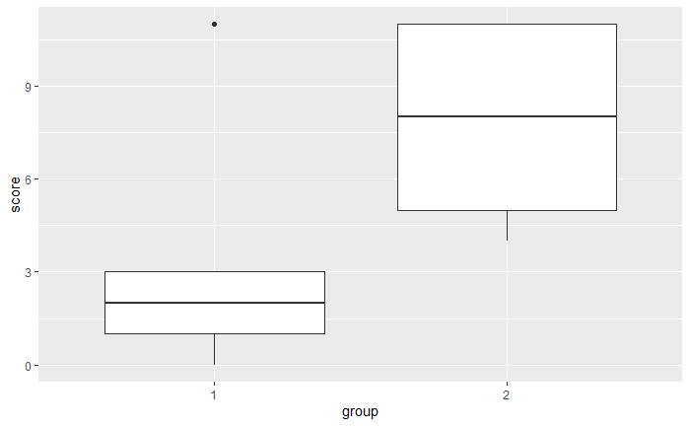
Example 1 - Output

Slide 10
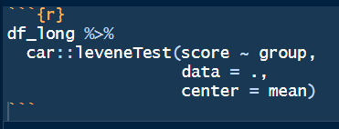
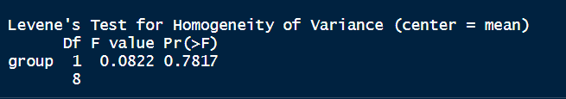
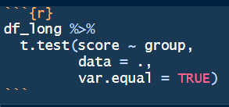
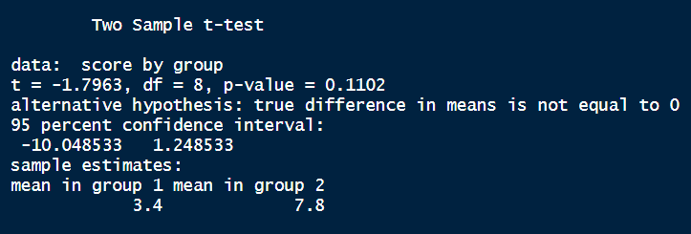
Example 1 – T-Test

Slide 11
Example 1
After 6 months, the five participants taking the drug scored numerically lower on the depression scale (M = 2.80, SD = 4.66), compared their five counter parts taking placebo (M = 7.80, SD = 3.27).
To test the effectiveness of the drug at reducing depression, an independent samples t-test was performed.
The distribution of depression scores were sufficiently normal for the purposes of conducting a t-test (i.e. skew < |2.0| and kurtosis < |9.0|; Schmider, Sigler, Danay, Beyer, & Buhner, 2010).
Additionally, the assumption of homogeneity of variances was tested and satisfied via Levene’s F-test, F(1, 8) = .08, p = .782.
The independent samples t-test did not find a statistically significant effect, t(8) = -1.796, p = .110.
Thus, there is no evidence this drug reduces depression.

Slide 12
Assumptions (similar to 1-sample t-tests)
BOTH Samples were drawn INDEPENDENTLY at random (at least as representative as possible)
Nothing can be done to fix NON-representative samples!
Can not statistically test…violation: paired-samples t-test
The variable has a NORMAL distribution, for BOTH population
Not as important if the sample is large (Central Limit Theorem)
IF the sample is far from normal &/or small n, might want to transform variables
Look at plots: histogram, boxplot, & QQ plot (straight 45º line) ← sensitive to outliers!!!
Skewness & Kurtosis: Divided value by its SE & > ± 2 indicates issues
Shapiro-Wilks test (small N): p < .05 → not normal
Kolmogorov-Smirnov test (large N):
HOV = Homogeneity of Variance: BOTH populations have the sample spread
use Levene’s F-test (null= HOV)

Slide 13
Random Assignment
Random assignment to groups ↓ experimenter biases
Cases are enumerated
Numbers drawn and assigned to group in any of several ways
Does not ensure equality of group characteristics
Experiment: Random assignment & manipulation of IV
Treatment vs. control or 2 treatment groups
Quasi-experiment: Either randomization or manipulation
Non-experiment: Neither randomization or manipulation
Participants self-select or form naturally occurring groups

Slide 14
Violations of assumptions
Equal groups: Violations ‘hurt’ less
Heterogeneity of variance
Small effects, p-value inaccurate ± .02
Non-normality
Small effects, p-value inaccurate ± .02
However: If samples are highly skewed or are skewed in opposite directions p-values can be *very* inaccurate
Both
Moderate effects if N is large, p-value can be inaccurate
Large effects if N is small, p-value can be *very* inaccurate

Slide 15
Violations of assumptions
Unequal groups: Violations ‘hurt’ more
Heterogeneity of variance
Large effects
Non-normality
Large effects
Both
Huge effects
p-values can be **very** inaccurate with unequal ns and violations of assumptions, especially when N is small

Slide 16
Alternatives (assumptions violated)
Violation of normality or ordinal DV
Two Sample Wilcoxon test (aka, Mann-Whitney U Test)
Sample re-use methods
Rely on empirical, rather than theoretical, probability distributions
Exact statistical methods
Permutation and randomization tests
Bootstrapping

Slide 17
Confidence Intervals
95% CI for difference between means: μ₁ - μ₂
Rearrange independent-samples t-test formula
Estimation as NHST (Null hypothesis Significance Test)
If H₀: μ₁ = μ₂ and if CI does NOT contain 0, reject H₀
If H₀: μ₁ = μ₂ and if CI does contain 0, fail to reject H₀
Compute for in-class example

Slide 18
Example 2
An industrial psychologist is investigation the effects of different types of motivation on the performance of simulated clerical tasks. The 10 participants in the “individual motivation” sample are told that they will be rewarded according to how many tasks they successfully complete. The 12 participants in the “group motivation” sample are told that they will be rewarded according to the average number of tasks completed by all the participants in their sample. The number of tasks completed by each participant are as follows:
Individual Motivation: 11, 17, 14, 12, 11, 15, 13, 12, 15, 16
Group Motivation: 10, 15, 4, 8, 9, 14, 6, 15, 7, 11, 13, 5
────────────────────────────
group
Individual Group
n = 10 n = 12
value
13.6 (2.1) 9.8 (3.9)
────────────────────────────
## data object is df2_long
df2_long %>%
dplyr::group_by(group) %>%
furniture::table1(value)

Slide 19
Example 2
library(tidyverse)
library(furniture)
## our data object is df2_long
## Check boxplots
df2_long %>%
ggplot(aes(x = group, y = value)) +
geom_boxplot()

Slide 20
Example 2
df2_long %>%
car::leveneTest(value ~ group,
data = .,
center = "mean")
#> Levene's Test for Homogeneity of Variance (center = "mean")
#> Df F value Pr(>F)
#> group 1 4.8287 0.03994 *
#> 20
df2_long %>%
t.test(value ~ group,
data = .,
var.equal = FALSE)
#> Welch Two Sample t-test
#> data: value by group
#> t = 2.9456, df = 17.518, p-value = 0.008833
#> alternative hypothesis: true difference in means is not equal to 0
#> 95 percent confidence interval:
#> 1.098587 6.601413
#> sample estimates:
#> mean in group 1 mean in group 2
#> 13.60 9.75

Slide 21
Example 2
#> Levene's Test for Homogeneity of Variance (center = "mean")
#> Df F value Pr(>F)
#> group 1 4.8287 0.03994 *
#> 20
#> Welch Two Sample t-test
#> data: value by group
#> t = 2.9456, df = 17.518, p-value = 0.008833
#> alternative hypothesis: true difference in means is not equal to 0
#> 95 percent confidence interval:
#> 1.098587 6.601413sample estimates:
#> mean in group 1 mean in group 2
#> 13.60 9.75
The number of tasks completed was numerically higher among the individually motivated group (n = 10, M = 13.60, SD = 2.12), compared to the individuals being motivated by the groups results (n = 12, M = 9.75, SD = 3.89).
To test the difference in mean productivity, an independent samples t-test was performed.
The distribution of depression scores were sufficiently normal for the purposes of conducting a t-test (i.e. skew < |2.0| and kertosis < |9.0|; Schmider, Sigler, Danay, Beyer, & Buhner, 2010).
Additionally, the assumption of homogeneity of variances was tested and rejected via Levene’s F-test, F(9, 11) = 4.829, p = .040.
The independent samples, separate variances t-test found a statistically significant effect, t(17.52) = 2.946, p = .009.
Thus, individual motivation does result in a mean 3.85 additional tasks completed compared to group motivation (95% CI: [1.01, 6.60]).

