Slide 1
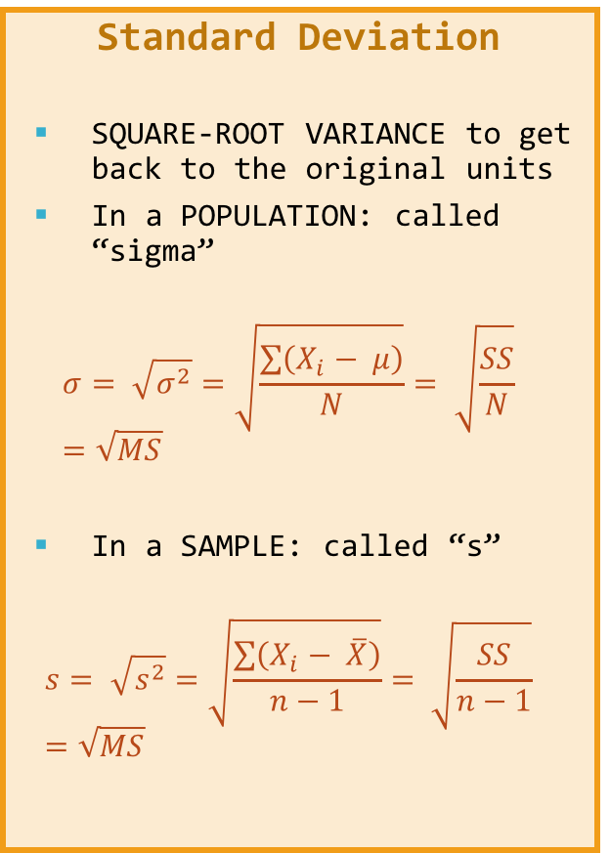
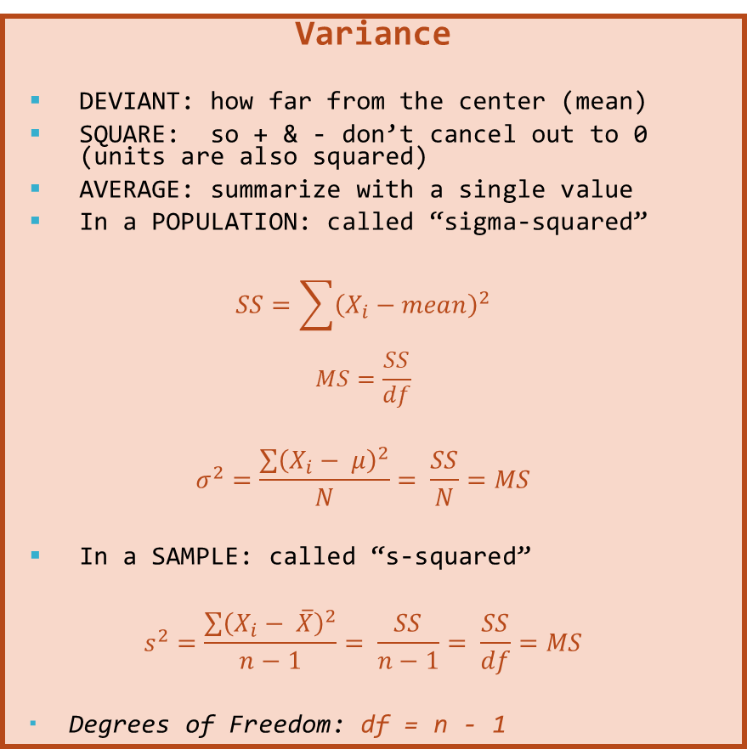
Range, IQR, & SIR
Range = Max – Min
Interquartile Range
IQR = Q3 – Q1
Semi-Interquartile Range
SIR = (Q3 – Q1) / 2
Range is super dependent on extreme values or outliers
IRG & SIR more resistant
Variance
DEVIANT: how far from the center (mean)
SQUARE: so + & - don’t cancel out to 0 (units are also squared)
AVERAGE: summarize with a single value
In a POPULATION: called “sigma-squared”
$$SS=\sum{{\left(X_{i}−mean\right)}^{2}}$$
$$MS=\frac{SS}{df}$$
$$σ^{2}=\frac{\sum{{\left(X_{i}− μ\right)}^{2}}}{N}= \frac{SS}{N}=MS$$
In a SAMPLE: called “s-squared”
$$s^{2}=\frac{\sum{{\left(X_{i}− \overline{X}\right)}^{2}}}{n−1}= \frac{SS}{n−1}= \frac{SS}{df}=MS$$
Degrees of Freedom: df = n - 1
Standard Deviation
SQUARE-ROOT VARIANCE to get back to the original units
In a POPULATION: called “sigma”
$$σ= \sqrt{σ^{2}}=\sqrt{\frac{\sum{\left(X_{i}− μ\right)}}{N}}= \sqrt{\frac{SS}{N}}=\sqrt{MS}$$
In a SAMPLE: called “s”
$$s= \sqrt{s^{2}}=\sqrt{\frac{\sum{\left(X_{i}− \overline{X}\right)}}{n−1}}= \sqrt{\frac{SS}{n−1}}=\sqrt{MS}$$

