Slide 1
Categorical Data Analysis
Cohen Chapters 19 & 20
For EDUC/PSY 6600

Slide 2
Creativity
involves breaking out of established patterns
in order to look at things
in a different way. --
Edward de Bono

Slide 3
Some Motivating Examples
Dr. Fisel wishes to know whether a random sample of adolescents will prefer a new of formulation of ‘JUMP’ softdrink over the old formulation. The proportion choosing the new formulation is tested against a hypothesized value of 50%.
Dr. Sheary hypothesizes that 1/3 of women experience increased depressive symptoms following childbirth, 1/3 experience increases in elevated mood after childbirth, and 1/3 experience no change. To evaluate this hypothesis Dr. Sheary randomly samples 100 women visiting a prenatal clinic and asks them to complete the Beck Depression Inventory. She then re-administers the BDI to each mother one week following the birth of her child. Each mother is classified into one of the 3 previously mentioned categories and observed proportions are compared to the hypothesized proportions.
Dr. Evanson asks a random sample of individuals whether they see both a physician and a dentist regularly (at least once per year). He compares the distributions of these binary variables to determine whether there is a relationship.

Slide 4
Categorical Data Analysis
Instead of means, comparing counts and proportions within and across groups
E.g., # ill across different treatment groups
Associations / dependencies among categorical variables
Data are nominal or ordinal ← NOT continuous
Discrete probability distribution
Number of finite values as opposed to infinite
Each subject/event assumes 1 of 2 mutually exclusive, exhaustive values
Called: binary or dichotomous
Yes/No
Male/Female
Well/Ill

Slide 5
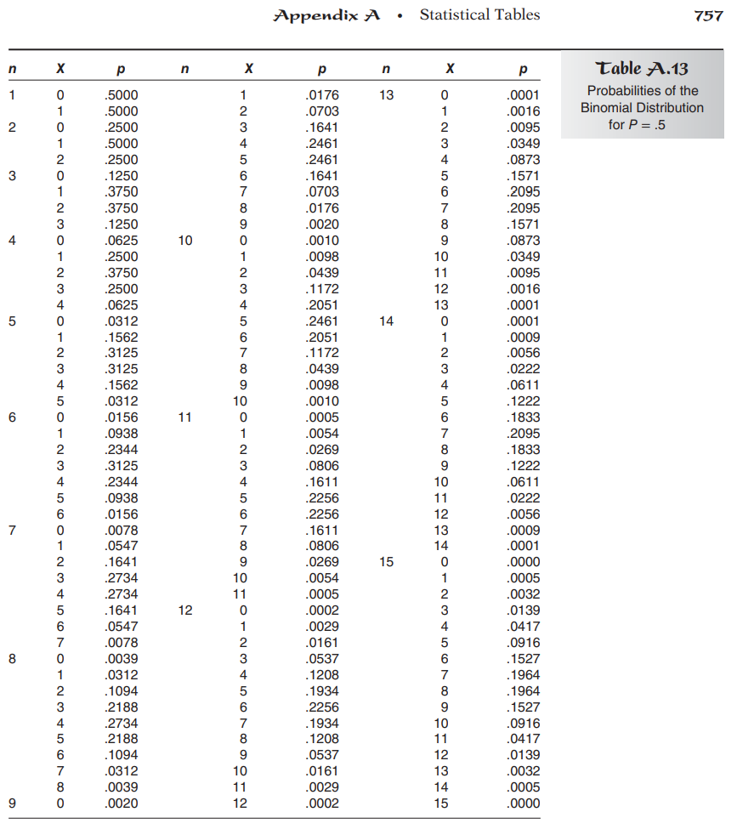
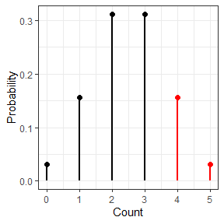
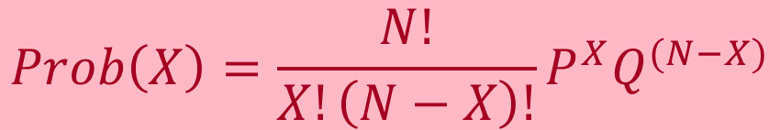
The Binomial Distribution Equations & Example - Coin
$$Prob\left(X\right)=\frac{N!}{X!\left(N−X\right)!}P^{X}Q^{(N−X)}$$
Arbitrarily
assign 1 outcome as ‘success’
and other as ‘failure’
N = # events
X = # “successes”
P_{Null} = Prob(“success”)
Hypothesized proportion / probability of success
Q_{Null} = Prob(“failure”)
Hypothesized proportion / probability of failure
P_{Null} + Q_{Null} = 1
Remember: 0! = 1; x⁰ = 1
Example:
Probability of correctly guessing side of coin 4 out of 5 flips?
5 events, 4 successes, 1 failure
P = Prob(correct guess on each flip) = .50
Q = Prob(incorrect guess on each flip) = .50
Use equation to obtain:
5 out of 5 successes = .03
4 out of 5 successes = .16
3 out of 5 successes = .31
2 out of 5 successes = .31
1 out of 5 successes = .16
0 out of 5 successes = .03
Sum of probabilities = 1.0
Probability = .19

Slide 6
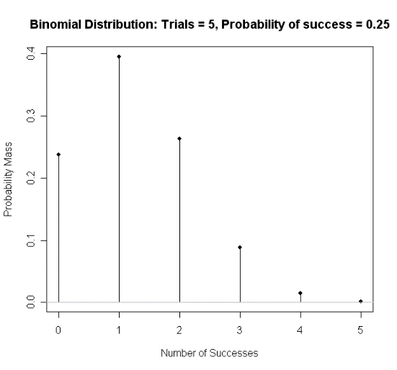
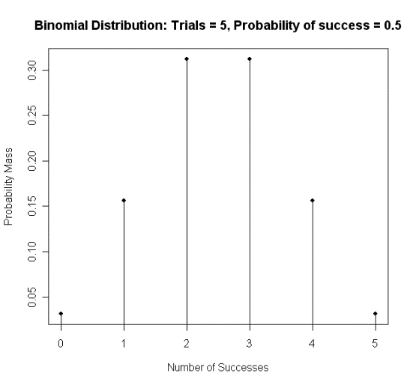
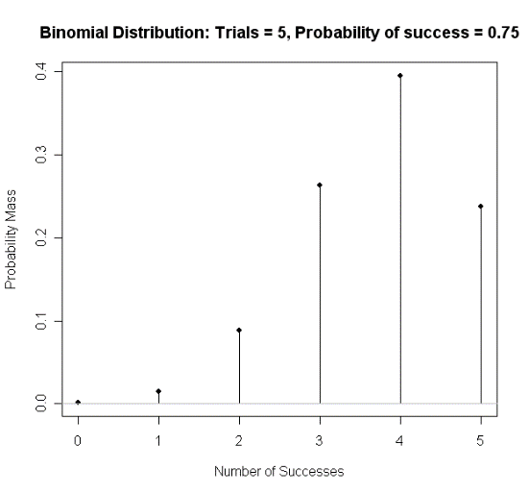
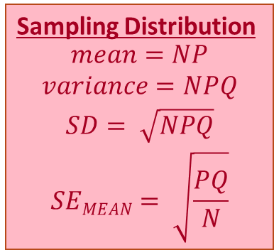
The Binomial Distribution Sampling Distribution: Center, Spread, and Shape & Example - Coin
Binomial probability distribution for N = 5 events, and P_{Null} = .50
Binomial Distribution Table (exact values) ← Table A.13
Sampling distribution as it was derived mathematically
We can only reject H₀ with 0 or 5 out of 5 successes (1-tailed)
Sampling Distribution
$$\begin{matrix}mean=NP \\ variance=NPQ \\ \begin{aligned}SD= \sqrt{NPQ} \\ SEMEAN= \sqrt{\frac{PQ}{N}}\end{aligned}\end{matrix}$$
Different binomial distribution for each N
Normal when P = .50, skewed when P ≠ .50
Critical value depends on: N events, X successes, P
Example
M = 5*.5 = 2.5 (See plots)
VAR = 5*.5*.5 = 1.25
SD = sqrt(1.25) = 1.12

Slide 7
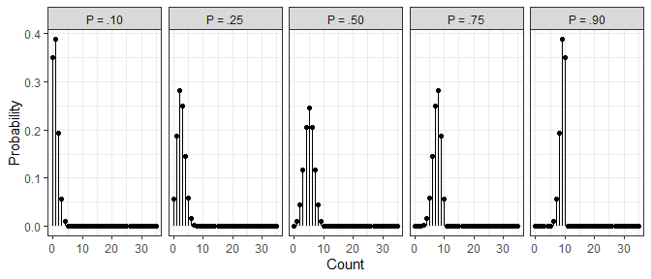
The Binomial Distribution Sampling Distribution: Shape based on H₀: P_{Null} = #

Slide 8
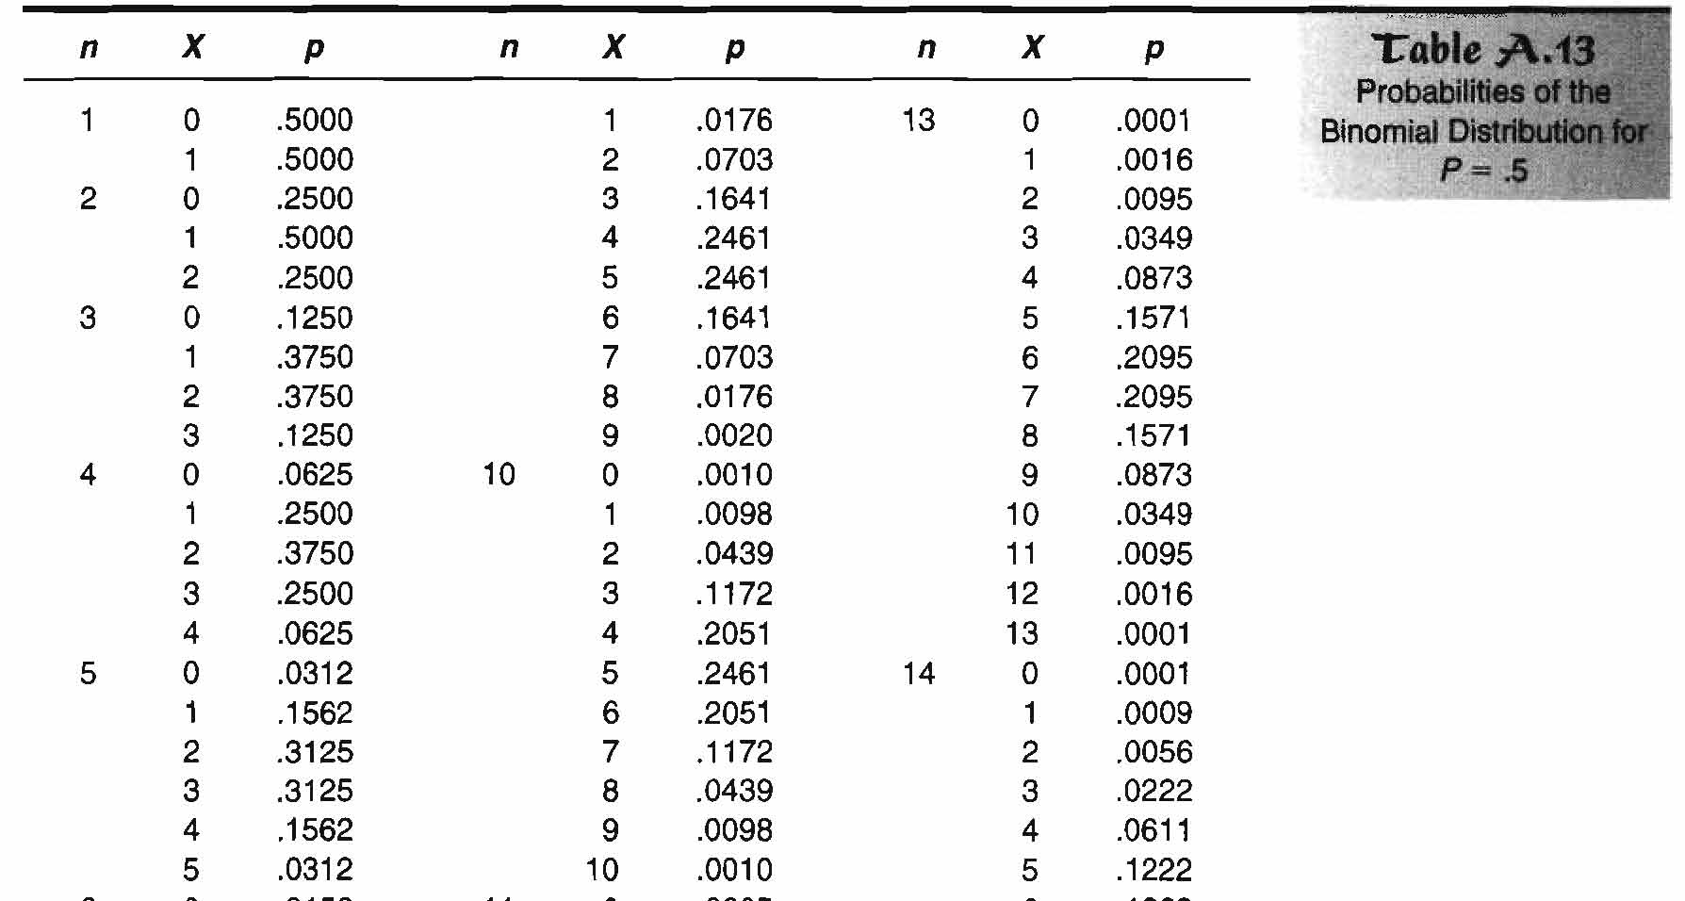
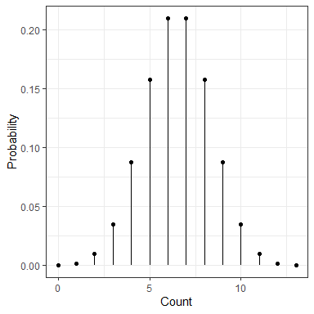
The Binomial Distribution Sampling Distribution – Table A.13
“Equally Likely”
Means P_{Null} = .50

Slide 9
The Binomial Sign Test Null Hypothesis & Assumptions
Examples
Coin flipped 10x, heads 8x
Is coin biased (Heads > .50)?
10 women surveyed, 8 select perfume “A”
Is one perfume preferred over another?
For both:
H₀: Proportion (X) = .50 in population
H₁: Proportion (X) ≠ .50 in population
Single sample test with
binary/dichotomous data
Null Hypothesis
The % successes is equal to
a specified % in population
Proportion of ‘successes’
differ from chance?
Assumptions
Independent, random sample ← “representative”
Mutually exclusive, exhaustive categories ← 1 and only 1
Probability of each outcome is same for all trials/observations of experiment

Slide 10
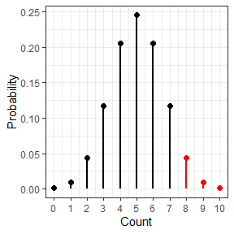

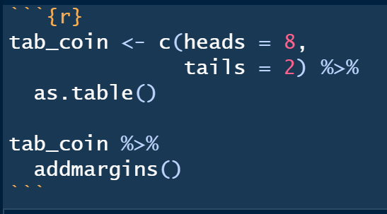
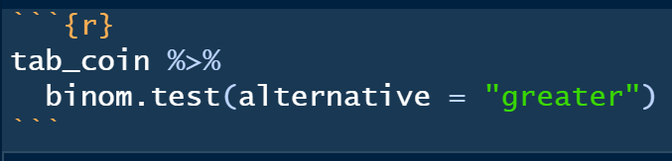
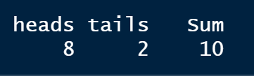
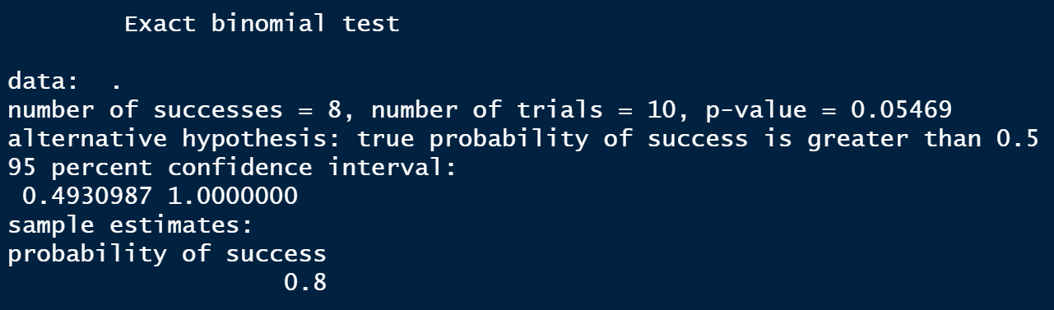
The Binomial sign test Example - Coin
Experiment:
Flip a coin 10x → land on heads 8x
Question: Is coin biased?
H₀: P_{null} = .50 in population
H₁: P_{Null} ≠ .50 in population
.0547
Notes:
Note that these are already in count form.

Slide 11

The Normal approximation to the binomial distribution (i.e. “z-test” for a single proportion)
$$z= \frac{X −NP}{\sqrt{NPQ}}$$
What if N were larger, say 15?
Same proportions: P_{Obs} =80% (12/15) Heads & Perfume A
Sum p(12, 13, 14, 15/15) = .0178 (1-tailed p-value)
Reject H₀ under both 1- and 2-tailed tests
2-tailed p = .0178 x 2 = .0356
Earlier: as N → infinity…Binomial distribution → normal distribution
Recommendation: Use z-test for single proportion when N is large (>25-30)
When NP and NQ are both > 10, close to normal
H₀ and H₁ are same as Binomial Test

Slide 12
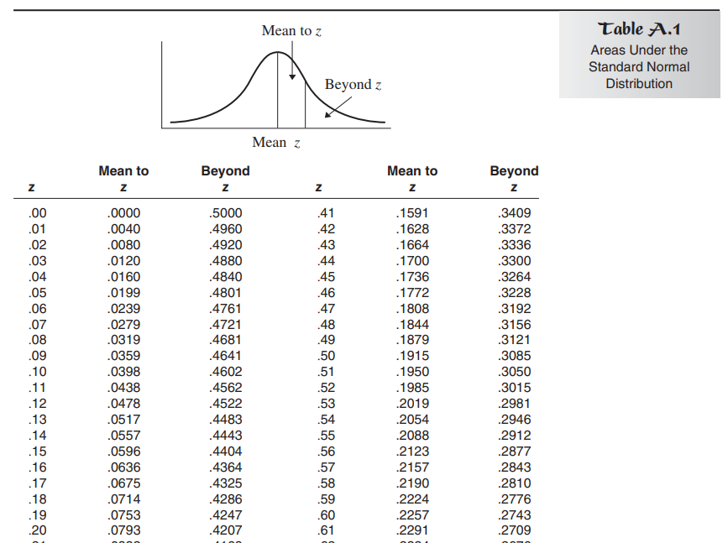
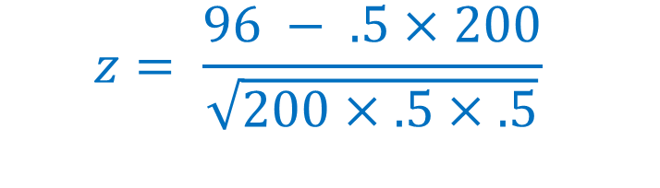
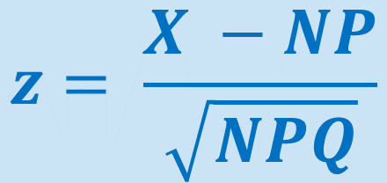


The Normal approximation to the binomial distribution (i.e. “z-test” for a single proportion)
Experiment:
Senator supports bill favoring stem cell research. However, she realizes her vote could influence whether or not her constituents endorse her bid for re-election. She decides to vote for the bill only if 50% of her constituents support this type of research. In a random survey of 200 constituents, 96 are in favor of stem cell research.
Will the senator support the bill?
N =200
X = 96
H₀: P_{Null} = .50
$$z= \frac{X −NP}{\sqrt{NPQ}}$$
1-tail:
p = .2843
$$z= \frac{96 − .5×200}{\sqrt{200×.5×.5}}$$
Observed: # = 96
2-tail:
p = .5686
Expected: # = 100
μ= PN = .50 x 200
$$= \frac{96 − 100}{\sqrt{50}}$$
$$=0.57$$

Slide 13
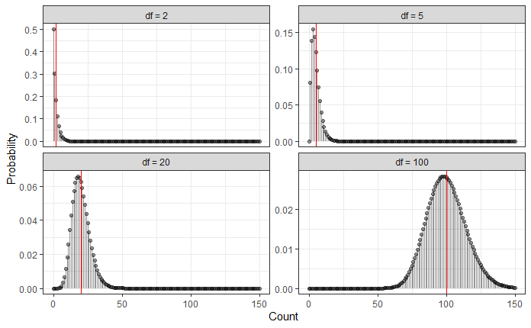
The Pearson’s Chi-Square (χ² ) Distribution Family of Distributions
χ² distribution
used in many statistical tests
As df (or k categories) ↑
Distribution becomes more
normal, bell-shaped
Mean & variance ↑
Mean = df
Variance = 2* df
Always positive,
0 to infinity
1-tailed distribution
z² = χ²

Slide 14
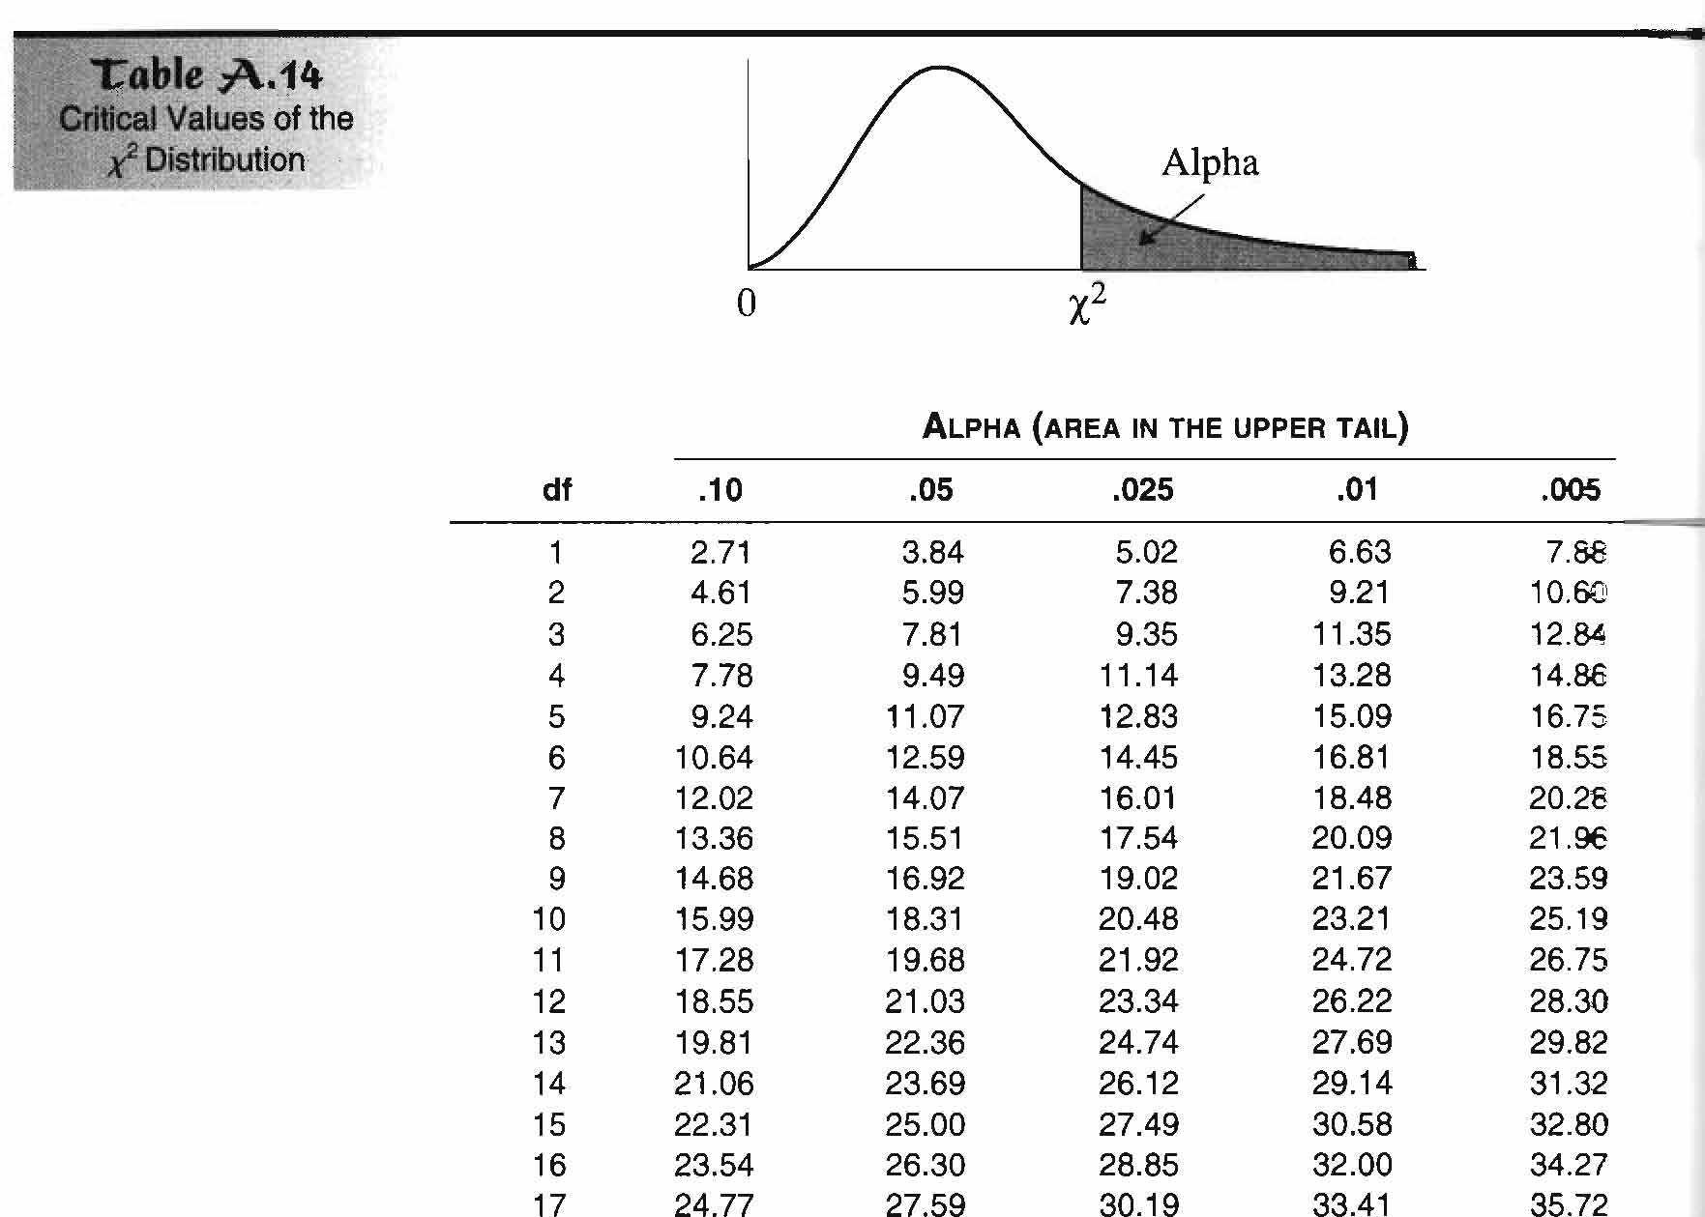
The Pearson’s Chi-Square (χ² ) Distribution Family of Distributions – Table A.14

Slide 15
Two Kinds of Chi-Squared Tests
1 WAY Chi Squared
“GOODNESS OF FIT” Test
2 WAY Chi Squared
Test of “Independence”
Are
observed frequencies
similar to
frequencies expected (if H₀ is true)
Or do they differ more than expected due to chance?
Sample broken down into groups or levels of ONE
categorical variable
Sample broken down into groups or levels of TWO
categorical variable
Expected frequencies
Usually equal across categories of variable
-OR-
Can be unequal if theory dictates
Expected frequencies
H_{0:} the 2 variables are independent
H₁: the 2 variables are associated

Slide 16
1-way Chi-Squared: “Goodness of Fit” Test Hypothesis Testing
Hypotheses
H₀: Observed = Expected frequencies in population
H₁: Observed ≠ Expected frequencies in population
General form:
O = observed frequency
E = expected frequency
If H₀ were true, numerator would be small
Denominator standardizes difference in terms of expected frequencies
Aka: Pearson or ‘1-way’ χ² test
1 nominal variable use to breakdown the sample
2 or more categories the sample is broken into
If nominal variable ONLY has 2 categories, χ² GoF test:
Is another large sample approximation to Binomial Sign Test
Gives same results as z-test for single proportion as z² = χ²
Has same H₀ and H₁ as binomial or z-tests
Compare obtained χ² statistic to critical value based on df = k – 1, k = # categories

Slide 17
1-way Chi-Squared: “Goodness of Fit” Test Assumptions
Assumptions
Independent, random sample ← “representative”
Mutually exclusive, exhaustive categories ← 1 and only 1
Expected frequencies: ≥ 5 per each cell ← approximation

Slide 18
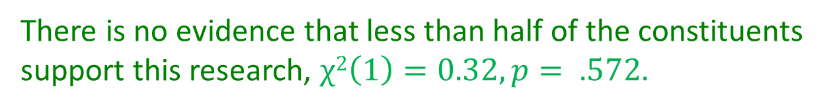
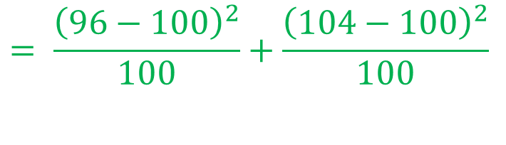




1-way Chi-Squared: “Goodness of Fit” Test
Example: K = 2 , P = .5 (“equally likely”)
Hypotheses:
H₀: P = 0.50
Observed frequencies: 96 and 104
Expected frequencies: N / k =200/2 = 100
df = 2 – 1 = 1
Test Statistic:
χ² _{OBSERVED}⁼
Critical Value:
χ²_{CRIT} (__) =
Conclusion:
Experiment:
Senator supports bill favoring stem cell research. However, she realizes her vote could influence whether or not her constituents endorse her bid for re-election. She decides to vote for the bill only if 50% of her constituents support this type of research. In a random survey of 200 constituents, 96 are in favor of stem cell research.
Will the senator support the bill?
$$= \frac{{\left(96−100\right)}^{2}}{100}+\frac{{\left(104−100\right)}^{2}}{100}$$
$$= \frac{16}{100}+\frac{16}{100}$$
$$= \frac{32}{100}=0.32$$
ALWAYS USE COUNTS!!! | 1 = “success” | 0 = “failure”
OBSERVED (the data)
EXPECTED (based on N, P, Q)
$$1$$
$$3.84$$
96
104
There is no evidence that less than half of the constituents support this research, $χ2\left(1\right)=0.32, p= .572.$
100
100

Slide 19
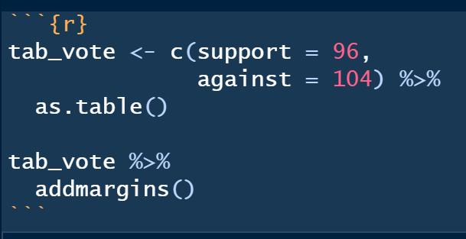

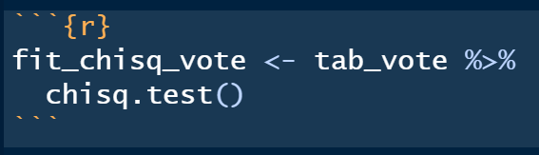




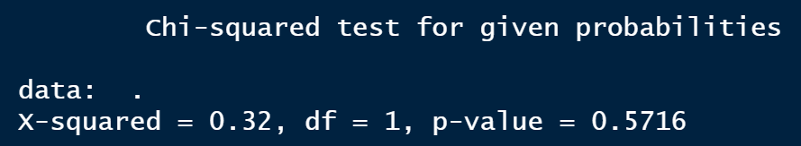
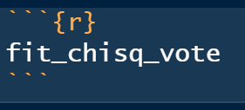
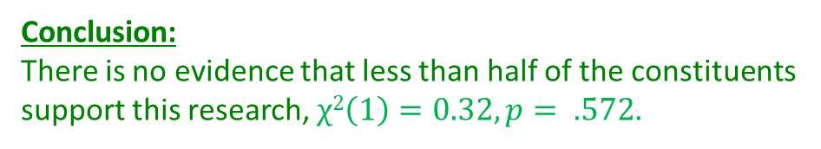
1-way Chi-Squared: “Goodness of Fit” Test
Example: K = 2, P = .5 (“equally likely”)
Experiment
Senator supports bill favoring stem cell research. However, she realizes her vote could influence whether or not her constituents endorse her bid for re-election. She decides to vote for the bill only if 50% of her constituents support this type of research. In a random survey of 200 constituents, 96 are in favor of stem cell research.
Will the senator support the bill?
Conclusion:
There is no evidence that less than half of the constituents support this research, $χ2\left(1\right)=0.32, p= .572.$
Notes:
Note that these are already in count form. If they aren’t, we need to use table()

Slide 20

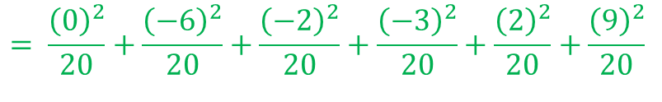

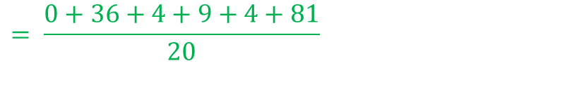

1-way Chi-Squared: “Goodness of Fit” Test
Example: K > 2, P = “equally likely”
ALWAYS USE COUNTS!!!
Hypotheses:
H₀: “equally likely” (k = 6, N = 120)
Observed frequencies: see table
Expected frequencies: N / k =120/6 = 20
df = 6 – 1 = 5
Test Statistic:
χ² _{OBSERVED}⁼
Critical Value:
χ²_{CRIT} (__) =
Conclusion:
 | M | T | W | Th | F | S
OBS | 20 | 14 | 18 | 17 | 22 | 29
EXP
$$= \frac{{\left(0\right)}^{2}}{20}+\frac{{\left(−6\right)}^{2}}{20}+\frac{{\left(−2\right)}^{2}}{20}+\frac{{\left(−3\right)}^{2}}{20}+\frac{{\left(2\right)}^{2}}{20}+\frac{{\left(9\right)}^{2}}{20}$$
20
20
20
20
20
20
$$= \frac{134}{20}=6.7$$
$$= \frac{0+36+4+9+4+81}{20}$$
Research Question
Is there a difference in # books checked out for different days of the week?
$$5$$
$$11.07$$
We have no evidence that book checkouts are different on any day of the week, $χ2\left(5\right)=6.7, p= .244.$

Slide 21
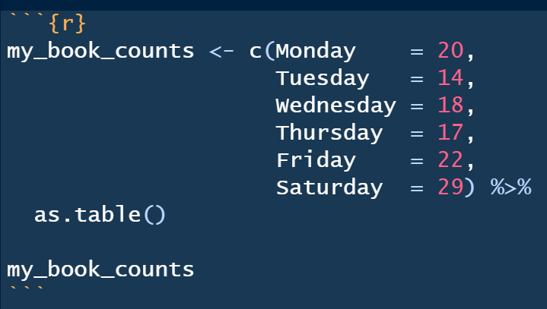
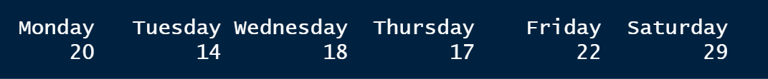

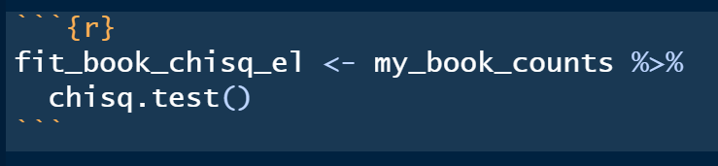
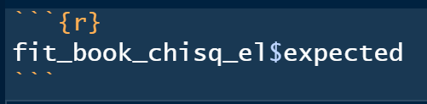
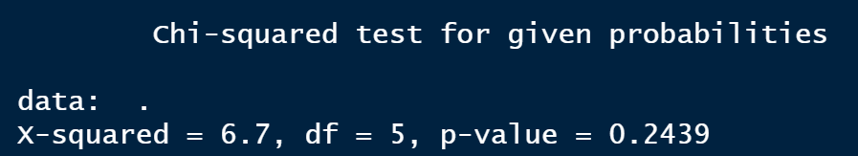
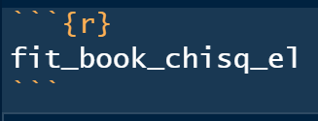
1-way Chi-Squared: “Goodness of Fit” Test
Example: K > 2, P = “equally likely”
Research Question
Is there a difference in # books checked out for different days of the week?

Slide 22
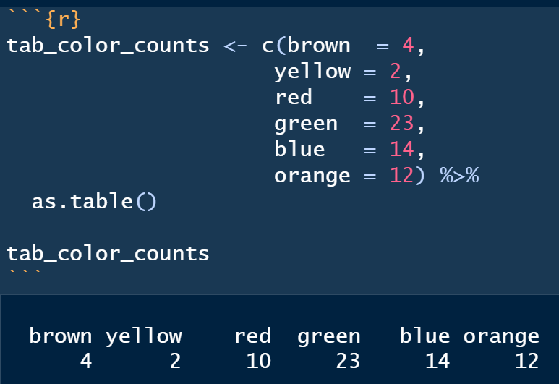
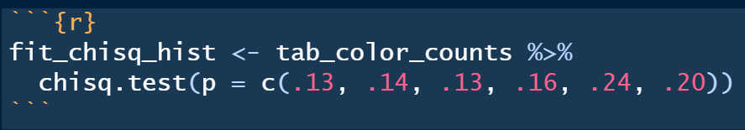

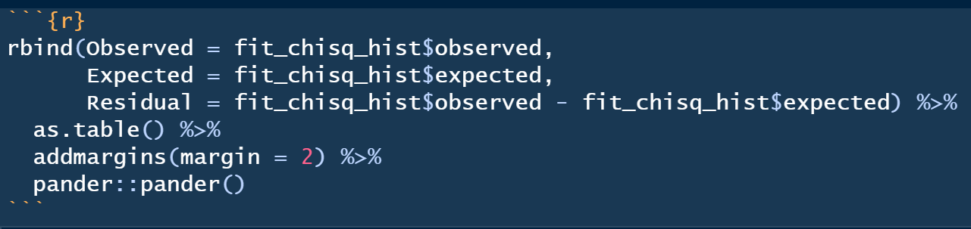
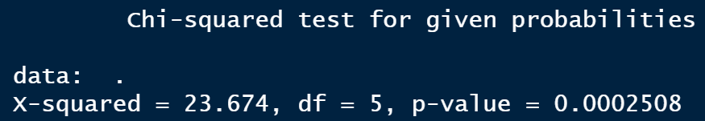
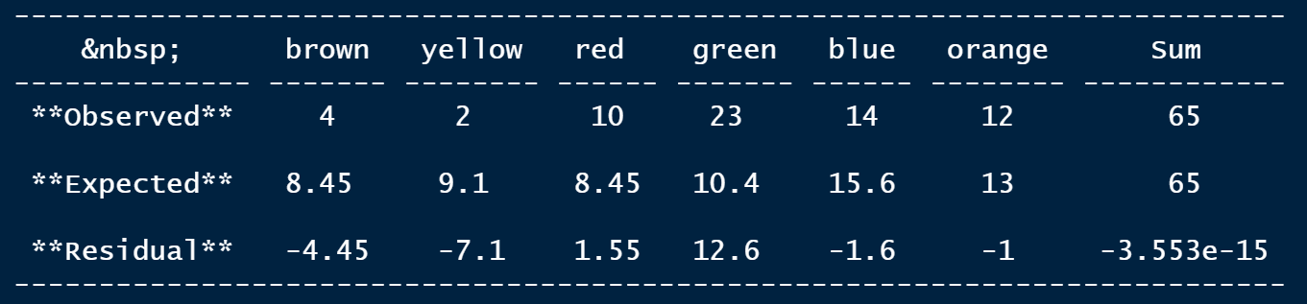
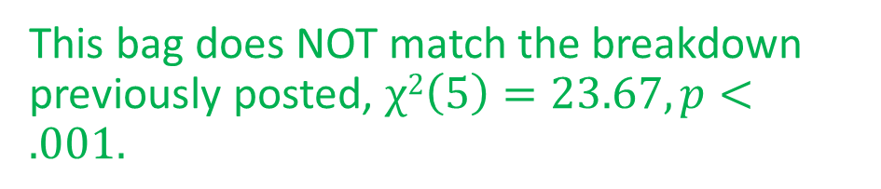
1-way Chi-Squared: “Goodness of Fit” Test
Example: K > 2, P = “specified breakdown”
Years ago, the Mars company used to post the 'color breakdown' for each type of M & M it produced on its website. The information has since been removed, but the last time I checked it claim that plain, milk chocolate M & M's consisted of: 13% brown, 14% yellow, 13% red, 16% green, 24% blue, and 20% orange.
Question
Do the M&M’s in my bag support the websites’ claimed color mix?
Must add up to exactly 1.0!
This bag does NOT match the breakdown previously posted, $χ2\left(5\right)=23.67, p<.001.$

Slide 23



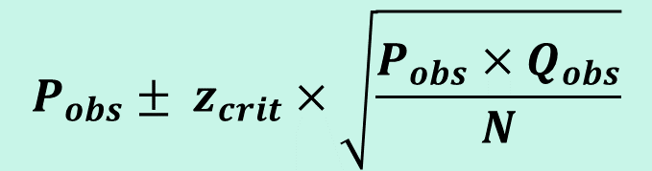
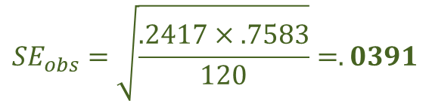

1-way Chi-Squared: “Goodness of Fit” Test
Confidence Intervals, for proportions
If k > 2, original table converted into table with 2 cells
Proportion for category of interest vs proportion in all other categories
Use same formula for z-test for single proportion:
Construct a 95% Confidence Interval
for proportion of books from Saturday
Point Estimate
Critical Value
Standard Error
Margin of Error
Interval
$$P_{obs}=\frac{29}{120}=.2417$$
$z_{CV}=$1.96
$${SE}_{obs}=\sqrt{\frac{.2417×.7583}{120}}=.0391$$
$$P_{obs}± z_{crit}×\sqrt{\frac{P_{obs}×Q_{obs}}{N}}$$
$$MoE=1.96×0.0391= .0766$$
$$CI=.2417±.0766$$
$$\left[.1651, .3183\right]$$

Slide 24
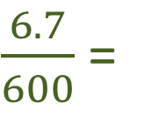
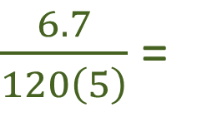

1-way Chi-Squared: “Goodness of Fit” Test
Effect Size
 | M | T | W | Th | F | S
OBS | 20 | 14 | 18 | 17 | 22 | 29
EXP
20
20
20
20
20
20
Ranges from 0 to 1:
0: Expected = Observed frequencies exactly
1: Expected ≠ Observed frequencies as much as possible
$\frac{6.7}{120\left(6−1\right)}$ =
$\frac{6.7}{120\left(5\right)}$ =
$\frac{6.7}{600}$ =
.0111

Slide 25

1-way Chi-Squared: “Goodness of Fit” Test
Post Hoc Follow-up Tests
Like ANOVA, omnibus test…
but where do differences lie?
‘Pinpointing the action’ in contingency tables
Post-hoc Binomial, z-tests, or smaller 1-way χ² tests
Collapsing, ignoring levels
Bonferonni correction, more conservative α per comparison
Examining
Observed vs. expected frequencies per cell
Contributions to χ² per cell
Visual analysis of differences in proportions
 | M | T | W | Th | F | S
OBS | 20 | 14 | 18 | 17 | 22 | 29
EXP
20
20
20
20
20
20

Slide 26
2-way Chi-Squared: Test of “Independence/Association”
Extension of χ² Goodness of Fit Test
Aka:
Contingency table
Cross-tabulation
row x column (r x c) analysis
2 nominal variables
Question:
Is distribution of 1 variable contingent on distribution of another?
Is there an association or dependence between 2 categorical variables
Hypotheses:
H₀: Variables are independent in population
H₁: Variables are dependent in population
Again, χ²_{obs} is compared with χ²_{cv}
r = # rows (levels of 1st variable)
c= # columns (levels of 2nd variable)
df = (r-1)(c-1)

Slide 27

2-way Chi-Squared: Test of “Independence/Association”
Equations
Equation:
Same as 1-way
Standardized squared deviations summed for all cells
Method for computing expected values:
For each cell…
Multiply corresponding row and column totals (marginals), divide by N
$$EXPcell=\frac{{Total}_{row}×{Total}_{column}}{{Total}_{grand}}$$

Slide 28


2-way Chi-Squared: Test of “Independence/Association”
Assumptions and Effect Size
Assumptions
Independent, random sample ← “representative”
Mutually exclusive, exhaustive categories ← 1 and only 1
Expected frequencies: ≥ 5 per each cell ← approximation
2x2 Tables
Name: Phi Coefficient
Also called: “Four-fold point correlation”
Ranges: 0 - 1
Interpret like Pearson’s correlation “r”
BiggerTables
Name: Cramer’s Phi (or V in SPSS)
L = smaller or # rows & # columns
“Degree of Association”
Ranges: 0 - 1
$$φ= \sqrt{\frac{χ^{2}}{N}}$$
$$φ_{C}= \sqrt{\frac{χ^{2}}{N\left(L−1\right)}}$$

Slide 29






2-way Chi-Squared: Test of “Independence/Association”
Example – Abuse & violet crimes
Observed frequencies
Expected frequencies:
Test Statistic:
Critical Value:
Experiment:
Random sample of 200 inmates are surveyed about abuse and violent criminal histories
Relationship between history of abuse and violent crime?
Hypotheses:
H₀: No association between abuse history and violent criminal history in population of prison inmates
O_{ij} = E_{ij} for all cells in population
H₁: Association between abuse history and violent criminal history in population of prison inmates
O_{ij} ≠ E_{ij} for at least one cell in population
 |  | Violent Crime
 |  | Yes | No
Abuse | Yes | 70 | 30 | 100
 | No | 40 | 60 | 100
 |  | 110 | 90 | 200
55 | 45 | 100
55 | 45 | 100
110 | 90 | 200
$χ_{obs}^{2}=\frac{{\left(70−55\right)}^{2}}{55}+\frac{{\left(30−45\right)}^{2}}{45}$ + $\frac{{\left(40−55\right)}^{2}}{55}$+ $\frac{{\left(60−45\right)}^{2}}{45}$
$=4.0909+5$ + 4.0909 +5
$=18.1818$
$$χ_{CV}^{2}=3.84$$
$$df= \left(2−1\right)×\left(2−1\right)$$
$$=1$$

Slide 30








2-way Chi-Squared: Test of “Independence/Association”
Example: Tabulated data (subtotals)
 |  | Violent Crime
 |  | Yes | No
Abuse | Yes | 70 | 30 | 100
 | No | 40 | 60 | 100
 |  | 110 | 90 | 200
Abuse is associated with violent crime, $χ^{2}\left(1\right)=18.182, p< .001, φ_{c}=.29.$

Slide 31




2-way Chi-Squared: Test of “Independence/Association”
Example: Person-specific data (needs to be tabulated)

Slide 32





2-way Chi-Squared: Test of “Independence/Association”
Example: Person-specific data (needs to be tabulated)
At least one of the groups had a differential outcome, $χ^{2}\left(6\right)=21.39, p= .002, φ_{c}=.37.$
The token economy was associated with more improvement, Rogerian therapy saw stability, and there were worse outcomes for those in group and psychodynamic therapy.

