Slide 1
Repeated Measures
Adapted from material by Jamison Fargo, PhD
Cohen Chapter 15
ANOVA
Notes:
https://www.youtube.com/watch?v=ubNF9QNEQLA&t=0s&list=WL&index=1

Slide 2
“The biggest job we have is to teach a newly hired employee how to fail intelligently. We have to train him to experiment over and over and to keep on trying and failing until he learns what will work.”
Charles Kettering, American engineer, 1876 - 1958

Slide 3
One-Way Repeated Measures ANOVA

Slide 4
Dr. Pearson is interested in determining whether the average man wants to express his worries to his wife more (or less) the longer they are married. The Desire to Express Worry (DEW) scale is administered to men when they initially get married and then at their 5th, 10th, and 15th wedding anniversaries.
What is the repeated-measures factor and what are its levels?
What is the outcome variable?
Dr. Fairchild wishes to compare reaction time differences for the three subtests of the Stroop Test in patients with Parkinson’s Disease: Color, Word, and Color Word.
What is the repeated-measures factor and what are its levels?
What is the outcome variable?

Slide 5
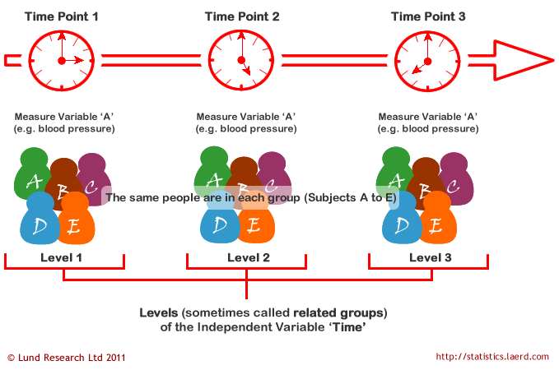
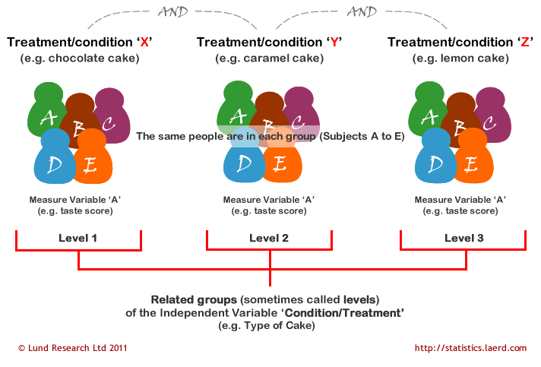

Slide 6
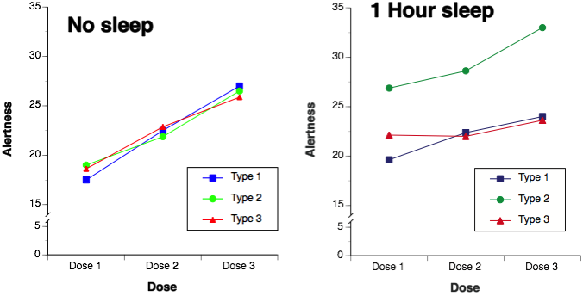
Design Types
Experimental
Quasi-experimental
Field/Naturalistic studies
Longitudinal/Developmental studies
Same outcome, same cases, different occasions
Time points are levels of factor
Different outcomes (all on same metric) on same cases
Different outcomes are levels of
factor
Same outcome, different condition/exposure, on cases that are matched into sets prior to random assignment
Different conditions are levels of
factor

Slide 7
More powerful:
Each case serves as their own control, less between-subject variation
Error term (denominator) of F-test for RM ANOVA is often less than in Independent Groups ANOVA
More economical:
Fewer cases required
Independent Groups ANOVA:
3 conditions,
10 cases per condition
= 30 cases
RM ANOVA:
3 conditions,
same 10 cases used in all conditions
= 10 cases
Repeated-Measures (RM) factor often referred to as:
‘Within-Subjects’ factor
Time 1, Time 2, Time 3, etc…
Condition1, Condition2, Condition3, etc…
May have…
Multiple RM factors → Factorial RM ANOVA
A combination of RM and independent groups factors → Mixed Design ANOVA
Lack of independence of observations → must be accounted for in analysis

Slide 8
Time as a RM Factor
Can answer questions such as:
Do measurements on outcome change over time or conditions?
Is change linear? Quadratic?
Is change positive or negative?
Does change 1st increase, then decrease (or vice versa)?
How long does change last?
Is change permanent over duration of study?
Is outcome same at beginning and end of study?
Researcher chooses when and how frequently to observe outcome, time is not traditionally considered experimental variable
Not a manipulated factor, cannot counterbalance time, or randomize participants to have different times or orders of observation
Although many experiments are longitudinal, they include an additional treatment variable that is experimentally manipulated
Time intervals must be equally spaced
If spacing is unequal, ANOVA with random-effects must be used instead

Slide 9
Condition as the RM Factor
Time as a RM Factor

Slide 10
Simultaneous RM Factors
Sometimes levels of RM factors are administered:
simultaneously or inter-mixed
within one experimental or observational study
For example…
Levels of RM factor might be verbs, nouns, and adjectives, which appear randomly within a passage to be memorized
# of words of each type recalled by participants are recorded

Slide 11
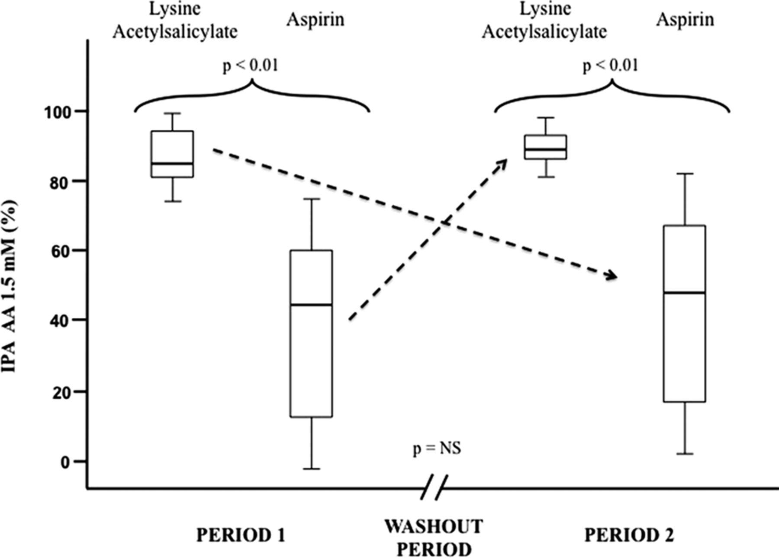
Carryover Effects: The Problem…
Exposure to treatment or participation in study/outcome at one time influences responses at another
Biases related to practice, fatigue, etc.
When time is RM factor, carryover effects are the focus of study
Learning, change over time
When CONDITION is RM factor and participants rotate through conditions, carryover effects are not of interest and may lead to spurious results
Magnitude of carryover effects will vary across treatment order
Differential carryover effects are very problematic
Effect of some levels of RM factor are more long-lasting than others

Slide 12
Carryover Effects: Possible Solutions
Counterbalancing: Varying RM condition order across subjects
3-level RM factor: ABC, ACB, BCA, BAC, CAB, CBA
Partial counterbalancing (Latin Squares): Too many possible orders of RM conditions so a representative set is used
Each subject receives a random order of RM conditions
Each subject receives a ‘run-in’ period (a series of practice trials) at beginning of study to ‘stabilize’ performance
Intervening (distractor, neutral) trials between conditions
Larger time interval, washout period, between conditions
Note: Effects may not be eliminated by any of these methods

Slide 13
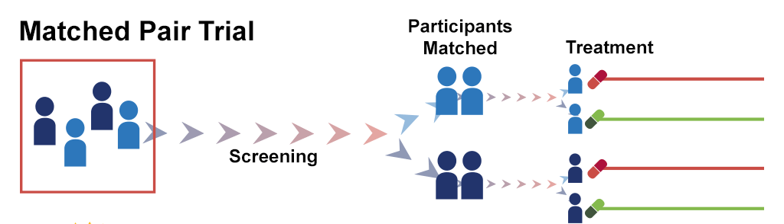
Matched Designs
Alternative to having same cases engage in all RM conditions
Used to limit problems associated with…
Confounding variables (e.g., age, sex, education)
Other threats to internal validity associated with RM studies, such as carryover effects or ordering
Each member of a set of unique, but similar or matched, participants is randomly assigned to one condition
In analysis, each set of participants treated as if they are the same participant
Participants matched into sets on potentially confounding variables (e.g., pretest scores, other characteristics) prior to random assignment
Researcher may have too much faith in matching
Need to report on process used for matching
Usually only match (if at all) on 1 or 2 variables
May match and conduct 1-Way Independent Groups ANOVA to be more conservative in statistical results

Slide 14
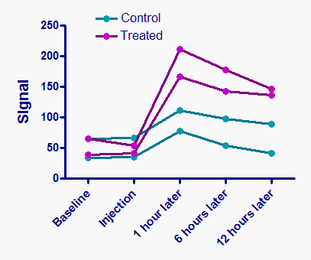
1-Way RM ANOVA
is actually a
2-Way Independent Groups ANOVA
in disguise!!
Factor 1: RM or Within-Subjects factor: Time, Condition
Factor 2: Subject factor: 8 participants = 8 levels
Only made with respect to marginal means of RM factor
Same form as 1-Way Independent Groups ANOVA
H₀: μ₁ = μ₂ =…= μ_{k}
H₁: H₀ is not true
Hypothesis:

Slide 15
Partitioning Variance
RM factor: Same or similar outcome is measured more than once (each level) by multiple participants
Subject factor: Same or similar outcome is measured more than once (each level) by same participants or sets of matched participants
RM x Subject factor interaction
Total variation partitioned into 3 parts…but no SS_{W} or error term!
SS_{Total} = SS_{RM} + SS_{Subj} + SS_{RMxSubj}
Note: only 1 score per cell (n = 1) in previous 1-Way RM ANOVA cross-classification, thus, no variability within cells; SS_{W} = 0
SS_{RMxSubj} is used as error term and represents variation in outcome explained by…
Interaction of participants with levels of RM factor
Random (i.e., left-over) variation (error)

Slide 16
SS_{Repeated Measure}
In computing column or marginal means of RM factor all scores in a given level are averaged regardless of row
n_{k} = # participants per RM level

Slide 17
SS_{Subject}
In computing individual subject means, all scores in a given row are averaged, regardless of level of RM factor
n_{row} = # repeated measurements of outcome from same participant, since n = 1 per cell

Slide 18
SS_{interaction}
Variability among cell means when variability due to individual Subject and RM effects have been removed

Slide 19

SS & degree of freedom
Independent Groups ANOVA
Repeated Measures ANOVA
SS_{Total} = SS_{Row} + SS_{Within}
SS_{Total} = SS_{RM} + SS_{Subj} + SS_{RMxS}
TOTAL
df = n_{T} – 1
TOTAL
df = n_{T} – 1
Bet-group
df = k – 1
With-group
df = n_{T} – k
Bet-Sub
df = n – 1
With-Sub
df = n( c – 1 )
RM
df = c – 1
SubxRM
df =( n - 1)( c – 1 )
F=
MS_{Effect Term}
MS_{Error Term}

Slide 20
MS _{Subj} = SS _{Subj} / df _{Subj}
Generally ignored, considered nuisance variable
However, may be of interest to know if participants vary significantly on outcome:
Considered ‘random effect’
assumed participants (which serve as levels) are a random sample
Correct analysis is random- or mixed-effects ANOVA
Mixed-effects ANOVA: Includes both fixed and random effects (which can either be independent or repeated)
Mixed-design ANOVA: Includes both independent (between-subjects) and repeated-measures (within-subjects) factors

Slide 21
MS_{RM*S} = SS _{RM*S} / df _{RM*S}
SS_{Within} = SS_{Subj} + SS_{RMxS}
Not always of inferential interest
Useful for testing assumptions (later)
Indicates whether RM effect is similar for all participants
When MS_{RMxS} = 0, effect of RM factor is consistent across participants → desirable
When MS_{RMxS} is large, effect of RM factor likely differs across participants → undesirable
Line plot of individual participant means across conditions/time can shed light
Variation due to participants (MS_{Subj}) is not included in error term for F-test of RM factor, MS_{RMxS}
Thus, error term is generally smaller in RM ANOVA than Independent Groups ANOVA
However, when matching leads to no variation across subjects (SS_{Subj} ≈ 0) and MS_{RMxS} = MS_{Within}
Results of RM ANOVA same as Independent Groups ANOVA
Increased effect of matching or repeating participants
SS_{RMxS} decreases, SS_{Subj} increases
Decreased effect of matching or repeating participants
SS_{RMxS} increases, SS_{Subj} decreases

Slide 22
1-Way RM ANOVA: Summary Table
Source | SS | df | MS | F | p
RM
Subj |  |  | X | X | X
Error(RM x Subj) |  |  |  | X | X
Total |  |  | X | X | X

Slide 23
Assumptions
Participants are a random sample from population and are independent of one another (Although participant observations are dependent, participants themselves are independent)
DV normally distributed in the population
Less concerned: equal n per level and df_{Intrx}≈ 20 (CLT) ← investigate via plotting
Homogeneity of variance
Variance of DV is similar for all levels of RM factor ← Leven’s or visual inspection
If Time is RM factor, data are measured at (near) equal intervals
**Sphericity** and Compound symmetry
CS is a special case of sphericity
If CS is satisfied, sphericity is satisfied
However, if CS is not satisfied, sphericity may still be satisfied

Slide 24
Sphericity
Informally, it is the degree of violation of independence same for all levels of RM factor?
Taking DV, difference scores can be calculated for each participant between all possible pairs of levels of RM factor
A variance can be calculated for each set of difference scores
When assumption of sphericity is met, difference score variances will be equal
Mauchly’s test of sphericity
Based on χ² distribution
H₀: Variances of difference scores between all pairs of levels of RM factor are equal (sphericity)
Test not extremely useful as most “tests of other tests” tend to be…misleading*
Small N = ↑ Type II error
Large N, non-normality, ⁺heterogeneity of covariances = ↑ Type I error
When using this test, assess all RM main effect(s)
Rule of thumb: cause for concern may exist when the largest variance is 4x greater than smallest
*Kesselman, Rogan, Mendoza, & Breen, 1980

Slide 25
Sphericity: Mauchly’s test
Only applies to RM factors with > 2 levels
Cannot compare variances of difference scores when there is only 1 set of differences
Sphericity always met when k = 2 (RM factor)
When violated, ↑ risk of Type I error
Critical F-statistics will be too small
F-test is + biased when sphericity is violated
Several “alternatives”, discussed later
Notes:
R code for plot
library(tidyverse)
weight <- c(164,164,158,159,155,220,245,176,155,162,261,275,264,280,272,306,326,320,330,312)
my.new.matrix <- matrix(weight, nrow=5, ncol=4)
my.new.matrix
model<-lm(my.new.matrix ~ 1)
design<-factor(c("week08", "week12", "week16", "week20"))
options(contrasts=c("contr.sum", "contr.poly"))
results<-car::Anova(model, idata=data.frame(design), idesign=~design, type="III")
summary(results, multivariate=F)
df = data.frame(my.new.matrix)
names(df) = c("week08", "week12", "week16", "week20")
df %>%
mutate(week20 = week20 - 35,
week08 = week08 + 20) %>%
mutate(id = row_number()) %>%
gather("time", "value", 1:4) %>%
ggplot(aes(time, value)) +
geom_line(aes(group = id),
alpha = .4) +
geom_point() +
geom_boxplot(alpha = .5) +
theme_classic()

Slide 26
Compound Symmetry
A bit stricter than sphericity, which is a special case, and is subsumed by CS
Homogeneity of variances of difference scores
Variance of difference scores assumed to be equal
Same as previously mentioned for sphericity
Homogeneity of covariances of difference scores
Covariances of difference scores
(between all possible pairs of levels of the RM factor) assumed to be equal
Most software does not assess this assumption
Additivity (discussed in later slides)

Slide 27
Independence
Compound Symmetry
 | A | B | C | D
A | s_{A}² | 0 | 0 | 0
B | 0 | s_{B}² | 0 | 0
C | 0 | 0 | s_{C}² | 0
D | 0 | 0 | 0 | s_{D}²
 | A | B | C | D
A | s_{A}² | s_{AB} | s_{AC} | s_{AD}
B | s_{BA} | s_{B}² | s_{BC} | s_{AB}
C | s_{CA} | s_{CB} | s_{C}² | s_{AC}
D | s_{DA} | s_{DB} | s_{DC} | s_{D}²
Groups or levels are independent of one another as there are different participants in each level; variances are non-0 and assumed equal, covariances are 0
Groups or levels are dependent or correlated. Variances are non-0 and assumed equal as are covariances (assumption met)

Slide 28
Additivity
Error term for RM ANOVA is RMxS interaction
Should only represent random error, not error plus variation of subjects over time or across conditions
Possible that effect of level A of RM factor is different for different subjects, and thus an interaction between RM and S truly exists
Then, some of what we consider to be error when we calculate RMxS, is really an interaction effect, and not just random error
Thus, Additivity = absence of RMxS interaction
Presence of such an interaction indicates a multiplicative or nonadditive effect where different participants have different patterns of response to RM factor
Error term is thus distorted by inclusion of a systematic (non-random) source of variation (due to Subjects)
Must determine what extraneous (between-subjects) factor (e.g., Gender) is causing interaction and test it explicitly (e.g., Gender X RM Factor interaction)
Inclusion removes effects from error term (MS_{Intrx}) -> Mixed-Design ANOVA (discussed next lecture)
Since nonadditivity implies heterogeneous variances for difference scores, sphericity assumption will be violated if this assumption is not met
A test exists for this assumption, called the “Tukey test for nonadditivity”, available in additivityTests::tukey.test()

Slide 29
Assessing Assumptions
If we want to assess these assumptions, we rely on results of the following approaches in practice:
Homogeneity of variances
Levene’s (or Bartlett’s) test
car::leveneTest()
Sphericity/Compound Symmetry
Mauchly test
Examination of variance-covariance matrix
Examination of variances among pairs of difference scores
Built intio afex::aov_4()
Additivity
Small MS_{Intrx}
Individual Subject lines in a means plot are mostly parallel
additivityTests::tukey.test()

Slide 30
Violations of Assumptions
Mostly concerned with sphericity -- > If violated, should pursue some alternative
If sphericity is met, 5 options:
Use standard univariate F-tests (recommended)
Use trend analysis (recommended, IF this is the goal)
Use a multivariate test (not recommended as findings should be same as standard univariate F-tests)
USE A MAXIMUM LIKELIHOOD PROCEDURE (HIGHLY RECOMMENDED)
Use a (not recommended, less power) nonparametric test …Friedman test (1-way only)
If sphericity is NOT met, 5 options:
Use an adjusted or alternative F-test (recommended)
Use trend analysis (recommended, if this is the goal)
Use a multivariate test (less recommended in most cases)
USE A MAXIMUM LIKELIHOOD PROCEDURE (HIGHLY RECOMMENDED)
Use a nonparametric test (recommended, as a last resort)…Friedman test (1-way only)
PSY 7650
MLM, HLM

Slide 31
Alternatives
Standard univariate F-tests are not recommended when sphericity is violated
As mentioned before, will be too liberal and inaccurate (increased risk for Type I error)
Trend analysis
Sphericity assumption irrelevant
Series of smaller pairwise comparisons across levels of the RM factor
Preferred for questions regarding the shape of the pattern in the DV over time

Slide 32
Adjusted or alternative univariate F-tests (Useful for “smaller” N)
DEGREES OF FREEDOM (numerator and denominator) are REDUCED by multiplying by EPSILON
Epsilon = an adjustment factor describing the magnitude of the departure from sphericity
If sphericity assumption is perfectly met, epsilon = 1
Epsilon < 1 indicates departure from sphericity
Lower-bound depends on k levels of RM factor
1 / (k – 1), thus when k = 3, epsilon can be as small as .50
MORE conservative F-critical value
df correction approaches have been criticized as too conservative,
increasing risk of Type II error, as they assume maximal heterogeneity among cells
Several approaches (most-to-least conservative)
Lower-bound: Uses the lower bound estimate of epsilon in the df correction
Greenhouse-Geisser: Considered conservative and tends to underestimate epsilon when epsilon is close to 1 (danger for over-correction)
Huynh-Feldt: Considered less conservative when true value of epsilon is ≥ .75; but also overestimates sphericity

Slide 33
Multivariate F-tests
DV is treated as a set of variables, ignores (does not assume) sphericity;
Assumes general covariance structure
Cost: Less powerful than RM ANOVA and should be avoided UNLESS…
k is low (< 5) and N is > (15 + k) (or k is high (5 to 8) and N is > (30 + k)) , epsilon is low (< .70), and correlations among levels of RM factor are high
Computed on differences among means
Most often used in context of non-experimental research
Different forms exist:
Pillai’s trace, ⁺Wilk’s λ, Hotelling’s trace, Roy’s largest root
⁺Preferred and most commonly used
All yield same result for 1-Way RM ANOVA
Additional assumptions for multivariate F-tests
Difference scores are multivariately normally distributed in population
Difference scores on outcome for each pair of levels are normally distributed
Difference scores on outcome for each pair of levels are normally distributed at every combination of the values of other factors
Difference scores from any one participant are independent from those of any other participant
Use multivariate η² for main effect or interaction when using multivariate F-tests
Multivariate η² = 1 – Wilk’s Lambda (Λ)

Slide 34
Maximum likelihood procedures
Mixed-effects, multilevel, or hierarchical linear models
Wave of the (present and) future
Structure of variance-covariance matrix is modeled explicitly
not assumed to follow compound symmetry (can be tested empirically)
Autoregressive, exchangeable, or unstructured correlational structures are but a few examples
Effect of N on results of the Mauchly test of sphericity
Could have large N, reject H₀, apply corrections, which are only minimal and unlikely to affect outcome of results
Could have small N, fail to reject H₀, not apply corrections and obtain spurious results
If epsilon is near 1, a correction is probably not necessary; however, if epsilon is near the lower bound, a correction is likely necessary
Could run both RM ANOVA (with corrections for sphericity) and Multivariate analyses and report analysis that is statistically significant as that analysis has the greater power given the circumstances

Slide 35
Effect Size: η²
Little evidence for a RM factor X Subject interaction (additivity met) (Keppel & Wickens, 2004)
Evidence for a RM factor X Subject interaction (non-additivity) (Myers & Well, 1991)
Conservative or ‘lower bound’ estimate

Slide 36
Effect Size: ω²
Little evidence for a RM factor X Subject interaction
Evidence for a RM factor X Subject interaction
Conservative or ‘lower bound’ estimate
In both equations, N = # independent participants or sets of participants

Slide 37
Factorial Repeated Measures ANOVA

Slide 38
Dr. Evans wishes to evaluate various coping strategies for pain.
He obtains 8 volunteers to come to the lab on 2 consecutive days. On both days, the volunteers plunge their hands into freezing cold water for 90 seconds.
They rate how painful the experience is on a scale from 1 to 50 (not painful) after 30 seconds, then 60 seconds, and then 90 seconds.
On one day they are given pain avoidance instructions and on the other day they are given concentration on pain instructions.
In order to counterbalance the design, 4 students are given the avoidance and 4 students are given the concentration strategy the 1st day, then switched the 2nd day.
What are the RM factors? What are their levels?
What is the outcome variable?
Generally, ‘Order’ would be another factor (not RM) that would need to be included in the ANOVA. For our purposes, we will say that this factor had no effect.

Slide 39
Dr. Chapman wishes to examine the effect of drugs A and B as well as their interaction on blood flow. Each drug has two possible formulations (levels). Each participant received each of the 4 possible combinations of the 2 drugs over several days (A1B1, A1B2, A2B1, A2B2). The half-life of each drug was such that there were no carry-over effects.
What are the RM factors? What are their levels?
What is the outcome variable?

Slide 40
Factorial RM ANOVA
Same/matched participant

Slide 41
Factorial RM ANOVA
2 or more RM factors (no independent factors)
Separate error term
for each RM main effect
and for interaction(s) among RM factors
Error terms = RM effect being tested (main effect or interaction) x Subjects interaction
1st RM main effect error term = RM₁ x Subjects intrx
2nd RM main effect error term = RM₂ x Subjects intrx
RM₁ x RM₂ interaction error term = RM₁ x RM₂ x Subjects intrx

Slide 42
Factorial RM ANOVA: Summary Table
Source | SS | df | MS | F | p
Subj |  |  | X | X | X
RM1
Error(RM1 x Subj) |  |  |  | X | X
RM2
Error(RM2 x Subj) |  |  |  | X | X
RM1 x RM2
Error(RM1 x RM2 x Subj) |  |  |  | X | X
Total |  |  | X | X | X

Slide 43
Effect Size: η²
Little evidence for a RM factor X Subject interaction (additivity met) (Keppel & Wickens, 2004)
Compute depending on effect of interest
Evidence for interaction (non-additivity)
Conservative or ‘lower bound’ estimate
Compute depending on effect of interest
Present the range

Slide 44
Effect Size: ω²
Little evidence for a RM factor X Subject interaction
Compute depending on effect of interest
In both equations, N = # independent participants or sets of participants

Slide 45
Multiple Comparisons
Similar procedures as other ANOVA designs
Different error term technically required for each RM comparison
Error represents differences among participants across levels of RM factor + random error
When a contrast omits one or more levels of the RM factor, how do we know whether omnibus error term represented by RM x Subjects factors still applies to remaining levels? Hard to say…
However, use of MS_{Intrx} as error term in omnibus multiple comparisons is usually justified
i.e., Follow-up 1-Way RM ANOVAs for simple main effects following interaction
Similar to follow-up 1-Way Independent Groups ANOVAs following significant Factorial ANOVA
Simple or pairwise comparisons avoid this problem by use of paired-samples t-tests or trend analysis procedures (recommended)

Slide 46
Non-Significant Interaction(s)
Only significant RM main effects
Reduces to two 1-Way RM ANOVAs
Marginal means are contrasted
Paired-samples t-tests; α_{PC} adjustment
Trend analysis or polynomial contrasts
Simple or complex comparisons among marginal means (levels) if F-test significant
No further tests if F-test of main-effect indicates difference

Slide 47
Significant Interaction(s)
Visualize: Plot means
Tests of simple (main) effects
Contrast means from levels of one RM factor within levels of another RM factor using 1-way RM ANOVA, paired-samples t-tests, or polynomial contrasts
Avoid interpretation of main effects
Alternative: Tests of interaction contrasts
Create difference scores between levels of one factor within each level of another factor and compare with paired-samples t-tests
Order dictates valence of difference scores
Results will indicate whether mean differences across one condition vary across levels of other condition

Slide 48
Significant Interaction(s)
Direction of ‘simple effect’ testing determined by researcher
Simple effects generally tested for each level of stratifying factor
Simple comparisons
Paired-samples t-tests
1-way RM ANOVA followed by simple or complex comparisons (e.g., Paired-samples t-tests)

Slide 49
Reporting Results
Summary information: sample means and either SDs, SEs, CIs
Effect size measures for main effects or interactions (even if non-significant)
Results of post hoc comparisons
Mean differences and interactions can be graphically depicted

Slide 50
Problems
Extraneous factors (internal validity)
Passage of time in longitudinal studies
Do conditions, equipment, experimenters, participants change (interest, practice, skills) over the course of the study in ways that may invalidate results?
Need methodological control
Generalizability (external validity)
Using fewer participants, so sample is less representative of population
Poor matching, small n, violated assumptions may lead to deflated power in RM ANOVA so that its power is same as Independent Groups ANOVA
If a participant is missing data on outcome from any level of any RM factor, all data from that participant is removed from analysis
Decreased N → less power
However, easier to impute missing data in RM ANOVA than in randomized- or independent-groups designs
Other outcome scores are available from participants with missing values
Imputation results in several data sets on which the same analysis is conducted and results are compared

Slide 51
Supplemental

Slide 52
MS_{RM*S}
Can use to calculate the ICC

