Slide 1
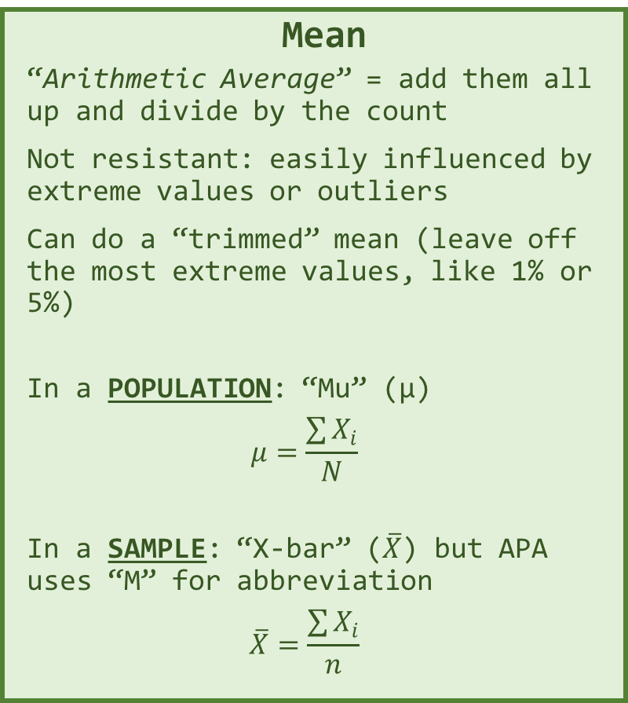
Mean
“Arithmetic Average” = add them all up and divide by the count
Not resistant: easily influenced by extreme values or outliers
Can do a “trimmed” mean (leave off the most extreme values, like 1% or 5%)
In a POPULATION: “Mu” (µ)
$$μ=\frac{\sum{X_{i}}}{N}$$
In a SAMPLE: “X-bar” ($\overline{X}$) but APA uses “M” for abbreviation
$$\overline{X}=\frac{\sum{X_{i}}}{n}$$
Median
50th percentile, APA: “Mdn”
“Middle” value, when ordered/ranked in increasing order
ODD #: middle value
EVEN #: avg of 2 middle
Half the values are above, and half below
Easy for a computer to do
RESISTANT: NOT influenced by a few extreme values or outliers
Mode
Most common value, largest frequency, highest peak
Non-uniqueness - can have more than one mode
Doesn’t always represent the ‘center’
Do NOT usually use, other than descriptively

