Slide 1
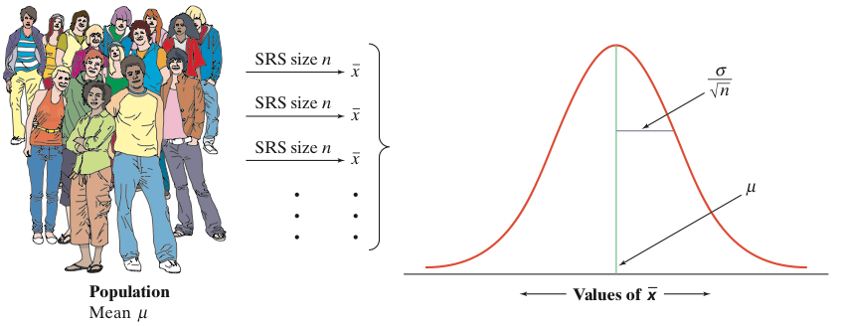
“SE”
Standard error
SE for mean = SD divided by square root of the sample size
IF
individual observations
have the
N(µ,σ) distribution
THEN
the sample mean of an SRS of size n has the N(µ, σ/√n) distribution

