Slide 1
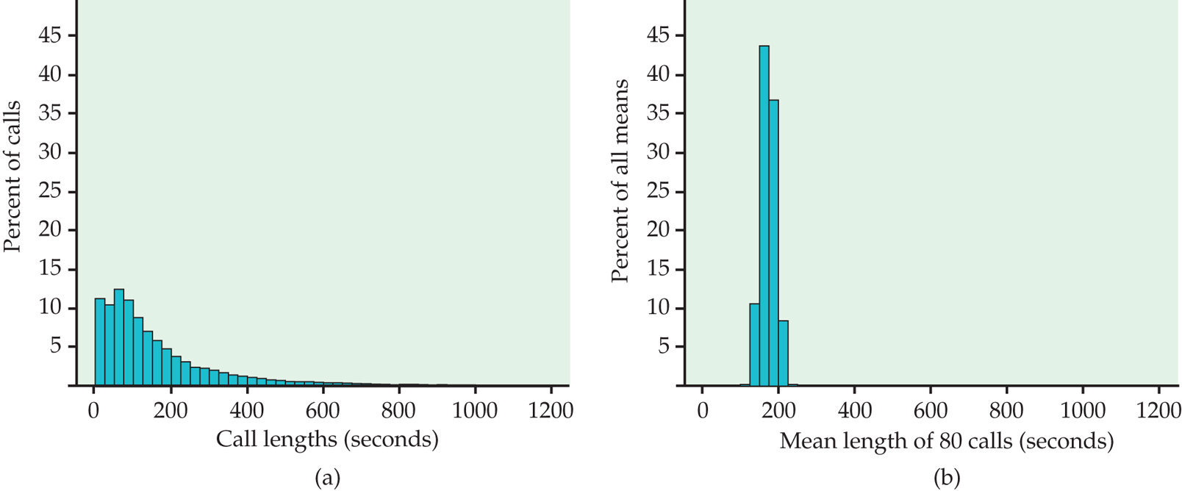
X = Raw data for ALL calls
X-bar = AVERAGE for 80
More normal
Right-skewed

