Slide 1
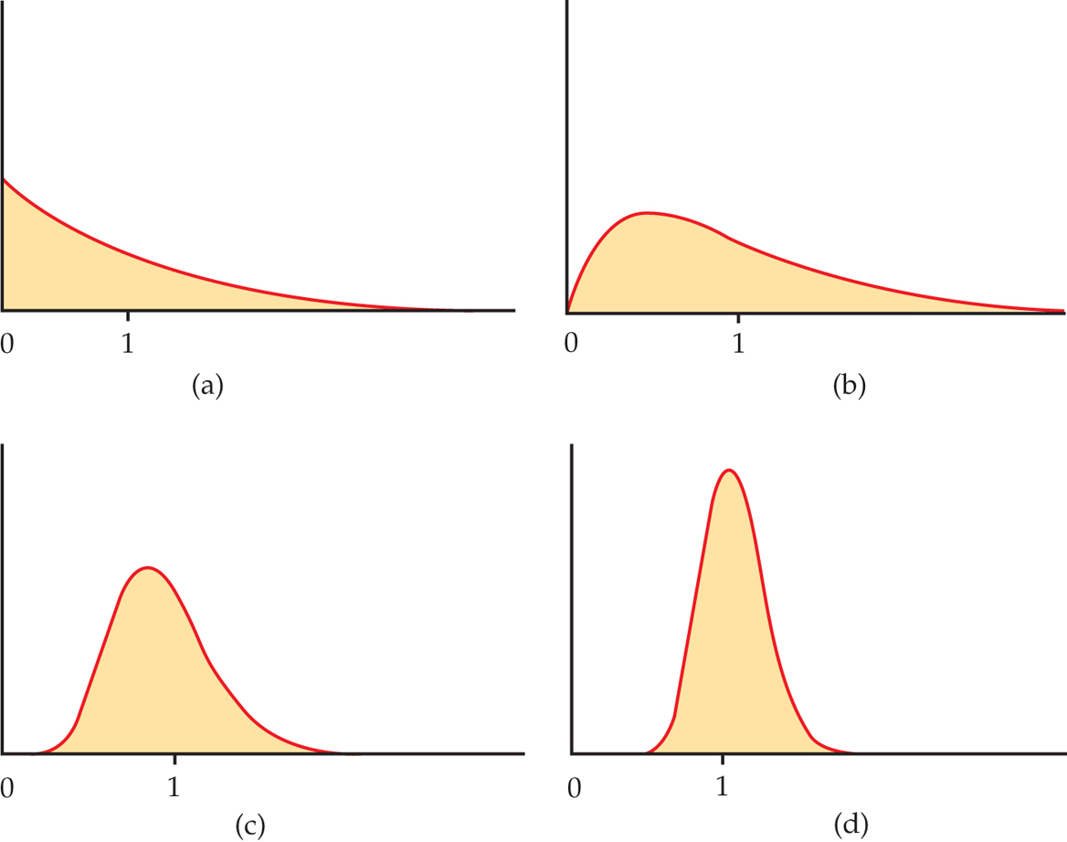
Population Distribution
(sample size 1)
Sampling Distribution
for MEAN of a sample size 2
Sampling Distribution
for MEAN of a sample size 10
Sampling Distribution
for MEAN of a sample size 10

