Slide 1
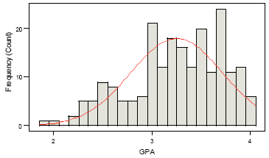
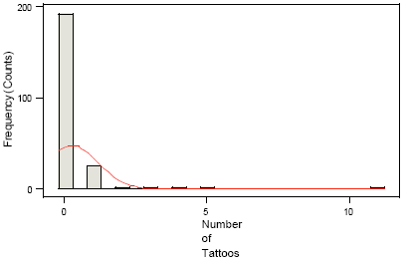
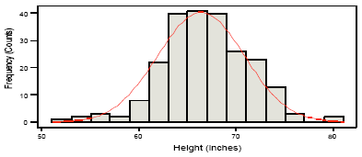
Heights (inches)
Mean = 66.3 inches
Median = 66 inches
GPA
Mean = 3.25
Median = 3.3
Number of Tattoos
Mean = .23
Median = 0

