Slide 1
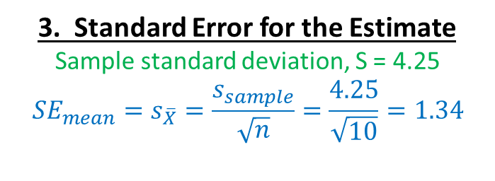

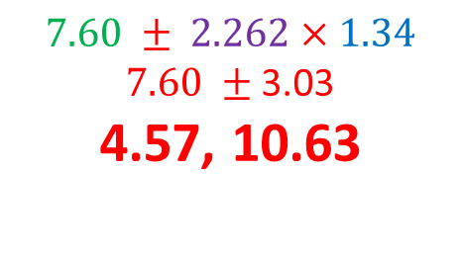

1. Best estimate
$$\overline{X}=\frac{\sum{X}}{n}=\frac{76}{10}=7.6$$
2. Critical Value
df = n – 1 = 10 – 1 = 9
Always use TWO tails
Critical t = 2.262
3. Standard Error for the Estimate
Sample standard deviation, S = 4.25
$${SE}_{mean}=s_{\overline{X}}=\frac{s_{sample}}{\sqrt{n}}=\frac{4.25}{\sqrt{10}}=1.34$$
$$\text{4}\text{.} \text{Put} \text{it} \text{together}$$
$Est ±CV×{SE}_{est}$ →
$$7.60 ± 2.262×1.34$$
$7.60 ±$ 3.03
4.57, 10.63

