Slide 1
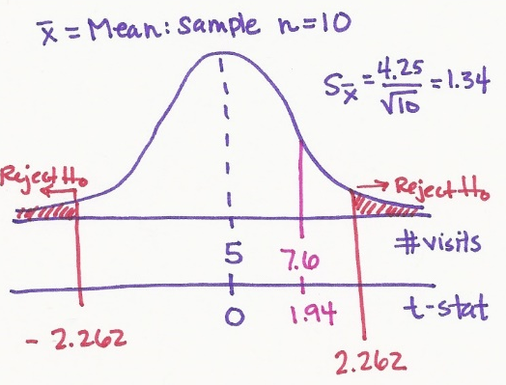
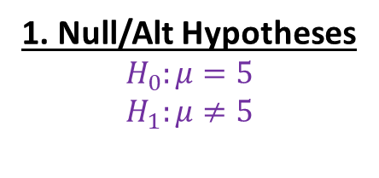
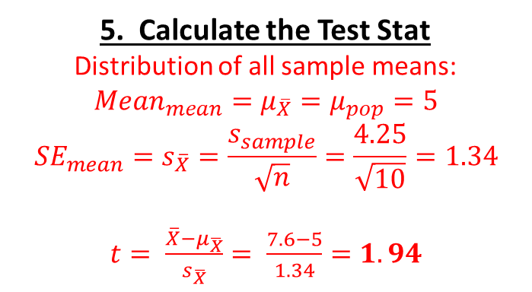
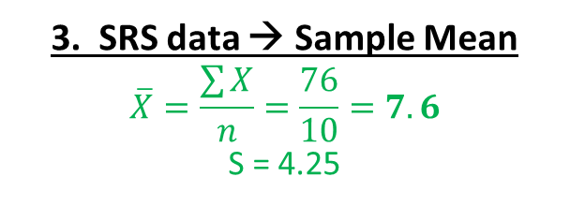
4. Rejection Region?
df = n – 1 = 10 – 1 = 9
Critical t = +/- 2.262 …
Reject if t-score is >2.262 or < -2.262
1. Null/Alt Hypotheses
$$H_{0}:μ=5$$
$$H_{1}:μ≠5$$
2. Choose Test Stat, α, & # tails
CLT: mean of repeated SRS → normally dist. w/o pop SD known
→ So use the t-stat
α = .05 & 2 tails (default)
5. Calculate the Test Stat
Distribution of all sample means:
$${Mean}_{mean}=μ_{\overline{X}}=μ_{pop}=5$$
$${SE}_{mean}=s_{\overline{X}}=\frac{s_{sample}}{\sqrt{n}}=\frac{4.25}{\sqrt{10}}=1.34$$
$t= \frac{\overline{X}−μ_{\overline{X}}}{s_{\overline{X}}}= \frac{7.6−5}{1.34}=1.94$
6. Conclusion
t-stat does NOT falls in the rejection region
No evidence the population’s mean is not 5
“FAIL to reject the Null”
“Even though this sample’s mean of 7.6 was more than 5, this could be due to random chance and another sample may find the opposite effect.”
3. SRS data → Sample Mean
$$\overline{X}=\frac{\sum{X}}{n}=\frac{76}{10}=7.6$$
S = 4.25

