Slide 1
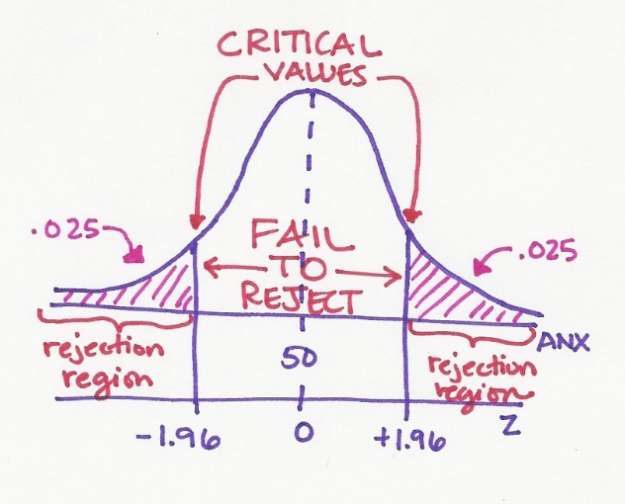

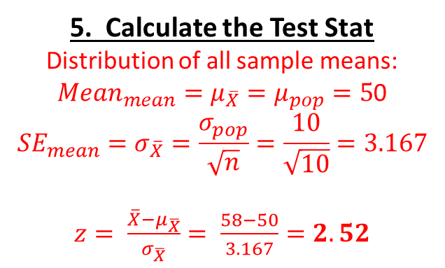
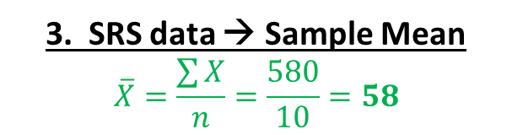
3. SRS data → Sample Mean
$$\overline{X}=\frac{\sum{X}}{n}=\frac{580}{10}=58$$
4. Rejection Region?
.05 in BOTH tails, so .025 in EACH tail …
Critical z = +/- 1.96 …
Reject if Z-score is > 1.96 or < -1.96
6. Conclusion
Z-stat falls in the rejection region
evidence the population’s mean is not 50
“reject the Null”
“After the earthquake,
townspeople’s anxiety levels are
higher than 50, on average.”
5. Calculate the Test Stat
Distribution of all sample means:
${Mean}_{mean}=μ_{\overline{X}}=μ_{pop}=5$0
$${SE}_{mean}=σ_{\overline{X}}=\frac{σ_{pop}}{\sqrt{n}}=\frac{10}{\sqrt{10}}=3.167$$
$z= \frac{\overline{X}−μ_{\overline{X}}}{σ_{\overline{X}}}= \frac{58−50}{3.167}=2.52$

