Slide 1
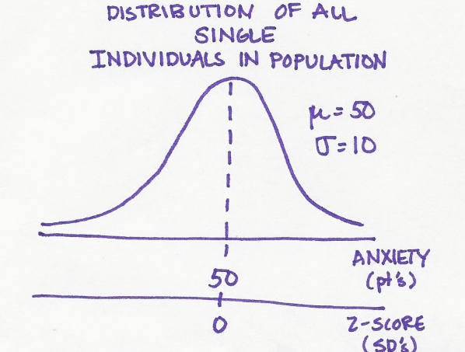
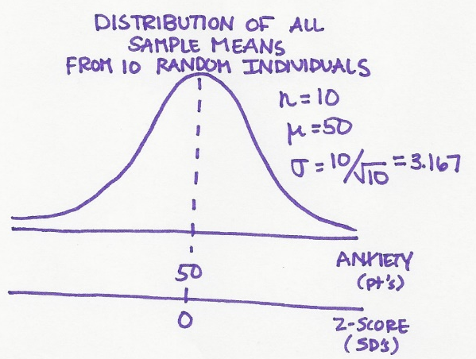
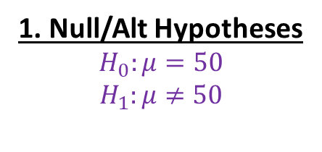
1. Null/Alt Hypotheses
$$H_{0}:μ=50$$
$$H_{1}:μ≠50$$
2. Choose Test Stat, α, & # tails
CLT: mean of repeated SRS → normally dist.
→ So use the z-stat
α = .05 & 2 tails (default)

