Slide 1
Categorical Data Analysis
Cohen Chapters 19 & 20
For EDUC/PSY 6600

Slide 2
Creativity involves breaking out of established patterns in order to look at things in a different way.
--
Edward de Bono

Slide 3
Motivating examples
Dr. Fisel wishes to know whether a random sample of adolescents will prefer a new of formulation of ‘JUMP’ softdrink over the old formulation. The proportion choosing the new formulation is tested against a hypothesized value of 50%.
Dr. Sheary hypothesizes that 1/3 of women experience increased depressive symptoms following childbirth, 1/3 experience increases in elevated mood after childbirth, and 1/3 experience no change. To evaluate this hypothesis Dr. Sheary randomly samples 100 women visiting a prenatal clinic and asks them to complete the Beck Depression Inventory. She then re-administers the BDI to each mother one week following the birth of her child. Each mother is classified into one of the 3 previously mentioned categories and observed proportions are compared to the hypothesized proportions.
Dr. Evanson asks a random sample of individuals whether they see both a physician and a dentist regularly (at least once per year). He compares the distributions of these binary variables to determine whether there is a relationship.

Slide 4
Categorical Methods
Instead of means, comparing counts and proportions within and across groups
E.g., # ill across different treatment groups
Associations / dependencies among categorical variables
Data are nominal or ordinal
Discrete probability distribution
Number of finite values as opposed to infinite
Each subject/event assumes 1 of 2 mutually exclusive values (binary or dichotomous)
Yes/No
Male/Female
Well/Ill

Slide 5
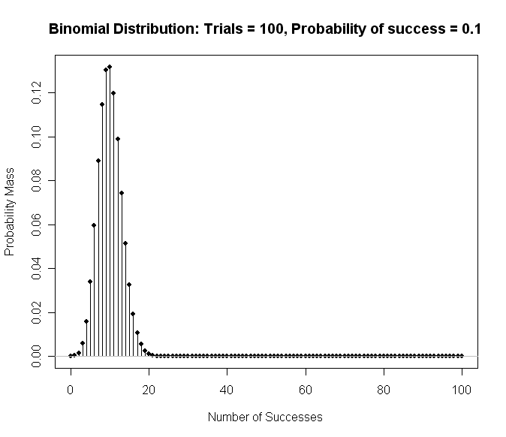
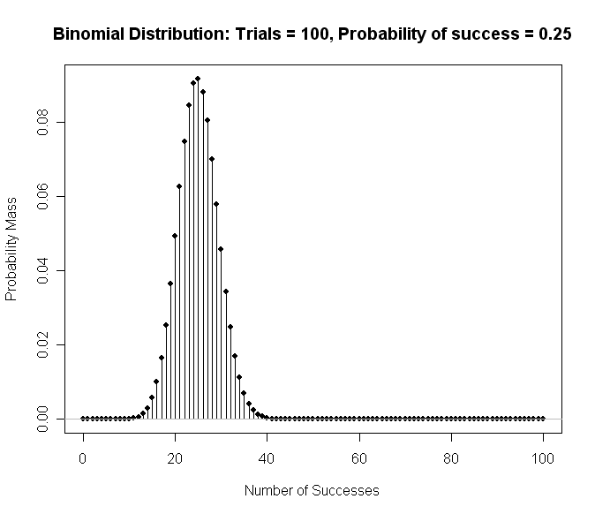
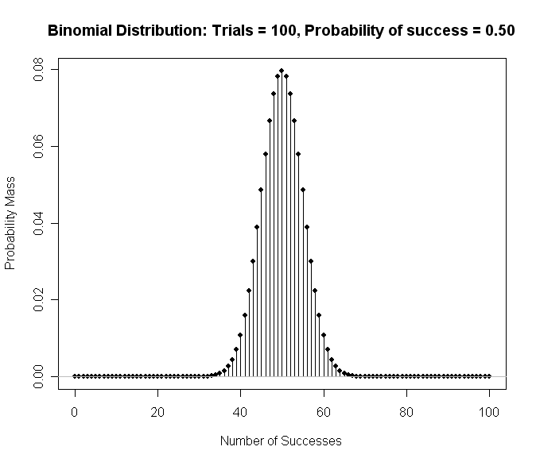
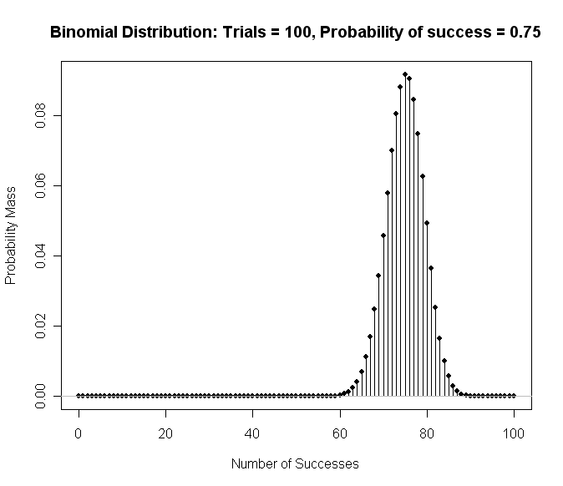
Categorical Methods
Instead of means, comparing counts and proportions within and across groups
E.g., # ill across different treatment groups
Associations / dependencies among categorical variables
Data are nominal or ordinal
Discrete probability distribution
Number of finite values as opposed to infinite
Each subject/event assumes 1 of 2 mutually exclusive values (binary or dichotomous)
Yes/No
Male/Female
Well/Ill

Slide 6
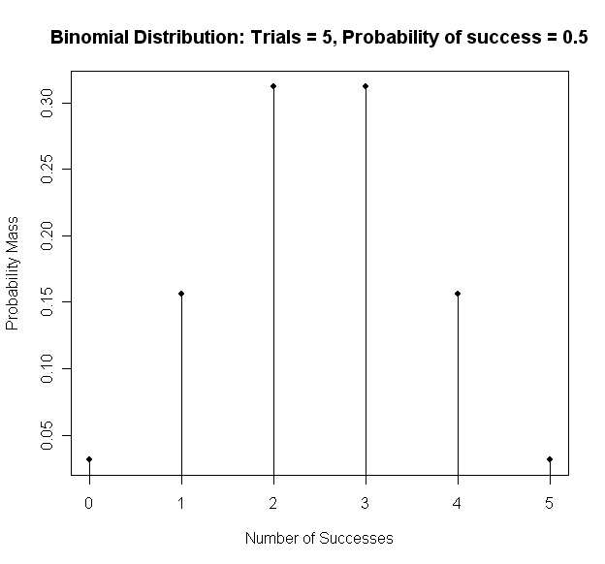
The Binomial Distribution: EQ & coin example
(Arbitrarily) assign 1 outcome as ‘success’ and other as ‘failure’
Example: Probability of correctly guessing side of coin 4 out of 5 flips?
5 events, 4 successes, 1 failure
P = p(correct guess on each flip) = .50
Q = p(incorrect guess on each flip) = .50
N = # events
X = # “successes”
P = p(“success”)
Hypothesized proportion / probability of success
Q = p(“failure”)
Hypothesized proportion / probability of failure
P + Q = 1
Remember: 0! = 1; x⁰ = 1
Use equation to obtain:
5 out of 5 successes = .03
4 out of 5 successes = .16
3 out of 5 successes = .31
2 out of 5 successes = .31
1 out of 5 successes = .16
0 out of 5 successes = .03
Sum of probabilities = 1.0

Slide 7
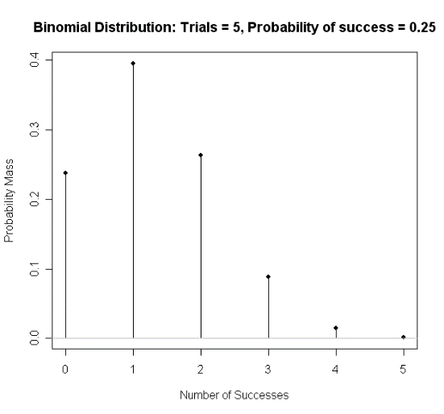
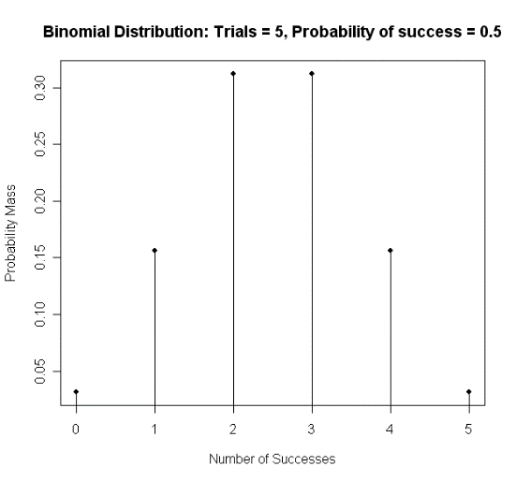
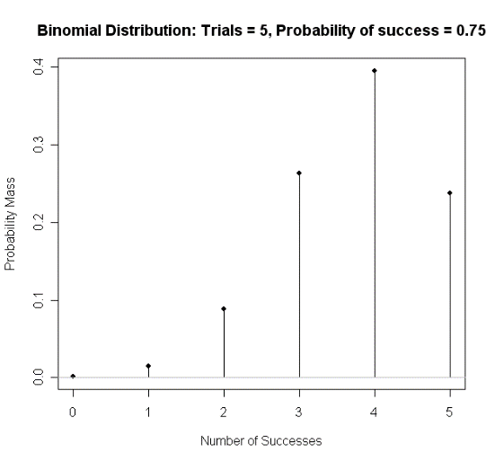

Sampling distribution for the binomial
Binomial probability distribution for N = 5 events, and P = .5
Binomial Distribution Table (exact values)
Sampling distribution as it was derived mathematically
We can only reject H₀ with 0 or 5 out of 5 successes (1-tailed)
Sampling Distribution
$$\begin{matrix}mean=NP \\ variance=NPQ \\ \begin{aligned}SD= \sqrt{NPQ} \\ SEMEAN= \sqrt{\frac{PQ}{N}}\end{aligned}\end{matrix}$$
Different binomial distribution for each N
Normal when P = .50, skewed when P ≠ .50
Critical value depends on: N events, X successes, P
Example
M = 5*.5 = 2.5 (See Histogram)
VAR = 5*.5*.5 = 1.25
SD = sqrt(1.25) = 1.12

Slide 8
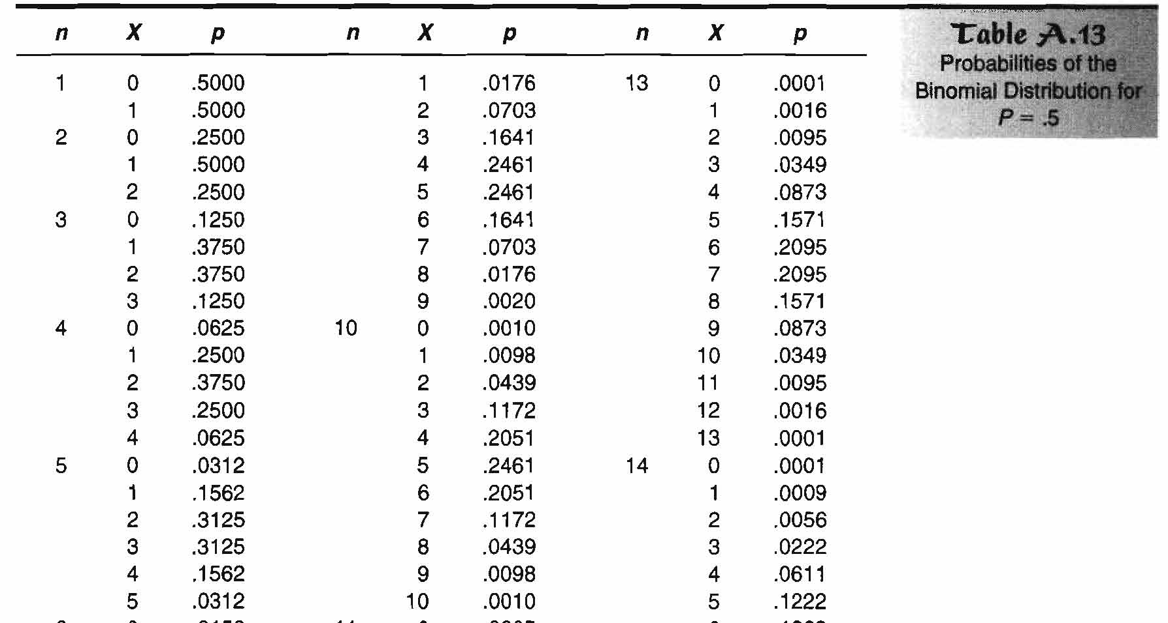
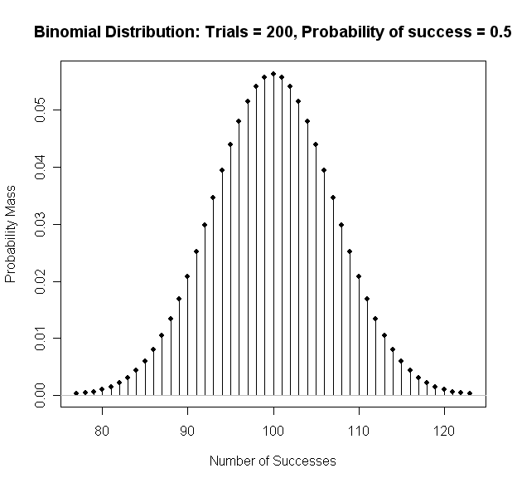
As N increases, binomial distribution → normal
“Equally Likely”
Means p = 0.5

Slide 9
Binomial Sign Test
Single sample test with binary/dichotomous data
Proportion or % of ‘successes’ differ from chance?
H₀: % of observations in one of two categories equals a specified % in population
H₀: Proportion of ‘yes’ votes = 50% in population
Experiment: Coin flipped 10x, heads 8x
Is coin biased (Heads > .50)?
Experiment: 10 women surveyed, 8 select perfume A
Is one perfume preferred over another?
For both:
H₀: Proportion (X) = .50 in population
H₁: Proportion (X) ≠ .50 in population (2-tailed)
Assumptions
Random selection of events or participants
Mutually exclusive categories
Probability of each outcome is same for all trials/observations of experiment

Slide 10
Binomial sign test: example
data.frame(heads = 8,
tails = 2) %>%
as.matrix() %>%
as.table() %>%
binom.test(alternative = "greater")
Experiment: Coin flipped 10x, heads 8x
Is coin biased (Heads > .50)?
H₀: Proportion (X) = .50 in population
H₁: Proportion (X) ≠ .50 in population (2-tailed)
Exact binomial test
data: .
number of successes = 8, number of trials = 10, p-value = 0.05469
alternative hypothesis: true probability of success is greater than 0.5
95 percent confidence interval:
0.4930987 1.0000000
sample estimates:
probability of success
0.8
Notes:
Note that these are already in count form.

Slide 11
Normal approximation to the binomial (i.e. “z-test” for a single proportion)
What if N were larger, say 15?
Same proportions: 80% (12/15) Heads & Perfume A
Sum p(12, 13, 14, 15/15) = .0178 (1-tailed p-value)
Reject H₀ under both 1- and 2-tailed tests
2-tailed p = .0178 x 2 = .0356
Experiment:
Senator supports bill favoring stem cell research. However, she realizes her vote could influence whether or not her constituents endorse her bid for re-election. She decides to vote for the bill only if 50% of her constituents support this type of research. In a random survey of 200 constituents, 96 are in favor of stem cell research.
Will the senator support the bill?
Earlier: Binomial distribution → normal distribution, as N → infinity
Recommendation: Use z-test for single proportion when N is large (>25-30)
When NP and NQ are both > 10, close to normal
H₀ and H₁ are same as Binomial Test
Test statistic:

Slide 12
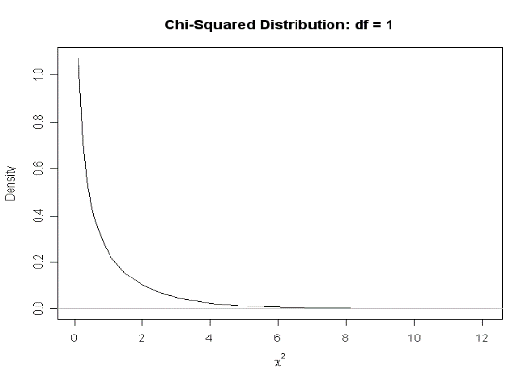
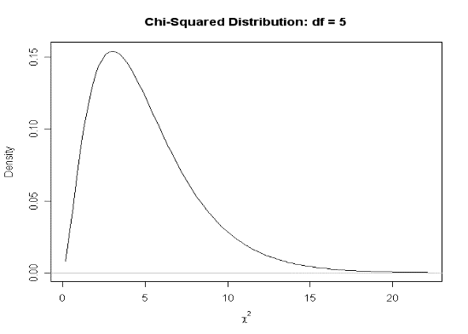
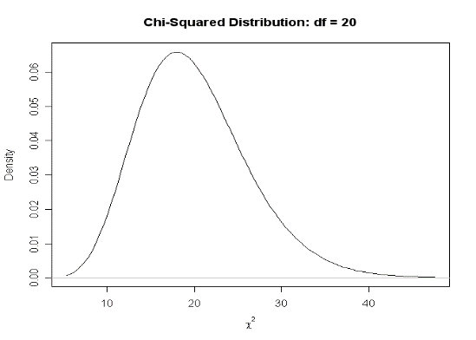
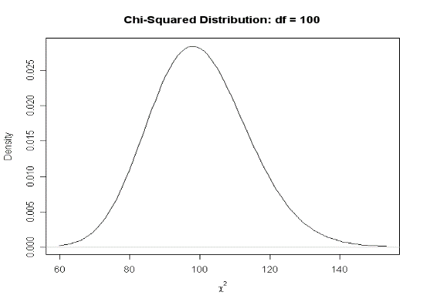
Chi-Square (χ² ) Distribution
Family of distributions
As df (or k categories) ↑
Distribution becomes more
normal, bell-shaped
Mean & variance ↑
Mean = df
Variance = 2* df
z² = χ²
Always positive, 0 to infinity
1-tailed distribution
χ² distribution used in many statistical tests
“GOODNESS OF FIT” Testing:
Are observed frequencies similar to frequencies expected by chance?
Expected frequencies
Frequencies you’d expect if H₀ were true
Usually equal across categories of variable (N / k)
Can be unequal if theory dictates

Slide 13
Chi-Squared: GOODNESS OF FIT Tests “GoF”
Hypotheses
H₀: Observed = Expected frequencies in population
H₁: Observed ≠ Expected frequencies in population
General form:
O = observed frequency
E = expected frequency
If H₀ were true, numerator would be small
Denominator standardizes difference in terms of expected frequencies
Aka: Pearson or ‘1-way’ χ² test
1 nominal variable
2 or more categories
If nominal variable ONLY has 2 categories, χ² GoF test:
Is another large sample approximation to Binomial Sign Test
Gives same results as z-test for single proportion as z² = χ²
Has same H₀ and H₁ as binomial or z-tests
Compare obtained χ² statistic to critical value based on df = k – 1, k = # categories

Slide 14
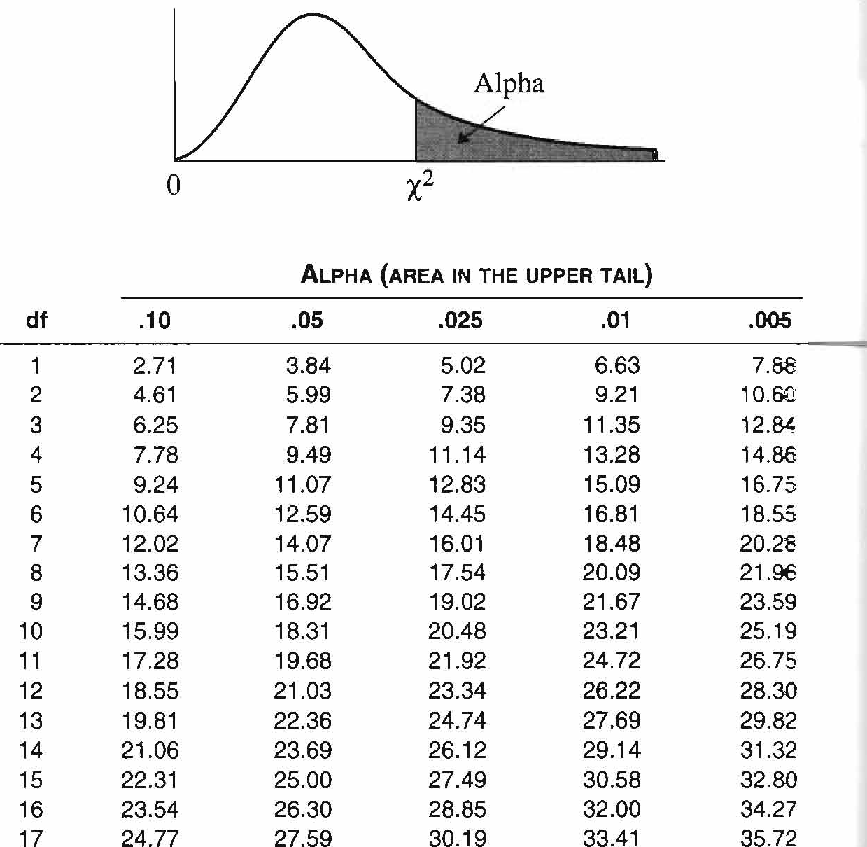
Chi-Squared: GOODNESS OF FIT Tests “GoF”
Hypotheses
H₀: Observed = Expected frequencies in population
H₁: Observed ≠ Expected frequencies in population
General form:
O = observed frequency
E = expected frequency
If H₀ were true, numerator would be small
Denominator standardizes difference in terms of expected frequencies
Aka: Pearson or ‘1-way’ χ² test
1 nominal variable
2 or more categories
If nominal variable ONLY has 2 categories, χ² GoF test:
Is another large sample approximation to Binomial Sign Test
Gives same results as z-test for single proportion as z² = χ²
Has same H₀ and H₁ as binomial or z-tests
Compare obtained χ² statistic to critical value based on df = k – 1, k = # categories
Assumptions
Independent random sample
Mutually exclusive categories
Expected frequencies: ≥ 5 per each cell

Slide 15
GOODNESS OF FIT Tests – EXAMPLE: K = 2
Experiment:
Senator supports bill favoring stem cell research. However, she realizes her vote could influence whether or not her constituents endorse her bid for re-election. She decides to vote for the bill only if 50% of her constituents support this type of research. In a random survey of 200 constituents, 96 are in favor of stem cell research.
Will the senator support the bill?
Hypotheses:
H₀: P = 0.50
Observed frequencies: 96 and 104
Expected frequencies: N / k =200/2 = 100df = 2 – 1 = 1
Test Statistic:
χ² _{OBSERVED}⁼
Critical Value:
χ²_{CRIT} (__) =
Conclusion:
Note:
ALWAYS USE COUNTS!!! | 1 = “success” | 0 = “failure”
OBSERVED (the data) | 96
EXPECTED (based on N, P, Q)

Slide 16
GOODNESS OF FIT Tests – EXAMPLE: K = 2
data.frame(support = 96,
not_support = 104) %>%
as.matrix() %>%
as.table() %>%
chisq.test()
Experiment:
Senator supports bill favoring stem cell research. However, she realizes her vote could influence whether or not her constituents endorse her bid for re-election. She decides to vote for the bill only if 50% of her constituents support this type of research. In a random survey of 200 constituents, 96 are in favor of stem cell research.
Will the senator support the bill?
Chi-squared test for given probabilities
data: .
X-squared = 0.32, df = 1, p-value = 0.5716
exp_obs <- data.frame(support = 96,
not_support = 104) %>%
as.matrix() %>%
as.table() %>%
chisq.test()
exp_obs$observed
exp_obs$expected
> exp_obs$observed
96 104
> exp_obs$expected
100 100
Notes:
Note that these are already in count form. If they aren’t, we need to use table()

Slide 17
GOODNESS OF FIT Tests – EXAMPLE: K > 2 (any number of categories within 1 variable)
ALWAYS USE COUNTS!!!
 | M | T | W | Th | F | S
OBS | 20 | 14 | 18 | 17 | 22 | 29
EXP
Hypotheses:
H₀: “ equally likely” (k = 6 & N = 120)
Expected frequencies: N / k =120/6 = 20
Observed frequencies: 20, 14, 18, 17, 22, 29 {Mon – Sat}
df = 6 – 1 = 5
Test Statistic:
χ² _{OBSERVED}⁼
Critical Value:
χ²_{CRIT} (__) =
Conclusion:
We do NOT have evidence the # of books checked out is NOT the same EVERY day
QUESTION:
Is there a difference in # books checked out for different days of the week?

Slide 18
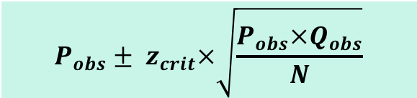
GOODNESS OF FIT Tests: Confidence Intervals
Say we wanted a CI for proportion of books from Saturday (29/120=0.242)
CIs for proportions
If k > 2, original table converted into table with 2 cells
Proportion for category of interest vs proportion in all other categories
Use same formula for z-test for single proportion:
$$P_{obs}± z_{crit}×\sqrt{\frac{P_{obs}×Q_{obs}}{N}}$$

Slide 19
GOODNESS OF FIT Tests: Effect Size
Ranges from 0 to 1
0: Expected = Observed frequencies exactly
1: Expected ≠ Observed frequencies as much as possible

Slide 20
GOODNESS OF FIT Tests: Post Hoc Pairwise Tests
Like ANOVA, omnibus test, but where do differences lie?
‘Pinpointing the action’ in contingency tables
Post-hoc Binomial, z-tests, or smaller 1-way χ² tests
Collapsing, ignoring levels
Bonferonni correction, more conservative α per comparison
Examining
Observed vs. expected frequencies per cell
Contributions to χ² per cell
Visual analysis of differences in proportions

Slide 21
2-way Pearson χ² Test of “Independence” or “Association”
Aka: Contingency table, cross-tabulation, or row x column (r x c) analysis
> 1 nominal variable
Is distribution of 1 variable contingent on distribution of another?
Is there an association or dependence between 2 categorical variables
Extension of χ² Goodness of Fit Test
Hypotheses:
H₀: Variables are independent in population
H₁: Variables are dependent in population
Again, χ²_{obt} is compared with χ²_{crit} → df = (r-1)(c-1)

Slide 22

2-way Pearson χ² Test of “Independence” or “Association”
Same equation: Standardized squared deviations summed for all cells
Different method for computing E
For each cell: Multiply corresponding row and column totals (marginals), divide by N
$$EXPcell=\frac{{Total}_{row}×{Total}_{column}}{{Total}_{grand}}$$

Slide 23
χ² Test of “Independence” – Example
Observed frequencies
Expected frequencies:
Test Statistic:
APA format:
Experiment:
Random sample of 200 inmates are surveyed about abuse and violent criminal histories
Relationship between history of abuse and violent crime?
H₀: No association between abuse history and violent criminal history in population of prison inmates
O_{ij} = E_{ij} for all cells in population
H₁: Association between abuse history and violent criminal history in population of prison inmates
O_{ij} ≠ E_{ij} for at least one cell in population

Slide 24
χ² Test of “Independence” – Example
data.frame(violent_yes = c(70, 40),
violent_no = c(30, 60),
row.names = c("Abuse_Yes", "Abuse_No")) %>%
as.matrix() %>%
as.table() %>%
chisq.test(correct = FALSE)
violent_yes violent_no
Abuse_Yes 70 30
Abuse_No 40 60
Pearson's Chi-squared test
data: .
X-squared = 18.182, df = 1, p-value = 2.008e-05

Slide 25
χ² Test of “Independence” – Example with Raw Data
data %>%
table() %>%
chisq.test(correct = FALSE)
ID violent abuse
01 1 1
02 1 0
03 0 1
04 1 1
05 0 0
... ... ...
199 0 1
200 1 1
violent_yes violent_no
Abuse_Yes 70 30
Abuse_No 40 60
Pearson's Chi-squared test
data: .
X-squared = 18.182, df = 1, p-value = 2.008e-05

