Slide 1

Cohen Textbook Intro
For EDUC/PSY 6600

Slide 2
“A-B-C” format of chapters
Section A
Simplest case of the procedure
Explain definitional formulas (for insight)
Emphasis is underlying similarity of formulas that may look very different
Detailed summary
Exercises
Section B
Basic statistical procedure
More general cases with real data
Computational formulas
Significance tests
Comments on research design
Supplementary procedures
How to report in APA style
Detailed summary
Exercises
Section C
How to use SPSS to perform the procedures
Little known syntax ‘tricks’
SPSS data management tools
How to read SPSS output
All exercises based on the Ihno Dataset

Slide 3

Unit | Unit Title | Chap # | Chapter Titles
0 | Getting Started |  | APA Style & Journal Articles R Basics & Data Manipulation
1 | Exploratory Data Analysis | 1 2 3 4 | Variables & Scales, Rounding, Summation Exploration Data with Plots Summarizing Data with Descriptive Statistics Standardized Scores & The Normal Distribution
2 | Groundwork for Inference | 5 6 7 8 | Intro to Hypothesis Testing: 1 Sample z-test Confidence Interval Estimation: The t Distribution 2 Independent Samples t-test for Means Statistical Power & Effect Size
3 | Hypothesis Tests for 2 Measures per Subject | 9 10 11 | Linear Correlation Linear Regression Matched t Test
4 | ANOVA w/o repeated measures | 12 13 14 | 1-Way ANOVA Multiple Comparisons 2-Way ANOVA
5 | ANOVA with repeated measures | 15 16 | Repeated-Measures ANOVA 2-Way Mixed-Design ANOVA
6 | Categorical Data Analysis | 19 20 | The Binomial Distribution Chi-Squared Test for Independence & Goodness of Fit

Slide 4
Appendixes at back of book
Appendix A
Statistical tables
“z” standard normal
“t” student’s t
“X²” chi squared
Etc.
Appendix B
Answers
to selected exercises (*) from sections A & B
Appendix C
Ihno’s dataset
The electronic ‘excel’ version is on CANVAS
Do NOT waste time typing it into the computer!!!

Slide 5
Ihno: Background Collection
Course
Day 1
Ihno was an advanced PhD student, TA several stats sections
sub_num
Id number: 1, 2, 3, …, 99, 100
gender
Female vs. Male
100 participants enrolled in those sections & voluntarily consented to participate (IRB)
major
Psychology, Premed, Biology, Sociology, Economics
reason
Program require, personal interest, advisor recomend
coffee
Regular drinker? Yes or No
prevmath
Number of previous math courses: 1, 2, 3, …
mathquiz
Background math quiz score (15 are missing)
phobia
Self rating of math phobia (0 = none, 10 = extreme)

Slide 6
Ihno: Week Prior to Experiment
Course
Day 1
Week Before
Standard weekly stats class quiz
# correct out of 10 questions
sub_num
statquiz
gender
major
reason
coffee
prevmath
mathquiz
phobia

Slide 7
Ihno: Intervention Experiment
# cups coffee drunk that day prior to class
The Experiment Day
The 11th question varied (25 each: easy, moderate, difficult, or impossible to solve)
num_cups
exp_cond
Announce Pop Quiz
Take Pop Quiz
hr_base
hr_pre
hr_post
Ihno explained the quiz would be graded (not 11th question) and returned, but would NOT count towards their grade
anx_base
anx_pre
anx_post
Self-report: Anxiety questionnaire w/10 items, each rated 0-4 (5-point Likert scale), total scores 0-40
exp_sqz
Taught students how to take their own pulse & took two baseline measures (bpm) and recorded the average of the 2
Pop Quiz
# correct out of 11 questions
Regular quiz w/11 multiple choice (10 questions, 1pt each + 11th question = 3 points extra credit)

Slide 8
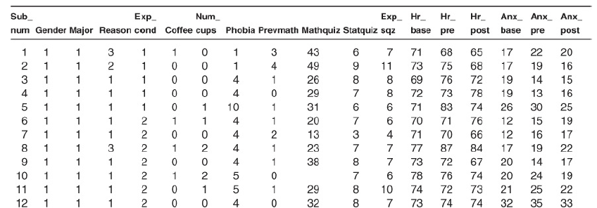
Course
Day 1
Week Before
The Experiment Day
num_cups
exp_cond
sub_num
statquiz
Announce Pop Quiz
Take Pop Quiz
hr_base
hr_pre
hr_post
gender
anx_base
anx_pre
anx_post
major
reason
exp_sqz
coffee
prevmath
mathquiz
phobia

Slide 9
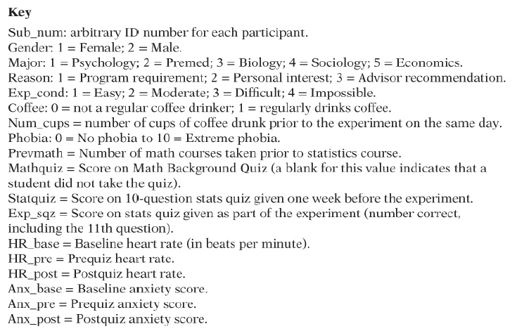
Data Dictionary

