Slide 1
Multiple Comparison Procedures Cohen Chapter 13
For EDUC/PSY 6600

Slide 2
“We have to go to the deductions and the inferences,” said Lestrade, winking at me.
“I find it hard enough to tackle facts, Holmes, without flying away after theories and fancies.”
Inspector Lestrade to Sherlock Holmes
The Boscombe Valley Mystery

Slide 3
ANOVA Omnibus: Significant F-ratio
Factor (IV) had effect on DV
Groups are not from same population
Which levels of factor differ?
Must compare and contrast means from different levels
Indicates ≥ 1 significant difference among all POSSIBLE comparisons
Simple vs. complex comparisons
Simple comparisons
Comparing 2 means, pairwise
Possible for no ‘pair’ of group means to significantly differ
Complex comparisons
Comparing combinations of > 2 means

Slide 4
Multiple Comparison Procedure
‘Multiple comparison procedures’ used to detect simple or complex differences
Significant omnibus test NOT always necessary
Inaccurate when assumptions violated
Type II error
OKAY to conduct multiple comparisons when p-value CLOSE to significance

Slide 5
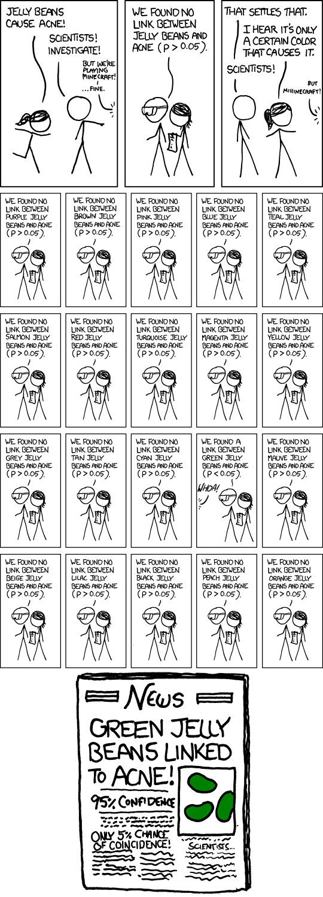

Slide 6
Error Rates
Experimentwise (α_{EW})
p( ≥ 1 Type I error for all comparisons)
Relationship between α_{PC}
and α_{EW}
α_{EW} = 1 – (1 – α_{PC})^{c}
c = Number of comparisons
(1 – α_{PC})^{c} = p(NOT making Type I error over c)
α = p(Type I error)
Determined in study design
Generally, α = .01, .05, or .10
comparison error rate (α_{PC})
α = α_{PC}
α_{PC} = Error rate for any 1 comparison

Slide 7
Error rates
ANOVA with 4 groups
F-statistic is significant
Comparing each group with one another
c = 6
α_{PC} = .05
α_{EW} = _____
α_{EW} when c = 10?
3 Options…
Ignore α_{PC} or α_{EW}
Modify α_{PC}
Modify α_{EW}

Slide 8
Comparisons
Post hoc (a posteriori) | Pre Planned (a priori)
Selected after data collection and analysis | Selected before data collection
Used in exploratory research | Follow hypotheses and theory
Larger set of or all possible comparisons | Justified conducting ANY planned comparison (ANOVA doesn’t need to be significant)
Inflated α_{EW}: Increased p(Type I error) | α_{EW} is much smaller than alternatives α_{EW} can slightly exceed α when planned Adjust when c is large or includes all possible comparisons?

Slide 9
Problems with comparisons
Decision to statistically test certain post hoc comparisons made after examining data
When only ‘most-promising’ comparisons are selected, need to correct for inflated p(Type I error)
Biased sample data often deviates from population
When all possible pairwise comparisons are conducted, p(Type I error) or α_{EW} is same for a priori and post hoc comparisons

Slide 10
For example, a significant F-statistic is obtained:
Assume 20 pairwise comparisons are possible
But, in population, no significant differences exist
Made a Type I error obtaining significant F-statistic
However, a post hoc comparison using sample data suggests largest and smallest means differ
If we had conducted 1 planned comparison
1 in 20 chance (α = .05) of conducting this comparison and making a type I error
If we had conducted all possible comparisons
100% chance (α = 1.00) of conducting this comparison and making a type I error
If researcher decides to make only 1 comparison after looking at data, between largest and smallest means, chance of type I error is still 100%
All other comparisons have been made ‘in head’ and this is only one of all possible comparisons
Testing largest vs. smallest means is probabilistically similar to testing all possible comparisons

Slide 11
Common techniques
a priori tests
Multiple t-tests
Bonferroni (Dunn)
Dunn-Ŝidák*
Holm*
Linear contrasts
*adjusts α_{PC}
Italicized: not covered
post hoc tests
Fisher LSD
Tukey HSD
Student-Newman-Keuls (SNK)
Tukey-b
Tukey-Kramer
Games-Howell
Duncan’s
Dunnett’s
REGWQ
Scheffé

Slide 12
Common techniques
Many more comparison techniques available
Most statistical packages make no a priori / post hoc distinction
All called post hoc (SPSS) or multiple comparisons (R)
In practice, most a priori comparison techniques can be used as post hoc procedures
Called post hoc, not because they were planned after doing the study per se, but because they are conducted after an omnibus test
a priori tests
Multiple t-tests
Bonferroni (Dunn)
Dunn-Ŝidák*
Holm*
Linear contrasts
*adjusts α_{PC}
Italicized: not covered
post hoc tests
Fisher LSD
Tukey HSD
Student-Newman-Keuls (SNK)
Tukey-b
Tukey-Kramer
Games-Howell
Duncan’s
Dunnett’s
REGWQ
Scheffé

Slide 13
A Priori procedures: multiple t-tests
Homogeneity of variance
MS_{W} (estimated pooled variance) and df_{W} (both from ANOVA) for critical value (smaller F_{crit})
Heterogeneity of variance and equal n
Above equation: Replace MS_{W} with s_{j}² and df_{W} with df = 2(n_{j} - 1) for t_{crit}
Heterogeneity of variance and unequal n
Above equation: Replace MS_{W} with s_{j}² and df_{W} with Welch-Satterwaite df for t_{crit}

Slide 14
A Priori procedures: Bonferroni (Dunn) t-test
Bonferroni inequality
p(occurrence for set of events (additive) ≤ ∑ of probabilities for each event)
Adjusting α_{PC}
Each comparison has p(Type I error) = α_{PC} = .05
α_{EW} = .05
α_{EW} ≤ c*α_{PC}
p(≥ 1 Type I error) can never exceed c*α_{PC}
Conduct standard independent-samples t-tests per pair
Example for 6 comparisons:
α_{PC} = .05/6 = .0083

Slide 15
A Priori procedures: Bonferroni (Dunn) t-test
t-tables lack Bonferroni-corrected critical values
Software: Exact p-values
Is exact p-value ≤ Bonferroni-corrected α-level?
Example for 6 comparisons:
α_{PC} = .05/6 = .0083
More conservative: Reduced p(Type I error)
Less powerful: Increased p(Type II error)

Slide 16
Post hoc procedures: Fisher’s LSD Test
Aka: Fisher’s Protected t-test = Multiple t-test
Conduct as described previously: ‘multiple t-tests’
‘Fisher’s LSD test’: Only after significant F_{stat}
‘Multiple t-test’: Planned a priori
One advantage is that equal ns are not required
Logic
If H₀ true and all means equal one another, significant overall F-statistic ensures α_{EW} is fixed at α_{PC}
Powerful: No adjustment to α_{PC}
Most liberal post hoc comparison
Highest p(Type I error)
Not recommended in most cases
Only use when k = 3

Slide 17
Post hoc procedures: studentized range q
t-distribution derived under assumption of comparing only 2 sample means
With >2 means, sampling distribution of t is NOT appropriate as p(Type I error) > α
Need sampling distributions based on comparing multiple means
Studentized range q-distribution
k random samples (equal n) from population
Difference between high and low means
Differences divided by
Obtain probability of multiple mean differences
Critical value varies to control α_{EW}
Rank order group means (low to high)
r = Range or distance between groups being compared
4 means: Comparing M₁ to M₄, r = 4; comparing M₃ to M₄, r = 2
Not part of calculations, used to find critical value
q_{crit}: Use r, df_{W} from ANOVA, and α
q_{crit} always positive
Most tests of form:

Slide 18
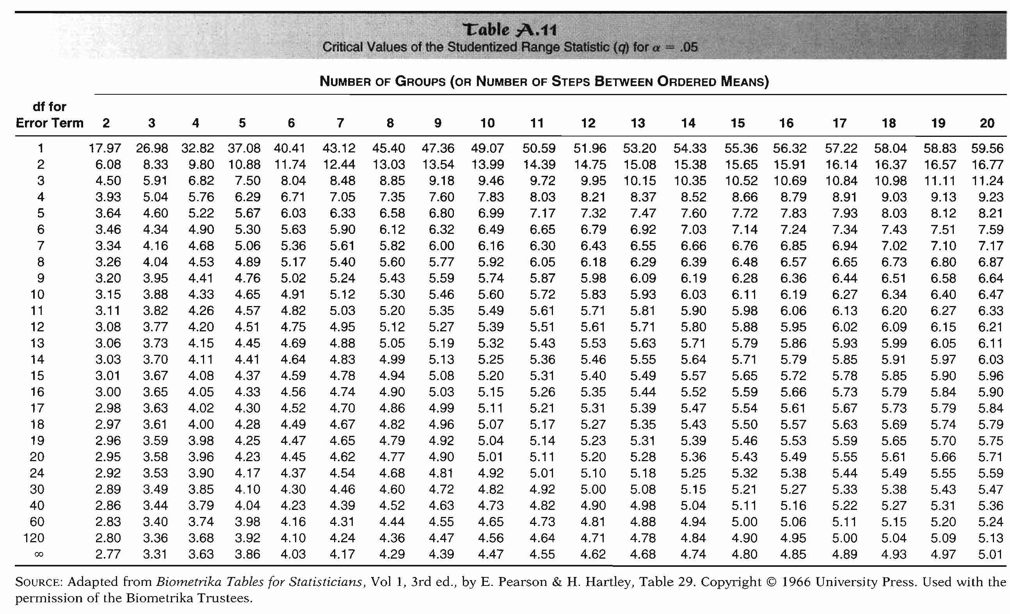
Post hoc procedures: studentized range q
r
df_{w}
q_{crit}

Slide 19
Post hoc procedures: studentized range q
Note square root of 2 missing from denominator
Each critical value (q_{crit}) in q-distribution has already been multiplied by square root of 2
Assumes all samples are of same n
Unequal ns can lead to inaccuracies depending on group size differences
If ns are unequal, alternatives are:
Compute harmonic mean (below) of n (if ns differ slightly)
Equal variance: Tukey-Kramer, Gabriel, Hochberg's GT2
Unequal variance: Games-Howell
Vs.
Post hoc tests that rely on studentized range distribution:
Tukey HSD
Tukey’s b
S-N-K
Games-Howell
REGWQ
Duncan

Slide 20
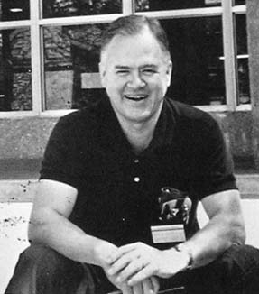
Post Hoc Procedures: Tukey’s HSD test
Based on premise that Type I error can be controlled for comparison involving largest and smallest means, thus controlling error for all
Significant ANOVA NOT required
q_{crit} based on df_{W}, α_{EW} (table .05), and largest r
If we had 5 means, all comparisons would be evaluated using q_{crit} based on r = 5
q_{crit} compared to q_{obt}
MS_{W} from ANOVA
One of most conservative post hoc comparisons, good control of α_{EW}
Compared to LSD…
HSD less powerful w/ 3 groups (Type II error)
HSD more conservative; less
Type I error w/ > 3 groups
Preferred with > 3 groups

Slide 21
Post Hoc Procedures: Tukey’s HSD test
Based on premise that Type I error can be controlled for comparison involving largest and smallest means, thus controlling error for all
Significant ANOVA NOT required
q_{crit} based on df_{W}, α_{EW} (table .05), and largest r
If we had 5 means, all comparisons would be evaluated using q_{crit} based on r = 5
q_{crit} compared to q_{obt}
MS_{W} from ANOVA
One of most conservative post hoc comparisons, good control of α_{EW}
Compared to LSD…
HSD less powerful w/ 3 groups (Type II error)
HSD more conservative; less
Type I error w/ > 3 groups
Preferred with > 3 groups
Fisher’s LSD is most liberal
Tukey’s HSD is nearly most conservative
Others are in-between

Slide 22
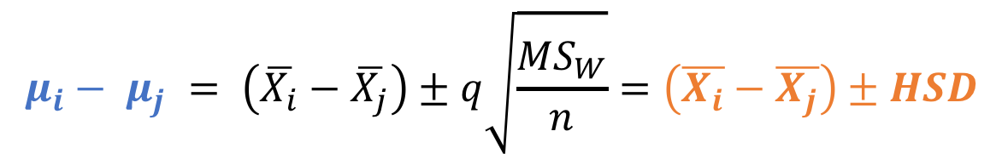
Post hoc: Confidence intervals: HSD
Simultaneous Confidence Intervals for all possible pairs of populations means…at the same time!
Interval DOES INCLUDS zero → fail to reject H0: means are the same…no difference
Interval does NOT INCLUDS zero → REJECT H0 → evidence there IS a DIFFERENCE
$$μ_{i}− μ_{j} = \left(\overline{X_{i}}−\overline{X_{j}}\right)±q\sqrt{\frac{{MS}_{W}}{n}}=\left(\overline{X_{i}}−\overline{X_{j}}\right)±HSD$$

Slide 23
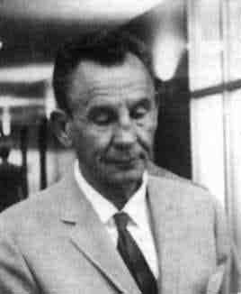
Post hoc procedures: Scheffé Test
Most conservative and least powerful
Uses F- rather than t-distribution to find critical value
F_{Scheffé} = (k-1)*F_{crit} (k-1, N-k)
Scheffé recommended running his test with α_{EW} = .10
F_{Scheffé} is now F_{crit} used in testing
Similar to Bonferroni; α_{PC} is computed by determining all possible linear contrasts AND pairwise contrasts
Not recommended in most situations
Only use for complex post-hoc comparisons
Compare F_{contrast} to F_{Scheffé}

Slide 24
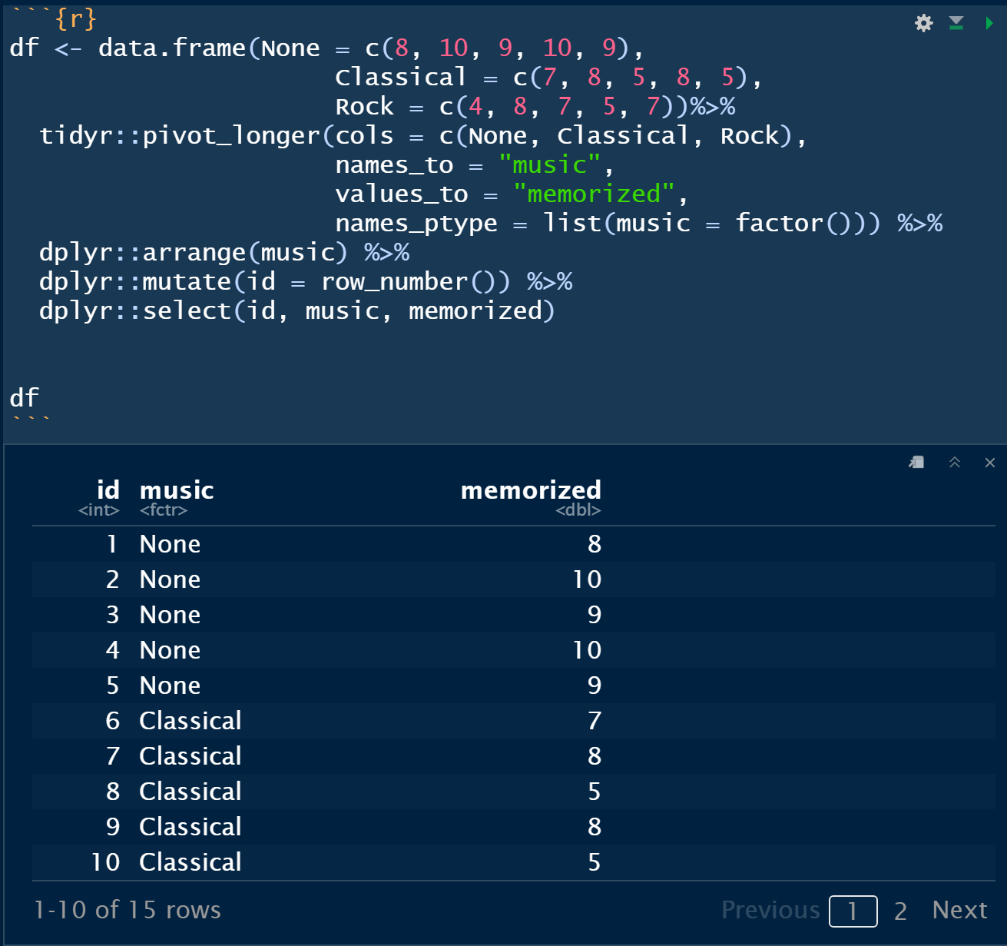

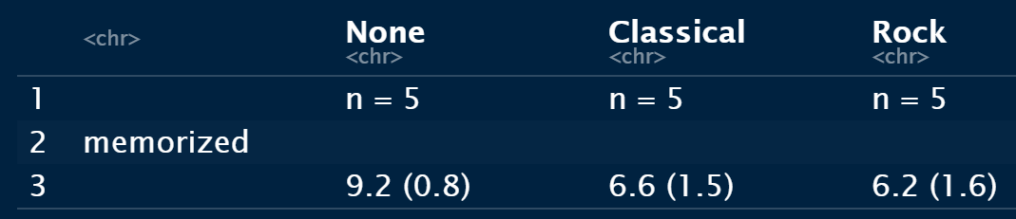
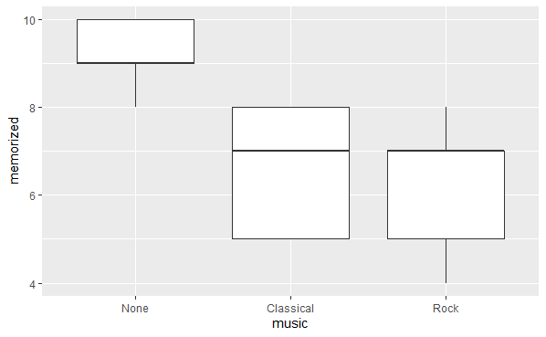
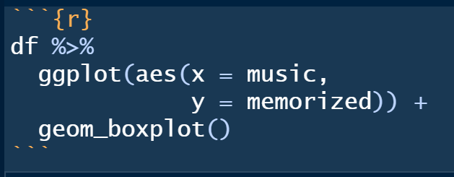
Chap 12 - Example: Exploratory Data Analysis
2. Calc the Group Means
IV (groups)
DV (outcome)
1. Enter data into R
3. Visualize the data

Slide 25
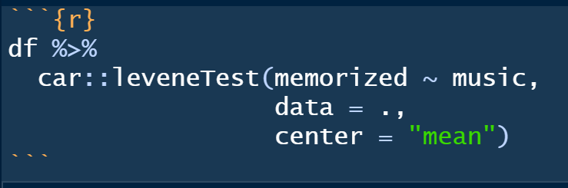
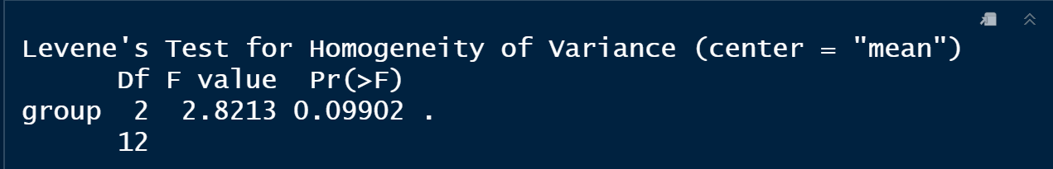
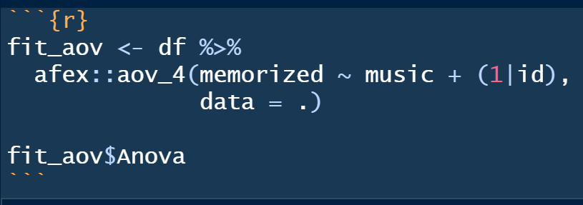
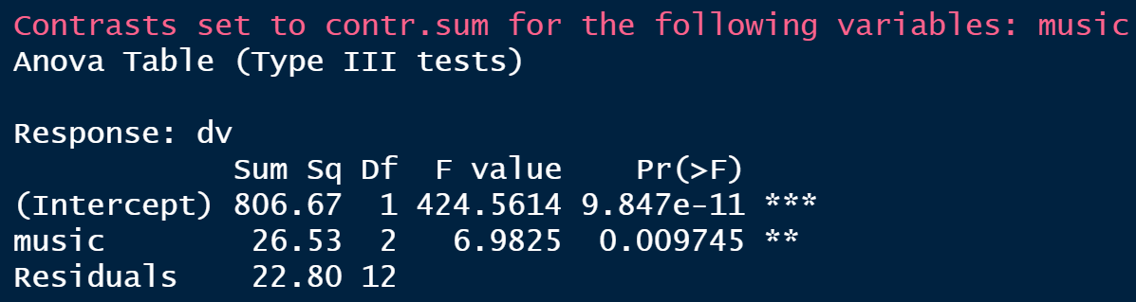
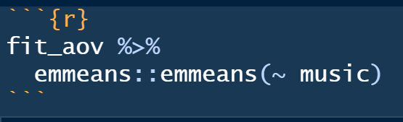
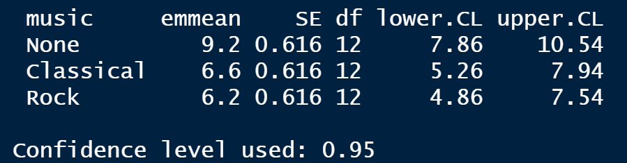
Chap 12 - Example: Fit an ANOVA
1. Test Assumption of HOV
No evidence of violations f HOV
2. Fit the ANOVA
At least 1 group
Is different
3. EM means
Close to Raw Means

Slide 26
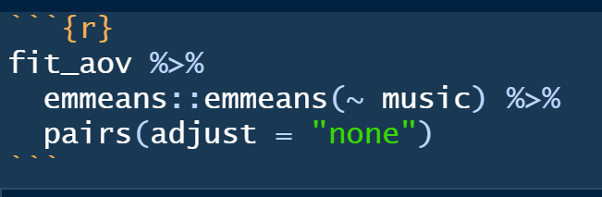
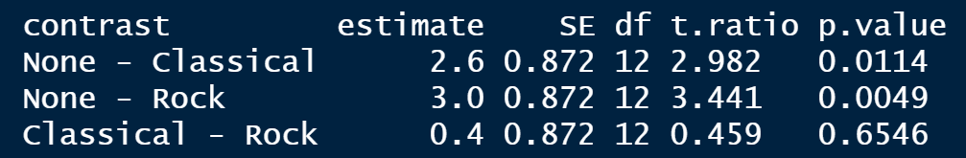
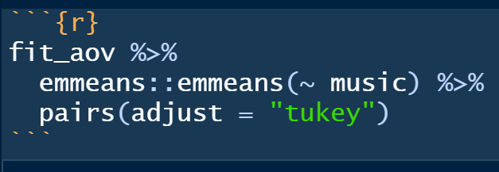
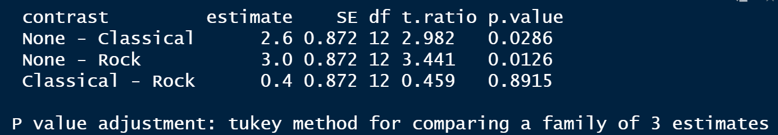
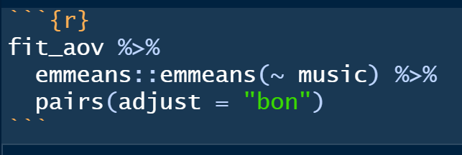
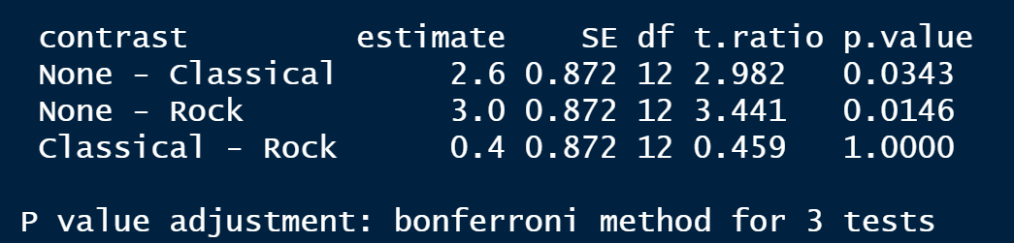
Chap 12 - Example: Post Hoc Tests
Fisher’s LDS
Tukey’s HSD
Bonnferoni

Slide 27
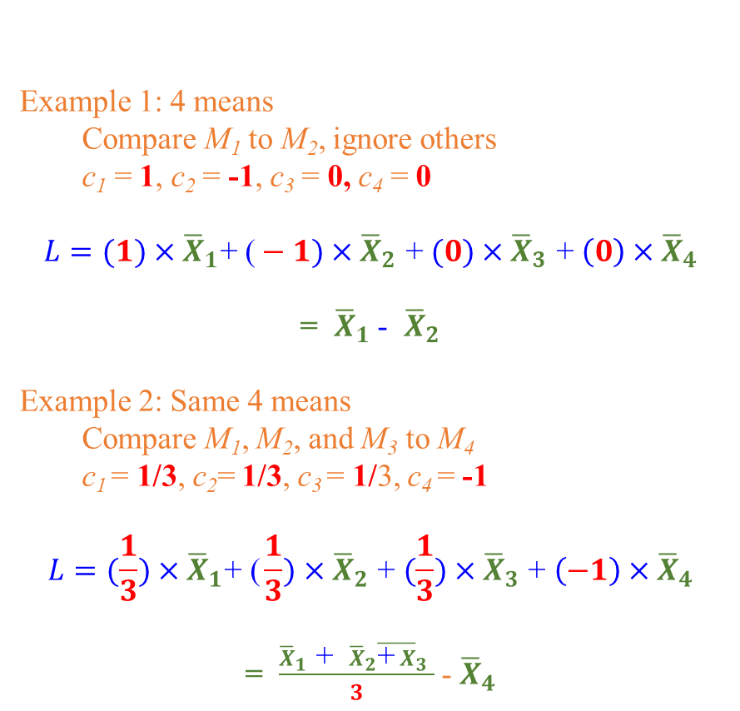
A Priori procedures: linear contrasts - Idea
Example 1: 4 means
Compare M₁ to M₂, ignore others
c₁ = 1, c₂ = -1, c₃ = 0, c₄ = 0
$$L=(1)×{\overline{X}}_{1}\text{+ (}−1)×{\overline{X}}_{2}\text{ + }(0)×{\overline{X}}_{3}\text{ + }\left(0\right)×{\overline{X}}_{4}$$
= ${\overline{X}}_{1}$ - ${\overline{X}}_{2}$
Example 2: Same 4 means
Compare M₁, M₂, and M₃ to M₄
c₁ = 1/3, c₂= 1/3, c₃ = 1/3, c₄ = -1
$$L=(\frac{1}{3})×{\overline{X}}_{1}\text{+ (}\frac{1}{3})×{\overline{X}}_{2}\text{ + }(\frac{1}{3})×{\overline{X}}_{3}\text{ + }\left(−1\right)×{\overline{X}}_{4}$$
= $\frac{{\overline{X}}_{1}\text{ + }{\overline{X}}_{2}{\overline{\text{+} X}}_{3} }{3}$ - ${\overline{X}}_{4}$
Linear combination of means:
Each group mean weighted by constant (c)
Products summed together
Weights selected so means of interest are compared:
Sum of weights = ZERO
One side positive, the other negative
Weights on the same size are EQUAL

Slide 28
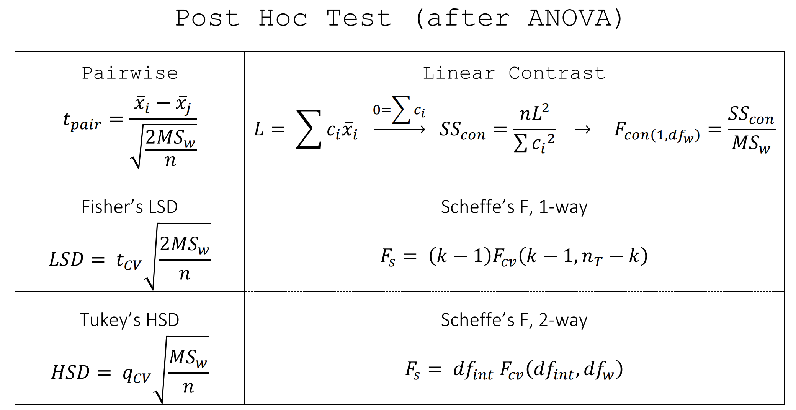
A Priori procedures: linear contrasts - Formulas
MS_{W} = MSE = pooled variance

Slide 29
A Priori procedures: linear contrasts - SS
Each linear combination: SS_{Contrast}
Equal ns: Unequal ns:
SS_{Between} partitioned into k SS_{Contrasts}
SS_{Between} = SS_{Contrast 1} + SS_{Contrast 2} +…+ SS_{Contrast k}
df for SS_{B} = k – 1
df for SS_{Contrast} = Number of ‘groups/sets’ included in contrast minus 1
F = MS_{Contrast} / MS_{W}
MS_{Contrast} = SS_{Contrast} / df_{Contrast}
As df = 1, MS_{Contrast} = SS_{Contrast}
MS_{W} from omnibus ANOVA results
Max # ‘legal’ contrasts = df_{B}
Do not need to consume all available df
Use smaller α_{EW} if # contrasts > df_{B}

Slide 30
A Priori procedures: linear contrasts - example
Test each Contrast (ANOVA: SS_{Between} = 26.53, SS_{Within} = 22.8)
Note: SS_{B} = SS_{Contrast1} + SS_{Contrast2} = 26.13 + 0.40 = 26.53
Mean | N
9.2 | 5
6.6 | 5
6.2 | 5
Contrast 1: M_{No Noise} versus M_{Moderate} and M_{loud,}
L = (-2)(9.2) + (1)(6.6) + (1)(6.2) = -18.4 + 12.8 = -5.6
SS_{Contrast1} = 5*(-5.6)² / (-2² + 1² + 1²) = 156.8 / 6 = 26.13
df_{B} = 2 – 1 = 1 → MS_{Contrast1} = 26.13/1 = 26.13
df_{W} = 15 – 3 = 12 → MS_{W} = 22.8/12 = 1.90
F = 26.13/1.980 = 13.75
P< .05
Contrast 2: M_{Moderate} versus M_{loud}
L = (0)(9.2) + (-1)(6.6) + (1)(6.2) = -0.4
SS_{Contrast2} = 5*(-0.4)² / (1² + [-1]²) = 0.8 / 2 = 0.40
df_{B}= 2 – 1 = 1→ MS_{Contrast2} = 0.40/1 = 0.40
df_{W} = 15 – 3 = 12 → MS_{W} = 22.8/12 = 1.90
F = 0.40/1.90 = 0.21
P > .05
α =.05 & df_{W} = 12 → F_{crit} = 4.75

Slide 31
A Priori procedures: linear contrasts - Orthogonal
Independent (orthogonal) contrasts
If M₁ is larger than average of M₂ and M₃
Tells us nothing about M₄ and M₅
Dependent (non-orthogonal) contrasts
If M₁ is larger than average of M₂ and M₃
Increased probability that M₁ > M₂ or M₁ > M₃
Can conduct non-orthogonal contrasts, but…
Dependency in data
Inefficiency in analysis
Contain redundant information
Increased p(Type I error)

Slide 32
A Priori procedures: linear contrasts - Orthogonal
Orthogonality indicates SS_{Contrasts} are independent partitions of SS_{B}
Orthogonality obtained when
Σ of SS_{Contrasts} = SS_{Between}
Two rules are met:
Rule 1: Rule 2:
where c_{Lj} = Contrast weights from additional linear combinations
From example…Orthogonal!
Rule 1: L₁ = (1)+(1)+(-2) = 0; L₂ = 1+(-1)+(0) = 0
Rule 2: -2*0 + 1*1 + 1*-1 = 1 + -1 + 0 = 0

Slide 33
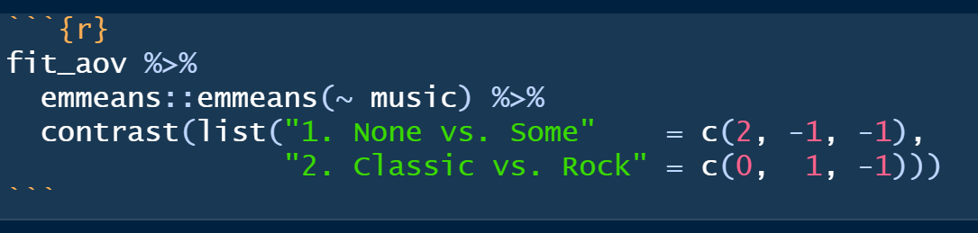
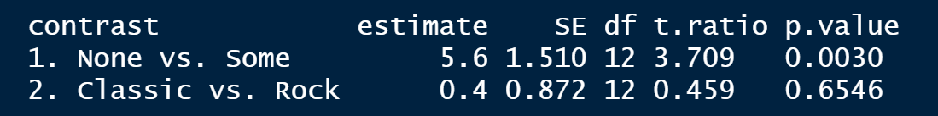
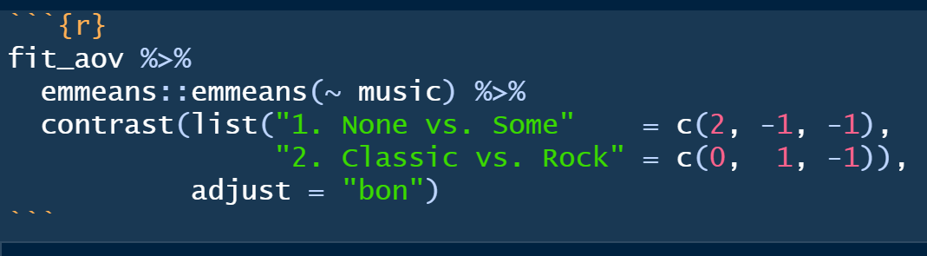
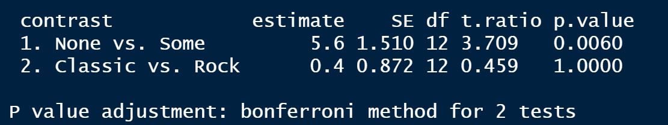
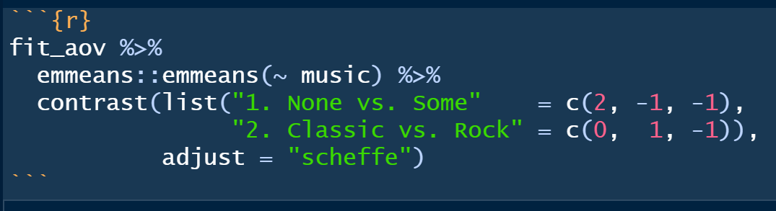
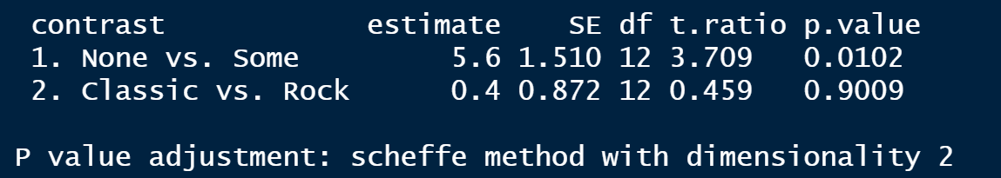
Chap 12 - Example: Linear Contrasts
No Adjustment
Bonferroni
Scheffe’

Slide 34
Analysis of trend components
Try when the independent variable (IV) is highly ordinal or truly underlying continuous
* LINEAR regression:
Run linear regression with the IV as predictor
Compare the F-statistic’s p-value for the source=regression to the ANOVA source=between
* CURVE-a-linear regression:
create a new variable that is = IV variable SQUARED
Run linear regression with BOTH the original IV & the squared-IV as predictors
Compare the F-statistic’s p-value for the source=regression

Slide 35
Conclusion
Not all researchers agree about best approach/methods
Method selection depends on
Researcher preference (conservative/liberal)
Seriousness of making Type I vs. II error
Equal or unequal ns
Homo- or heterogeneity of variance
Can also run mixes of pairwise and complex comparisons
Adjusting α_{PC} to ↓ p(type I error), ↑ p(Type II error)
a priori more powerful than post hoc
a priori are better choice
Fewer in number; more meaningful
Forces thinking about analysis in advance

Slide 36
A Priori procedures: recommendations
1 pairwise comparison of interest
Standard t-test
Several pairwise comparisons
Bonferroni, Multiple t-tests
Bonferroni is most widely used (varies by field), and can be used for multiple statistical testing situations
1 complex comparison
Linear contrast
Several complex comparisons
Orthogonal linear contrasts – no adjustment
Non-orthogonal contrasts – Bonferroni correction or more conservative α_{PC}

Slide 37
Post hoc procedures: recommendations
1 pairwise comparison of interest
Standard independent-samples t-test
Several pairwise comparisons
3 → LSD
> 3 → HSD or other alternatives such as Tukey-b or REGWQ
Control vs. set of Tx groups → Dunnett’s
1 complex comparison (linear contrast)
No adjustment
Several complex comparisons (linear contrasts)
Non-orthogonal – Scheffé test
Orthogonal – Use more conservative α_{PC}

