Slide 1
Matched T-Test
Cohen Chapter 11
For EDUC/PSY 6600

Slide 2
“…we are suffering from a plethora of surmise, conjecture, and hypothesis. The difficulty is to detach the framework of fact – of absolute undeniable fact – from the embellishments of theorists and reporters.”
Sherlock Holmes
Silver Blaze

Slide 3
Motivating examples
Dr. Filburn wishes to assess the effectiveness of a leadership workshop for 60 middle managers. The 60 managers are rated by their immediate supervisors on the Leadership Rating Form (LRF), before and after the workshop.
Dr. Clarke is interested in determining if workers are more concerned with job security or pay. He gains the cooperation of 30 individuals who work in different settings and asks each employee to rate his or her concern about 1) salary level and 2) job security on a scale from 1 to 10.
Dr. Gale questions whether husbands or wives with infertility problems feel equally anxious. She recruits 24 infertile couples and then administers the Infertility Anxiety Measure (IAM) to both the husbands and the wives.

Slide 4
Paired-samples designs
Comparing means of 2 groups
Assumption of independence has been violated resulting in a dependency across groups
E.g., Members of same family, class, group, litter, twinship
Variance of DV smaller as groups consist of same or closely matched cases
Paired-samples t-test also known as…
Matched-, Related-, Correlated-, Dependent-, or Non-independent samples t-test
Repeated-measures t-test
Experimental
Matching groups on some variable(s)
E.g., sex, age, education
↓ potential confounds on IV-DV relationship or when cases cannot receive both conditions
Naturalistic
Samples naturally related, correlated, dependent

Slide 5
Repeated-Measures designs
Successive designs:
2 measurements, conditions, or sets of stimuli are applied to cases sequentially
Before-and-after (or longitudinal ) designs
Pre- / post-test, time 1 / time 2
Cross-over designs
Order effects? Need to counterbalance order
Random subset of cases → A then B
Another random subset of cases → B then A
Counterbalancing may not eliminate carry-over effects
Wash-out period
Simultaneous designs:
2 varying conditions or sets of stimuli inter-mixed w/in study and all cases receive both
No concern for order effects or temporality
Order is generally random

Slide 6
Hypotheses: ‘direct difference’ method
Same as Independent-samples t-test
H₀: μ₁ = μ₂ or μ₁ - μ₂ = 0 or μ₁ - μ₂ = 0
H₁: μ₁ ≠ μ₂ or μ₁ > μ₂ or μ₁ < μ₂
H₀: μ₁ - μ₂ = 0 → H₀: μ_{D} = 0
Compute difference score for each subject
X_{i1} – X_{i2} = D
H₀: μ_{D} = 0 and H₁: μ_{D} ≠ 0
Now equivalent to 1-sample t-test
Mean of difference scores compared w/ H₀: μ_{D} = 0

Slide 7
calculations
Hypothesized population difference
Mean of difference scores
df = N - 1
Number of difference scores (pairs) - 1
= SD of difference scores

Slide 8
Assumptions
Independence of pairs of observations
Normality of sampling distribution of difference scores in population
Equal ns
Pair deleted when 1 member missing data

Slide 9
Paired-Samples t-test and Correlation
Paired-samples t-test almost always more powerful than independent-samples t-test
More likely to reject H₀ when false
Requires fewer subjects
Degree of correlation (r) between scores on 2 groups related to size of difference between paired- and independent-samples t-statistics
Larger correlation → larger difference

Slide 10
Paired-Samples t-test and Correlation
Paired-samples t-test almost always more powerful than independent-samples t-test
More likely to reject H₀ when false
Requires fewer subjects
Degree of correlation (r) between scores on 2 groups related to size of difference between paired- and independent-samples t-statistics
Larger correlation → larger difference
Paired-samples t-test calculated as a function of r
When r = 0,
equation reduces to independent-samples t-test
When r > 0
denominator reduces, leading to larger t-statistic
When r < 0
denominator increases, leading to smaller t-statistic
Rare to have a negative correlation with paired-data

Slide 11
Confidence Intervals
95% CI around μ_{D}
Rewrite: As:
Are paired sample means significantly different?
Yes: H₀ value not w/in CI
No: H₀ value within CI

Slide 12
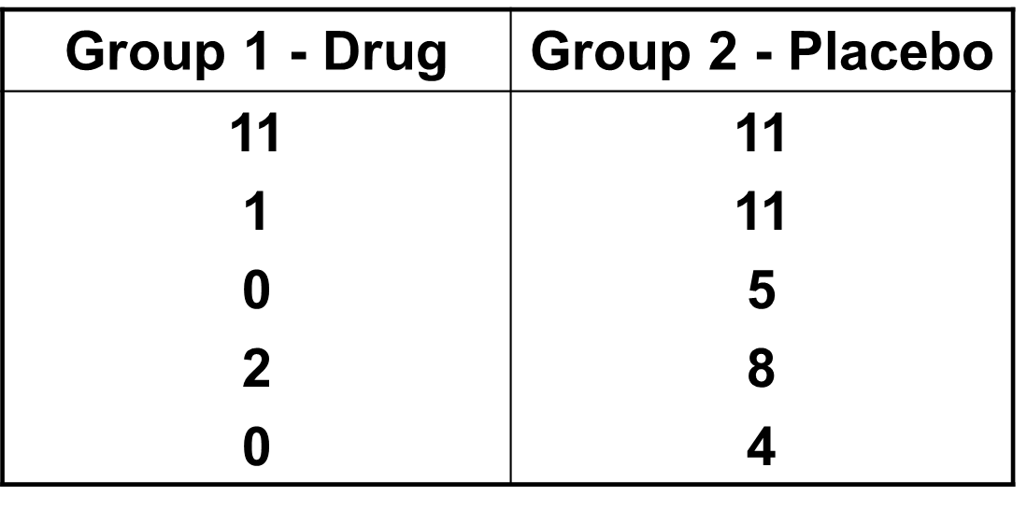
example
Same example from independent-samples t-test lecture
But suppose participants were carefully matched into pairs based on their level of depression prior to initiation of study
One member of each pair was randomly assigned to drug group, other to placebo group
After 6 months, level of depression was measured by a psychiatrist
Need to conduct paired-samples t-test due to matching

Slide 13
R Code: First Approach
df <- read.csv(“drug_paired.csv”)
## do some plots and summaries
df %>%
tidyr::gather(key = “group”,
value = “value”,
group1, group2,
na.rm = TRUE) %>%
t.test(value ~ group,
data = .,
paired = TRUE)
Get the data into R
Plot and summaries
Reshape the data into wide form
Paired samples t-test

Slide 14
R Code: First Approach
Paired t-test
data: value by group
t = -3.1009, df = 4, p-value = 0.03619
alternative hypothesis: true difference in means is not equal to 0
95 percent confidence interval:
-9.4768832 -0.5231168
sample estimates:
mean of the differences
-5

Slide 15
R Code: Second Approach
df <- read.csv(“drug_paired.csv”)
## do some plots and summaries
df %>%
dplyr::mutate(group_diff = group2 – group1) %>%
dplyr::pull(group_diff) %>%
t.test(mu = 0)
Get the data into R
Plot and summaries
Create group difference variable
Single samples t-test of the group difference

Slide 16
R Code: Second Approach
One Sample t-test
data: .
t = 3.1009, df = 4, p-value = 0.03619
alternative hypothesis: true mean is not equal to 0
95 percent confidence interval:
0.5231168 9.4768832
sample estimates:
mean of x
5

Slide 17
Effect Size
*Cohen’s d (same as in 1-sample t-test)
Eta squared (η²)

Slide 18
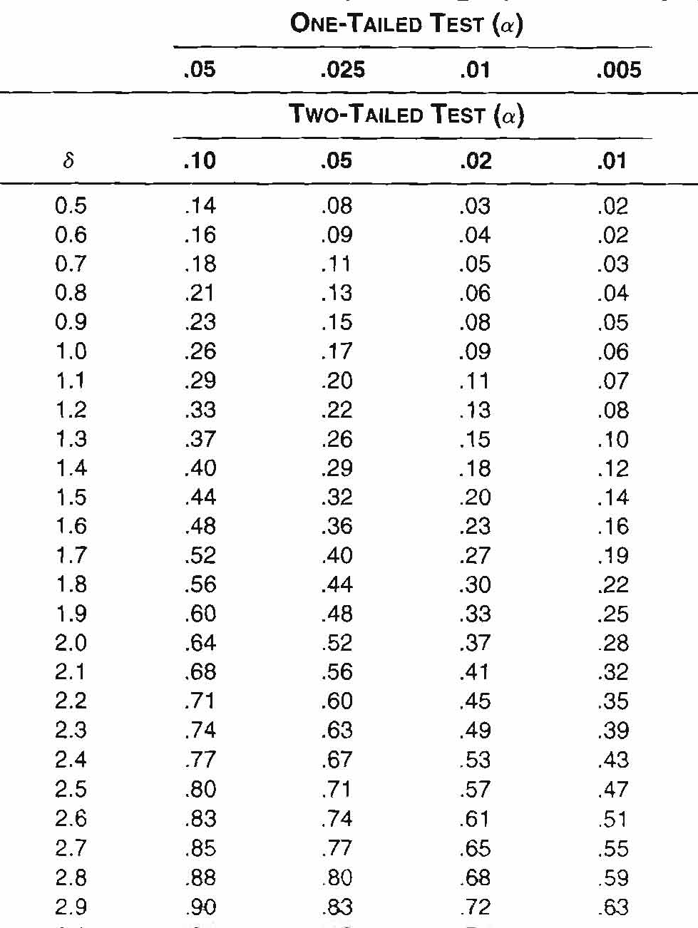
Power Analysis
Post hoc
With Cohen’s d estimate and # pairs, compute delta to obtain power of study
A Priori
With desired power, compute delta and combine
with estimated Cohen’s d to obtain # pairs (N)

Slide 19
Weaknesses
Reduction in df for critical value
Lack of a control group (sometimes)
If samples are not truly matched, results will be spurious

Slide 20
Alternatives
Violation of normality
Matched-pairs Wilcoxon Test
Binomial Sign Test for Two Dependent Samples
Sample Re-use methods
Exact tests
Randomization and permutation tests

