Slide 1


Slide 2
AI-Driven Crop Disease Prediction and Management System
PIP4004 Capstone Project
Review-0
Batch Number: CEI 08
Under the Supervision of,
Dr. Sudha P
Associate Professor
School of Computer Science and Engineering
Presidency University
Roll Number | Student Name
20211CEI0152 | YARRAGUDI AKSHATH KUMAR REDDY
20211CEI0137 | PASALURU ABHINAY KUMAR
Name of the Program: CEI
Name of the HoD: Dr. Gopal Krishna Shyam
Name of the Program Project Coordinator: Dr. Sudha P
Name of the School Project Coordinators: Dr. Sampath A K / Dr. Abdul Khadar A / Mr. Md Ziaur Rahman

Slide 3
Content
Problem Statement
GitHub Link
Analysis of Problem Statement
Timeline of the Project
References

Slide 4
Problem Statement Number:
Organization: Agriculture and Rural Development
Category (Hardware / Software / Both) : Software
Problem Description: Develop an AI-driven system that analyzes crop images and environmental data to predict potential disease outbreaks. This system will provide farmers with actionable insights and treatment recommendations to mitigate risks. Expected Solution: A web-based application CropCare that utilizes machine learning algorithms to identify crop diseases and suggest preventive measures and treatments based on real-time data.
Background: Crop diseases can devastate yields, leading to significant financial losses for farmers. Early detection and timely intervention are crucial for effective management. .
Difficulty Level: Simple

Slide 5
GitHub Link
The GitHub link provided should have public access permission
https://github.com/CEI-08/8th-Sem-PSCS_343-AI-Driven-Crop-Disease-Prediction-and-Management-System

Slide 6
Analysis of Problem Statement
Technology Stack Components:
Disease Detection (using images of crops)
Deep Learning Frameworks:
TensorFlow : For building Convolutional Neural Networks (CNNs) to classify and detect plant diseases.
Pre-trained Models:
EfficientNet : These models can be fine-tuned for plant disease detection using transfer learning.
Image Dataset:
Use datasets like PlantVillage for training and validation.
Cloud Services:
Google Cloud AI Platform : For scalable training and deployment

Slide 7
Analysis of Problem Statement (contd...)
2.Crop Recommendations (based on soil, weather, etc.)
Machine Learning Algorithms:
Gradient Boosting Machines: For crop prediction based on historical data.
• Deep Learning:
LSTMs for time series forecasting (e.g., predicting weather patterns or seasonal variations)
Data Sources:
Weather APIs like OpenWeatherMap, Soil APIs, and government agricultural data.
• Feature Engineering:
Use geospatial data for location-specific crop recommendations

Slide 8
Analysis of Problem Statement (contd...)
3. Fertilizer Suggestions
Recommender Systems:
Build a collaborative filtering model using TensorFlow Recommenders to suggest fertilizers based on soil health, crop type, and weather.
• Soil Health Prediction:
Use Support Vector Machines (SVMs) to predict soil quality based on input data.
• IoT Integration:
Use sensors (Raspberry Pi) for real-time soil health monitoring.

Slide 9
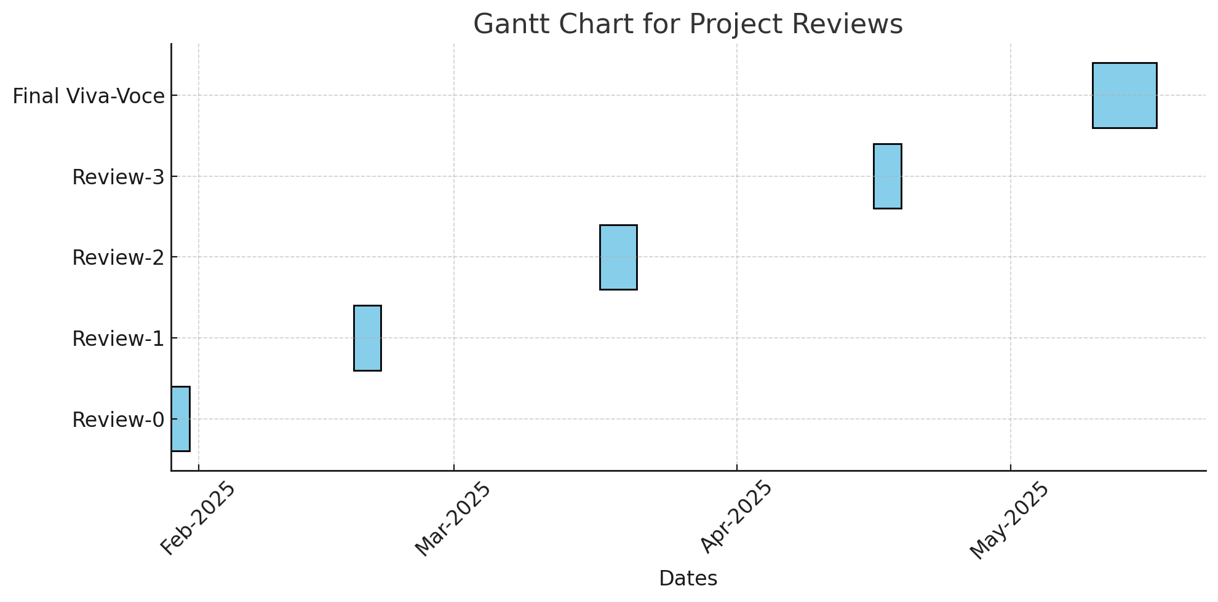
Timeline of the Project (Gantt Chart)

Slide 10
REFERENCES
http://www.fao.org/in-action/integrated-crop-management

Slide 11


