Slide 1
Patient Case Similarity
PIP2001 Capstone Project
Review-1
Batch Number: CEI-08
Under the Supervision of,
Dr. P Sudha
Assistant Professor
School of Computer Science and Engineering
Presidency University
Roll Number | Student Name
20211CEI0121 | PASALA JASWANTH
20211CEI0137 | P ABHINAY KUMAR
20211CEI0152 | Y AKSHATH KUMAR REDDY
20211CEI0153 | PERISETTY UDAYKIRAN
Name of the Program: Computer Engineering AI and ML(CEI)
Name of the HoD: Dr. Gopal shyam
Name of the Program Project Coordinator: P Sudha Expert: AI, ML and Application Development
Name of the School Project Coordinators: Dr. Sampath A K / Dr. Abdul Khadar A / Mr. Md Ziaur Rahman

Slide 2
Introduction
The Patient Case Similarity project aims to improve healthcare by using data from Electronic Health Records (EHRs). EHRs contain important information about patients, such as their medical history, treatments, and outcomes. Analyzing this data can help doctors make better decisions and improve patient care.
This project will create a web application that helps two main groups:
USERS: Users can register, login, scan skin diseases using image recognition, view nearby hospitals, add appointments, and maintain a medical history all through a user-friendly mobile application.
ADMIN: Admins can securely login, add new hospitals to the system, and view registered users' details using the mobile application interface.
HOSPITAL: Hospitals can log in securely and access their dedicated interface to view scheduled appointments made by users through the mobile application.
By making it easier to access and analyze patient data, the Patient Case Similarity system aims to enhance healthcare outcomes for both patients and medical professionals.

Slide 3
Literature Review
This literature review focuses on key research and methodologies relevant to the Patient Case Similarity project, emphasizing patient clustering, machine learning, and the use of electronic health records (EHRs).
Machine Learning in Healthcare: Liu et al. (2020) highlight how machine learning algorithms can analyze EHR data to improve patient care and clinical decision-making, revealing patterns in large datasets.
Patient Clustering: Elhassan and Al-Shammari (2021) explore various patient similarity measures, showing that effective clustering enhances treatment strategies by identifying patients with similar medical histories.
Data Privacy: Dhamija et al. (2010) emphasize the importance of robust security measures to protect sensitive patient data from breaches, underlining the need for strong privacy protocols in the project.
Clinical Decision Support Systems (CDSS): Talab et al. (2022) discuss how integrating machine learning into CDSS can aid doctors by providing relevant patient information and similarity scores for better diagnosis.
Challenges in EHR Utilization: Rahman et al. (2019) address challenges like data heterogeneity and missing values, proposing strategies to ensure effective use of EHRs for research and clinical practice.
Data-Driven Insights for Research: Ashraf and Haque (2022) highlight the role of EHRs in facilitating clinical research, demonstrating that patient similarity data can improve trial design and outcomes.
Predictive Analytics: O'Sullivan and Thakral (2021) review how machine learning can predict patient outcomes, suggesting that similarity scores provide valuable context for clinical decisions.
Big Data Analytics: Saha et al. (2021) discuss the potential of big data in healthcare, noting that analyzing large datasets can inform clinical practice and improve understanding of patient populations.

Slide 4
Reference
H. Liu et al., "Application of Machine Learning in Healthcare: A Systematic Review," IEEE Access, vol. 8, pp. 74759-74773, 2020.
N. Elhassan and A. M. Al-Shammari, "Comparative Study of Patient Similarity Measures in Electronic Health Records," IEEE Access, vol. 9, pp. 74691-74705, 2021.
H. Liu, L. Wang, L. Zhang, Y. Li, and Z. Chen, "Application of Machine Learning in Healthcare: A Systematic Review," IEEE Access, vol. 8, pp. 74759-74773, 2020.
A. S. Talab, M. H. A. E. Kamal, and S. I. B. Mahfouz, "Clinical Decision Support Systems: A Machine Learning Perspective," IEEE Access, vol. 10, pp. 10140-10152, 2022.
M. U. Rahman, K. N. R. Kumar, and N. M. B. R. Narayanan, "Data Analytics in Healthcare: A Review," IEEE Access, vol. 7, pp. 20367-20384, 2019.

Slide 5
Existing method Drawback
Here we Discuss methods like K-Means clustering, DBSCAN, hierarchical clustering, or other classification models used for patient grouping.
K-Means Clustering: Used to cluster patients with similar medical histories or symptoms, helping in the classification of new cases.
Hierarchical Clustering: Useful in medical research for discovering relationships between various patient groups or conditions, where the number of clusters isn’t fixed.
Feature Engineering: Most existing methods require substantial manual feature engineering, which is time-consuming and prone to error.
Scalability: Many clustering methods don’t scale well with large patient datasets, which is a key issue when dealing with massive EHR databases.
Handling of Outliers: Some methods, like K-Means and Euclidean distance, are sensitive to outliers, which can reduce the quality of clusters and similarity scores.
Dimensionality Issues: High-dimensional EHR data can cause challenges for distance-based, leading to poor differentiation between patients.
Interpretability: Clinicians need to understand how models arrive at a similarity score. Some methods may not provide interpretable insights in non-linear healthcare data.

Slide 6
Proposed Method
The proposed method for developing the Patient Case Similarity application involves several key components: data preprocessing, machine learning model implementation, and interface design for researchers and doctors. Below is a step-by-step breakdown of how this method will be applied to the project:
Data Collection and Preprocessing
Data Source: The EHR (Electronic Health Records) database will serve as the central repository for patient information, including demographics, medical conditions, treatments, and outcomes.
Data Cleaning: Remove incomplete or inconsistent data, such as missing values or errors in patient records.
Data Transformation: Convert the raw data into a structured format suitable for machine learning algorithms.

Slide 7
Proposed Method…..
Machine Learning Model
Clustering Patients:
Algorithm: Use an unsupervised learning algorithm such as K-Means, Hierarchical Clustering, or DBSCAN to group patients based on their medical conditions, symptoms, and treatment history.
Evaluation Metric: RMSE
Root Mean Square Error (RMSE): The similarity scores generated by the model will be evaluated using RMSE to assess the model’s accuracy in predicting patient similarities.
Ground Truth: The RMSE can be calculated based on known similarities in the data or verified case studies, where similarity scores are compared with expected outcomes.
System Architecture
The system consists of three core layers:
Data Layer: The EHR database containing all patient data.
Processing Layer: Data preprocessing and the machine learning model (for clustering and similarity scoring).
Interface Layer: The web-based interface for researchers and doctors to query the system and retrieve similarity results.

Slide 8
Objectives
Develop a Machine Learning Model: Create algorithms to group patients and calculate similarity scores.
Design User-Friendly Interfaces: Build easy-to-use platforms for doctors and researchers.
Improve Diagnosis: Help doctors access insights from similar past cases.
Support Research: Enable researchers to conduct studies using patient data.
Ensure Data Security: Protect patient information with strong security measures.
Evaluate Accuracy: Use metrics like RMSE to assess score reliability.
Provide Training: Offer support to help users navigate the application.
Encourage Feedback: Gather user input for continuous improvement.
Promote Data-Driven Decisions: Enhance patient care with data analytics.
Foster Collaboration: Build partnerships to share knowledge and improve the application.
These objectives focus on enhancing user experience and improving healthcare outcomes.

Slide 9
Methodology/Modules
To develop the Patient Case Similarity application, the project will be divided into several key modules. Each module is responsible for a specific part of the system, from data handling to machine learning processing and user interaction. The overall methodology follows a structured approach to ensure each aspect is thoroughly addressed. Below is a detailed breakdown of each module:
Data Collection & Preprocessing: Cleans and prepares patient data for analysis.
Machine Learning: Clusters patients and calculates similarity scores.
Query System: Allows users (doctors/researchers) to query and analyze patient similarities.
Evaluation: Ensures accuracy of similarity scores using RMSE.
User Interface: Provides tailored tools for doctors and researchers to interact with the system.
This simplified structure keeps the process clear, efficient, and user-friendly for all stakeholders involved.

Slide 10
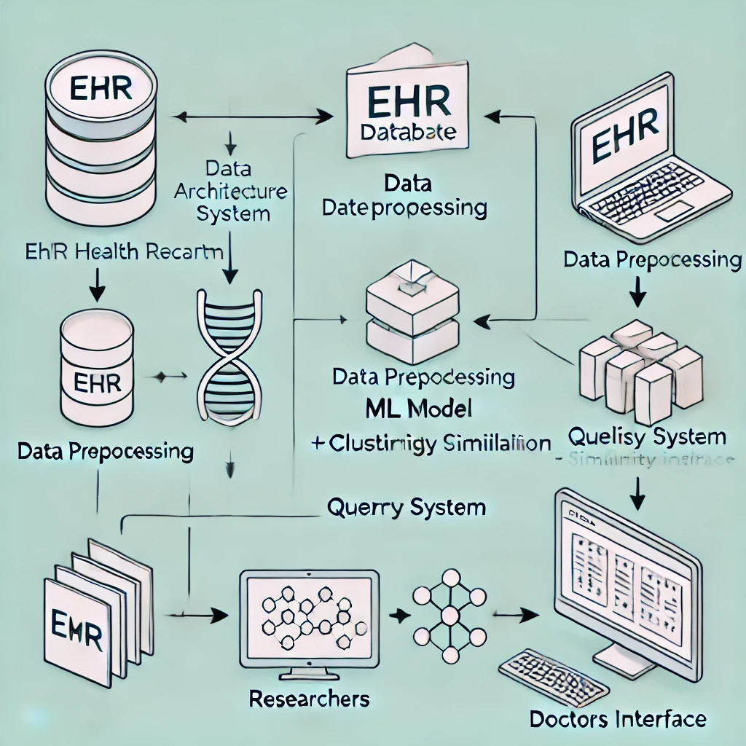
Architecture

Slide 11
Hardware/software components
Hardware: Server infrastructure, user devices, and networking equipment.
Software: Operating systems, web frameworks, database management systems, machine learning libraries, data processing tools, security measures, and development tools.
These components will work together to create a robust and secure Patient Case Similarity application that meets the needs of healthcare professionals and researchers.

Slide 12
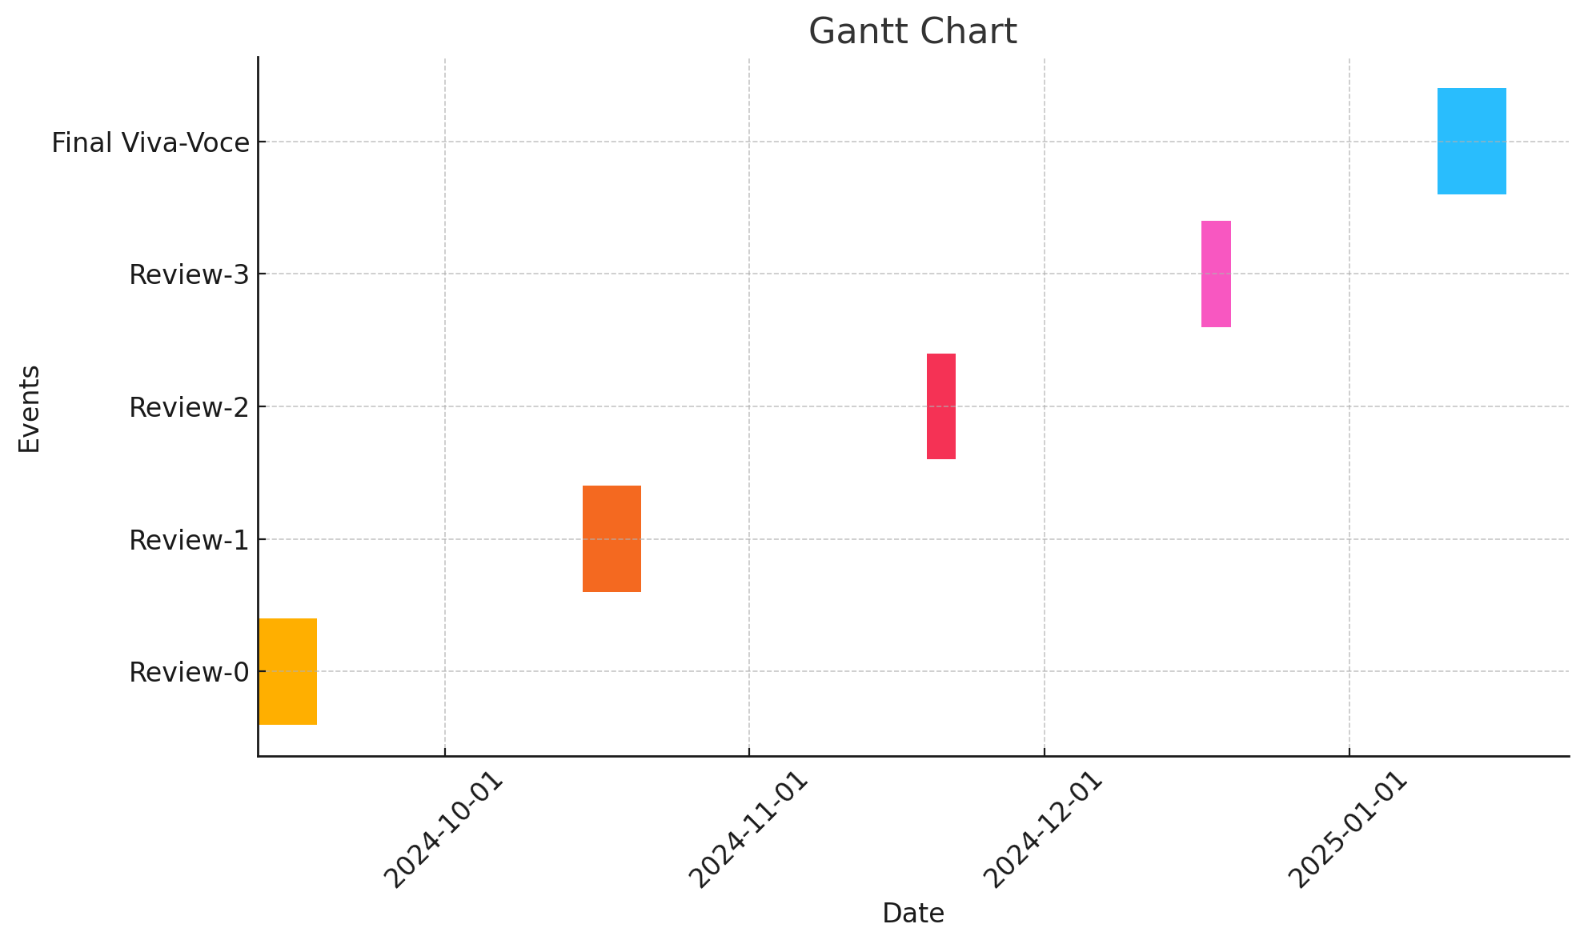
Timeline of Project

Slide 13
Expected Outcomes
The Patient Case Similarity project aims to achieve several important results that will benefit healthcare professionals and researchers. Here’s a simplified summary of the expected outcomes:
Better Diagnoses
Efficient Patient Management
Enhanced Research Opportunities
User-Friendly Design
Scalable System

Slide 14
Conclusion
The Patient Case Similarity project aims to improve healthcare by using data from Electronic Health Records (EHRs). By applying machine learning, the application will help doctors and researchers analyze patient cases more effectively.
For doctors, the application will provide quick access to similar past cases, enabling better diagnosis and personalized treatment plans. For researchers, it will offer tools to conduct studies and find participants for clinical trials, leading to valuable insights in medicine.
Overall, this project emphasizes the power of data in healthcare. By making it easier to access and analyze patient information, the Patient Case Similarity application will enhance clinical decision-making and advance medical research, ultimately benefiting patients and healthcare providers alike.

Slide 15
Github Link
The Github link provided should have public access permission.
https://github.com/Team658

Slide 16
References
Referred Papers containing similar problems:
EHR Data Analysis:
R. J. McNaughton, K. C. Kuhl, J. P. M. Sousa, and A. K. Gupta, "A Machine Learning Approach to Electronic Health Record Data Analysis," IEEE Journal of Biomedical and Health Informatics, vol. 22, no. 4, pp. 1183-1190, 2018.Link
Patient Similarity Measures:
N. Elhassan and A. M. Al-Shammari, "Comparative Study of Patient Similarity Measures in Electronic Health Records," IEEE Access, vol. 9, pp. 74691-74705, 2021.Link
Health Informatics and Machine Learning:
H. Liu, L. Wang, L. Zhang, Y. Li, and Z. Chen, "Application of Machine Learning in Healthcare: A Systematic Review," IEEE Access, vol. 8, pp. 74759-74773, 2020.Link
Machine Learning for Clinical Decision Support:
A. S. Talab, M. H. A. E. Kamal, and S. I. B. Mahfouz, "Clinical Decision Support Systems: A Machine Learning Perspective," IEEE Access, vol. 10, pp. 10140-10152, 2022. Link
Healthcare Data Analytics:
M. U. Rahman, K. N. R. Kumar, and N. M. B. R. Narayanan, "Data Analytics in Healthcare: A Review," IEEE Access, vol. 7, pp. 20367-20384, 2019. Link

Slide 17
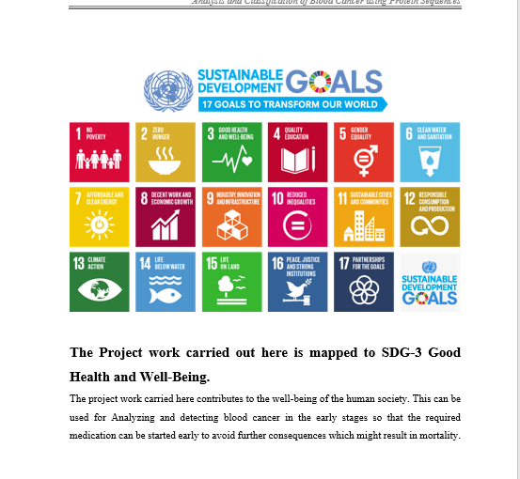
Project work mapping with SDG

Slide 18
Thank You

