Slide 1
IDENTIFICATION OF MEDICINAL PLANTS AND RAW MATERIALS THROUGH IMAGE PROCESSING AND MACHINE LEARNING
PSCS184 Capstone Project
VIVA - VOCE
Batch Number: G-9
STUDENT NAME | ROLL NUMBER
GURANAVAR VINUSHA RUDRAPPA | 20211CEI0129
ABHISHEK K S | 20211CEI0131
POORNIMA C BALAGONDAR | 20211CEI0135
MANCHIKANTI ASHRITA | 20211CEI0154
Under the Supervision of,
Dr. Joe Arun Raja
Associate Professor
School of Computer Science and Engineering
Presidency University
Name of the Program: B.Tech
Name of the HoD: Dr. Gopal Krishna Shyam
Name of the Program Project Coordinator: Dr. Sudha P
Name of the School Project Coordinators: Dr. Sampath A K / Mr. Md Zia Ur Rahman

Slide 2
Introduction
India, which has been blessed with a heritage of floral diversity, has a great wealth of medicinal plants, yet one of the key burning issues in Ayurvedic Pharmaceutics is the identification of these plants.
Various crude drugs are available in the market under the same name causing confusion and their misidentification. Even the traders and collectors do not fully know the precise morphological look or distinguishing features of the numerous drugs due to seasonal and geographical variations, and corresponding features. In addition, the large-scale use to balance the demand-supply ratio puts heavy pressure on available resources. It also results in the practice of adulteration, substitution, and loss of faith in the curative power of the system ultimately.
Therefore, software that can recognize various medicinal plants and raw materials using Image Processing Using Various Deep Learning algorithms will be of great utility. It will prove useful at all levels viz. wholesaler, distributor, etc.

Slide 3
Literature Review
Title | Authors | Algorithms | Limitations
Medicinal Plant Leaf Identification Using Deep Learning Techniques | H. Lee, C. Yoon, D. Kim | Convolutional Neural Networks (CNNs) | Accuracy was affected by background noise and similarity in leaf morphology among some species; dataset was limited in diversity.
Automatic Classification of Medicinal Plants Using Image Processing | P. Ramesh, K. Anitha | K-Nearest Neighbor (KNN) | Performance degraded with images taken in uncontrolled lighting; model overfitting on small datasets.
Deep Leaf: A CNN- based Approach for Medicinal Plant Identification | M. Sharma, A. Verma, R. Thakur | CNN with Transfer Learning (VGG16, ResNet50) | Required large computational power; difficulty in differentiating morphologically similar species.

Slide 4
Continued
Identification of Traditional Medicinal Plant Leaves Using an Effective Deep Learning Model and Self-Curated Dataset | Deepjyoti Chetia, Sanjib Kr Kalita, Partha Pratim Baruah, Debasish Dutta, Tanaz Akhter | Custom CNN architecture with 6 convolutional layers, max-pooling, and dense layers | While the model achieved high accuracy on the tested datasets, its performance on more diverse or real-world datasets remains untested, potentially limiting its applicability in varied conditions
Leaf Identification Using a Deep Convolutional Neural Network | Christoph Wick, Frank Puppe | Nine-layer CNN architecture | The study utilized the Flavia and Foliage datasets, which contain a limited number of species and samples.
Medicinal Plant Identification Using CNN and Data Augmentation Techniques | N. Ghosh, S. Das | CNN with Data Augmentation | Augmentation improved generalization but failed to capture real- world variation across regions.

Slide 5
Continued..
Medicinal Plant Identification in Real-Time Using Deep Learning Model | Jana Wäldchen, Patrick Mader | Deep learning model for real-time identification | Challenges include small training sets, errors in identification, limited scalability to large numbers of species, and difficulty in recognizing novel species not present in the training data
Leaf Image Recognition System for Medicinal Plants Based on Shape Features | L. Zhang, W. Wang | Shape-based Feature Extraction + ANN | Performance degraded when leaves were partially occluded or folded; shape alone was insufficient.

Slide 6
Research Gaps Identified
Small and Unbalanced Datasets:
The most crucial gap in research so far is the absence of large, diverse, and balanced datasets for identifying medicinal plants. Most research has been based on self-curated datasets or tiny collections such as Flavia, Folio and other local datasets. Such datasets tend to have the following problems:
Geographical Bias: Most datasets are region-specific and hence models will be less accurate when used across the world.
Limited Variety of Plants: The available datasets might represent just a fraction of the immense range of medicinal plants and hence, the datasets might result in poor generalization.
Class Imbalance: Certain species might be more prevalent than others, which might have negative impacts during training and result in skewed predictions.

Slide 7
Continued..
Challenges in Feature Extraction and Model Generalization:
Deep learning models, particularly Convolutional Neural Networks (CNNs), are very sensitive to feature extraction quality. But recognizing medicinal plants involves detecting minute variations in leaf patterns, shapes, texture and colours. The main areas of voids are:
Overfitting to Individual Features: Models tend to learn individual patterns from a small dataset, thus overfitting in the face of unseen data.
Inconsistency Between Models: Various CNN models (such as Res-Net, VGG, Mobile Net) can have very different accuracies on the same dataset, reflecting a lack of robustness.
Sensitivity to Variations: Models often fail when the plant images differ due to seasonal changes, lighting variations, or partial occlusions.

Slide 8
Proposed Methodology
Data Collection Collecting a dataset of medicinal plant leaves, roots, flowers, bark, seeds and raw dried materials.
Sources:
Kaggle datasets
Government botanical databases
Self-captured images using smartphone/digital camera.
Image Preprocessing Steps:
Resize images to standard size (e.g., 128x128)
Convert to grayscale or normalize RGB
Apply filters: Gaussian blur, median filter
Data augmentation: rotation, zoom, flipping.

Slide 9
Continued…
3. Feature Extraction
Feature extraction is a process of identifying and extracting important characteristics or features from image
4. Model Selection and Training
Training involves feeding the pre-processed images through the CNN model and updating weights using backpropagation.
Training Data Split: 80% Training, 10% Validation, 10% Testing.
Epochs: 50
Batch Size: 32
Learning Rate: 0.001

Slide 10
Continued..
5. Model Evaluation
Use the following metrics:
Accuracy
Precision, Recall, F1-score.
6. Deployment
The trained model is exported as a saved model file (e.g., .pth for PyTorch) and integrated into a web or mobile application.
Platform: Flask (web), Android (mobile)
User Interface: Upload leaf image for instant prediction
Real-Time Prediction: Utilizes a lightweight version of the model for quick inference.

Slide 11
Objectives
Automatically identify medicinal plants through deep learning approaches.
Guarantee authenticity and quality assurance in the herbal medicine sector.
Apply CNNs and transfer learning for the analysis of plant morphological traits.
Construct a rich, annotated dataset of images of medicinal plants.
Improve model accuracy and generalizability with data augmentation methods.
Create lightweight AI models for real-time identification on mobile and edge devices.
Facilitate plant identification via an easy-to-use web and mobile application.
Install an adulteration detection system to ensure raw medicinal material purity.

Slide 12
System design and Implementation
Backend Modules
Data Ingestion Uses ImageFolder for structured dataset input (training, validation, test).
Image Transformation Applies resizing (256x256), normalization, and augmentation for better generalization.
Model Training Utilizes ResNet9 architecture with residual connections for stable and efficient learning.
Optimization Employs Adam optimizer, OneCycleLR scheduler, and gradient clipping to improve convergence and prevent exploding gradients.
Model Export Saves the trained model in .pth format for deployment or further inference.

Slide 13
Continued..
Frontend Modules
Page Layouts:
layout.html defines shared headers and footers for consistency
Image Upload and Display:
leaf.html: Allows users to upload a leaf image via a form.
Styling (CSS):
Ensures cross-device responsiveness.
Client-Side Validation:
Uses JavaScript to verify file types, size constraints and form fields.

Slide 14
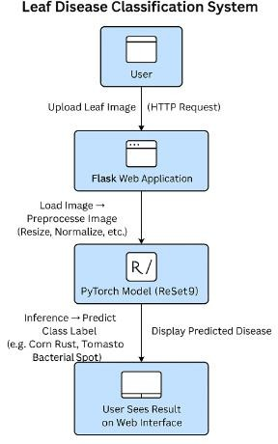
Architecture
Architecture Diagram for Plant Leaves Identification Using Machine Learning

Slide 15
Hardware/software components
GPU-enabled system (NVIDIA CUDA recommended) for training.
Python 3.8+.
Required Python libraries: torchvision, matplotlib, numpy.
Web server for frontend hosting (optional: GitHub Pages, Netlify for static parts).

Slide 16
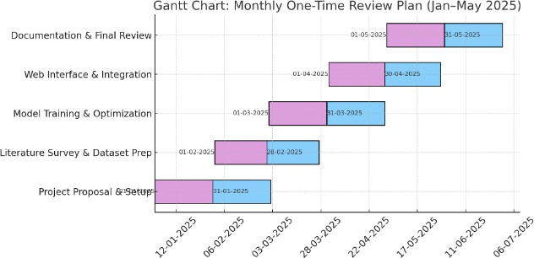
Timeline of Project

Slide 17
Expected Outcomes
Accurate Medicinal Plant Identification
High validation accuracy in classifying plant leaves using deep learning models.
Real-Time Deployment Capability
Lightweight model suitable for mobile and edge devices for on-field identification.
Enhanced Herbal Product Authenticity
Detection of adulteration in raw plant materials to ensure quality and safety.
Improved Agricultural Productivity
Timely leaf diagnosis enabling better crop management and increased yields.
Potential for Widespread Adoption
Scalable solution for the ayurvedic, agricultural, and healthcare sectors.

Slide 18
Conclusion
This project illustrates the applied success of deep learning in agriculture through the automation of medicinal plant leaf recognition. Utilizing a lightweight ResNet9 model implemented in PyTorch. The system is both performance-balanced and scalable, making it accessible to farmers and fieldworkers without high-end infrastructure. Its robustness is further enhanced through data augmentation, residual connections, and precise hyperparameter tuning.
Future development involves increasing the dataset to include more environmental conditions, incorporating interpretability tools such as Grad-CAM, and creating a multilingual smartphone app for wider use. Moreover, the integration of IoT devices to do leaf monitoring autonomously and federated learning can further improve data privacy and real-time responses in smart farm settings.

Slide 19
References
Too, E. S., And O'Connor, K. P. (2019). "A Survey of Machine Learning in Agricultural Applications." Computers and Electronics in Agriculture.
Ferentinos, K. P. (2018). "Deep Learning Models for Plant Detection and Diagnosis." Computers and Electronics in Agriculture.
He, K., Zhang, X., Ren, S., And Sun, J. (2016). "Deep Residual Learning for Image Recognition." Proceedings of the IEEE Conference on Computer Vision and Pattern Recognition (CVPR).
Simonyan, K., And Zisserman, A. (2015). Very deep convolutional networks for large-scale image recognition. arXiv preprint arXiv:1409.1556.
Krizhevsky, A., Sutskever, I., And Hinton, G. E. (2012). ImageNet classification with deep convolutional neural networks. Advances in Neural Information Processing Systems, 25, 1097–1105.

Slide 20
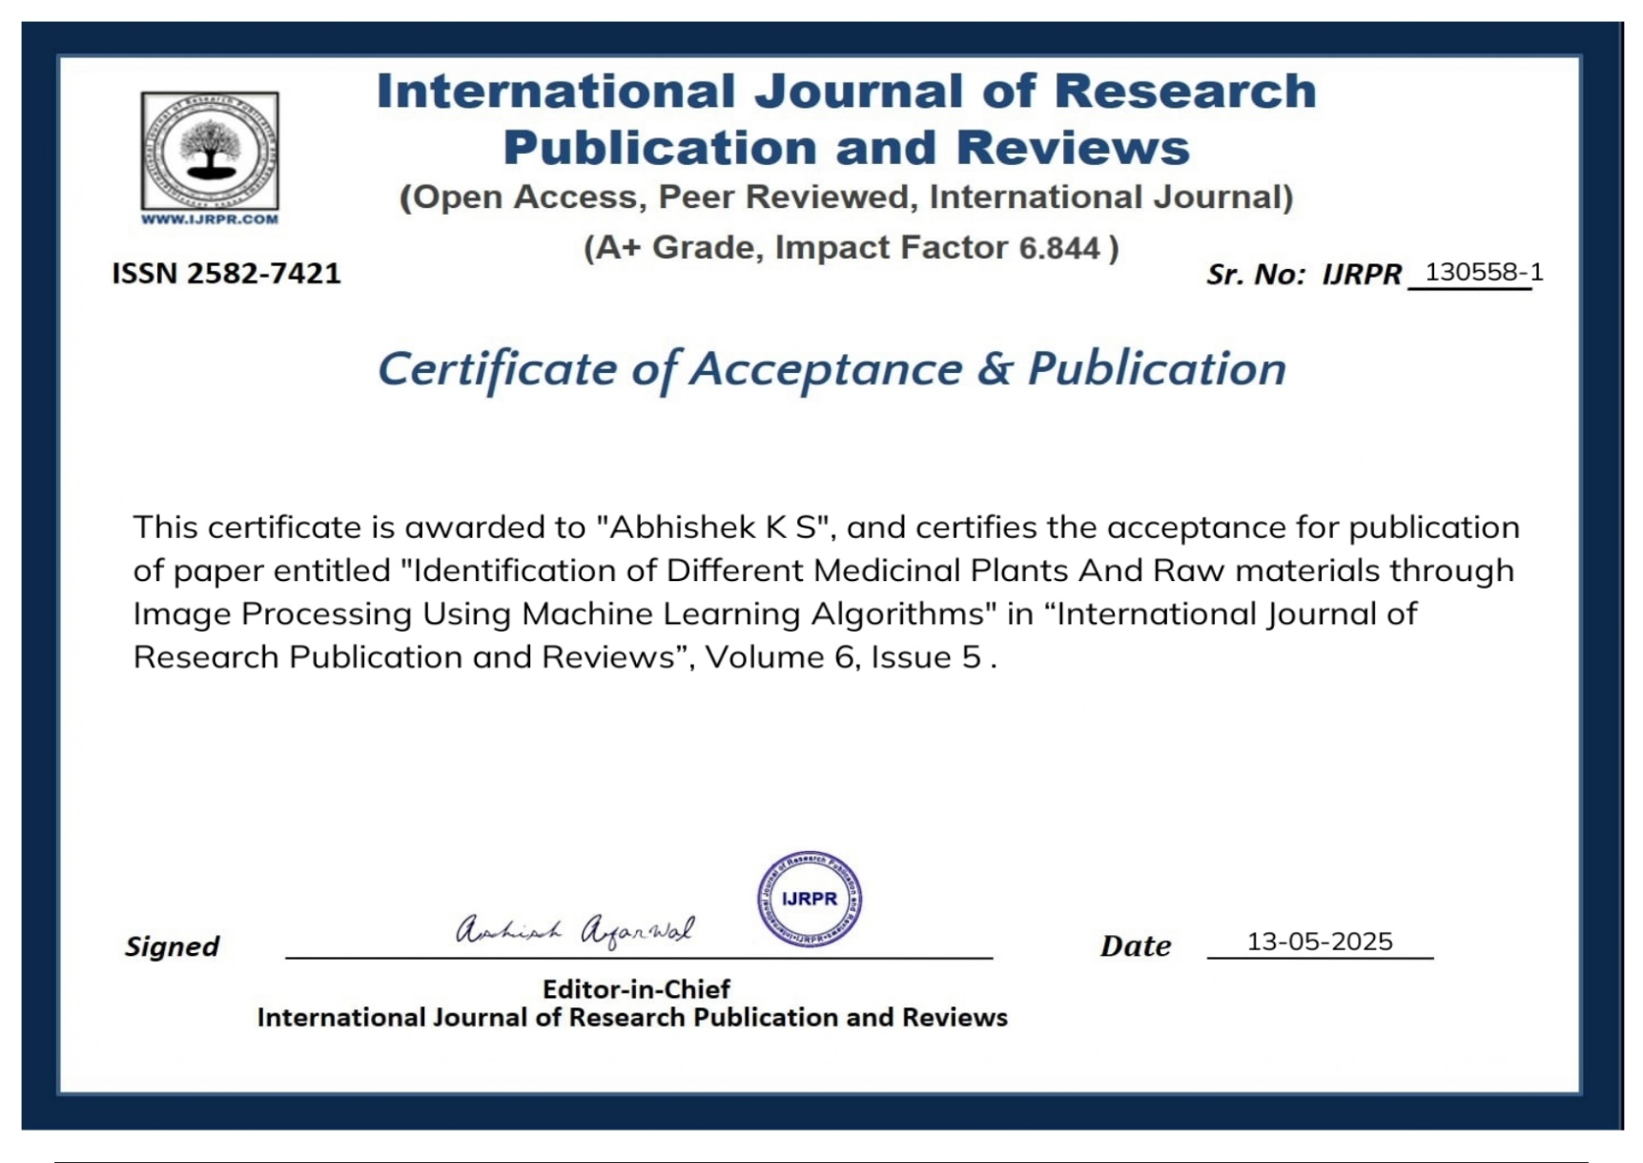
Publication Details

Slide 21
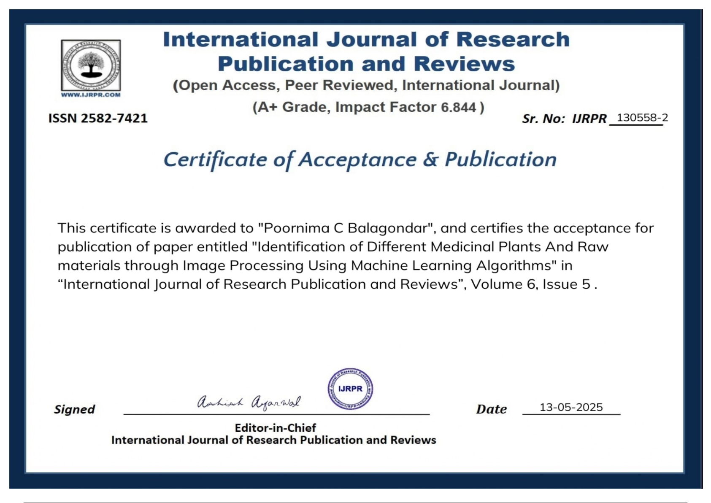

Slide 22


Slide 23
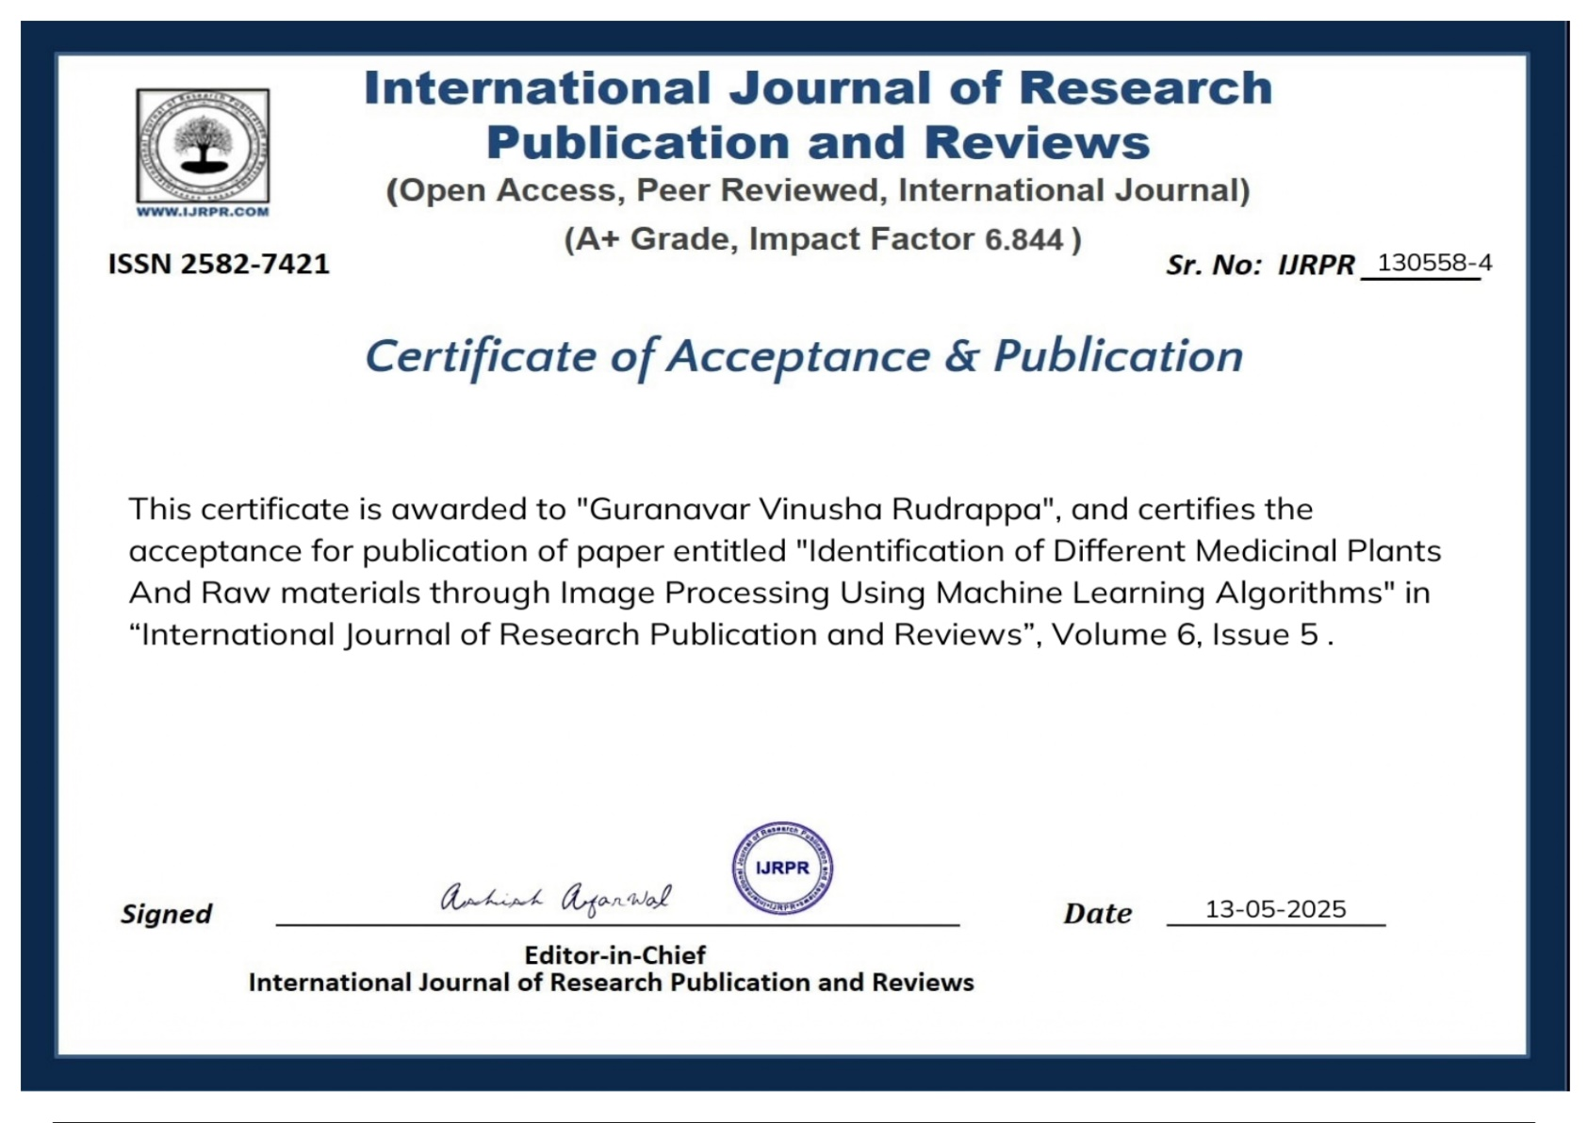

Slide 24

SUSTAINABLE DEVELOPMENT GOALS
SDG 3: Good Health and Well-being
SDG 9: Industry, Innovation, and Infrastructure
SDG 12: Responsible Consumption and Production

Slide 25

Thank You

