Slide 1
Wiselib
Algorithmic library written in C++
Created by 9 european partners
Initially designed for heterogenous sensor networks
Provides algorithms for routing, localization, scheduling...
Very efficient

Slide 2
Wiselib Features
Generic programming
Flexible design
It can be used for many platforms
New algorithms can be implemented
Easy port to new platforms since most code is platfrom independent

Slide 3
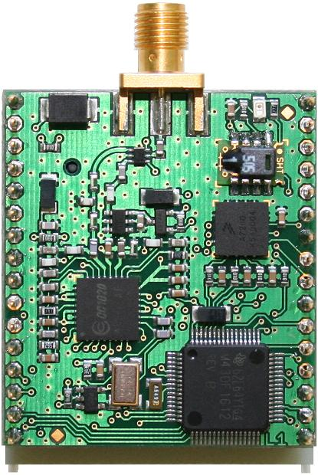
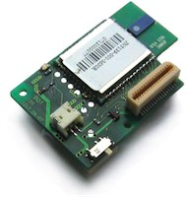

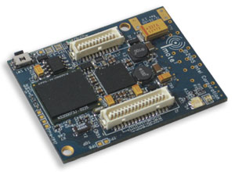
Heterogeneity
iSense | iMote2 | ScatterWeb MSB | Tmote Sky
Hardware
Jennic | Intel XScale | MSP430 | MSP430
Operating Systems
iSense | TinyOS | ScatterWeb, Contiki | Contiki, TinyOS
Programming Language
C++ | nesC | C | C, nesC

Slide 4
Wiselib in Android
Basic concepts of Wiselib were succesfully ported to android.
Through wiselib algorithms can be tested using simulation environment first and then compiled for android without any modification.
Routing algorithms
Zeroconf algorithms

