Slide 1
Cbox: communicate anytime, anyplace, anyhow
Akasoglou K., Baltas A., Gkatziouras E., Kapetanos N., Karavias D., Moustakakis K., Oikonomou G., Palaghias N., Papaneofytou G., Triantafyllis N., Vasilakis F.
Akrivopoulos O., Koninis C., Logaras M.
Chatzigiannakis I.

Slide 2






cBox
Palaghias Nikos
Vasilakis Filippos
Karavias Dimitrios Emmanouil
Oikonomou Giorgos
Papaneofytou Georgia
Baltas Alexandros
Moustakakis Kostas
Akasoglou Kostas
Gkatziouras Manolis
Kapetanos Nikos
Triantafyllis Nikos

Slide 3
cBox
Proxy and Application Layer

Slide 4
Proxy
Squid Proxy Server
  Anonymity
  Caching
  Hierarchy
  Reduce Bandwidth
  Improve Response Times

Slide 5
Application Layer
Consists of:
  Android: Mobile Application
  cBox: Caching Proxy Application
Applications
  Twitter Client
  Flickr Client

Slide 6
Application Layer
Android Twitter Client:
  Sign in from various accounts ( OAuth )
  Update Status
  Friends Timeline ( Tweets from Friends )
  Profile Statistics ( icon, number of tweets etc )

Slide 7
Application Layer
Android Twitter Client – Future Additions
  Send / Receive Direct Messages
  Search for Tweets
  Account Lists

Slide 8
Application Layer
cBox Twitter Caching Proxy
  Caches Twitter Update Statuses on Internet Connectivity Loss
  Twitter Update Status may come from either Android Application or PC browser

Slide 9




Application Layer
Android Mobile
(No Internet Connection)
Internet
cBox 2
cBox 1

Slide 10
Application Layer
Flickr Client :
  Similar functionality with Twitter Application
  Basic functionality
    Sign in
    Upload photo
    Browse photo
  Android and cBox Application

Slide 11
cBox
Android Wiselib Layer

Slide 12
Wiselib
Algorithmic library written in C++
Created by 9 european partners
Initially designed for heterogenous sensor networks
Provides algorithms for routing, localization, scheduling...
Very efficient

Slide 13
Wiselib Features
Generic programming
Flexible design
It can be used for many platforms
New algorithms can be implemented
Easy port to new platforms since most code is platfrom independent

Slide 14
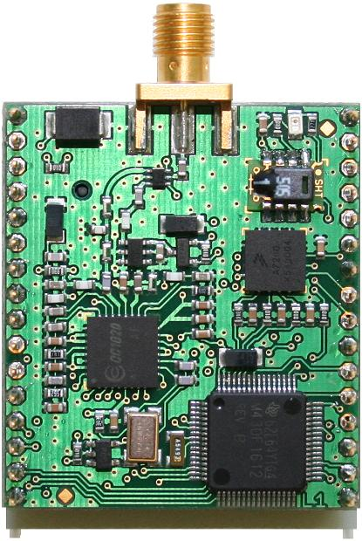
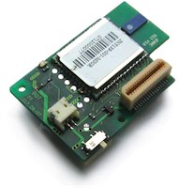

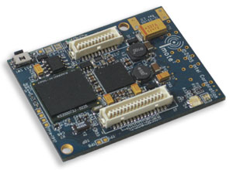
Heterogeneity
iSense | iMote2 | ScatterWeb MSB | Tmote Sky
Hardware
Jennic | Intel XScale | MSP430 | MSP430
Operating Systems
iSense | TinyOS | ScatterWeb, Contiki | Contiki, TinyOS
Programming Language
C++ | nesC | C | C, nesC

Slide 15
Wiselib in Android
Basic concepts of Wiselib were succesfully ported to android.
Through wiselib algorithms can be tested using simulation environment first and then compiled for android without any modification.
Routing algorithms
Zeroconf algorithms

Slide 16
cBox
ZeroConf Layer

Slide 17
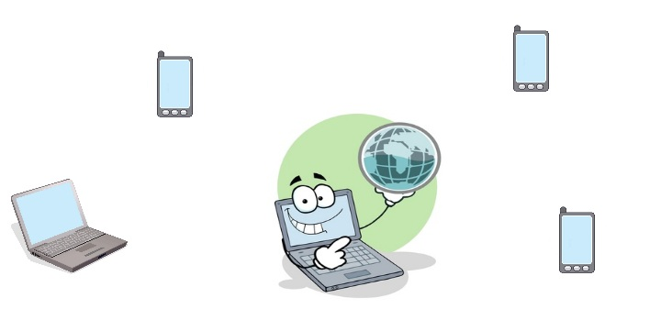
ZeroConf
Problem: services sharing
  Internet, web server, chat, proxy server, ftp server, etc.

Slide 18
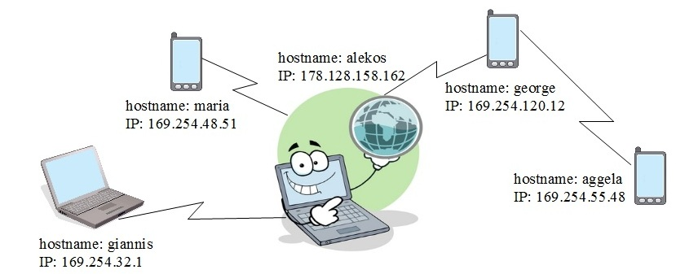
ZeroConf
Solution: Wiselib Implementation of ZeroConf/mDNS protocol.
Each node is characterized by a unique IP and a unique hostname.
Implementation of a protocol for sharing services in the network.

Slide 19
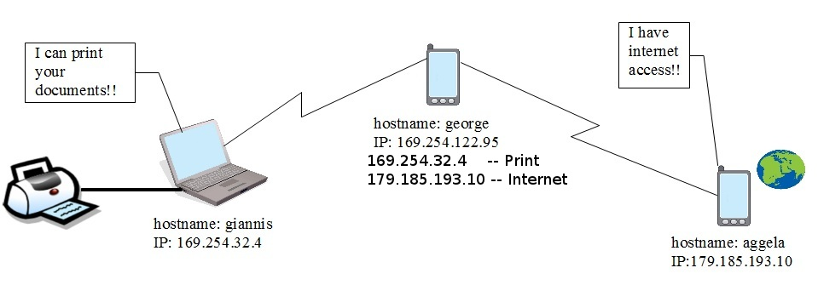
ZeroConf
First idea:
  Normally ZeroConf gives random IPs.
  IP – Services mapping.

Slide 20
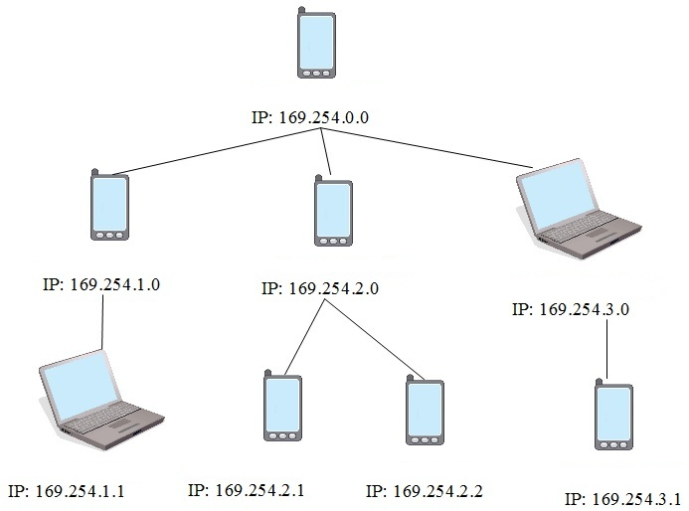
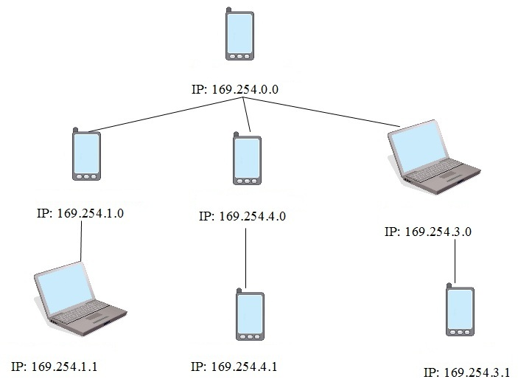
ZeroConf
Routing with subneting:
  IPs are given depending on the location of the device in the tree.
  IPs change easily when the tree is adjusted.

Slide 21
ZeroConf
Problem:
  The IP of a device will change frequently as the node moves inside the network or a node leaves.

Slide 22
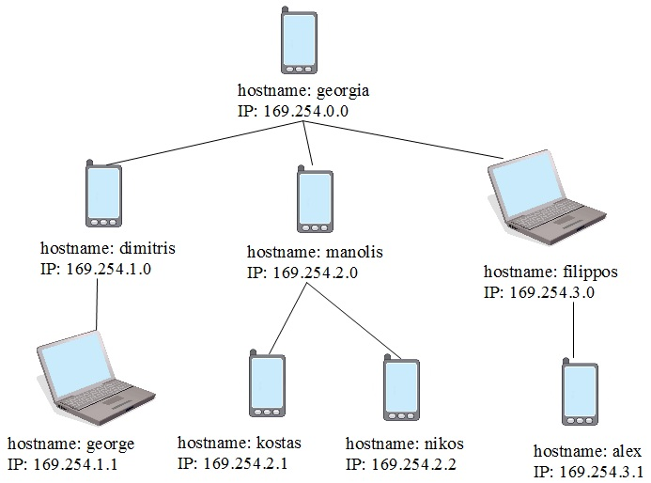
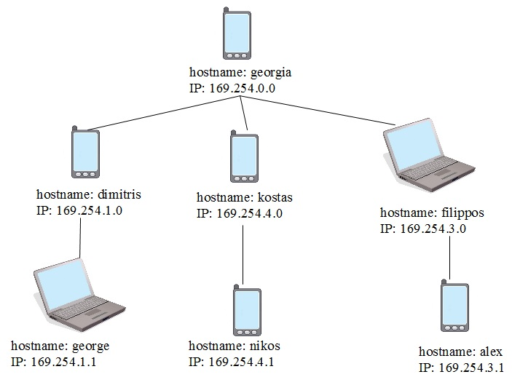
ZeroConf
Solution:
  Hostnames.
  Service – Hostname mapping.

Slide 23
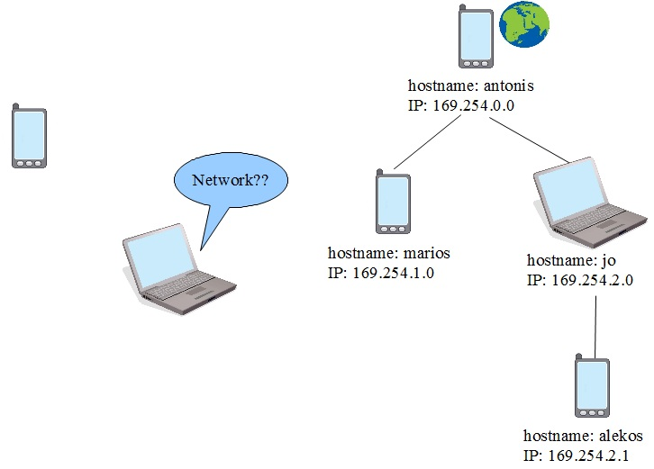
ZeroConf
Workflow
  1) One device that is not in a network, periodically searches for a network.

Slide 24
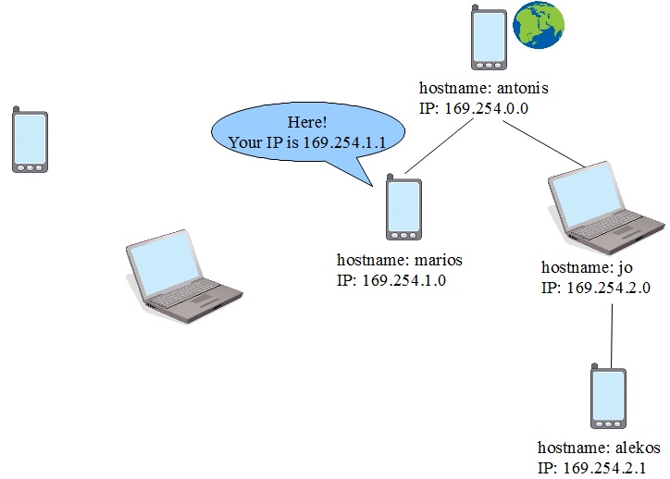
ZeroConf
  2) Receives a response from an other device when and only when it's in a network, with a message that defines the IP which the new node will have in the network.

Slide 25
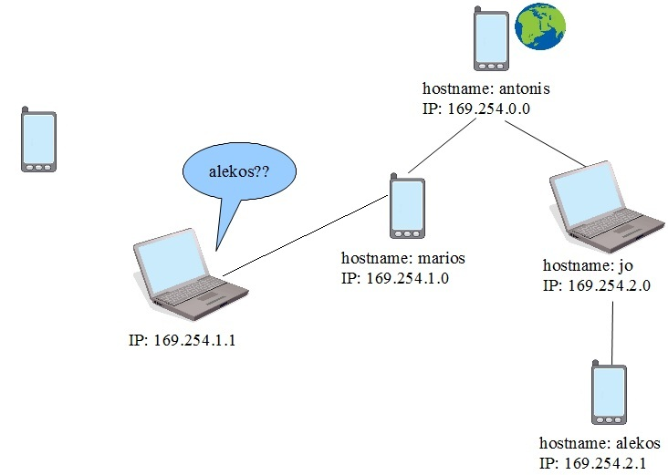
ZeroConf
  3) Selects a hostname and it floods the network to claim it. Receives a reply only from someone who has this hostname.

Slide 26
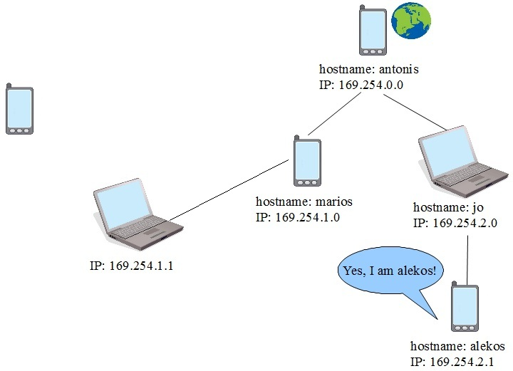
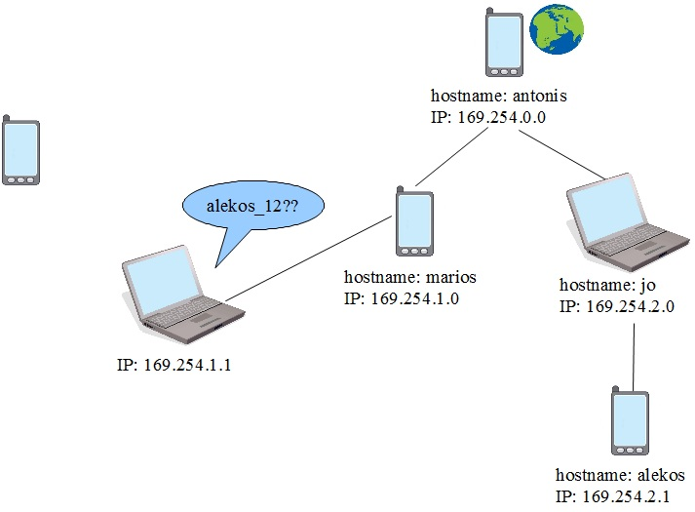
ZeroConf
  4a) If no reply is received after a certain time it enters the network with this hostname and the IP given to it.
  4b) In the case it receives a reply, changes the hostname and tries again.
    alekos → alekos_ΧΧ , where ΧΧ random number

Slide 27
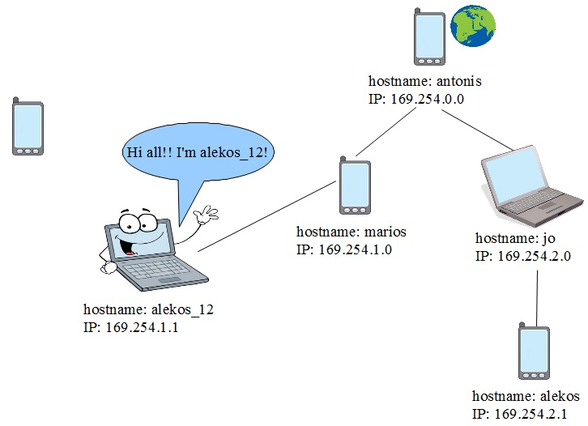
ZeroConf
  5) When enters the network it announces itself and the services it provides.

Slide 28
cBox
Routing Layer

Slide 29
Routing
Network Construction
Self-healing mechanism
Unique address assignment for each node
Message routing

Slide 30
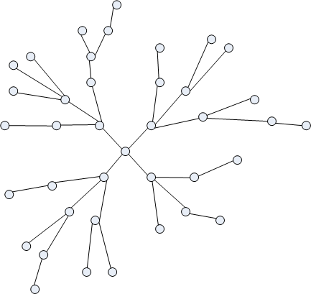
Network Construction
Tree structure
Usually root shares resources (such as internet connectivity)
Multiple trees in given topology

Slide 31
Self Healing Mechanism
Network is continously changing
Periodical excecution of an algorithm that re-initializates the network
When a node detects it has no father, it issues a join request

Slide 32
Routing
Each node functions as a DHCP server, by assigning Ipv6 addresses to nodes that enter the network
The only information needed by a node for a successful routing is the destination address

Slide 33
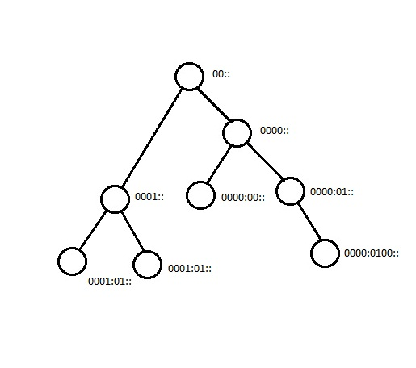
Routing Examples
0001:01:: → 0000:0100::
    0001:01:: → 0001:: → 00:: → 0000:: → 0000:01:: → 0000:0100::

Slide 34
Routing Examples
0000:00:: → 0000:0100::
    0000:00:: → 0000:: → 0000:01:: → 0000:0100::

Slide 35
cBox
Android Connectivity Layer

Slide 36
Android Connectivity
The project's lowest level
It provides the connection between android devices ,android devices-personal computers
Generally it provides the connection between android devices and devices that have installed cbox

Slide 37


Android Connectivity

Slide 38
Android Connectivity
The result for all nodes is the same
A connection between them is established
But the way to achive this differs depending on each nodes specs
We can use either wifi or bluetooth

Slide 39
Android Connectivity
For example
Node A is unable to connect through wifi but it is able to achieve connection via bluetooth
Node B is unable to connect through bluetooth
but is able to achieve connection throuh wifi
In this case a node which is able to connect either via wifi or bluetooth can be the device to connect Node A and Node B in result to make our own network

Slide 40
Android Connectivity
In other words we have a level providing the connection and data transfer between nodes no matter the device specs (bluetooth/wifi)
By this way the upper levels don't have to worry about the connection between nodes and the data transfer

Slide 41
Android Connectivity
The android connectivity level is achieved by having some android services running on the background
User interaction is needed when the user chooses his preferences
(only wifi connection only bluetooth connection
both ,preferences over the content provider)

Slide 42
Android Connectivity
The communication and the information sharing with the upper levels is achieved by messages and using a content provider -sqlite database which is provided on android devices

Slide 43
cBox
Network Abstraction Layer

Slide 44
Network Abstraction Layer
The goal of this layer is to provide the necessary abstraction so that the network interfaces work in a single common way, regardless of the technology of the interface.
Specifically, Ethernet, Bluetooth, Wifi can be used in the same way as the layer abstracts the details of the technology used.

Slide 45
Network Abstraction Layer
We offer to the upper levels a minimalistic API so that the network interfaces work as one.
The API interface consists of simple functions.
The basic idea is to:
enable interface
send/receive
disable interface
no matter what's the network interface we are talking about (bluetooth, wifi, ethernet)

Slide 46
Network Abstraction Layer
The implementation is in C++.
The implementation is developed within WiseLib.
  It exploits C++ feautures (such as templates) to provide platform independent algorithms for distributed systems.
For each network technology, new Radio Interfaces have been developed (the API is provided through these Radio Interfaces) which are utilized by the upper levels to achieve communication between network nodes.

Slide 47
Network Abstraction Layer
Bluez library is used for the Bluetooth module of the layer.
  It offeres unix-like socket interface.
For the Ethernet and Wifi modules, standard posix sockets are used.
Where is plausible TCP protocol is used to achieve network communication, otherwise UDP is used.

