Slide 1
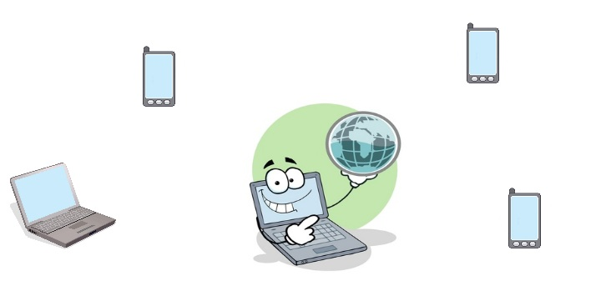
cBox
Problem: services sharing
  Internet, web server, chat, proxy server, ftp server, etc.

Slide 2
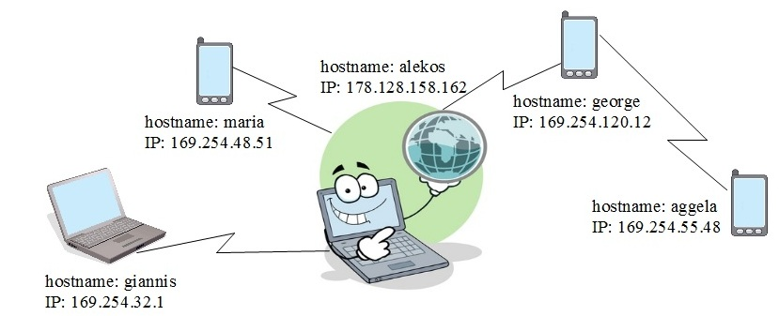
cBox
Solution: Wiselib Implementation of ZeroConf/mDNS protocol.
Each node is characterized by unique IP and hostname.
Implementation of a protocol for sharing services in the network.

Slide 3
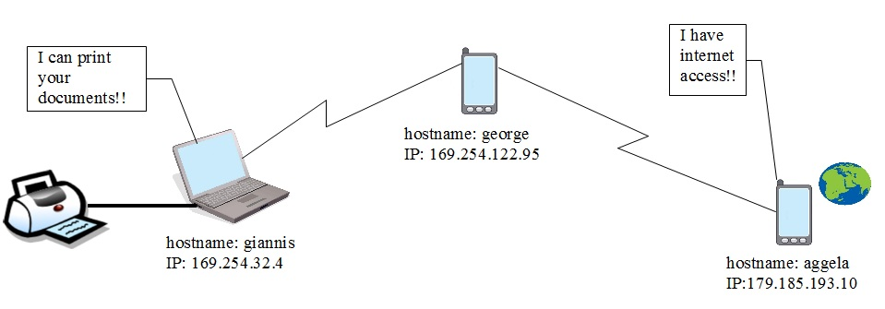
cBox
Variation of the protocol:
  Normally gives random IPs.
  IP – services correspondence

Slide 4
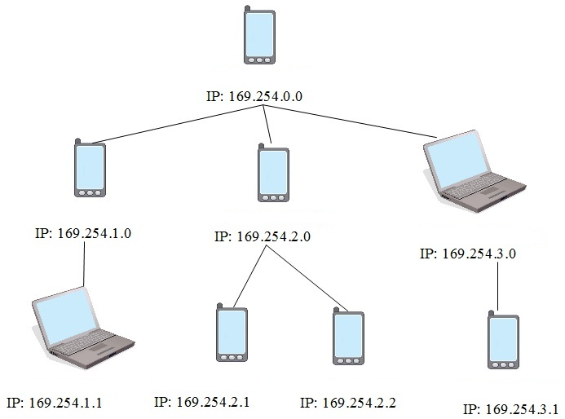
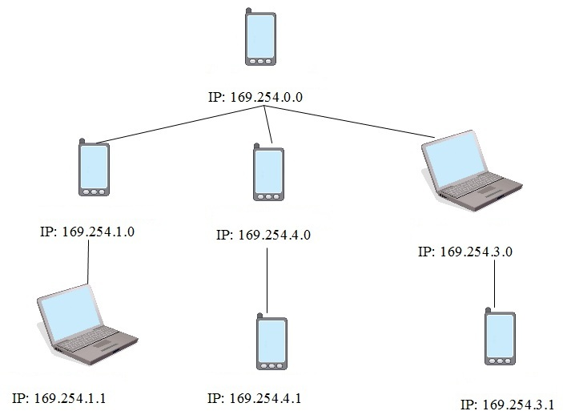
cBox
Routing with subneting:
  IPs are given depending on the location of the device in the tree.
  IPs change easily when the tree is adjusted.

Slide 5
cBox
Problem:
  The IP of a device will change frequently as the node moves inside the network or a node leaves.

Slide 6
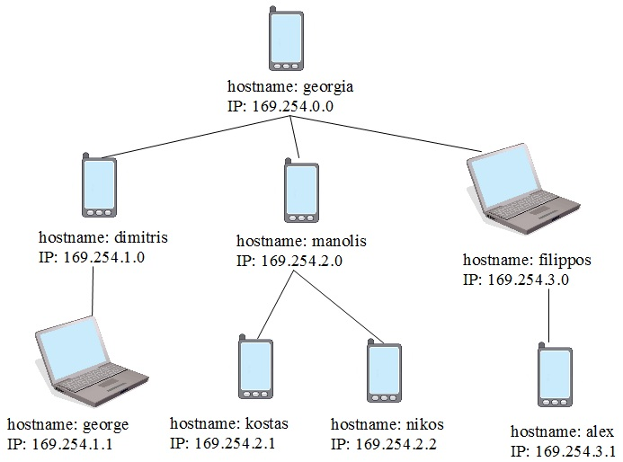
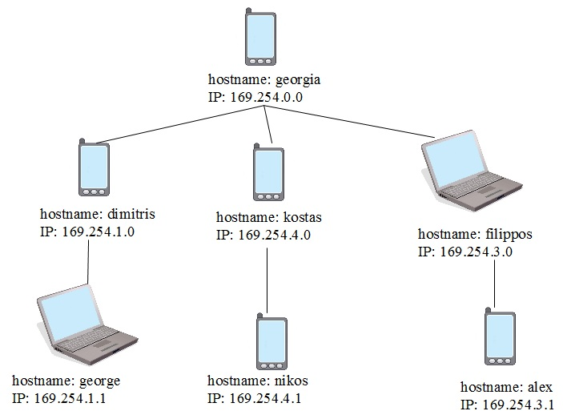
Cbox
Solution:
  Hostnames.
  Service – Hostname mapping.

Slide 7
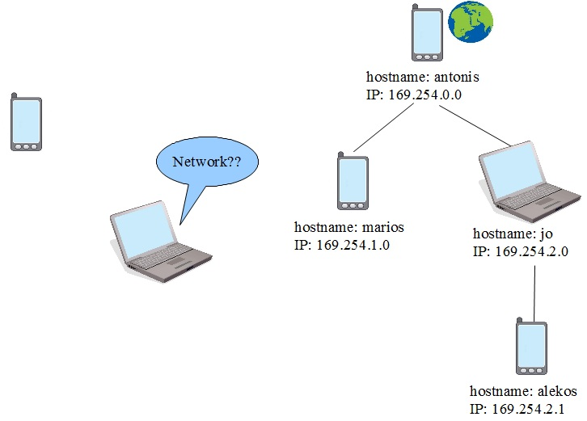
cBox
Workflow
  1) One device that is not in a network, periodically searches for a network.

Slide 8
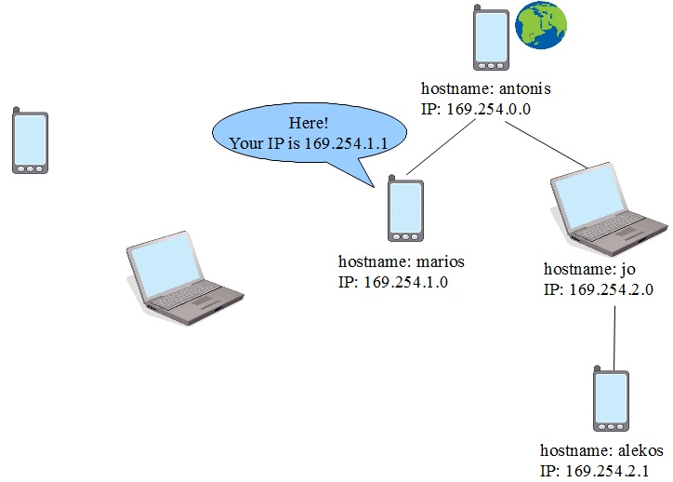
cBox
  2) Receives a response from an other device when and only when it's in a network, with a message that defines the IP which the new node will have in the network.

Slide 9
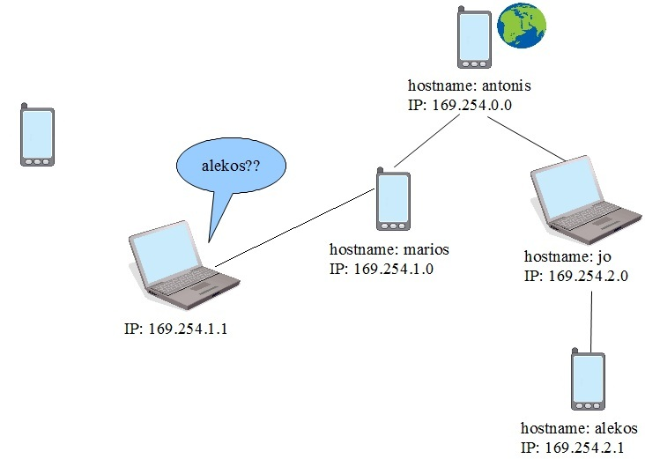
cBox
  3) Selects a hostname and it floods the network to claim it. Receives a reply only from someone who has this hostname.

Slide 10
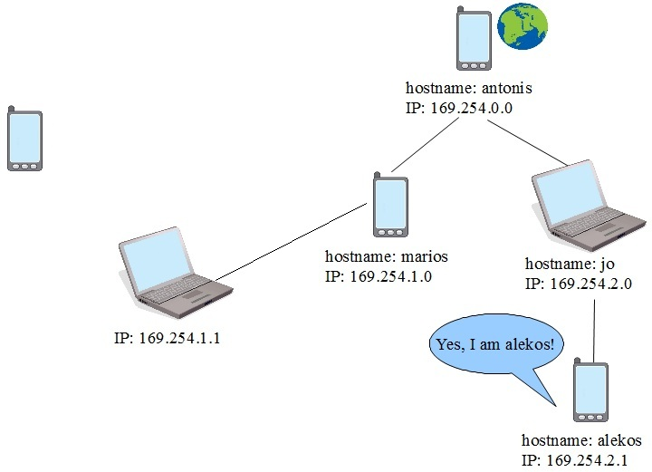
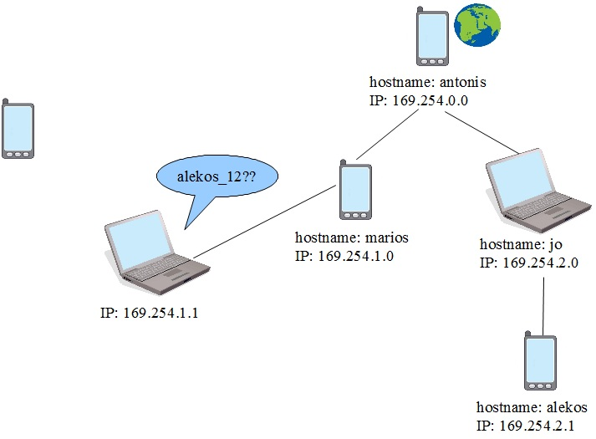
cBox
  4a) If no reply is received after a certain time it enters the network with this hostname and the IP given to it.
  4b) In the case it receives a reply, changes the hostname and tries again.
    alekos → alekos_ΧΧ , where ΧΧ random number

Slide 11
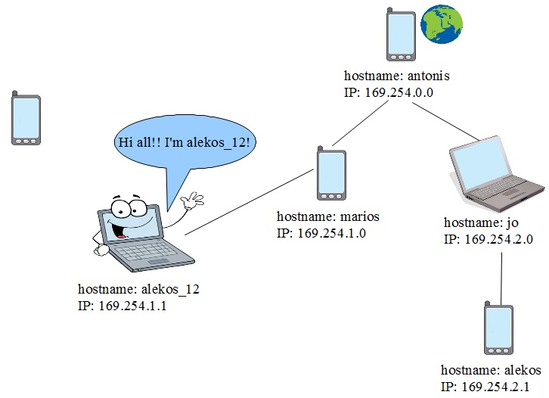
cBox
  When enters the network it announces itself and the services it provides.

