Slide 1
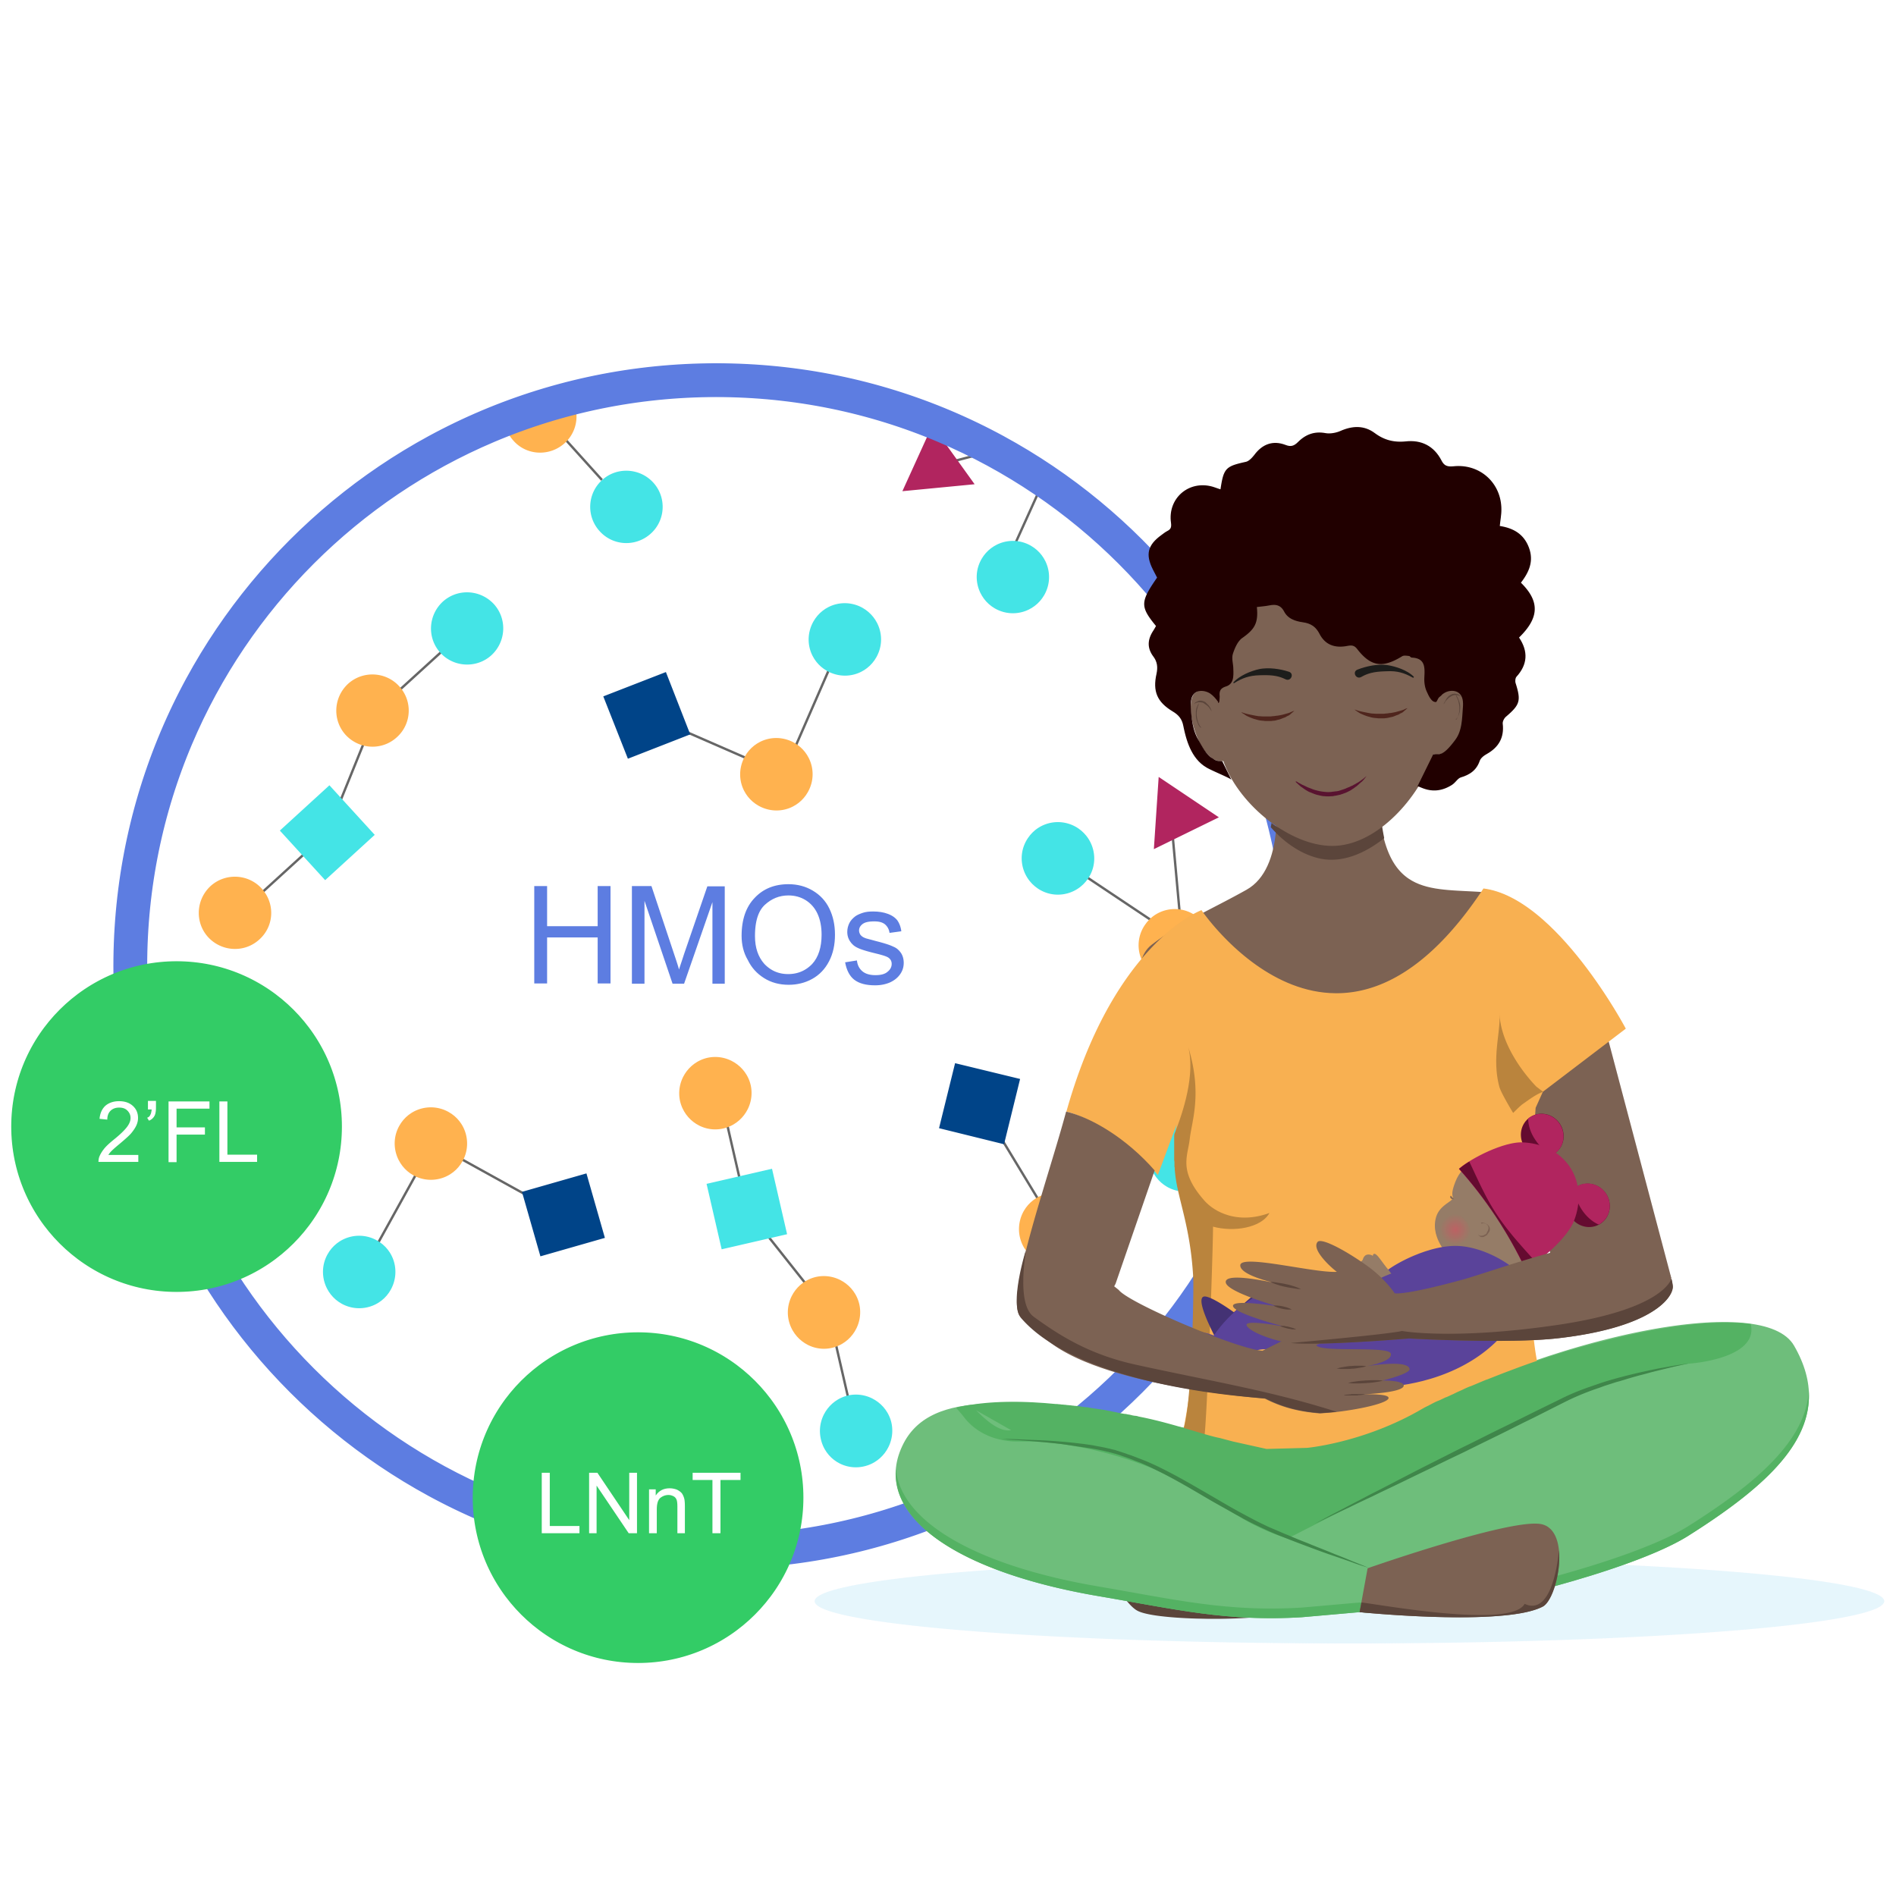
With HMO supplement (2’FL and LNnT), the mean time to reach full enteral feeding was 2 days shorter^{1*翻译内容}
翻译内容
Full enteral feeding^翻译内容
Placebo翻译内容
(n=43)翻译内容
14,3翻译内容
翻译内容
HMO (2’FL, LNnT) supplement 翻译内容
(n=43)翻译内容
12,2翻译内容
2 days shorter翻译内容
0翻译内容
5翻译内容
10翻译内容
15翻译内容
Faster progression to FEF may help reduce the risk of growth restriction and exacerbated gut immaturity¹ 翻译内容
^Time to reach full enteral feeding is a reliable indicator of feeding tolerance翻译内容
2’FL, 2-fucosyllactose; HMO, human milk oligosaccharide; LNnT, Lacto-N-neotetraose.翻译内容
1. Hascoët JM et al., Abstract at WCPGHAN 2021. * Randomised, clinical trial 翻译内容

