Slide 1
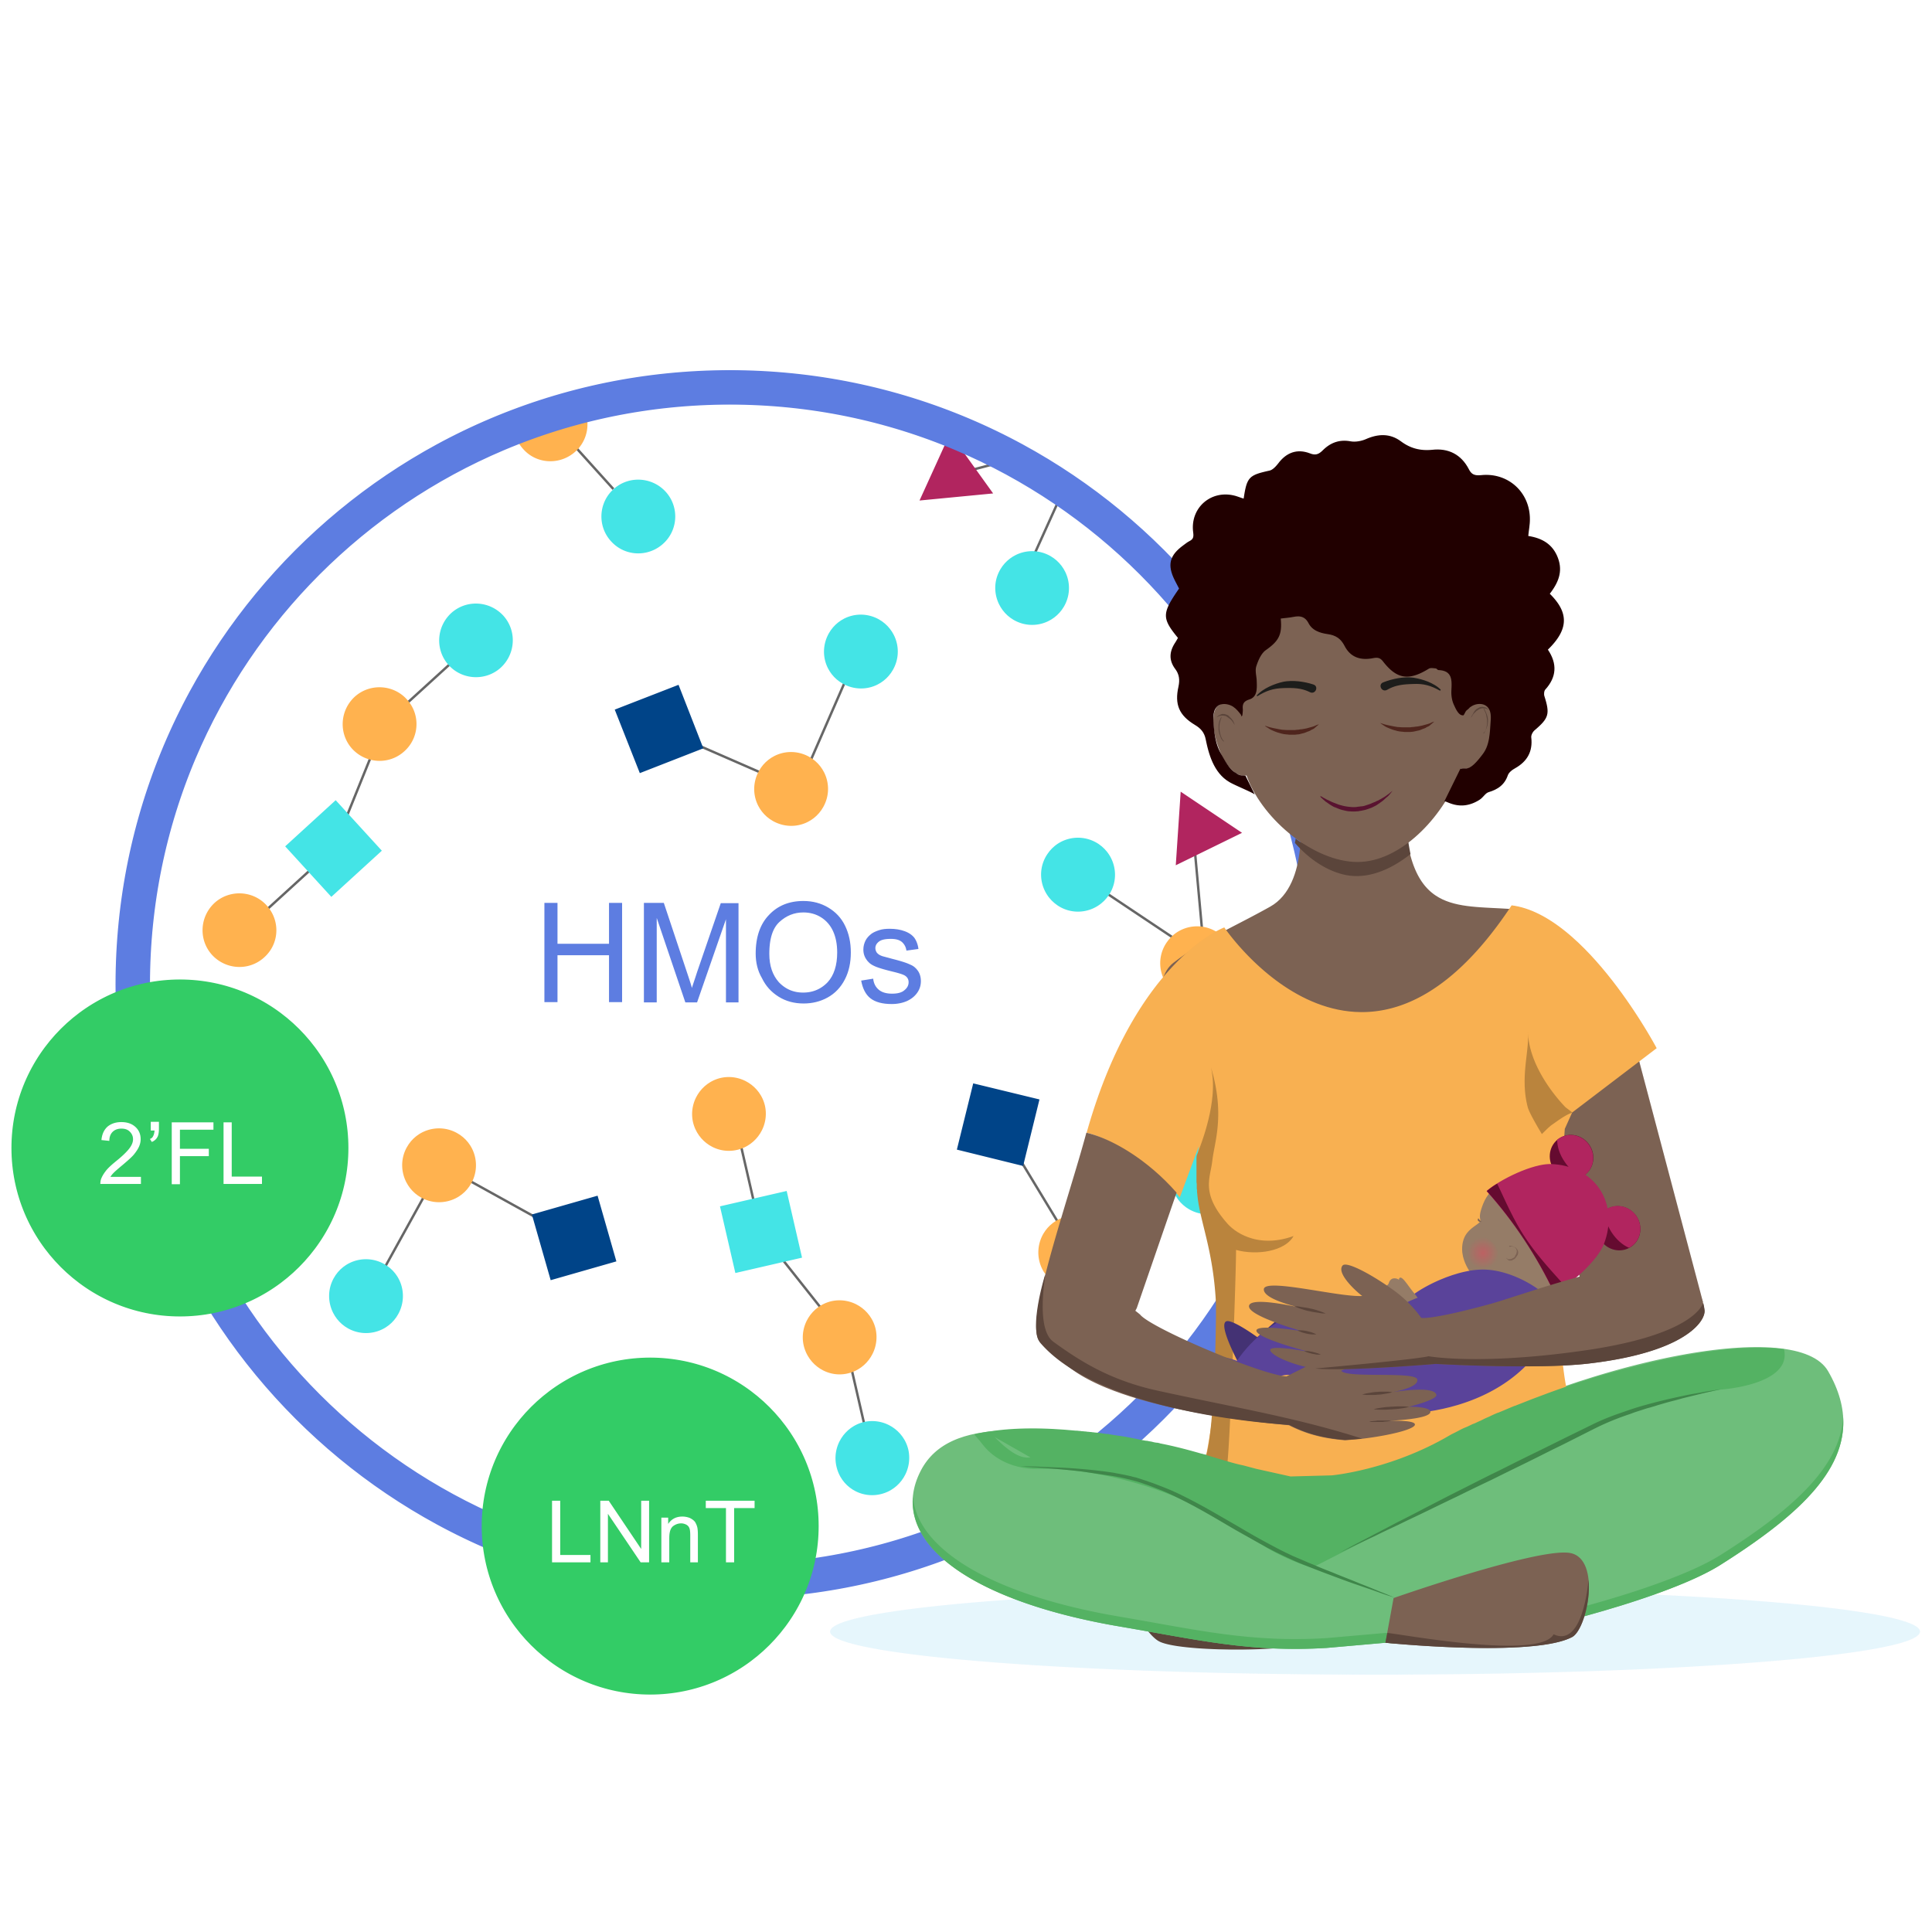
With HMO supplement (2’FL and LNnT), the mean time to reach full enteral feeding was 2 days shorter1* 补充HMO（2’FL和LNnT）后，达到全肠喂养的平均时间缩短了2天1*
第 1 页 OCR识别结果 (英中对照)
========================================
图片 1: image_0001.png
原文:
HMOs 2'FL LNnT
译文:
HMOs 2'FL LNnT
Full enteral feeding^
Placebo
(n=43)
14,3
HMO (2’FL, LNnT) supplement
(n=43)
12,2
2 days shorter
0
5
10
15
Faster progression to FEF may help reduce the risk of growth restriction and exacerbated gut immaturity1 更快地达到全肠喂养可能有助于降低生长受限和肠道不成熟加剧的风险1
^Time to reach full enteral feeding is a reliable indicator of feeding tolerance ^达到全肠喂养的时间是评估喂养耐受性的可靠指标
2’FL, 2-fucosyllactose; HMO, human milk oligosaccharide; LNnT, Lacto-N-neotetraose. 2’FL，2-岩藻糖基乳糖；HMO，人乳寡糖；LNnT，乳-N-新四糖。
1. Hascoët JM et al., Abstract at WCPGHAN 2021. * Randomised, clinical trial 1. Hascoët JM等，WCPGHAN 2021摘要。* 随机临床试验

