Slide 1
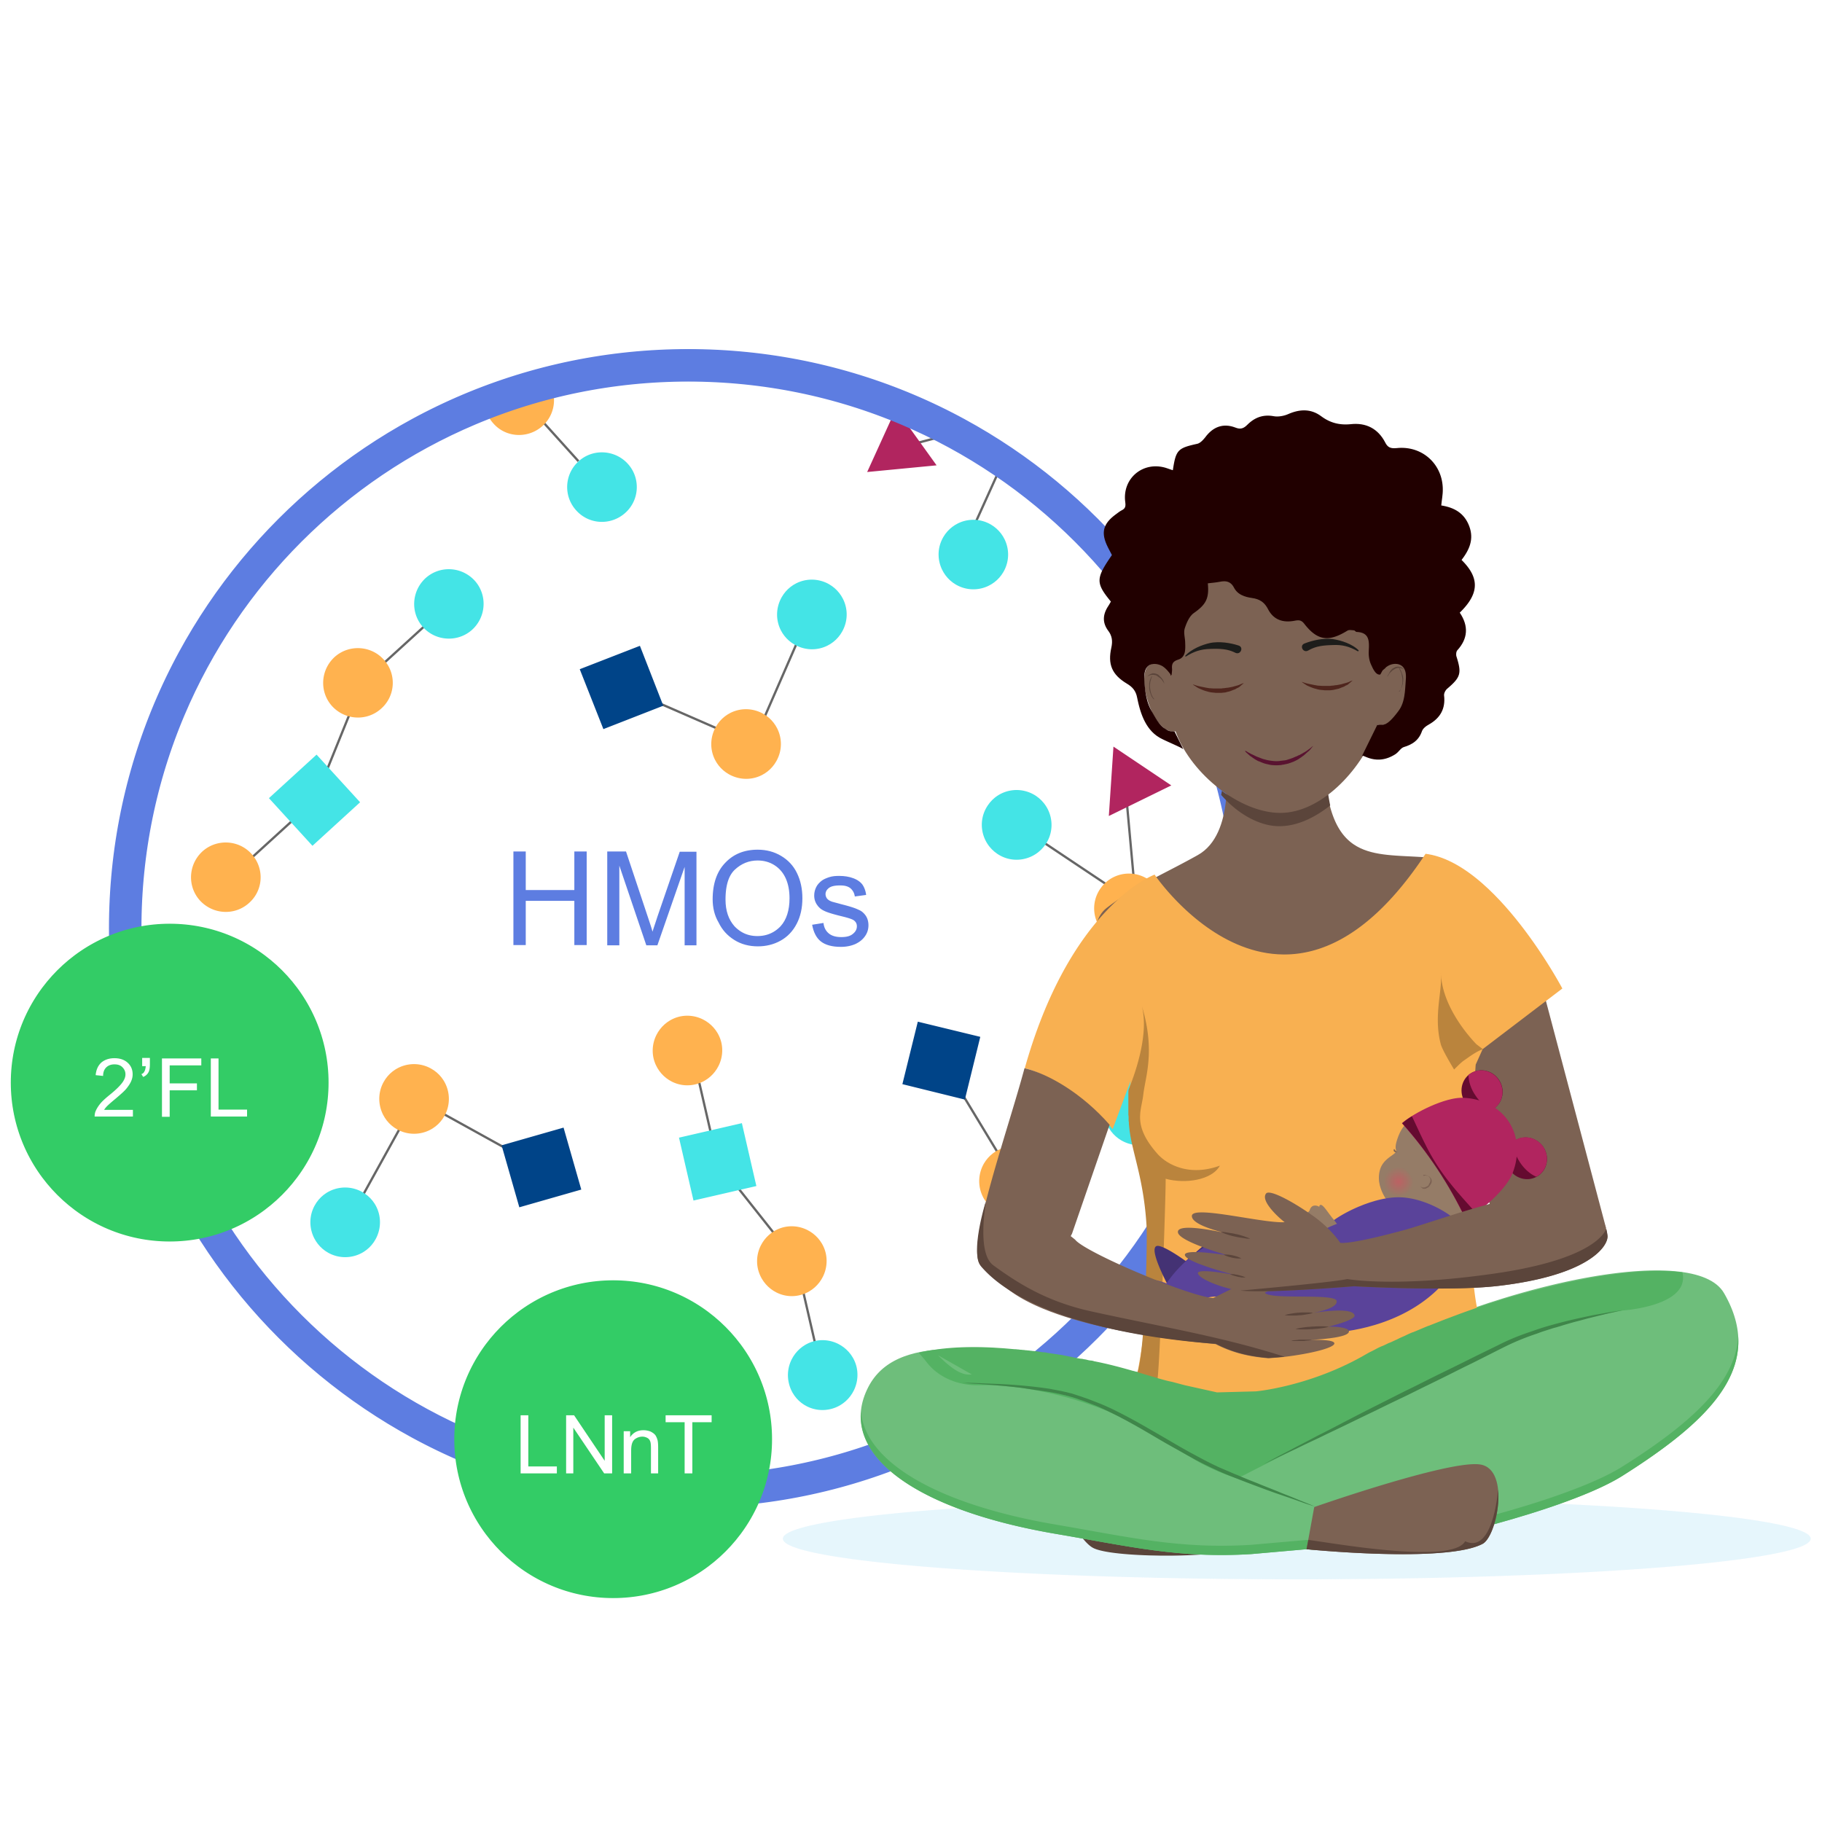
With HMO supplement (2’FL and LNnT), the mean time to reach full enteral feeding was 2 days shorter^{1*}
第 1 页 OCR识别结果 (英中对照)
========================================
图片 1: image_0001.png
原文:
HMOs 2'FL LNnT
译文:
HMOs 2'岩藻糖基乳糖 LNnT
Full enteral feeding^
Placebo
(n=43)
14,3
HMO (2’FL, LNnT) supplement
(n=43)
12,2
2 days shorter
0
5
10
15
Faster progression to FEF may help reduce the risk of growth restriction and exacerbated gut immaturity¹
^Time to reach full enteral feeding is a reliable indicator of feeding tolerance
2’FL, 2-fucosyllactose; HMO, human milk oligosaccharide; LNnT, Lacto-N-neotetraose.
1. Hascoët JM et al., Abstract at WCPGHAN 2021. * Randomised, clinical trial

