Slide 1
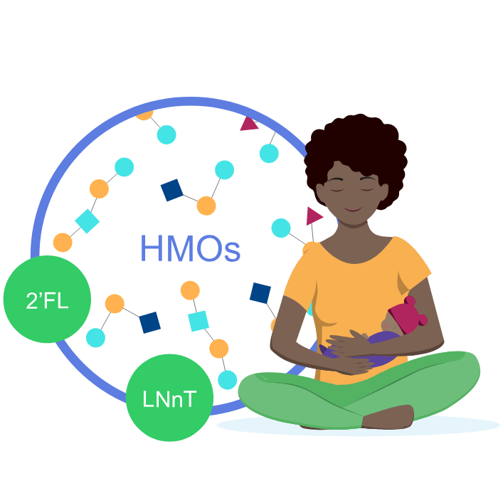
With HMO supplement (2’FL and LNnT), the mean 添加HMO（2’FL和LNnT）后的平均
time to reach full enteral feedingwas 2 days shorter^{1*} 达到全肠内喂养的时间缩短了2天^{1*}
Full enteral feeding^
Placebo
(n=43)
14,3
HMO (2’FL, LNnT) supplement
(n=43)
12,2
2 days shorter
0
5
10
15
Faster progression to FEF may help reduce the risk of growth restriction and exacerbated gut immaturity¹ 更快地进展到FEF可能有助于降低生长受限和肠道不成熟加剧的风险¹
^Time to reach full enteral feeding is a reliable indicator of feeding tolerance ^达到全肠内喂养的时间是喂养耐受性的可靠指标
2’FL, 2-fucosyllactose; HMO, human milk oligosaccharide; LNnT, Lacto-N-neotetraose. 2’FL，2-岩藻糖基乳糖；HMO，人乳寡糖；LNnT，乳-N-新四糖。
1. Hascoët JM et al., Abstract at WCPGHAN 2021. * Randomised, clinical trial 1. Hascoët JM等，WCPGHAN 2021摘要。* 随机临床试验

