Slide 1

Technical session of Vivinal LF recovery in GB method with local customers
与当地客户讨论Vivinal LF在GB方法中的回收技术会议
Feb 17th 2025 │ Beijing│ PAN team │ Benfeng Sun
2025年2月17^{日}北京│PAN团队│孙本峰

Slide 2
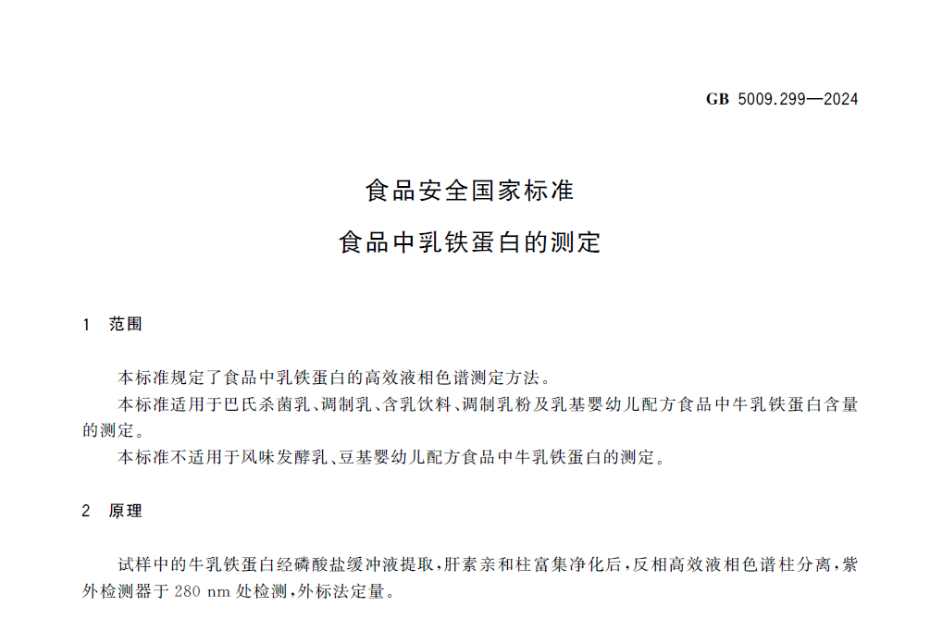
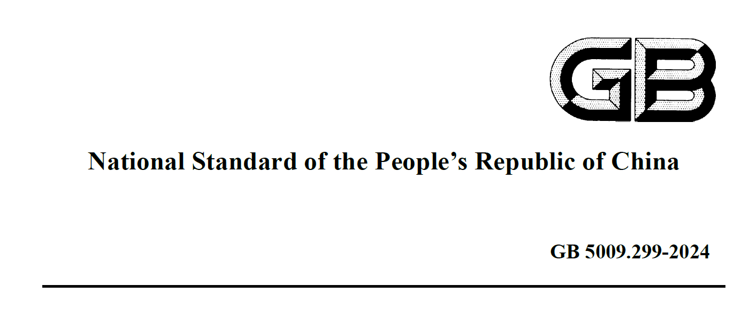
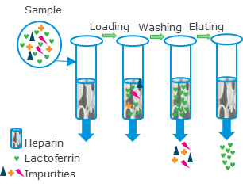
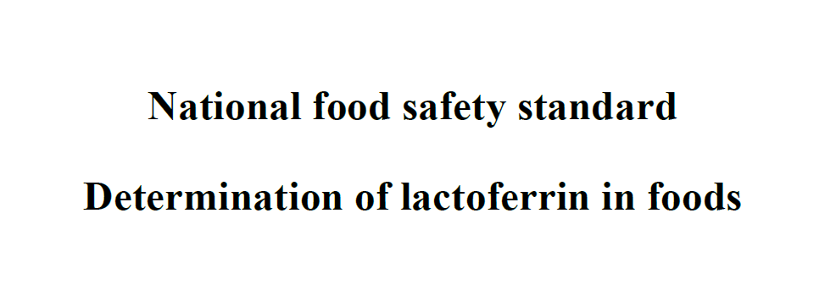
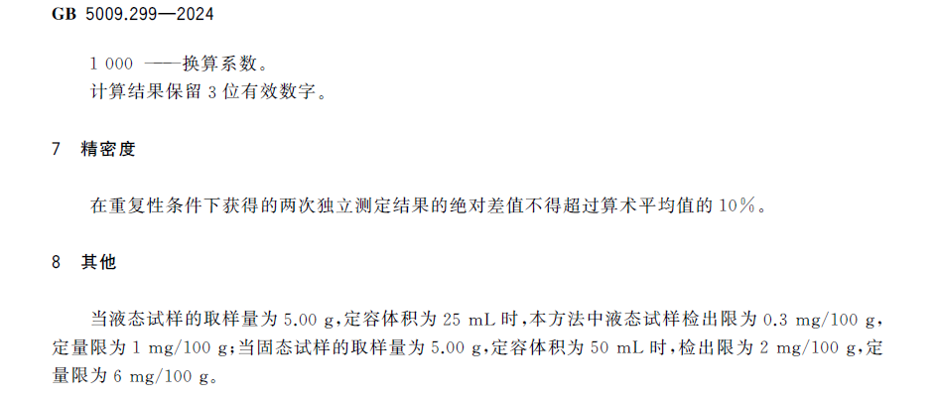
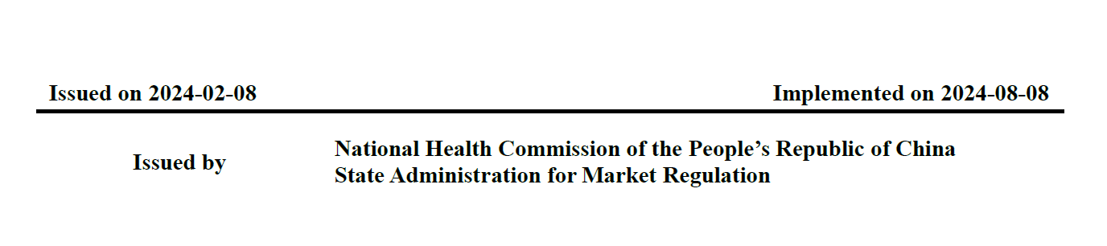
Why: new GB for Lactoferrin determination in food
为什么：新的乳铁蛋白食品测定国家标准
Active LF only
仅活性乳铁蛋白
Notes:
With the new method analyzing LF, SN gets lower results. It is also seen that this differs per supplier.

Slide 3
What: new GB for Lactoferrin determination in food
什么：新的食品中乳铁蛋白测定的 GB
Old situation
旧情况
No analysis in food, based on dosage calculation
没有食品分析，基于剂量计算
New situation
新情况
Different analysis method in raw material LF vs LF in IFT
不同的分析方法：原料乳铁蛋白与IFT中的乳铁蛋白
LF Ingredient
乳铁蛋白成分
GB 1903.17 analysis LF raw material
GB 1903.17 分析乳铁蛋白原料
LF in Infant formula
婴儿配方中的乳铁蛋白
LF level in final product calculated by mass balance:
最终产品中的乳铁蛋白水平通过质量平衡计算得出：
dosage x protein% x purity%
剂量 x蛋白质%x纯度%
Total LF
总乳铁蛋白
LF Ingredient
乳铁蛋白成分
GB 1903.17 analysis LF raw material
GB 1903.17 分析乳铁蛋白原料
LF in infant formula
婴儿配方中的乳铁蛋白
GB 5009.229 LF in food
GB 5009.229 食品中的乳铁蛋白
IFT
Total ingredient LF
总成分乳铁蛋白
% protein
蛋白质%
Total ingredient LF
总成分乳铁蛋白
% protein
蛋白质%
% LF on protein
蛋白质上的乳铁蛋白%
% LF on protein
蛋白质上的乳铁蛋白%
Total LF
总乳铁蛋白
Total LF
总乳铁蛋白
Active LF
活性乳铁蛋白
only
仅
Active LF
活性乳铁蛋白
only
仅
>93%
>93%
=spec
=规格
>95%
>95%
=spec
=规格
= GB
= GB
requirement
要求
>95%
>95%
=spec
=规格
>95%
>95%
=spec
=规格
= GB
= GB
requirement
要求
Set spec with supplier
与供应商确定规格
Challenge:
挑战:
Calculated %total LF (purity x protein) in ingredient does not predict the active lactoferrin level analyzed/recovered in food matrix
计算的原料中总乳铁蛋白百分比（纯度 x 蛋白质）无法预测食品基质中分析/回收的活性乳铁蛋白水平
Notes:
With the new method analyzing LF, SN gets lower results. It is also seen that this differs per supplier.

Slide 4
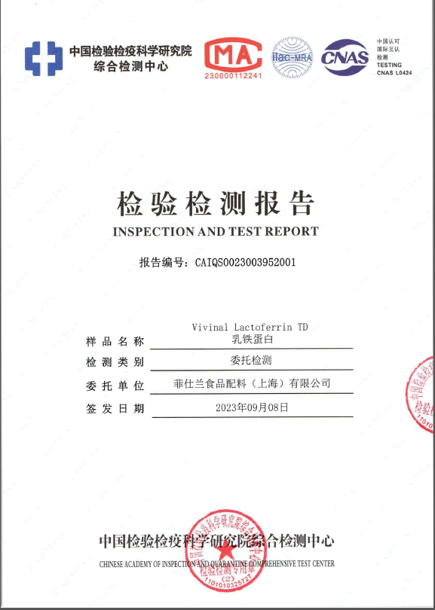
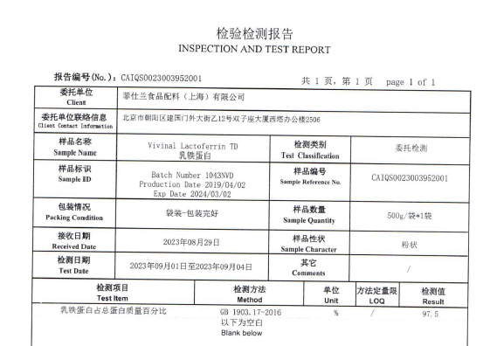
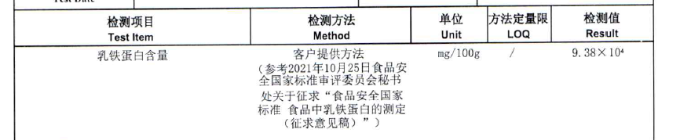
Where: method for the recovery of lactoferrin in the ingredient via CAIQ
方法：通过CAIQ在原料中回收乳铁蛋白的方法
LF/100g protein (heparin collected LF)
LF/100g 蛋白质（肝素收集的LF）
% LF in native structure =
天然结构中的LF百分比 =
LF/100g protein (Total LF)
LF/100g 蛋白质（总LF）
% of LF collected by heparin
肝素收集的LF百分比
93.8%/97.5% = 96.20%
93.8%/97.5% = 96.20%
Error bar: one standard deviation. n = 7 (Veghel); 43 (LEV); 7 (UDAD)
误差条：一个标准差。n = 7 (Veghel); 43 (LEV); 7 (UDAD)
Notes:
With the new method analyzing LF, SN gets lower results. It is also seen that this differs per supplier.

Slide 5
Where: FCI scores very well compared to competitors in the market
市场表现：FCI相比竞争对手得分非常高
Company 公司 |  | Iron binding capacity 铁结合能力 | DSC 差示扫描量热法 (DSC) | E. Coli Inhibition 大肠杆菌抑制
Veghel 维赫尔 | Spray 喷雾 | ++ | +++ | ++
UDAD | Spray | ++ | +++ | +
Competitor 1 竞争对手 1 | Freeze 冷冻 | - | -- | ++
Competitor 2 竞争对手 2 | Spray | ++ | -- | --
Competitor 3 竞争对手 3 | Spray | + | ++ | -
Competitor 4 竞争对手 4 | Freeze | + | +- | -
Competitor 5 竞争对手 5 | Spray | + | + | +
Competitor 6 竞争对手 6 | Freeze | + | + | +
Competitor 7 竞争对手 7 | Freeze | +++ | ++ | +++
Ranked from good (+++) to bad (---) performance
从优秀（+++）到较差（---）进行排名
For internal use only *Data based on own benchmark study results
仅供内部使用*数据基于我们自己的基准研究结果
Notes:
With the new method analyzing LF, SN gets lower results. It is also seen that this differs per supplier.

Slide 6
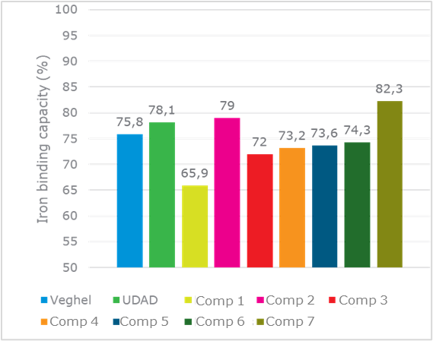
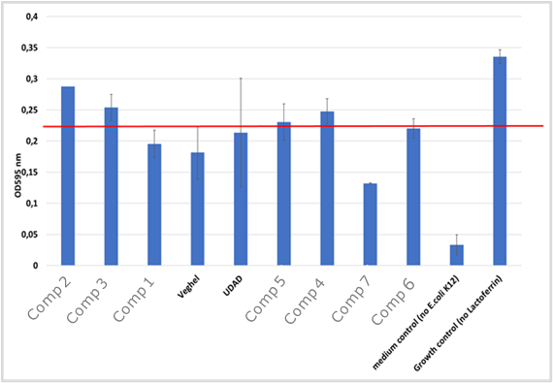
Where: No difference observed in functionality between spray dried and freeze dried lactoferrin
地点：喷雾干燥乳铁蛋白和冷冻干燥乳铁蛋白的功能没有差异
Company 公司
Veghel 维赫尔 | Spray 喷涂
UDAD | Spray
Competitor 1 竞争对手1 | Freeze 冷冻
Competitor 2 竞争对手2 | Spray
Competitor 3 竞争对手3 | Spray
Competitor 4 竞争对手4 | Freeze
Competitor 5 竞争对手5 | Spray
Competitor 6 竞争对手6 | Freeze
Competitor 7 竞争对手7 | Freeze
Iron binding capacity
铁结合能力
E coli inhibition
大肠杆菌抑制
Notes:
With the new method analyzing LF, SN gets lower results. It is also seen that this differs per supplier.

Slide 7


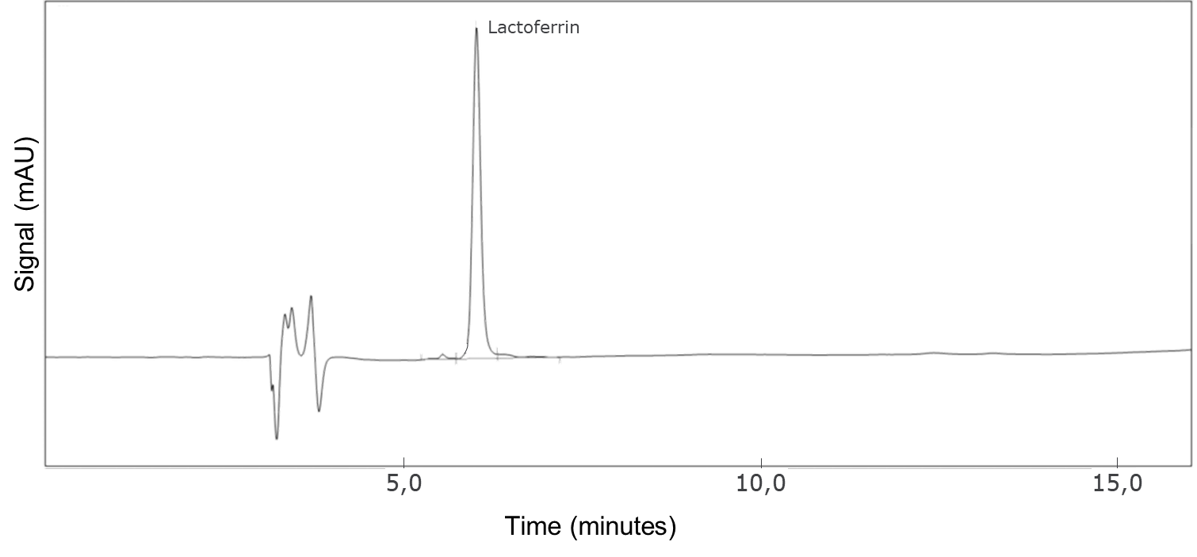

Where: method for the recovery of lactoferrin in the food through customer
方法：通过客户在食品中回收乳铁蛋白
Simplified procedure LF recovery by heparin affinity chromatography followed by quantification with HPLC
简化程序：通过肝素亲和色谱回收LF，随后用HPLC进行定量
Quantify by external calibration standard
通过外部校准标准进行定量
Result: active LF in product
结果：产品中的活性LF
Dissolve in buffer
溶解在缓冲液中
Separate active LF from other ‘impurities’
将活性LF与其他‘杂质’分离
Filter solution into HPLC vial
将溶液过滤到HPLC小瓶中
Analyze filtrates & external calibrant RP-HPLC-UV280 C4 column
分析滤液和外部校准剂RP-HPLC-UV280 C4柱
Which type of heparin column do you use? (Meizheng, Gangyannake, GE healthcare, Anpel,..)
您使用哪种类型的肝素柱？(美正，刚研纳克，GE医疗，安谱，...)
which LF standard do you use to quantify? (Meizheng, Gangyannake, Cerriliant, Fujifilm wako, ..)
您使用哪种LF标准品进行定量？(美正，刚研纳克，赛瑞利安特，富士胶片和光，...)
Do you add anything to the buffer? Like a ‘lactoferrin extraction reagent’ or was nothing extra added compared to the GB protocol?
您是否向缓冲液中添加了任何物质？例如‘乳铁蛋白提取试剂’，还是与GB协议相比没有添加任何额外物质？
Did you investigate any optimizations in this method? Any insights from local authority to optimize this GB method?
您是否研究了此方法的任何优化？当地机构是否有任何见解来优化此GB方法？
Challenge:
挑战：
How can this method be optimized during sample preparation using lactoferrin extraction reagent with a local supplier? We found that the recoveries can vary by 10% depending on the matrix and that these matrix differences are reduced by the addition of e.g. Tween. We will publish data in 2025 to support an improved method (with Tween) that better represents the recoveries.
如何在样品制备过程中使用本地供应商提供的乳铁蛋白提取试剂来优化此方法？我们发现回收率可能因基质而异，相差可达10%，并且通过添加例如Tween可以减少这些基质差异。我们将在2025年发布数据，以支持一种改进的方法（使用Tween），更好地代表回收率。
Notes:
With the new method analyzing LF, SN gets lower results. It is also seen that this differs per supplier.

Slide 8
Where: Vivinal LF Recovery percentage with customers's base powder before and after with extraction agent, below data only for internal use
地点：使用客户基础粉末在添加萃取剂前后Vivinal LF 回收率的百分比,以下数据仅供内部使用
LF LEV with batch 10C5T15 spiked on: 批号10C5T15的LF LEV加标： | LF Recovery in IFT(%) IFT中LF的回收率（%） | LF Recovery in IFT(%) |  | LF Recovery in IFT(%)
 | Internal method: FLCV0528 - LF spike recovery before use Meizheng 内部方法：FLCV0528 - 使用美正柱前的LF加标回收 | Only using the Meizheng column (without extraction agent), results are much lower 仅使用美正柱（不加萃取剂），结果显著偏低 | Gap compared to FLCV0528 - LF spike recovery 与FLCV0528 - LF加标回收的差距 | Both of Meizheng column + Meizheng buffer (including extraction agent) 美正柱 + 美正缓冲液（含萃取剂） | Gap compared to FLCV0528 - LF spike recovery | Gap compared to without extraction agent) 与不加萃取剂的差距
Reference LQS HK IFT 参考LQS HK IFT | 78.3 | 76.6 | -2% | 87.2 | 11% | 14%
1. Feihe 1. 飞鹤 | 83 | 75.8 | -9% | 89.9 | 8% | 19%
2. Junglebao 2. 金领冠 | 81.9 | 77.3 | -6% | 88.5 | 8% | 14%
3. Beingmate 3. 贝因美 | 77.6 | 73.8 | -5% | 89.2 | 15% | 21%
4. Synutra 4. 宜品 | 72.8 | 68.8 | -5% | 86.3 | 19% | 25%
5. Huishan 5. 惠氏 | 78.4 | 75.6 | -4% | 88.7 | 13% | 17%
6. Yili 6. 伊利 | 77.3 | 75 | -3% | 87.2 | 13% | 16%
Average 平均值 | 78.5 | 74.7 | -5% | 88.1 | 12% | 18%
Notes:
With the new method analyzing LF, SN gets lower results. It is also seen that this differs per supplier.

Slide 9
Where: Vivinal LF Recovery percentage with customers's base powder before and after with extraction agent, below data only for external use
地点：加入提取剂前后客户基础粉末中的Vivinal LF 回收率,以下数据仅供外部使用
LF LEV with batch 10C5T15 spiked on: 批号10C5T15的LF LEV加标： | LF Recovery in IFT(%) IFT中LF的回收率(%)
 | Both of Meizheng column + Meizheng buffer (including extraction agent) 美正柱 + 美正缓冲液（包括提取剂）
Reference LQS HK IFT 参照LQS HK IFT | 87.2
1. Base powder 1. 基粉 | 89.9
2. Base powder 2. 基粉 | 88.5
3. Base powder 3. 基粉 | 89.2
4. Base powder 4. 基粉 | 86.3
5. Base powder 5. 基粉 | 88.7
6. Base powder 6. 基粉 | 87.2
Average 平均值 | 88.1
Notes:
With the new method analyzing LF, SN gets lower results. It is also seen that this differs per supplier.

Slide 10
Where: Competitor benchmark study shows that the type of drying does not have a direct impact on the recovery of lactoferrin in IFT
在哪里：竞争对手基准研究表明，干燥类型对IFT中乳铁蛋白的回收没有直接影响
Spray / Freeze dried 喷雾干燥/冷冻干燥 | LF recovery in IFT (g/100g) IFT 中的 LF 回收率 (g/100g)
Freeze dried 冷冻干燥 | 92,6
Spray dried 喷雾干燥 | 92,4
Spray dried | 90,7
Freeze dried | 89,6
Freeze dried | 88,4
Spray dried | 85,9
Spray dried | 81,6
Freeze dried | 76,9
Notes:
With the new method analyzing LF, SN gets lower results. It is also seen that this differs per supplier.

Slide 11
How: Characteristics and biofunctionality of lactoferrin are different
如何：乳铁蛋白的特性和生物功能不同
Supplier 供应商 | Purity (PAGE) 纯度 (PAGE) | Endotoxin present 内毒素存在 | In vitro digested 体外消化 | LF uptake LF 吸收 | Iron uptake from LF 从 LF 中吸收铁 | Proliferation 增殖 | Differentiation 分化 | IL-18 secretion IL-18 分泌 | EPEC inhibition EPEC 抑制
RFC | ++ | - | + | ++ | ++ | +++ | +++ | +++ | +++
1 | +++ | ++ | ++ | +++ | +++ | + | ++ | +++ | +++
2 | + | +/- | + | + | ++ | ++ | +++ | ++ | +++
3 | + | - | + | ++ | + | + | ++ | +++ | ++
4 | ++ | ++ | ++ | + | ++ | +++ | +++ | ++ | ++
5 | +/- | ++ | + | + | ++ | ++ | ++ | +++ | +
6 | + | + | ++ | ++ | ++ | ++ | ++ | ++ | ++
7 | +/- | ++ | ++ | + | +++ | ++ | ++ | +++ | ++
8 | +/- | ++ | ++ | + | ++ | ++ | ++ | ++ | ++
9 | - | ++ | +/- | + | + | + | ++ | ++ | ++
Best 最佳 | Runner up 亚军 | Rest 其余
Based on Lönnerdal, Biochemistry & Cell Biology, July 2020
基于 Lönnerdal，《生物化学与细胞生物学》，2020年7月
Notes:
With the new method analyzing LF, SN gets lower results. It is also seen that this differs per supplier.

