Slide 1
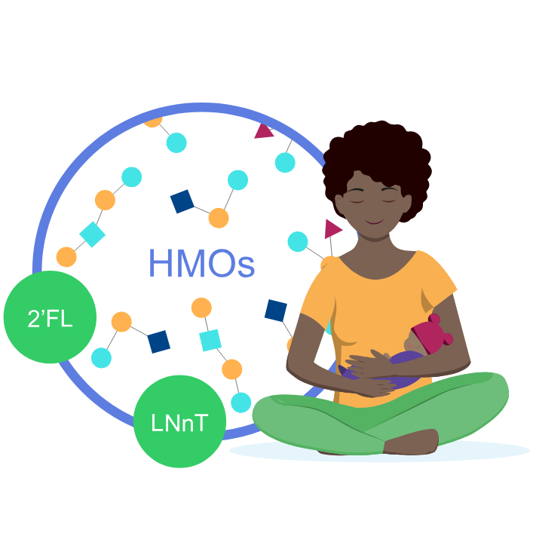
With HMO supplement (2’FL and LNnT), the mean 添加HMO（2’FL和LNnT）后，平均
time to reach full enteral feedingwas 2 days shorter^{1*} 达到全肠内喂养的时间缩短了2天1*
Full enteral feeding^
Placebo
(n=43)
14,3
HMO (2’FL, LNnT) supplement
(n=43)
12,2
2 days shorter
0
5
10
15
Faster progression to FEF may help reduce the risk of growth restriction and exacerbated gut immaturity¹ 更快地进展到全肠内喂养可能有助于降低生长受限和肠道不成熟加剧的风险¹
^Time to reach full enteral feeding is a reliable indicator of feeding tolerance ^达到全肠内喂养的时间是评估喂养耐受性的可靠指标
2’FL, 2-fucosyllactose; HMO, human milk oligosaccharide; LNnT, Lacto-N-neotetraose. 2’FL，2-岩藻糖基乳糖；HMO，人乳低聚糖；LNnT，乳-N-新四糖。
1. Hascoët JM et al., Abstract at WCPGHAN 2021. * Randomised, clinical trial 1. Hascoët JM等，WCPGHAN 2021摘要。* 随机临床试验

