Slide 1
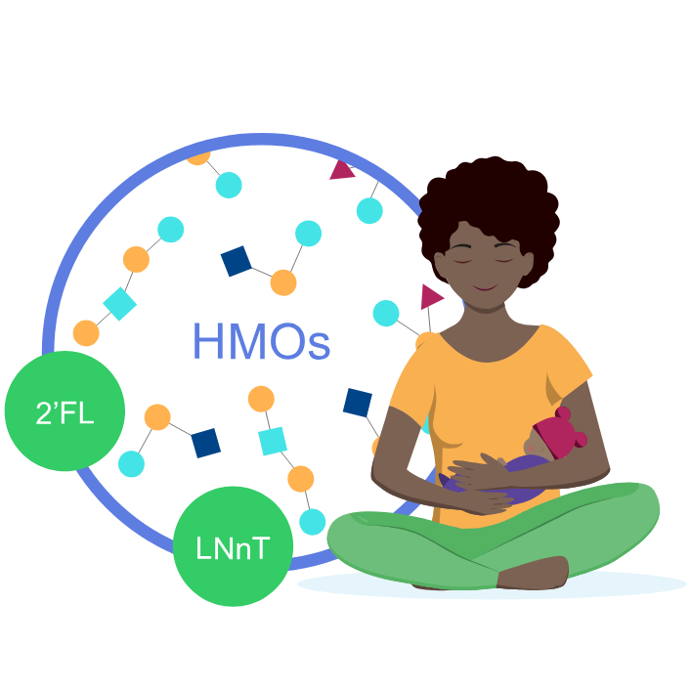
With HMO supplement (2’FL and LNnT), the mean time to reach full enteral feeding was 2 days shorter1*
添加HMO（2’FL和LNnT）后，达到全肠内喂养的平均时间缩短了2天1*
Full enteral feeding^
Placebo
(n=43)
14,3
HMO (2’FL, LNnT) supplement
(n=43)
12,2
2 days shorter
0
5
10
15
Faster progression to FEF may help reduce the risk of growth restriction and exacerbated gut immaturity1
更快地达到FEF可能有助于降低生长受限和肠道不成熟加剧的风险1
^Time to reach full enteral feeding is a reliable indicator of feeding tolerance
^达到全肠内喂养的时间是喂养耐受性的可靠指标
2’FL, 2-fucosyllactose; HMO, human milk oligosaccharide; LNnT, Lacto-N-neotetraose.
2’FL，2-岩藻糖基乳糖；HMO，人乳低聚糖；LNnT，乳-N-新四糖。
1. Hascoët JM et al., Abstract at WCPGHAN 2021. * Randomised, clinical trial
1. Hascoët JM等，WCPGHAN 2021摘要。* 随机临床试验

