Slide 1
Pre-processing of scRNAseq data: steps, motivations and limitations
Etienne Becht
scRNAseq OPEN group
co-organized by
Carte d’Identité des Tumeursm ESPCI and Institut Curie

Slide 2
Start with a UMI-deduplicated count matrix and do the following
Cells
counts_matrix
seurat_object = NormalizeData(counts_matrix) %>%
FindVariableFeatures() %>%
ScaleData() %>%
RunPCA()
What just happened?!
Genes

Slide 3
Why should you care?
Seurat is great to quickly analyze your data!
You should however be wary to not use it as a black box.

Slide 4
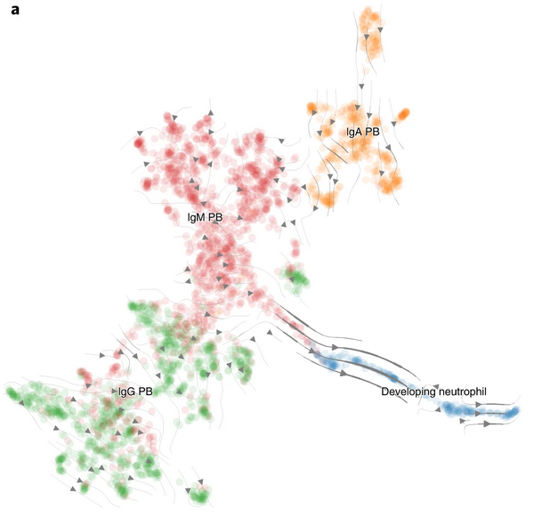
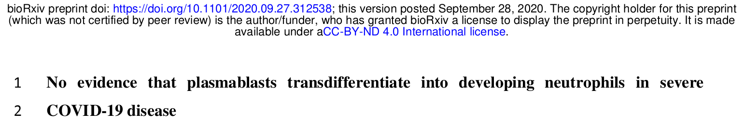
B cells are unlikely to transdifferentiate into neutrophils ...
Wilk et al, Nature Medicine, 2020
Alquicira-Hernandez et al, preprint

Slide 5
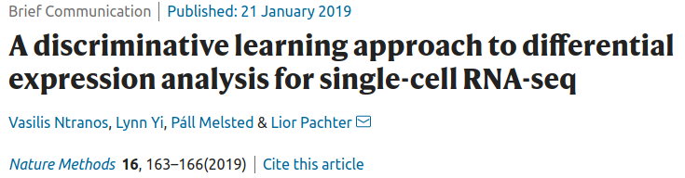
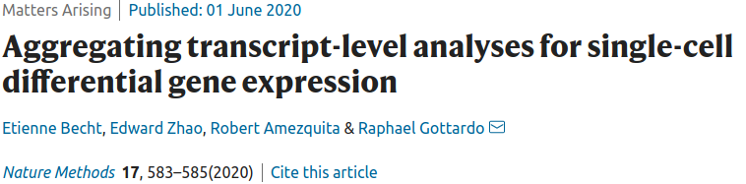
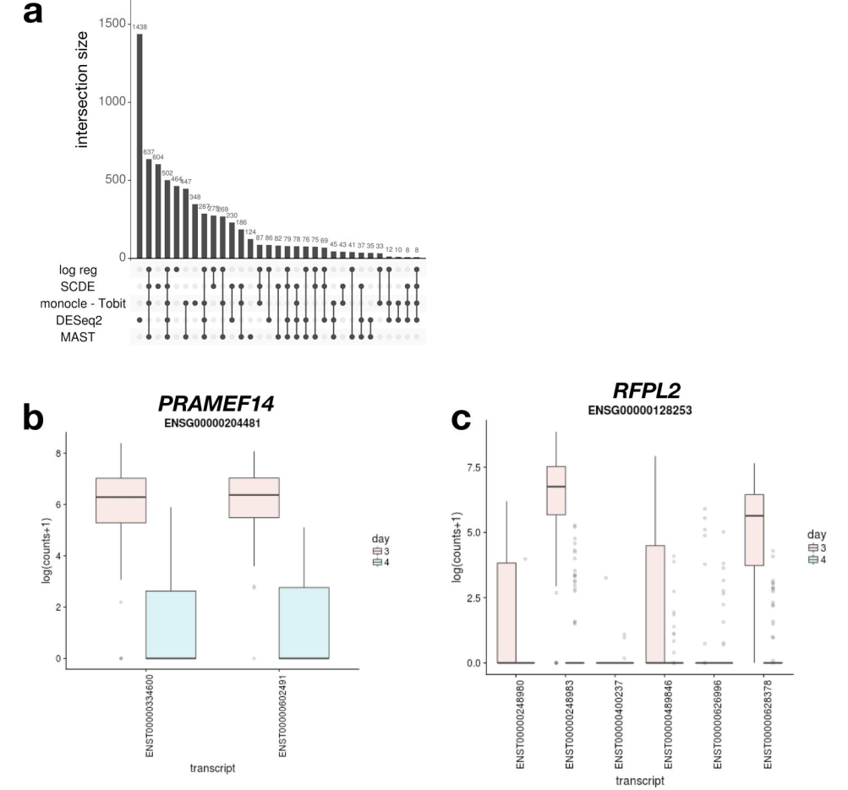
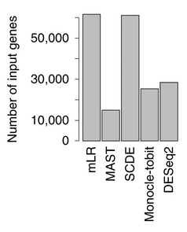
Seurat can have an unexpected behaviour
Methods ran using Seurat

Slide 6
Preprocessing with Seurat
seurat_object = NormalizeData(counts_matrix) %>% FindVariableFeatures() %>%
ScaleData() %>% RunPCA()
Counts
NormalizeData
“Library size”
“Var. stabiliz.”
FindNeighbors+ FindClusters
FindAllMarkers
Variable features
“High” CV
ScaleData
Z-score
RunPCA
Approx. SVD
RunUMAP

Slide 7
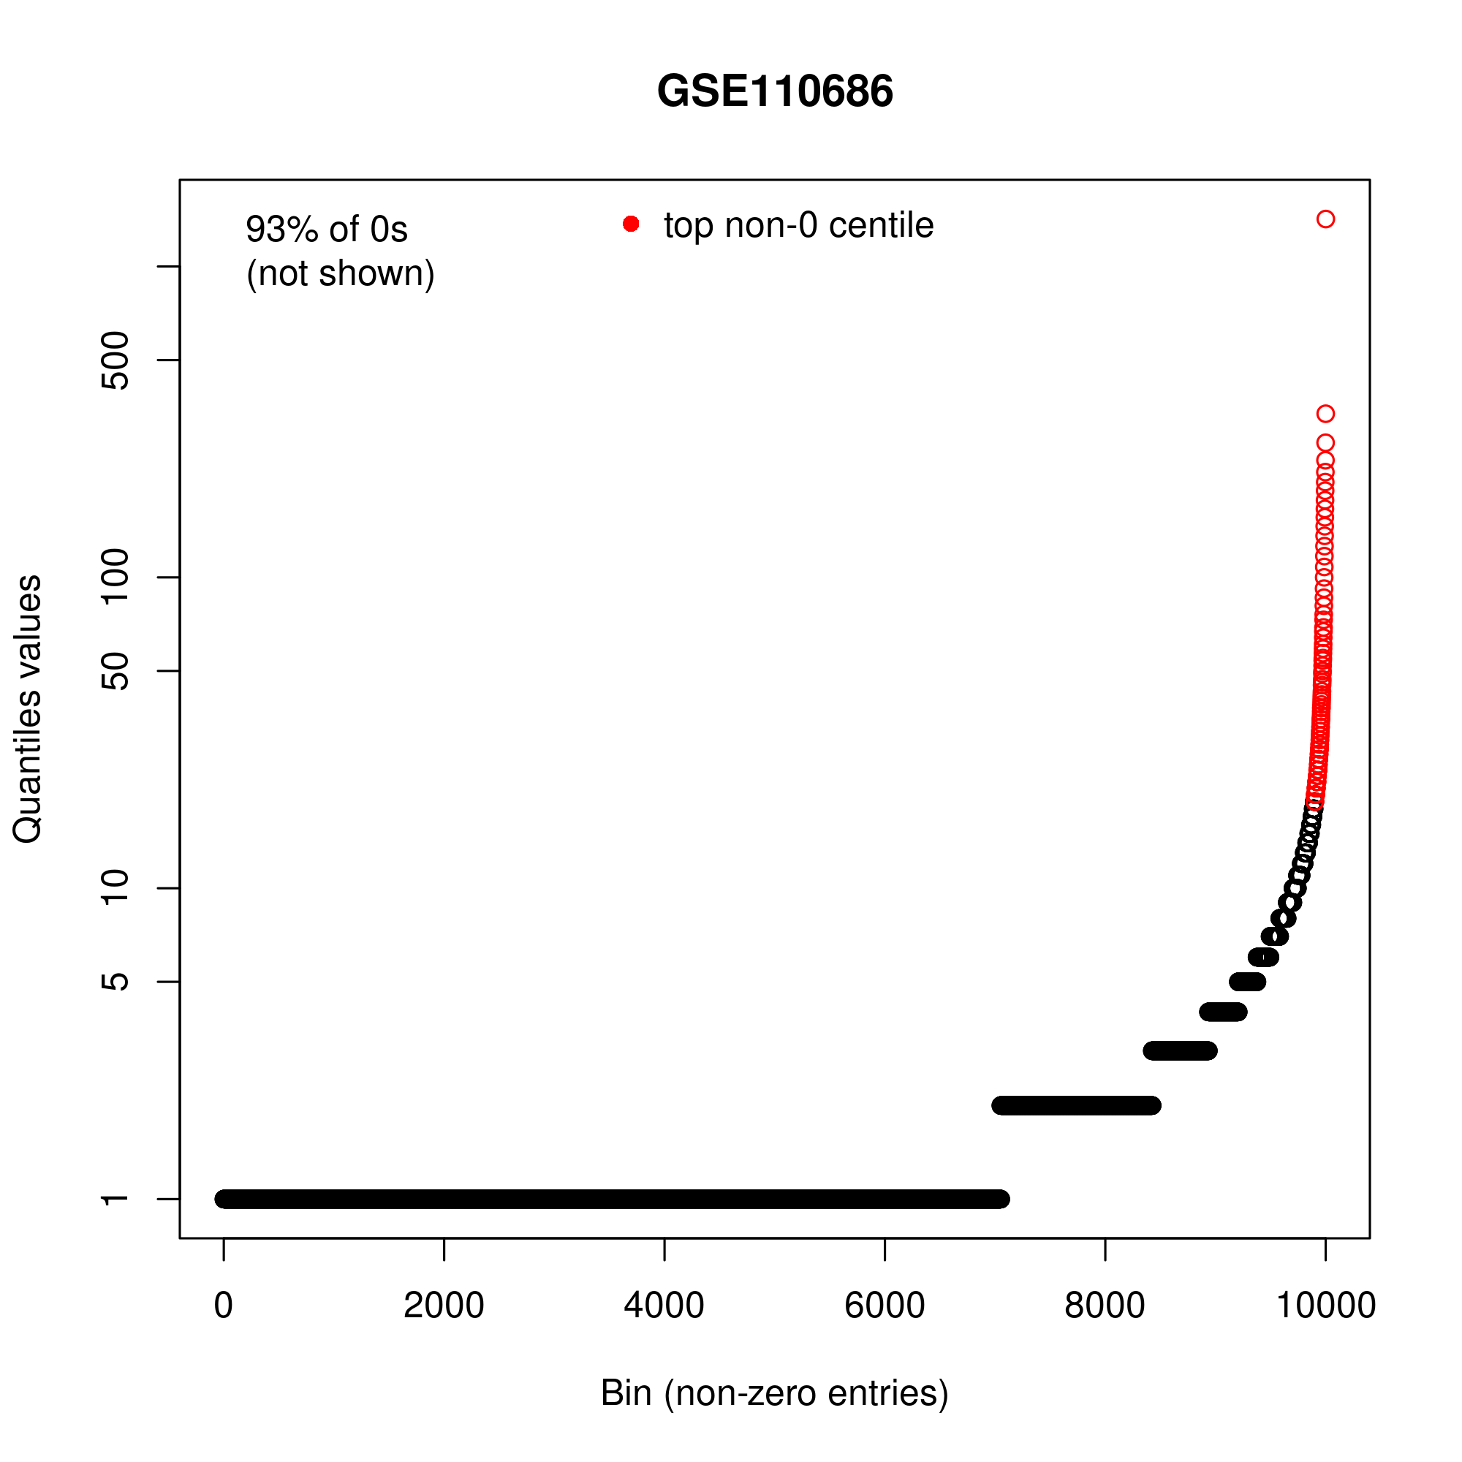
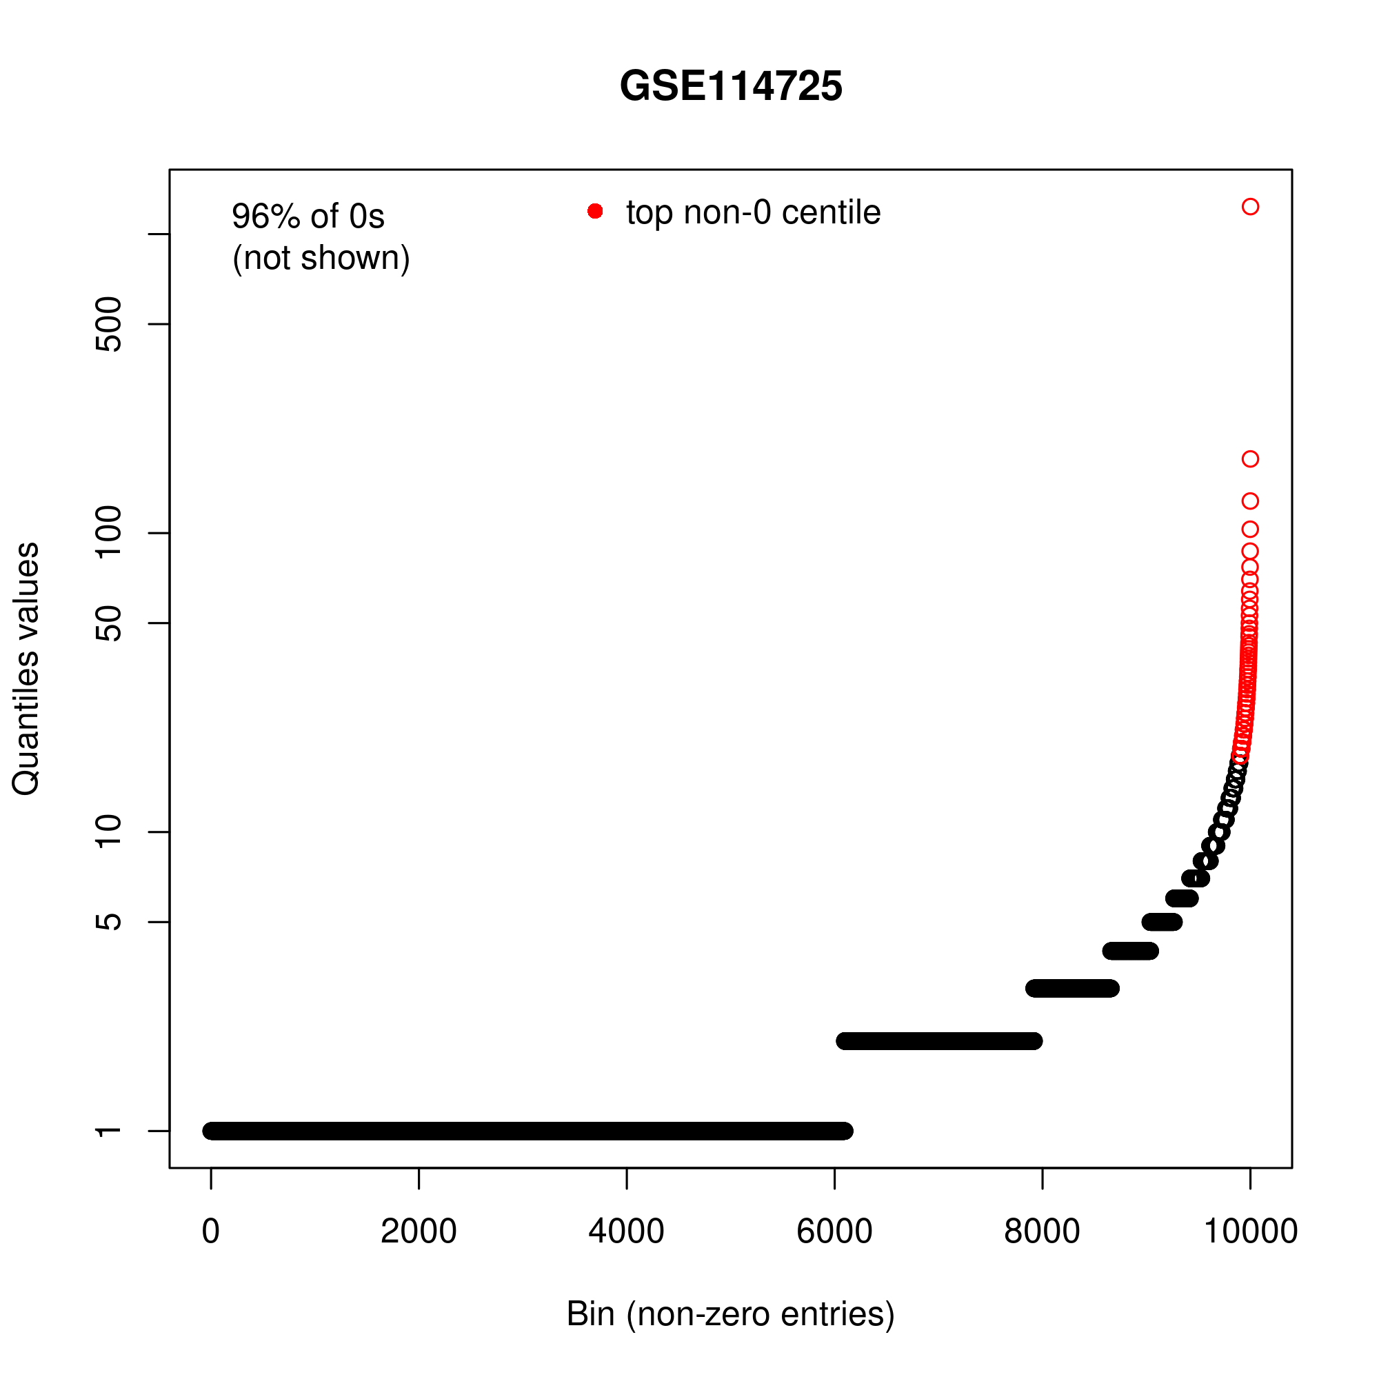
Distribution of counts
Breast cancer datasets
10X Chromium v1

Slide 8
Preprocessing with Seurat
seurat_object = NormalizeData(counts_matrix) %>% FindVariableFeatures() %>%
ScaleData() %>% RunPCA()
Counts
NormalizeData
“Library size”
“Var. stabiliz.”
FindNeighbors+ FindClusters
FindAllMarkers
Variable features
“High” CV
ScaleData
Z-score
RunPCA
Approx. SVD
RunUMAP

Slide 9
“Library size”-normalization
”Library size”
Number of mapped transcripts per cell
“Cell size factors”?
Per single-cell
x <- x / sum(x) * scale_factor
Converts counts to relative abundances
Notes:
The term “library size” is a legacy term from bulk RNA-seq. It’s quite confusing for scRNAseq. Some writers use

Slide 10
Preprocessing with Seurat
seurat_object = NormalizeData(counts_matrix) %>% FindVariableFeatures() %>%
ScaleData() %>% RunPCA()
Counts
NormalizeData
“Library size”
“Var. stabiliz.”
FindNeighbors+ FindClusters
FindAllMarkers
Variable features
“High” CV
ScaleData
Z-score
RunPCA
Approx. SVD
RunUMAP

Slide 11
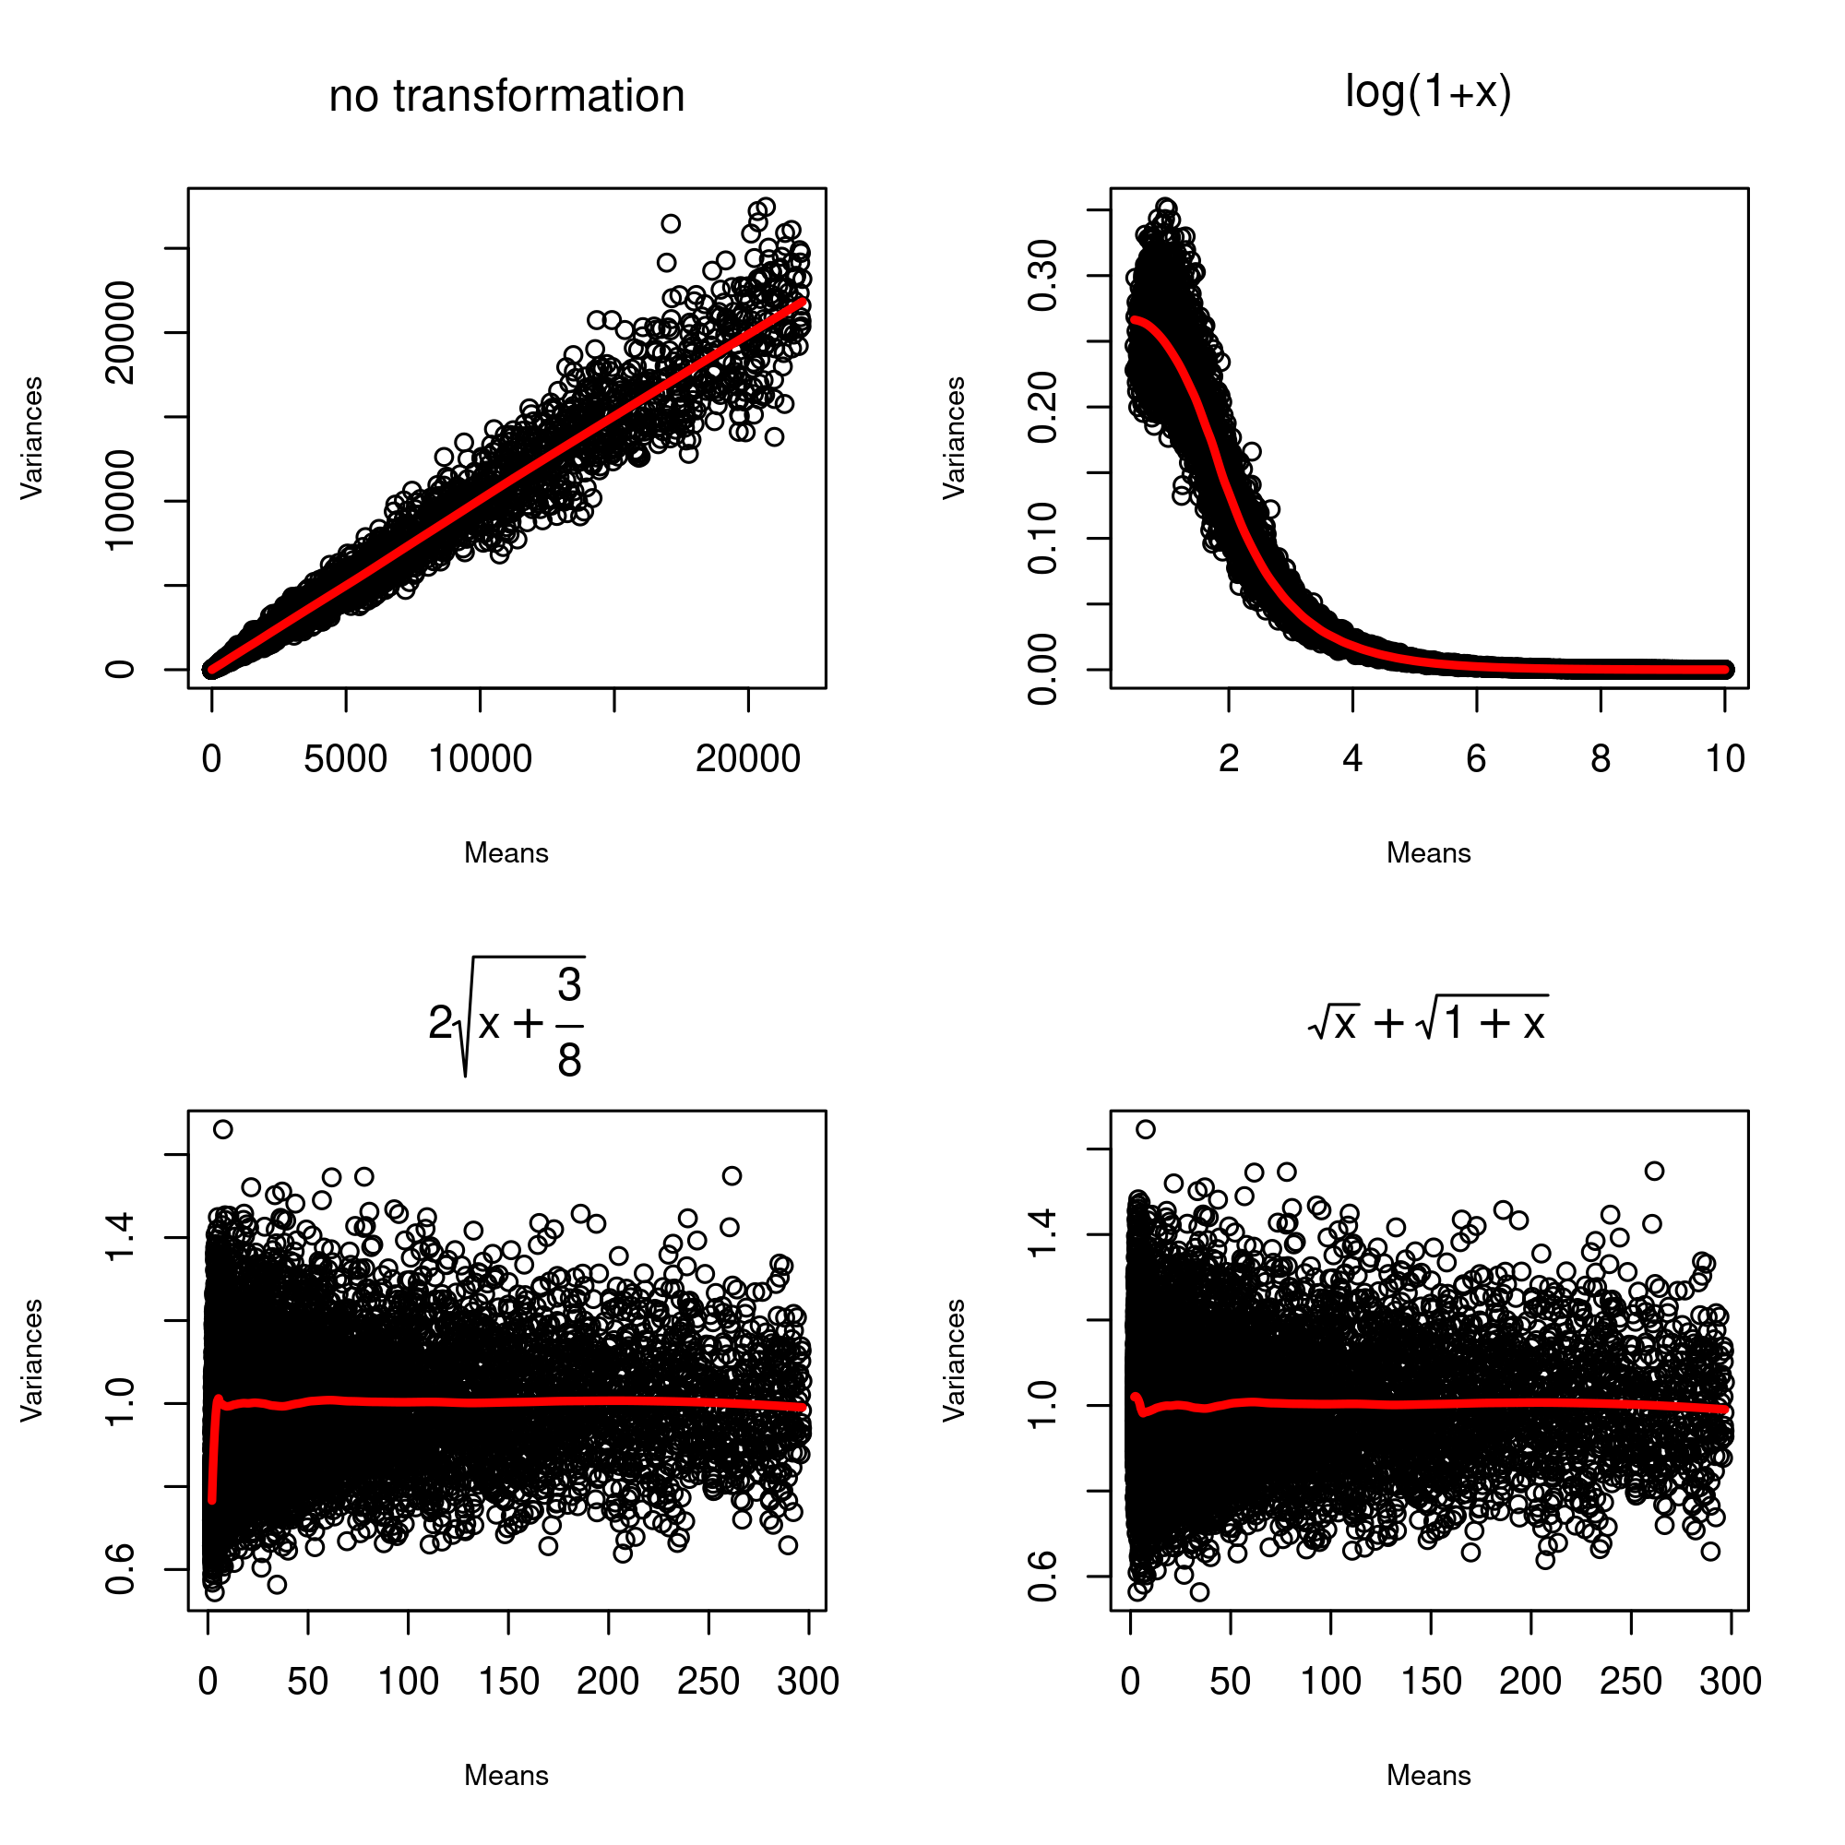
“Variance stabilization”
10,000 Poisson distribs (100 draws each)
Typically x <- log(1+x)
Motivation for this step is not completely clear
Combat heteroscedasticity
For Poisson-distributed data, σ² = µ
For NB-distributed data, σ² = µ + Φ*µ²
For Poisson data
square-root based transformation
Anscombe’s transform
Freeman-Tukey transform

Slide 12
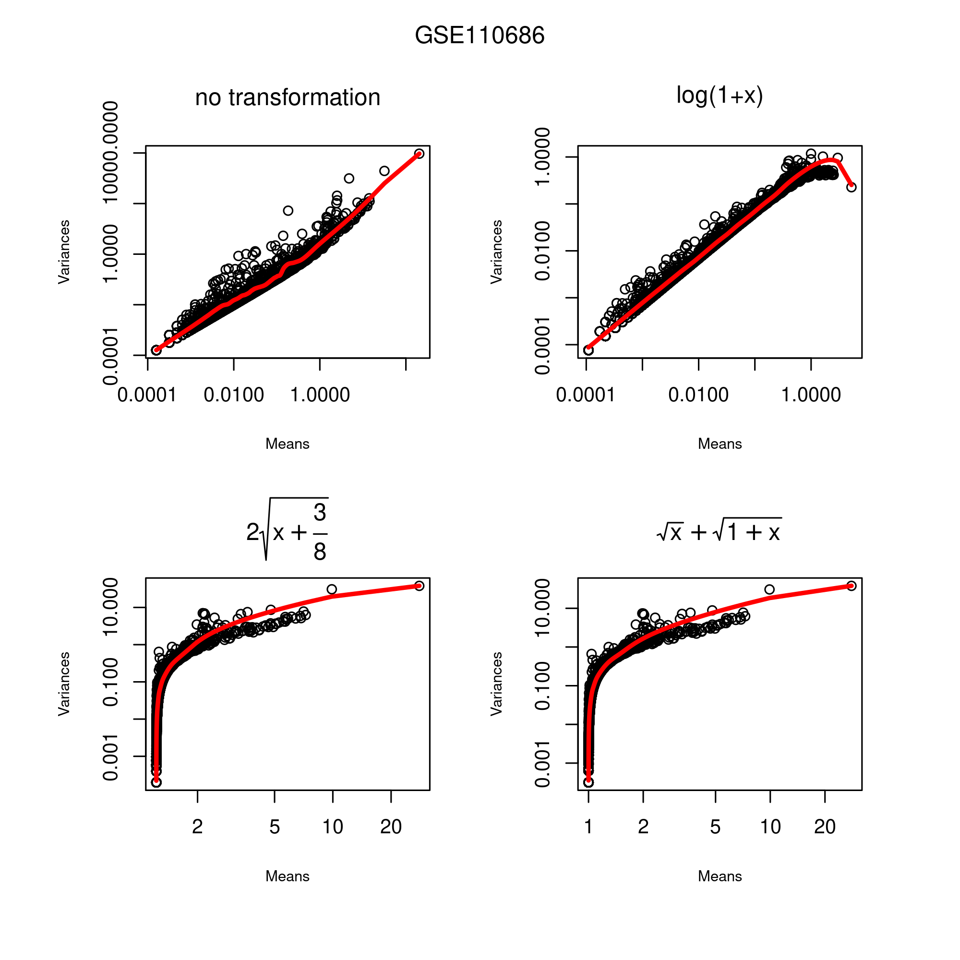
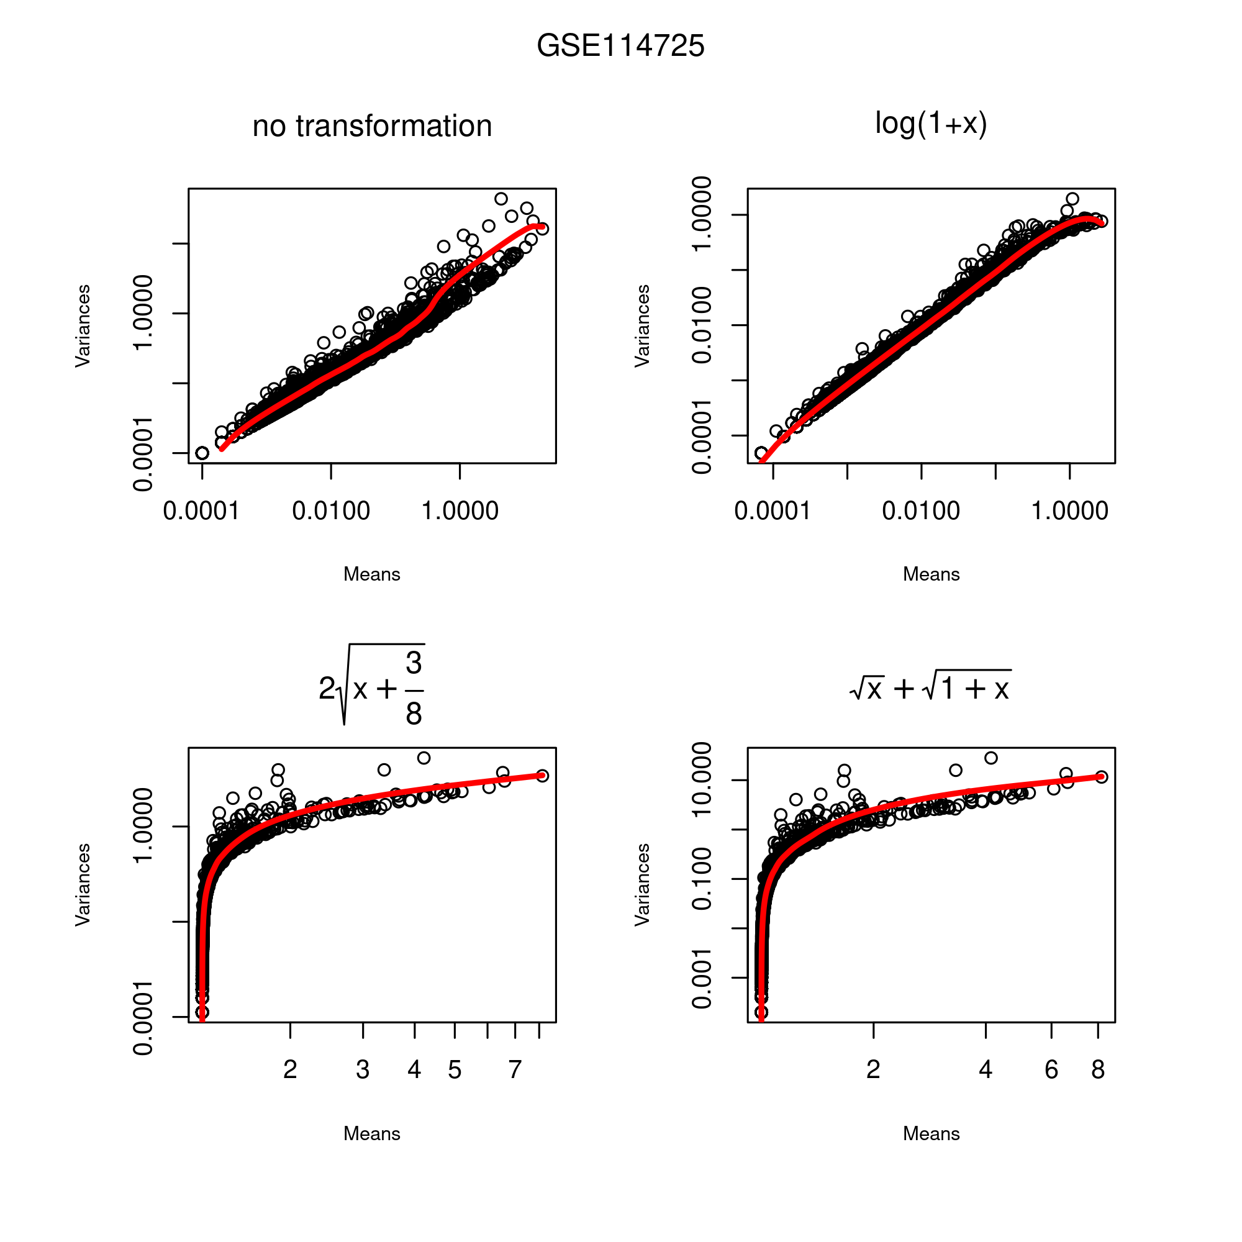
Notes:
Anscombe and Freeman Tukey not quite stabilizing the variance?

Slide 13
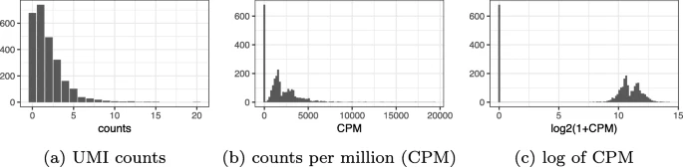
The “scale factor”
log(1 + x * scale_factor / library_size)
in bulk RNA-seq, typically 10⁶ (CPM)
not a good choice for scRNAseq
Seurat defaults to 10,000
Bioconductor’s scater to mean(library_size)
Townes et al., Genome Biology, 2019

Slide 14
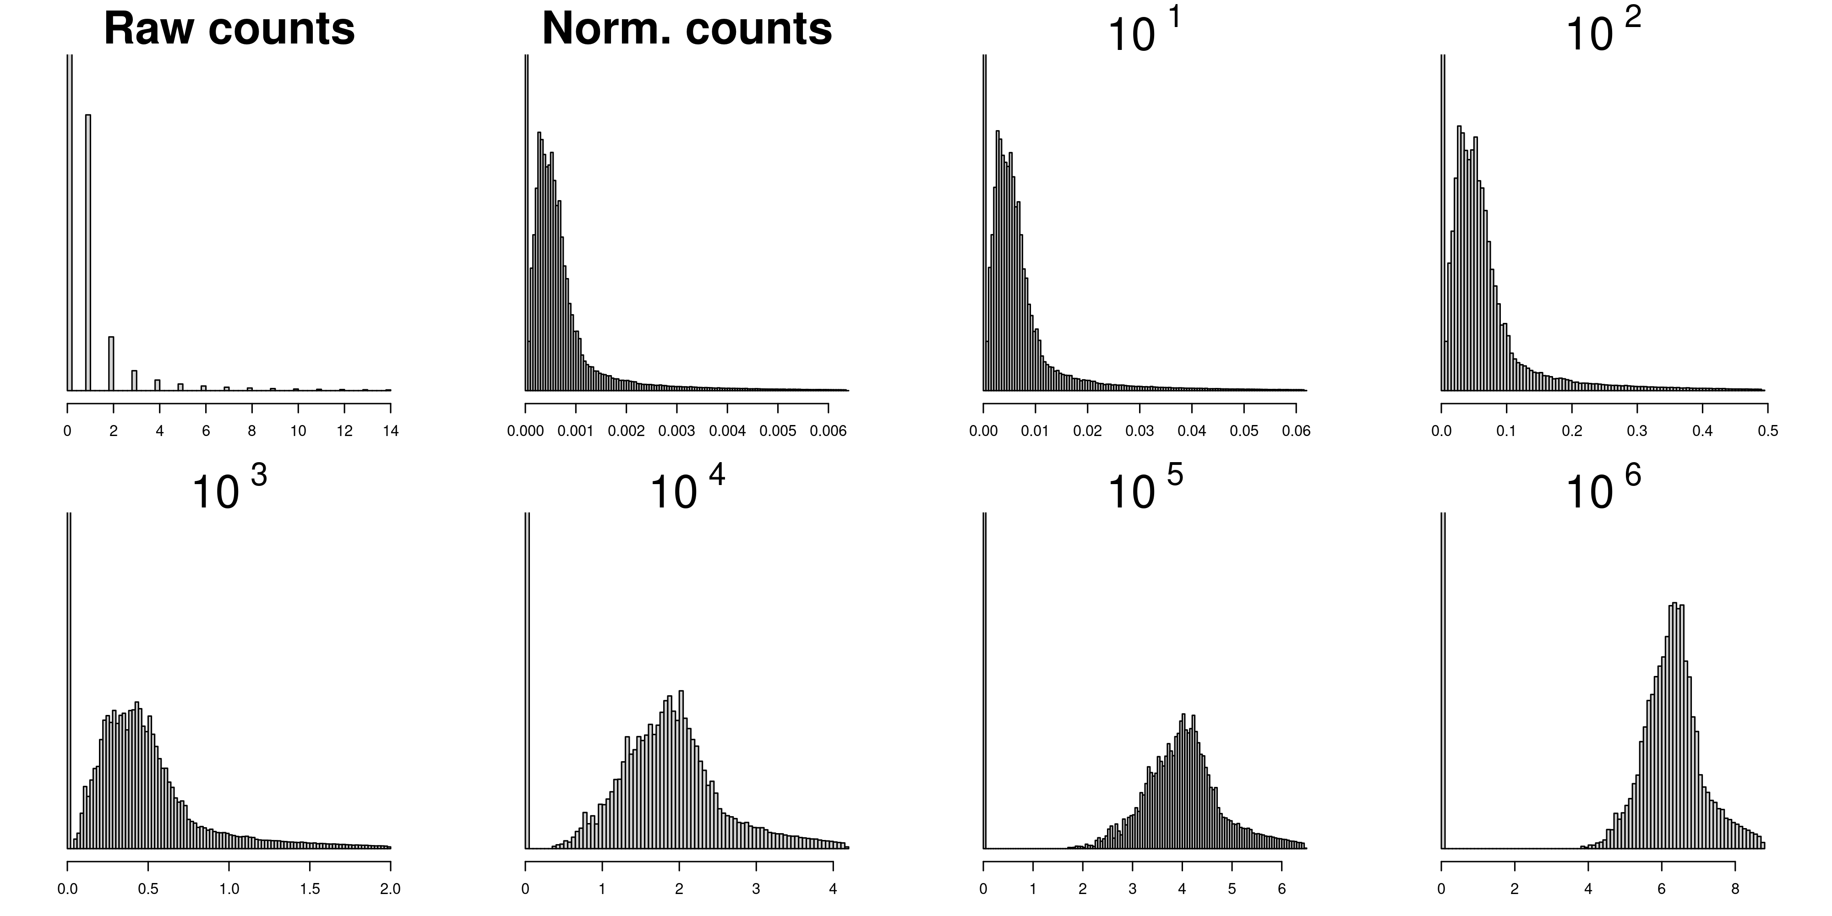
log(1+x): useless, or bad?
GSE110686

Slide 15
log(1+x): useless, or bad?
Log is linear
0 << 1
GSE110686

Slide 16
Preprocessing with Seurat
seurat_object = NormalizeData(counts_matrix) %>% FindVariableFeatures() %>%
ScaleData() %>% RunPCA()
Counts
NormalizeData
“Library size”
“Var. stabiliz.”
FindNeighbors+ FindClusters
FindAllMarkers
Variable features
“High” CV
ScaleData
Z-score
RunPCA
Approx. SVD
RunUMAP

Slide 17
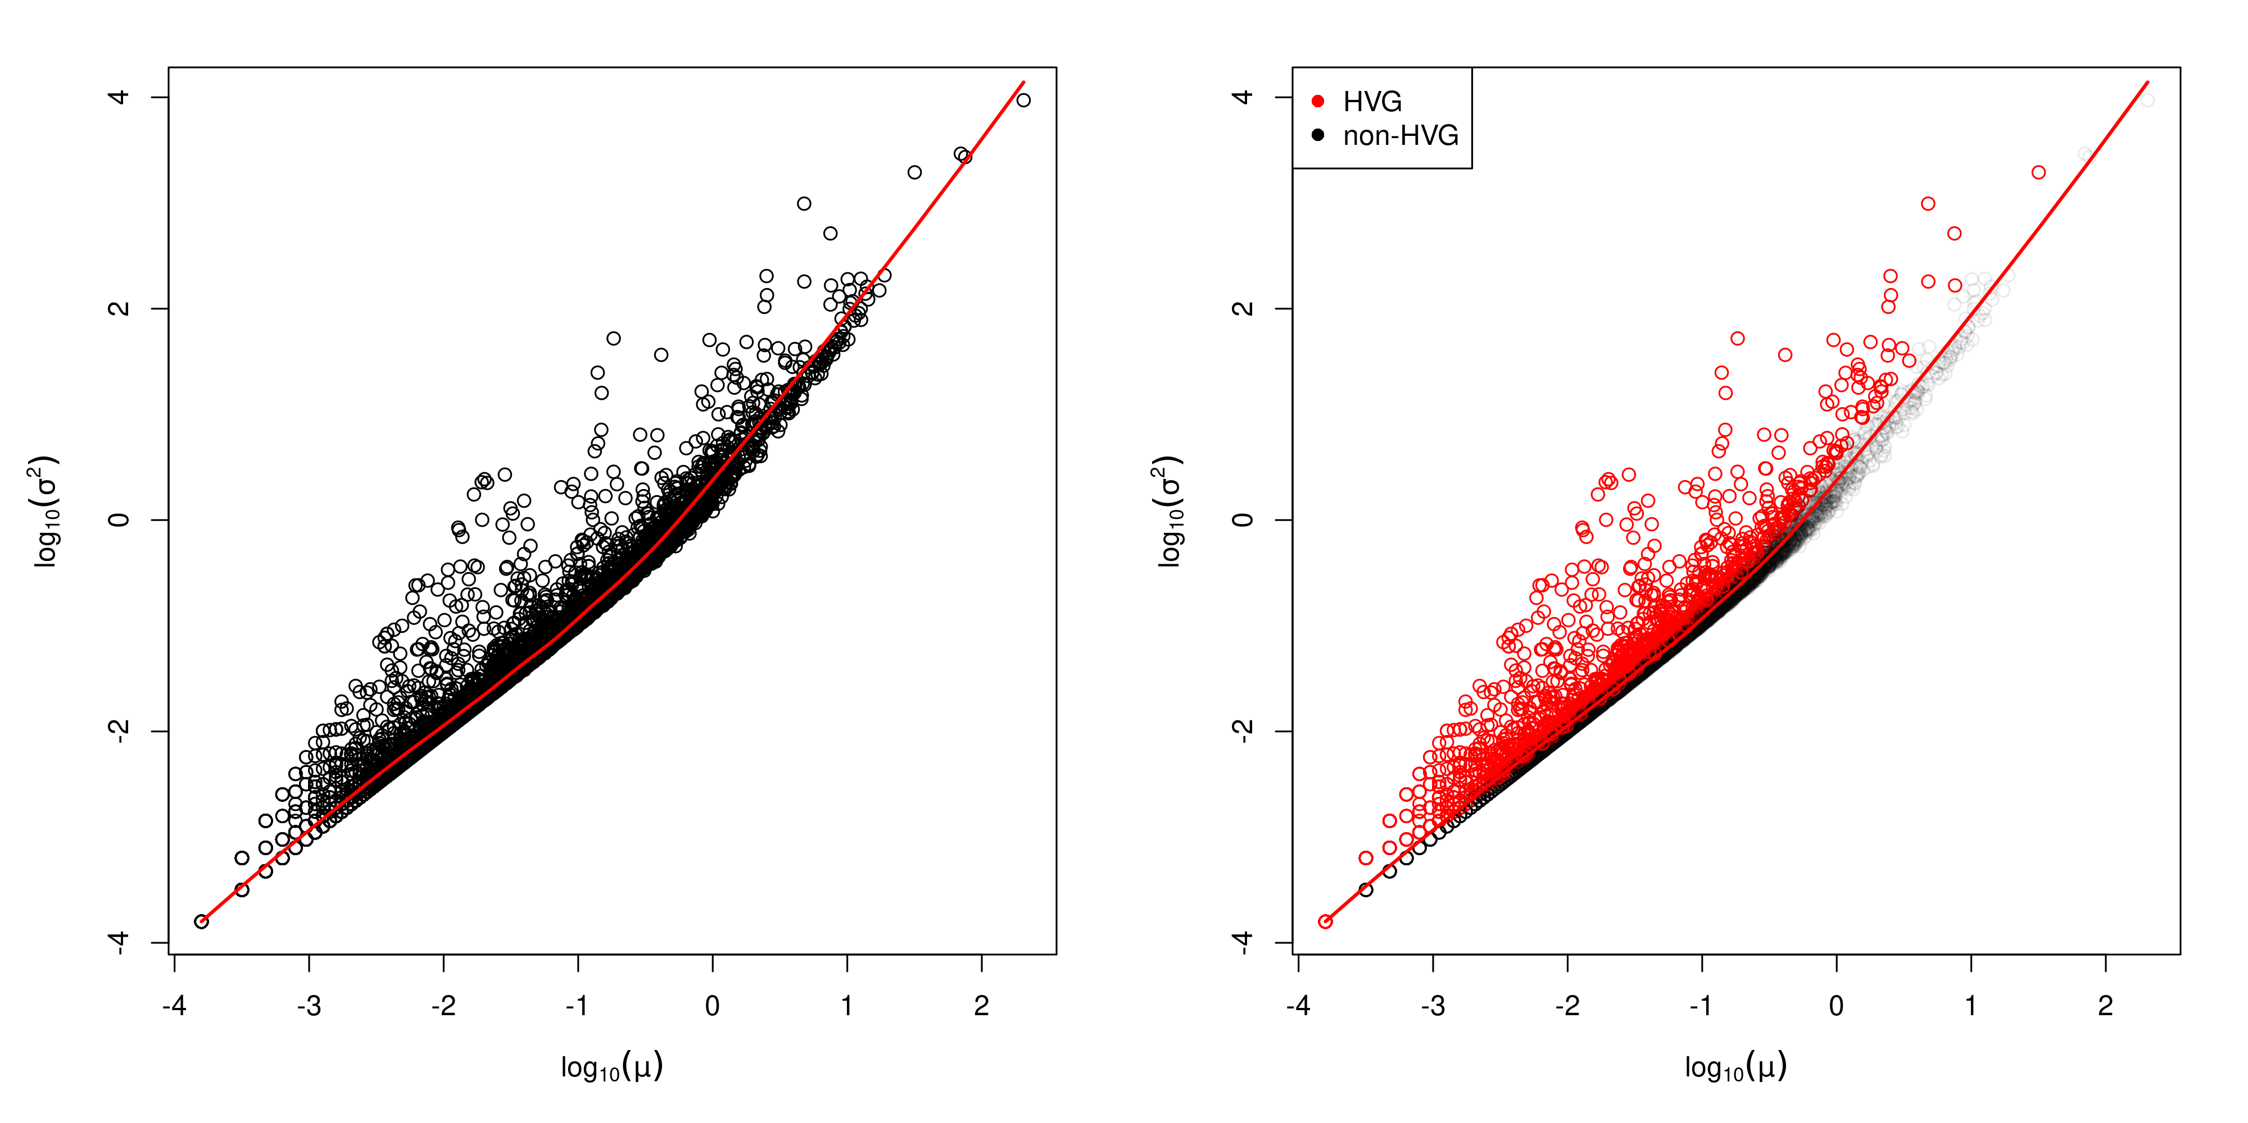
FindVariableFeatures: approximation
For each gene, compute log₁₀(mean) and log₁₀(variance).
Fit log₁₀(mean)~log₁₀(variance) using local polynomial regression (LOESS).
Use the regression to obtain σ²_{expected} for each gene given µ_{observed}
Rank genes by σ²_{observed} / σ²_{expected}, select the top ones

Slide 18
FindVariableFeatures
For each gene, compute log₁₀(mean) and log₁₀(variance).
Fit log₁₀(mean)~log₁₀(variance) using local polynomial regression (LOESS).
Use the regression to obtain σ²_{expected} for each gene given µ_{observed}
Standardize each gene : x -> (x - µ_{observed}) / σ²_{expected}
Additionnally, Seurat clips standardized values that are too high
Compute variances for the rescaled and clipped gene expression vectors
Select an arbitrary number (default: 2,000) with the highest variance

Slide 20
Preprocessing with Seurat
seurat_object = NormalizeData(counts_matrix) %>% FindVariableFeatures() %>%
ScaleData() %>% RunPCA()
Counts
NormalizeData
“Library size”
“Var. stabiliz.”
FindNeighbors+ FindClusters
FindAllMarkers
Variable features
“High” CV
ScaleData
Z-score
RunPCA
Approx. SVD
RunUMAP

Slide 21
ScaleData
Z-score transform each variable gene
Only OK because we selected highly-variable genes first
Gives more weights to markers of rare populations

Slide 22
Preprocessing with Seurat
seurat_object = NormalizeData(counts_matrix) %>% FindVariableFeatures() %>%
ScaleData() %>% RunPCA()
Counts
NormalizeData
“Library size”
“Var. stabiliz.”
FindNeighbors+ FindClusters
FindAllMarkers
Variable features
“High” CV
ScaleData
Z-score
RunPCA
Approx. SVD
RunUMAP

Slide 23
PCA
Instead of the complete PCA, use approximate and truncated SVD.
Identify only a given number of PCs
Approximation is close to PCs

Slide 24
Preprocessing with Seurat
seurat_object = NormalizeData(counts_matrix) %>% FindVariableFeatures() %>%
ScaleData() %>% RunPCA()
Counts
NormalizeData
“Library size”
“Var. stabiliz.”
FindNeighbors+ FindClusters
FindAllMarkers
Variable features
“High” CV
ScaleData
Z-score
RunPCA
Approx. SVD
RunUMAP

Slide 25
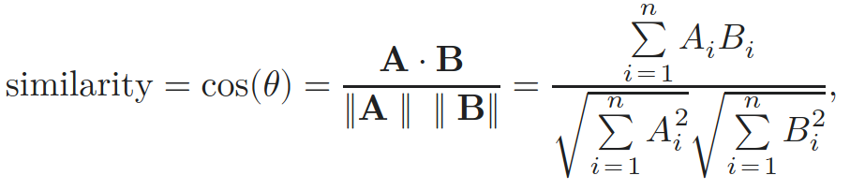
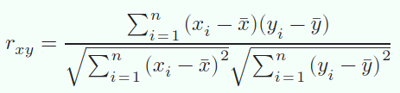
RunUMAP
cosine distance ( = Pearson on centered data, which is the case for PCA)
n_neighbors = 30L
min_dist = 0.3
Sources: Wikipedia

Slide 26
Preprocessing with Seurat
d_seurat = NormalizeData(d_seurat) %>% FindVariableFeatures() %>% ScaleData() %>% RunPCA(verbose = FALSE)
Counts
NormalizeData
“Library size”
log(1+x)
FindNeighbors+ FindClusters
FindAllMarkers
Variable features
ScaleData
RunPCA
RunUMAP
Can be replaced by
highly deviant multinomial
residuals (gene-wise)
Can be replaced by GLM-PCA
(approximated by
PCA on binomial deviance residuals)
Townes et al., Genome Biology, 2019

Slide 27
Multinomial model
Multinomial: extension of the binomial to outcomes with J levels
roll a J-sided dice n times and tally the roll values
Dice faces = the genes (J total)
Number of rolls = “cell library size”
Drawing from a pool of transcripts with replacement.
Replacement is wrong but approximately correct since the library size is much less than the number of transcripts in the cell?
Townes et al., Genome Biology, 2019

Slide 28
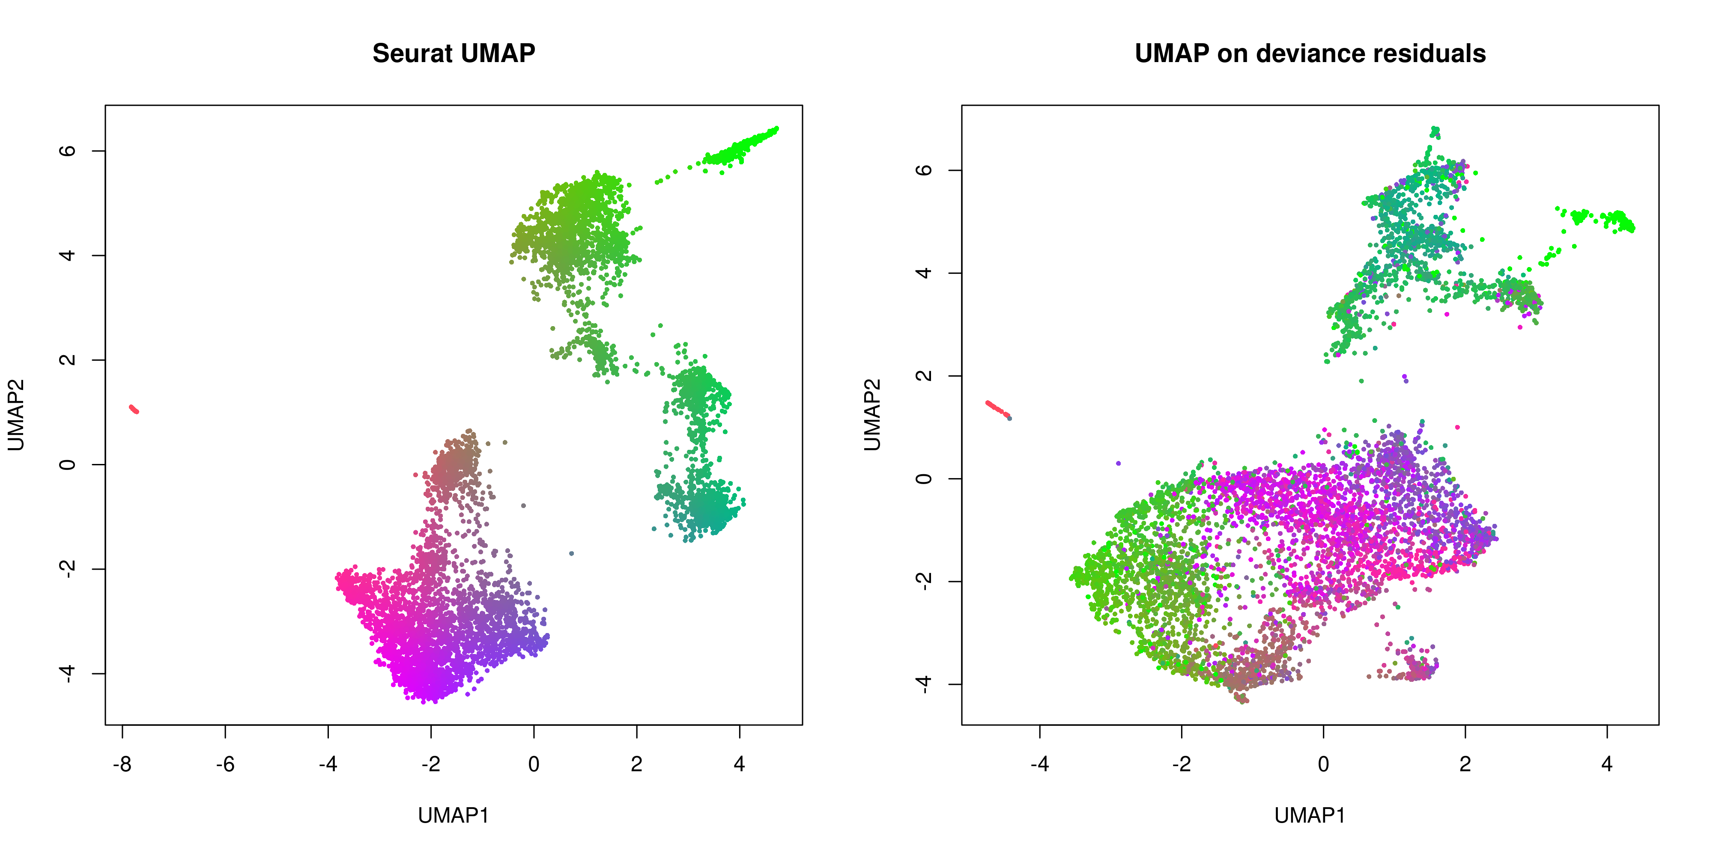
Approximate GLM-PCA vs Seurat
Ref: Townes et al., Genome Biology, 2019
Code for residuals: https://github.com/willtownes/scrna2019

Slide 29
Take homes
Check “library sizes” if you’re using Seurat, if they’re far from 10,000, change the scale factor.
log(1+x) seems to be mostly about outlier count entries.
Seurat is great for inspiration and quick analysis, not so much for developping new methods
Lots of heuristics, statistical models that relate to the data generation procedure are reassuring

Slide 30
Open questions
Motivation for log(1+x) transformation? Is it all about outlier entries? Any alternative?
Discrepancy between finding highly-variable features on the count matrix instead of the normalized matrix?
How dependent are these aspects on the technology used?

Slide 31
Thanks!
Questions ?

Slide 32
NormalizeData
xp = x$counts
xp_norm = x$counts %*% Diagonal(x = scale_factor/colSums(xp))
xp_norm@x = log(1 + xp_norm@x)

Slide 33
FindVariableFeatures
xp = d$counts ## Raw counts
means = rowMeans(xp)
vars = apply(xp, 1, var)
not.const = vars > 0
hvg.info = data.frame(mean = means, variance = vars)
fit = loess(log10(variance) ~ log10(mean), data = subset(hvg.info, not.const), span = 0.3)
hvg.info$variance.expected = 0
hvg.info$variance.expected[not.const] = 10^fit$fitted
hvg.info$variance.standardized = 0 ## Below. Defined in Seurat:::SparseRowVarStd (https://github.com/satijalab/seurat/blob/master/src/data_manipulation.cpp)
clip.max = sqrt(ncol(xp))
xp_varstd = xp
tmp = split(xp_varstd@x, xp_varstd@i) ## Split expression matrix row-wise (genes)
varstd = lapply(
seq.int(length(tmp)),
function(i){
mu = hvg.info$mean[not.const][i]
sigma = sqrt(hvg.info$variance.expected[not.const][i])
res = ((tmp[[i]] - mu) / sigma)
res = sapply(res, min, clip.max)
res = res^2
colSum = sum(res)
nZeros = ncol(xp_varstd) - length(tmp)
colSum = colSum + nZeros*(mu/sigma)^2
colSum / (ncol(xp_varstd) - 1)
}
)
hvg.info$variance.standardized[not.const] = unlist(varstd)
hvg = hvg.info
hvg = hvg[order(hvg$variance.standardized, decreasing = TRUE), ]
hvg = rownames(hvg)[1:(min(nrow(hvg), 2000))]

Slide 34
ScaleData
If present, subsets on variable features and ignores the rest
xp_scaled = as.matrix(d$normalized_counts[hvg, ])
xp_scaled = t(xp_scaled)
w = apply(xp_scaled, 2, sd) > 0
xp_scaled = scale(xp_scaled[, w])
xp_scaled = t(xp_scaled)

Slide 35
PCA
svd = irlba(t(xp_scaled), nv = 50, nu = 0, centers = colSums(t(xp_scaled)))
pca = t(xp_scaled) %*% svd$v
pca = as.matrix(pca)

