Slide 1
Sparse Matrix Operator Kernel Emissions SMOKE Modeling System
version 1.4
TRAINING
http://www.emc.mcnc.org/products/smoke

Slide 2
Training Overview
Emissions processing basics
SMOKE basics
SMOKE scripts
Overview lab
SMOKE programs and options
SMOKE problem solving
Area sources lab
Biogenics lab
Point sources lab
Mobile sources lab
Merge lab
Quality assurance lab

Slide 3
Training details
Inventory is the 1996 National Emission Inventory (NEI) version 3.11, but abridged for better processing speed during training
CO, NO_{x}, VOC, SO₂, NH₃, PM₁₀, PM_{2.5}
Mobile sources use vehicle miles traveled (VMT), MOBILE6 emission factors
National gridded domain, user-defined subdomain for some steps
All runs are a 1-day episode on July 10th, 1996

Slide 4
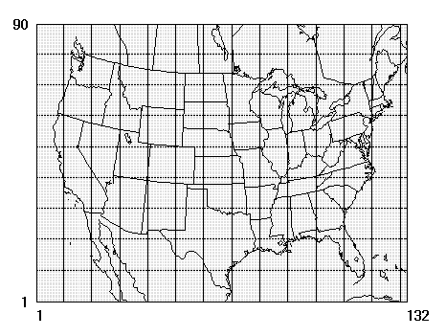
National 36-km cell domain for training:

Slide 5
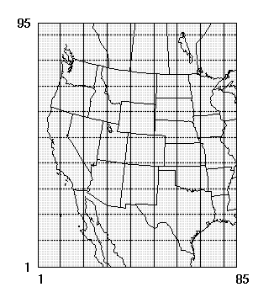
Western 36-km cell domain for training:

Slide 6
About This Training
Specific to UNIX
Run SMOKE from scripts
NOT running from Models-3/MIMS or EDSS graphical user interface

