Slide 1
Emissions Data Processing
Source categories
Definitions
Area emissions processing
Point emissions processing
Mobile emissions processing
Biogenic emissions processing
Merging
Quality assurance

Slide 2
Source Categories (1)
Area source characteristics
  Country, state, county
  Source category code (SCC) or area source category (ASC)
  Optional grid cell
Point source characteristics
  Country, state, county, and…
  Facility, stack, device, process (EMS-95 input format)
    OR
  Plant, stack, point, segment, SCC (NET/IDA or EPS input format)

Slide 3
Source Categories (2)
Mobile source characteristics
  Country, state, county
  Road type (e.g., rural interstate, urban local)
  Vehicle type (e.g., light duty gasoline vehicles)
  Link ID (optional)
Biogenic source characteristics
  Country, state, county
  Landuse type
    OR
  Grid cell
  Landuse type

Slide 4
Definitions (1)
Inventory pollutant: A compound or group of compounds defined for record keeping and regulatory purposes (e.g. CO, NO_{x}, VOC, PM₁₀)
Species: A compound or group of compounds defined as part of the estimation of air chemistry in an air quality model (e.g., CO, NO, NO₂, PAR, ECC)
Chemical mechanism: A set of chemical species and their interactions used to represent air chemistry (e.g., CB-IV, RADM, SAPRC)

Slide 5
Definitions (2)
Map projection: The mathematical representation of the spherical surface of the earth in 2-d
Model grid: A 2-d grid based on a map projection, defined by starting coordinates, number of grid cells in each direction, and the physical size of the grid cells
Model layers: Vertical spatial divisions defined by an air quality model because the atmosphere has varied characteristics in the vertical direction

Slide 6
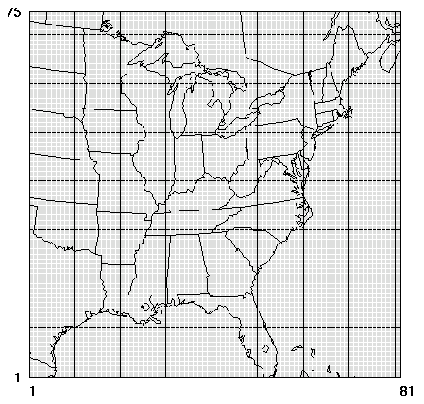
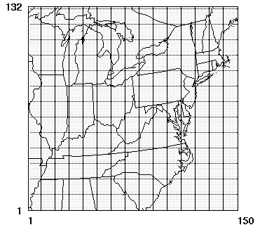
Examples of Model Grids

Slide 7
Definitions (4)
Plume rise: The rising of the exhaust from point sources due to the velocity and temperature of the exhaust gases
Elevated source: A point source in which emissions are higher than the first model layer because of plume rise
Plume-in-grid: A special treatment of elevated sources by which the plume rise is modeled with extra detail by the air quality model

Slide 8
Definitions (5)
Spatial allocation:
Convert the source spatial extent to the grid cell resolution needed by the air quality model
Chemical speciation:
Convert the inventory pollutant data to the chemical species needed by the air quality model
(e.g., VOC gets split to PAR, OLE, XYL, TOL, ISOP, and more).
Temporal allocation:
Convert the inventory temporal resolution to the hourly temporal resolution needed by the air quality model

Slide 9
Definitions (3)
Profile data: Factors used for disaggregating emissions data as is done during chemical speciation or temporal allocation
Cross-reference: A dataset used for matching sources in the emissions inventory with profile data based on the source characteristics
Gridding surrogate: A dataset developed from data at a finer resolution than the emissions, used to spatially allocate the emissions to the grid cells (e.g., population, housing, agricultural regions)

Slide 10
Definitions (4)
Cross-references and profiles or surrogates:
X-REF table
Profiles table
State, County, ID
ID, Factor 1, 2, 3
NC, Durham , 15
NC, Orange, 15
NC, Wake, 16
SC, All 17
13 0.2, 0.3, 0.5
14 0.4, 0.4, 0.2
15 0.4, 0.3, 0.3
16 0.4, 0.5, 0.1
17 0.4, 0.4, 0.2

Slide 11
Area Emissions Processing
Import data
Spatial allocation
  Allocation of county emissions into grid cells using spatial surrogate
  Distribute county total emissions nonuniformly to grid cells that intersect the county based on variation of some other dataset (I.e., a “surrogate” data set)
Chemical speciation
Temporal allocation
Approach also applied to “mobile” sources: road dust and non-road mobile sources

Slide 12
Point Emissions Processing
Import, chemical speciation, temporal, plus...
All emissions for a source in single grid cell
Use day-specific and hour-specific inventory data
Determine elevated sources and plume-in-grid (PinG) sources
Special processing and output for elevated and PinG sources
  Create 3-d emissions file & optional PinG emissions files
    OR
  Create special elevated (PinG optional) & 2-d emissions file
  Meteorology based

Slide 13
Mobile Emissions Processing (1)
Steps for area sources, plus...
Possibly start with vehicle miles traveled (VMT) instead of emissions
Create emission factors based on meteorology
  Emission factors model such as MOBILE5b or MOBILE6
  Gridded hourly or average meteorology
  Emissions = Emission factor × VMT
Spatial allocation may include link sources

Slide 14
Mobile Emissions Processing (2)
Emission factors typically depend on emissions process (e.g., start exhaust, running exhaust, evaporative, diurnal evaporative)
Temporal allocation and speciation may depend on emissions process
Approach only for on-road mobile sources

Slide 15
Biogenic Emissions Processing
Typically created by BEIS2 emissions model or derivative
About 120 landuse types (for BELD2 data)
Landuse types have emission factors which are adjusted by gridded temperature and solar radiation
Winter and summer emission factors
If landuse is county total, then use gridding surrogate to allocate emissions to grid cells
Plants and soil emissions, not geogenic

Slide 16
Merging and Formatting
Combining steps taken for a given source category to create model-ready formatted files (e.g., combine import, gridding, speciation, temporal allocation steps)
Combine multiple source categories into a single data set (e.g., combine area, biogenics, mobile, and point)
Output correct units, species, time steps, grid projection, and file format for the air quality model of interest

Slide 17
Quality Assurance
Compare emissions totals from emissions processor with inventory totals
  By state, county, SCC, combinations, other
Compare emissions totals at each stage of the processing
Ensure input file formats are correct
Ensure no significant errors or warnings in processing
Compare emissions among states and counties
Compare emission ratios to ambient measurement ratios

