Slide 1
Numerical methods
and deep learning
Phase-field fracture and differentiable simulation
Presented by
Sathiskumar A. Ponnusami
Queen Mary University of London · CEMS-Lab
Prepared for the UKACM Autumn School 2026
Notes:
Delivery placement: L1.
Introduce the numerical questions that connect phase-field fracture to differentiable simulation. The course develops the fracture model, computes a small example and uses sensitivities to guide inverse recovery and learning.
Sources and provenance:
User-created Physics Constrained Differentiable Solver Key Points.key, exported 9 September 2026.
Course material created by Allamaprabhu Ani, CEMS-Lab, UKACM Autumn School 2026. Presented by Sathiskumar A. Ponnusami, Queen Mary University of London.

Slide 2
The six-hour learning sequence
Lecture questions
Practical evidence
1. Fracture and numerical solution
1. A small PhAST forward calculation
2. Differentiation through a solve
2. A checked sensitivity and recovery
3. Learning inside numerical methods
3. Train, reload and assess a proposal
Three lecture hours, followed by three practical hours.
CEMS-Lab · UKACM Autumn School 2026
02
Notes:
Delivery placement: L1.
The live route has 180 minutes of lectures followed by 180 minutes of practical work. Select the diffusion lesson within the second practical. The teaching schedule supplies the detailed allocation.
Sources and provenance:
COURSE_PLAN.md; TEACHING_SCHEDULE.md; MVP_DELIVERY.md.
Course material created by Allamaprabhu Ani, CEMS-Lab, UKACM Autumn School 2026. Presented by Sathiskumar A. Ponnusami, Queen Mary University of London.

Slide 3
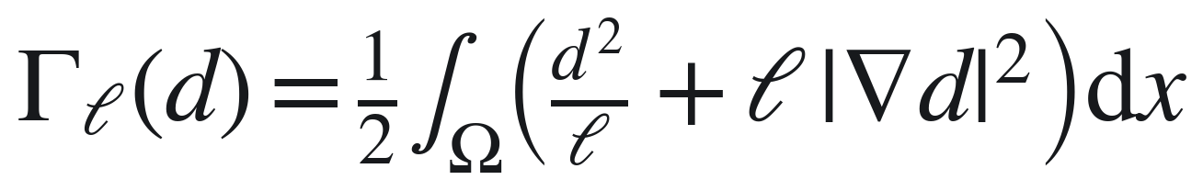
A crack represented by a damage field
Stored elastic energy
Regularised crack cost
External work
Illustrative isotropic AT2 energy; tension/compression splits are a separate modelling choice.
CEMS-Lab · UKACM Autumn School 2026
03
Notes:
Delivery placement: L1.
Define displacement u, small strain, undamaged energy density, toughness Gc, regularisation length ell and external work. Use d=0 for intact material and d=1 for damaged material. AT2 has c0=2. This isotropic energy matches the quick PhAST exercise. Introduce irreversibility as a separate constraint.
Sources and provenance:
Course source/book/02_phase_field_energy.md; Miehe et al. (2010), https://doi.org/10.1002/nme.2861; Bourdin et al. (2000), https://doi.org/10.1016/S0022-5096(99)00028-9.
Course material created by Allamaprabhu Ani, CEMS-Lab, UKACM Autumn School 2026. Presented by Sathiskumar A. Ponnusami, Queen Mary University of London.

Slide 4
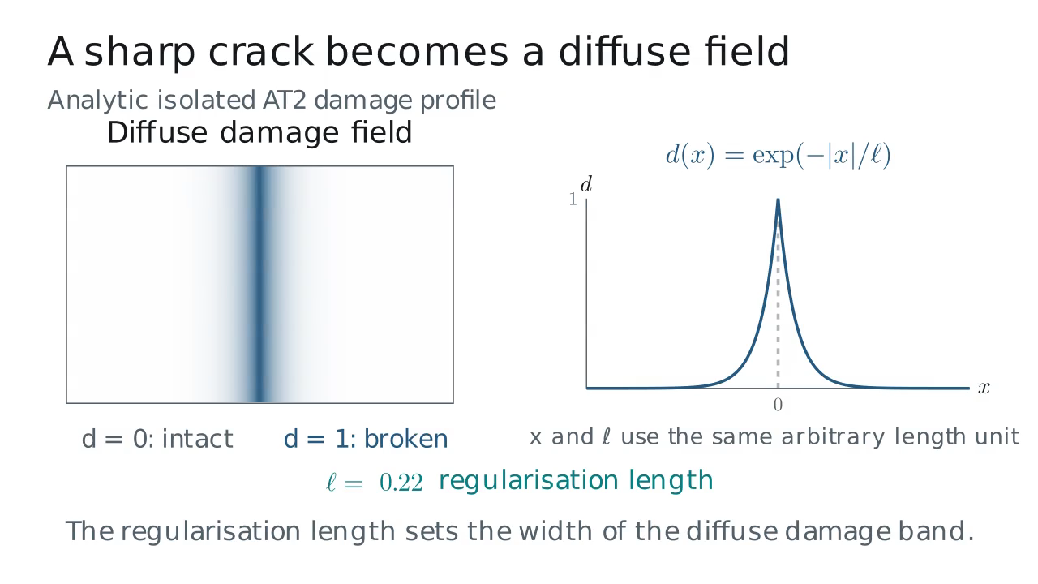
The length scale controls the crack band
Observe
Larger length scale
Wider diffuse band
Finer mesh resolves smaller bands
Click the figure to play or pause.
Analytic isolated AT2 profile. Lengths use one arbitrary unit.
04
Notes:
L1 · 13–26 min. Analytic isolated AT2 profile. Lengths use one arbitrary unit.
Play the 24.8-second clip. Pause around 15 seconds.
Ask: How should the mesh change when the regularisation length is halved?
Discussion: Keep the mesh-to-length-scale ratio comparable: halving the length scale suggests halving the local mesh spacing, followed by a resolution study.
Static fallback: media/phase_field_band_poster.png. Describe the same sequence from its poster.
Replay from the beginning after discussion. The clip is embedded in this deck and needs no network connection.
Original source: source/animations/mechanics_scenes.py: PhaseFieldBand
Created by Allamaprabhu Ani, CEMS-Lab, for the UKACM Autumn School 2026. Presented by Sathiskumar A. Ponnusami, Queen Mary University of London.

Slide 5
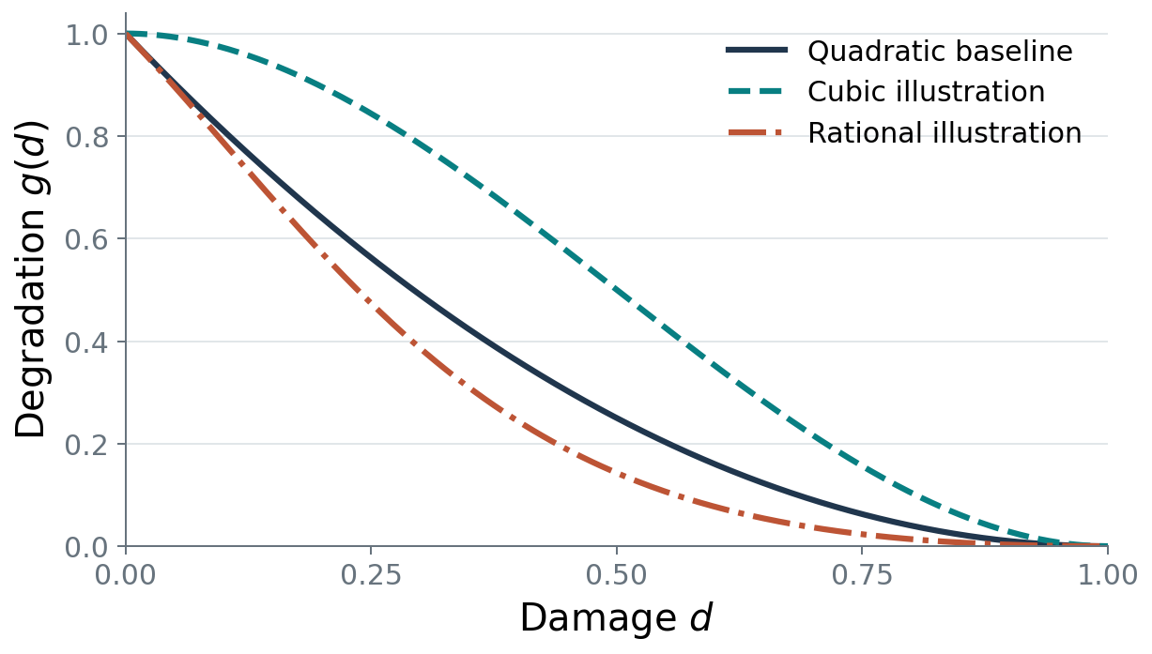
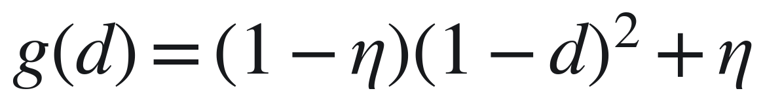
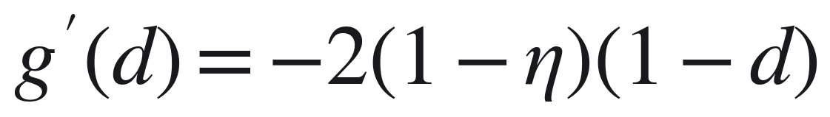
How damage changes stiffness
Predict the sign of the derivative.
What changes near complete damage?
Quadratic baseline with illustrative cubic and rational alternatives.
CEMS-Lab · UKACM Autumn School 2026
05
Notes:
Delivery placement: L1.
Read the degradation curve and its slope together. Eta supplies residual stiffness. The figure uses eta=1e-6 and the numerical practical uses 1e-7. The quadratic baseline is paired with illustrative cubic and rational functions. Distinguish degradation g from the crack-density function w.
Sources and provenance:
Original course figure build_beamer_figures.py and latex_figures/analytic_plot_data.json; public PhAST quadratic law pinned f6324f899f0701769810be117f27f1208f7a582e.
Course material created by Allamaprabhu Ani, CEMS-Lab, UKACM Autumn School 2026. Presented by Sathiskumar A. Ponnusami, Queen Mary University of London.

Slide 6
The staggered solution
At a fixed load increment, update one coupled field at a time.
Mechanics
Driving energy
Damage
Hold damage fixed
Update the history
Enforce admissibility
Repeat with the updated damage until the chosen convergence checks pass.
Load increment, staggered iteration and physical time are different indices.
CEMS-Lab · UKACM Autumn School 2026
06
Notes:
Delivery placement: L1.
Follow the data dependencies. Mechanics receives the latest damage, and the updated driving or history field enters the damage problem. Enforce prescribed values and irreversibility. A staggered algorithm can combine dynamic mechanics and implicit damage. The classroom PhAST example uses quasistatic mechanics.
Sources and provenance:
Course source/book/03_staggered_solution.md; vendor/PhAST/src/phast/solvers/staggered.py.
Course material created by Allamaprabhu Ani, CEMS-Lab, UKACM Autumn School 2026. Presented by Sathiskumar A. Ponnusami, Queen Mary University of London.

Slide 7
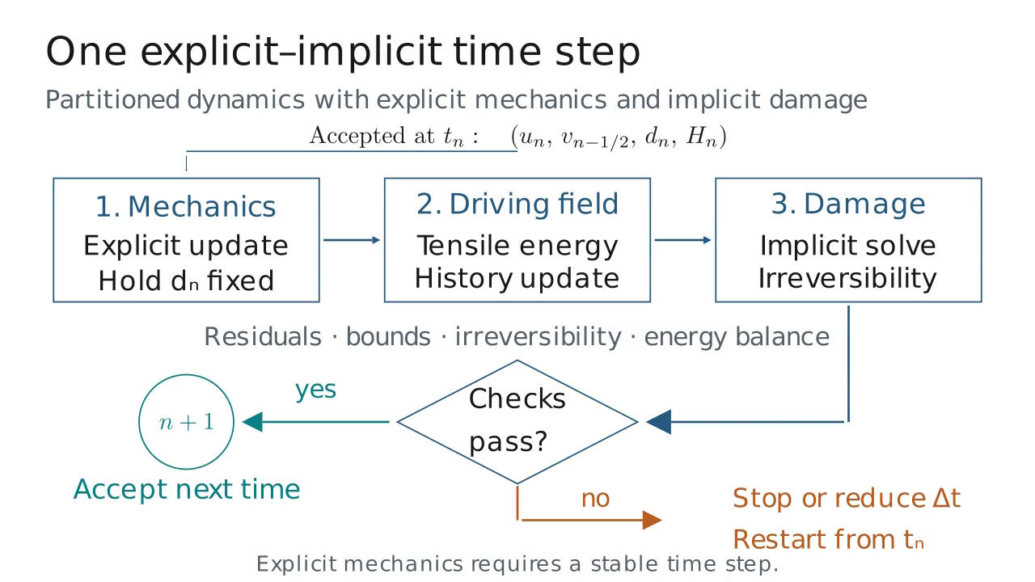
Follow one partitioned dynamic update
Observe
Mechanics
Driving energy
Damage
Accept the checked state
Click the figure to play or pause.
Partitioned dynamic schematic. The PhAST practical uses quasistatic mechanics.
07
Notes:
L1 · 26–40 min. Partitioned dynamic schematic. The PhAST practical uses quasistatic mechanics.
Play the 26.5-second clip. Pause around 11 seconds.
Ask: Which fields are held fixed during the mechanics and damage updates?
Discussion: The explicit mechanics update uses the accepted damage. Its updated tensile energy and stored history drive the implicit damage problem. Describe the time-step stability and acceptance checks before advancing.
Static fallback: media/explicit_implicit_step_poster.png. Describe the same sequence from its poster.
Replay from the beginning after discussion. The clip is embedded in this deck and needs no network connection.
Original source: source/animations/mechanics_scenes.py: ExplicitImplicitStep
Created by Allamaprabhu Ani, CEMS-Lab, for the UKACM Autumn School 2026. Presented by Sathiskumar A. Ponnusami, Queen Mary University of London.

Slide 8
Finite elements as tensor operations
Gather nodal values
Element kernels
Quadrature reduction
Scatter contributions
Element, quadrature and component axes express the numerical structure.
The same operations can expose derivatives when the computational path supports them.
Differentiability depends on the operations along the computational path.
CEMS-Lab · UKACM Autumn School 2026
08
Notes:
Delivery placement: L1.
Define each tensor axis and the connectivity-based gather and scatter operations. Tensor notation expresses batched element calculations. Matrix-free evaluation applies the global operator through local operations. The quick forward practical uses assembled SciPy sparse-direct mechanics.
Sources and provenance:
Course source/book/04_fem_to_tensors.md; public PhAST source pin f6324f899f0701769810be117f27f1208f7a582e.
Course material created by Allamaprabhu Ani, CEMS-Lab, UKACM Autumn School 2026. Presented by Sathiskumar A. Ponnusami, Queen Mary University of London.

Slide 9
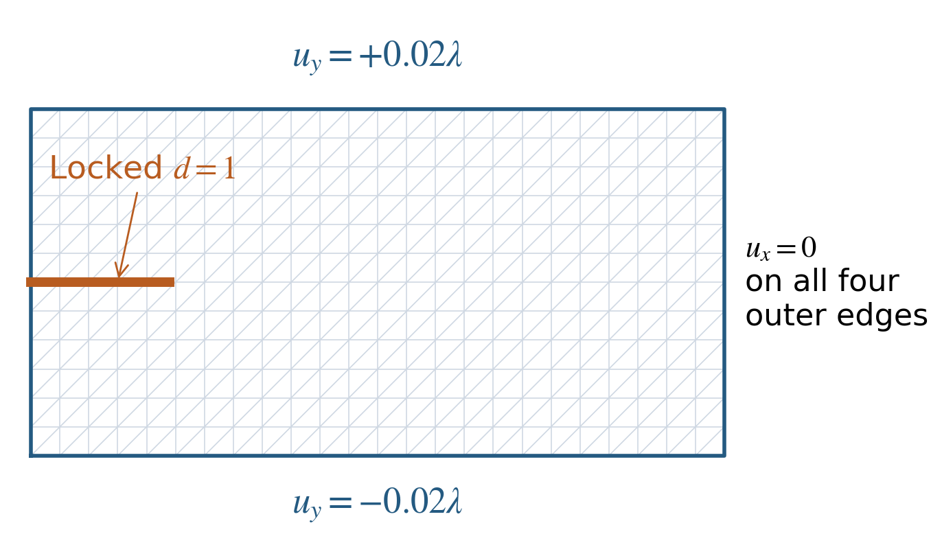
A mesh, a prescribed notch and boundary values
Represent the notch by
prescribing fully damaged
nodes on the intact mesh.
Inspect every boundary set
and displacement component
before solving.
Diagram uses a coarse mesh; the actual quick run has 8,385 nodes and 16,384 triangles.
CEMS-Lab · UKACM Autumn School 2026
09
Notes:
Delivery placement: L1.
The practical fixes ux=0 on all outer boundaries and splits the total opening between top and bottom. Prescribed damaged nodes represent the initial notch. The load factor runs from .0125 to 1 over 60 increments. Read the effective configuration used by the solve and compare it with the mesh and boundary diagram.
Sources and provenance:
Original BC schematic based on notebooks/day2_helpers/course_tools.py and public symmetric_tension_bcs; no new fracture solve.
Course material created by Allamaprabhu Ani, CEMS-Lab, UKACM Autumn School 2026. Presented by Sathiskumar A. Ponnusami, Queen Mary University of London.

Slide 10
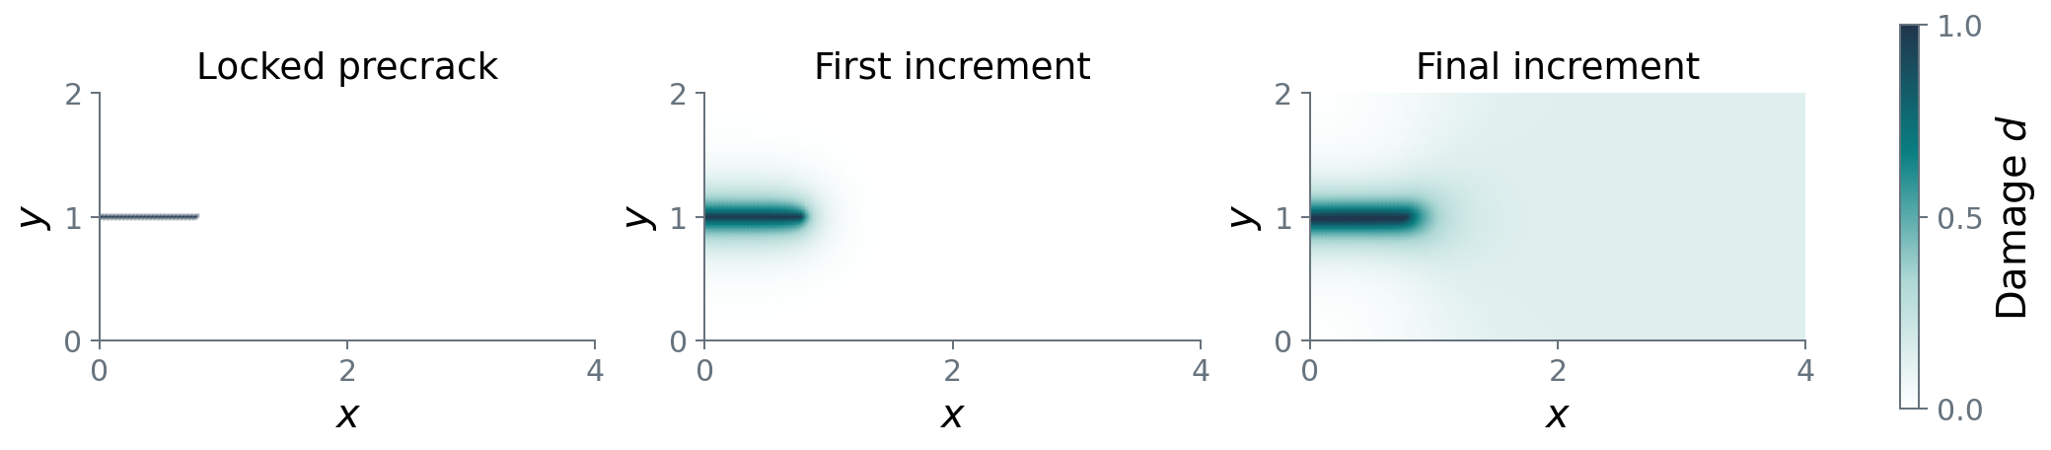
Read the field as well as the response
Separate the prescribed seed, its diffuse profile and subsequent damage change.
Quasistatic AT2 response: initial damage, diffuse regularisation and loading-induced change.
CEMS-Lab · UKACM Autumn School 2026
10
Notes:
Delivery placement: L1.
Compare the prescribed seed, first solution and final field on one damage scale. These figures display the retained course calculation. Read the reaction trace and convergence diagnostics alongside the field. Use the execution receipt for the measured environment and runtime.
Sources and provenance:
source/slides/latex_figures/forward_fields.npz; forward_summary.json; evidence/notebook_runtime.json; evidence/package_rehearsal.json.
Course material created by Allamaprabhu Ani, CEMS-Lab, UKACM Autumn School 2026. Presented by Sathiskumar A. Ponnusami, Queen Mary University of London.

Slide 11
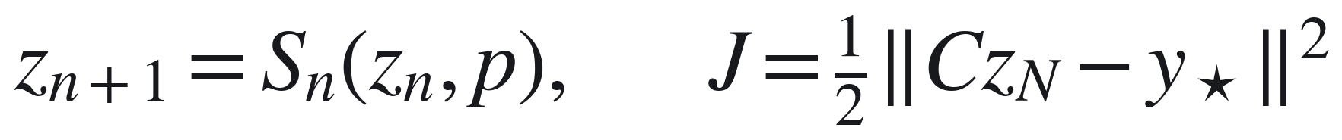

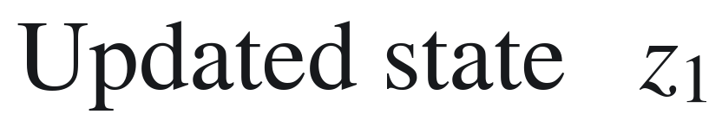

From an input to a final observation
Input: a material parameter, a load parameter or model weights
Observation: a fixed map from the final state to the measured quantities
Differentiate the final scalar loss with respect to a defined input.
CEMS-Lab · UKACM Autumn School 2026
11
Notes:
Delivery placement: L2.
Define the state vector z, parameter p, observation map C and fixed target. This example uses a fixed initial state and parameter dependence through the updates. Differentiation gives dJ/dp. An optimisation method then uses that gradient to choose a parameter update.
Sources and provenance:
Course source/book/05a_backpropagation_step_by_step.md; https://physicsbaseddeeplearning.org/diffphys.html.
Course material created by Allamaprabhu Ani, CEMS-Lab, UKACM Autumn School 2026. Presented by Sathiskumar A. Ponnusami, Queen Mary University of London.

Slide 12
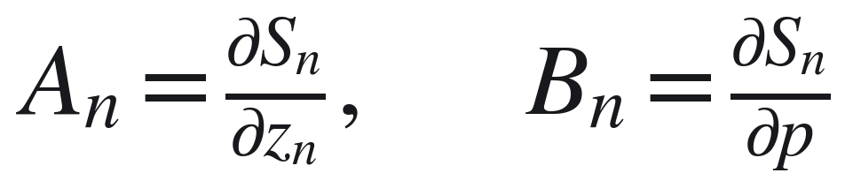
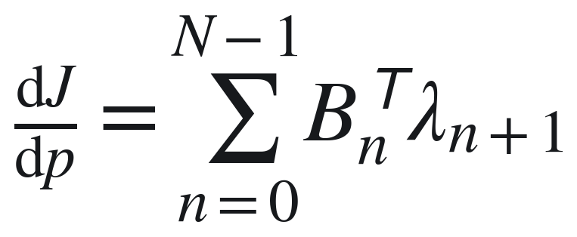
The backward pass through time steps
Each use of the same parameter
contributes to the final gradient.
Fixed initial state and observation map; parameter dependence enters through the updates.
CEMS-Lab · UKACM Autumn School 2026
12
Notes:
Delivery placement: L2.
Use column adjoints. Seed the terminal adjoint from the loss, propagate with local transposed state Jacobians and accumulate the parameter-Jacobian products at every use of p. Evaluate vector-Jacobian products directly. Direct loss dependence and parameter-dependent initial states contribute additional terms in the general case.
Sources and provenance:
Original course derivation source/book/05a_backpropagation_step_by_step.md; PyTorch autograd documentation; https://physicsbaseddeeplearning.org/diffphys.html.
Course material created by Allamaprabhu Ani, CEMS-Lab, UKACM Autumn School 2026. Presented by Sathiskumar A. Ponnusami, Queen Mary University of London.

Slide 13
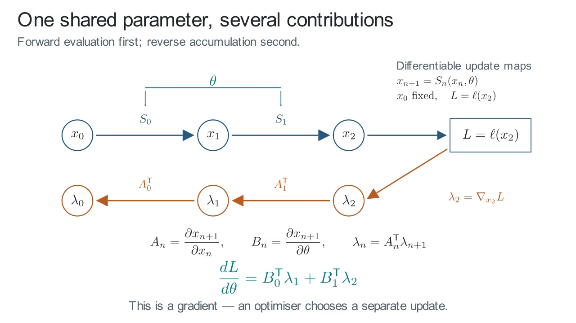
Every use of a parameter contributes
Observe
Clip notation
x: state z
θ: parameter p
L: loss J
Sum both parameter contributions
Click the figure to play or pause.
Two differentiable updates; fixed initial state; terminal scalar loss.
13
Notes:
L2 · 22–35 min. Two differentiable updates; fixed initial state; terminal scalar loss.
Play the 27.7-second clip. Pause around 15 seconds.
Ask: Why does the final derivative contain one contribution from each update?
Discussion: The shared parameter enters both update maps. Reverse accumulation propagates the terminal loss sensitivity through the state path and adds the local parameter-Jacobian products at both uses. The clip uses x, theta and L for the state, parameter and loss denoted z, p and J in the preceding slides.
Static fallback: media/reverse_accumulation_poster.png. Describe the same sequence from its poster.
Replay from the beginning after discussion. The clip is embedded in this deck and needs no network connection.
Original source: source/animations/learning_scenes.py: ReverseAccumulation
Created by Allamaprabhu Ani, CEMS-Lab, for the UKACM Autumn School 2026. Presented by Sathiskumar A. Ponnusami, Queen Mary University of London.

Slide 14
Implicit differentiation of a solved equation
Forward solve
Find a converged state satisfying the residual equation.
Adjoint solve
Solve the transposed sensitivity system, then form the parameter derivative.
Requires a differentiable residual and a locally nonsingular state Jacobian.
CEMS-Lab · UKACM Autumn School 2026
14
Notes:
Delivery placement: L2.
Rz and Rp are the residual Jacobians with respect to the state and parameter. Solve the transposed state system against the state loss gradient, then form the total parameter derivative. Unrolling differentiates the executed iterations. Implicit differentiation describes a local converged root with a differentiable residual and nonsingular state Jacobian. Treat active-set changes separately.
Sources and provenance:
Course source/book/05_differentiation_and_inverse.md; Ceyron adjoint_linear_system_example.py, commit a2e50a9df4bb6e938901b33fd957c06ac06b5224, pedagogical reference only.
Course material created by Allamaprabhu Ani, CEMS-Lab, UKACM Autumn School 2026. Presented by Sathiskumar A. Ponnusami, Queen Mary University of London.

Slide 15
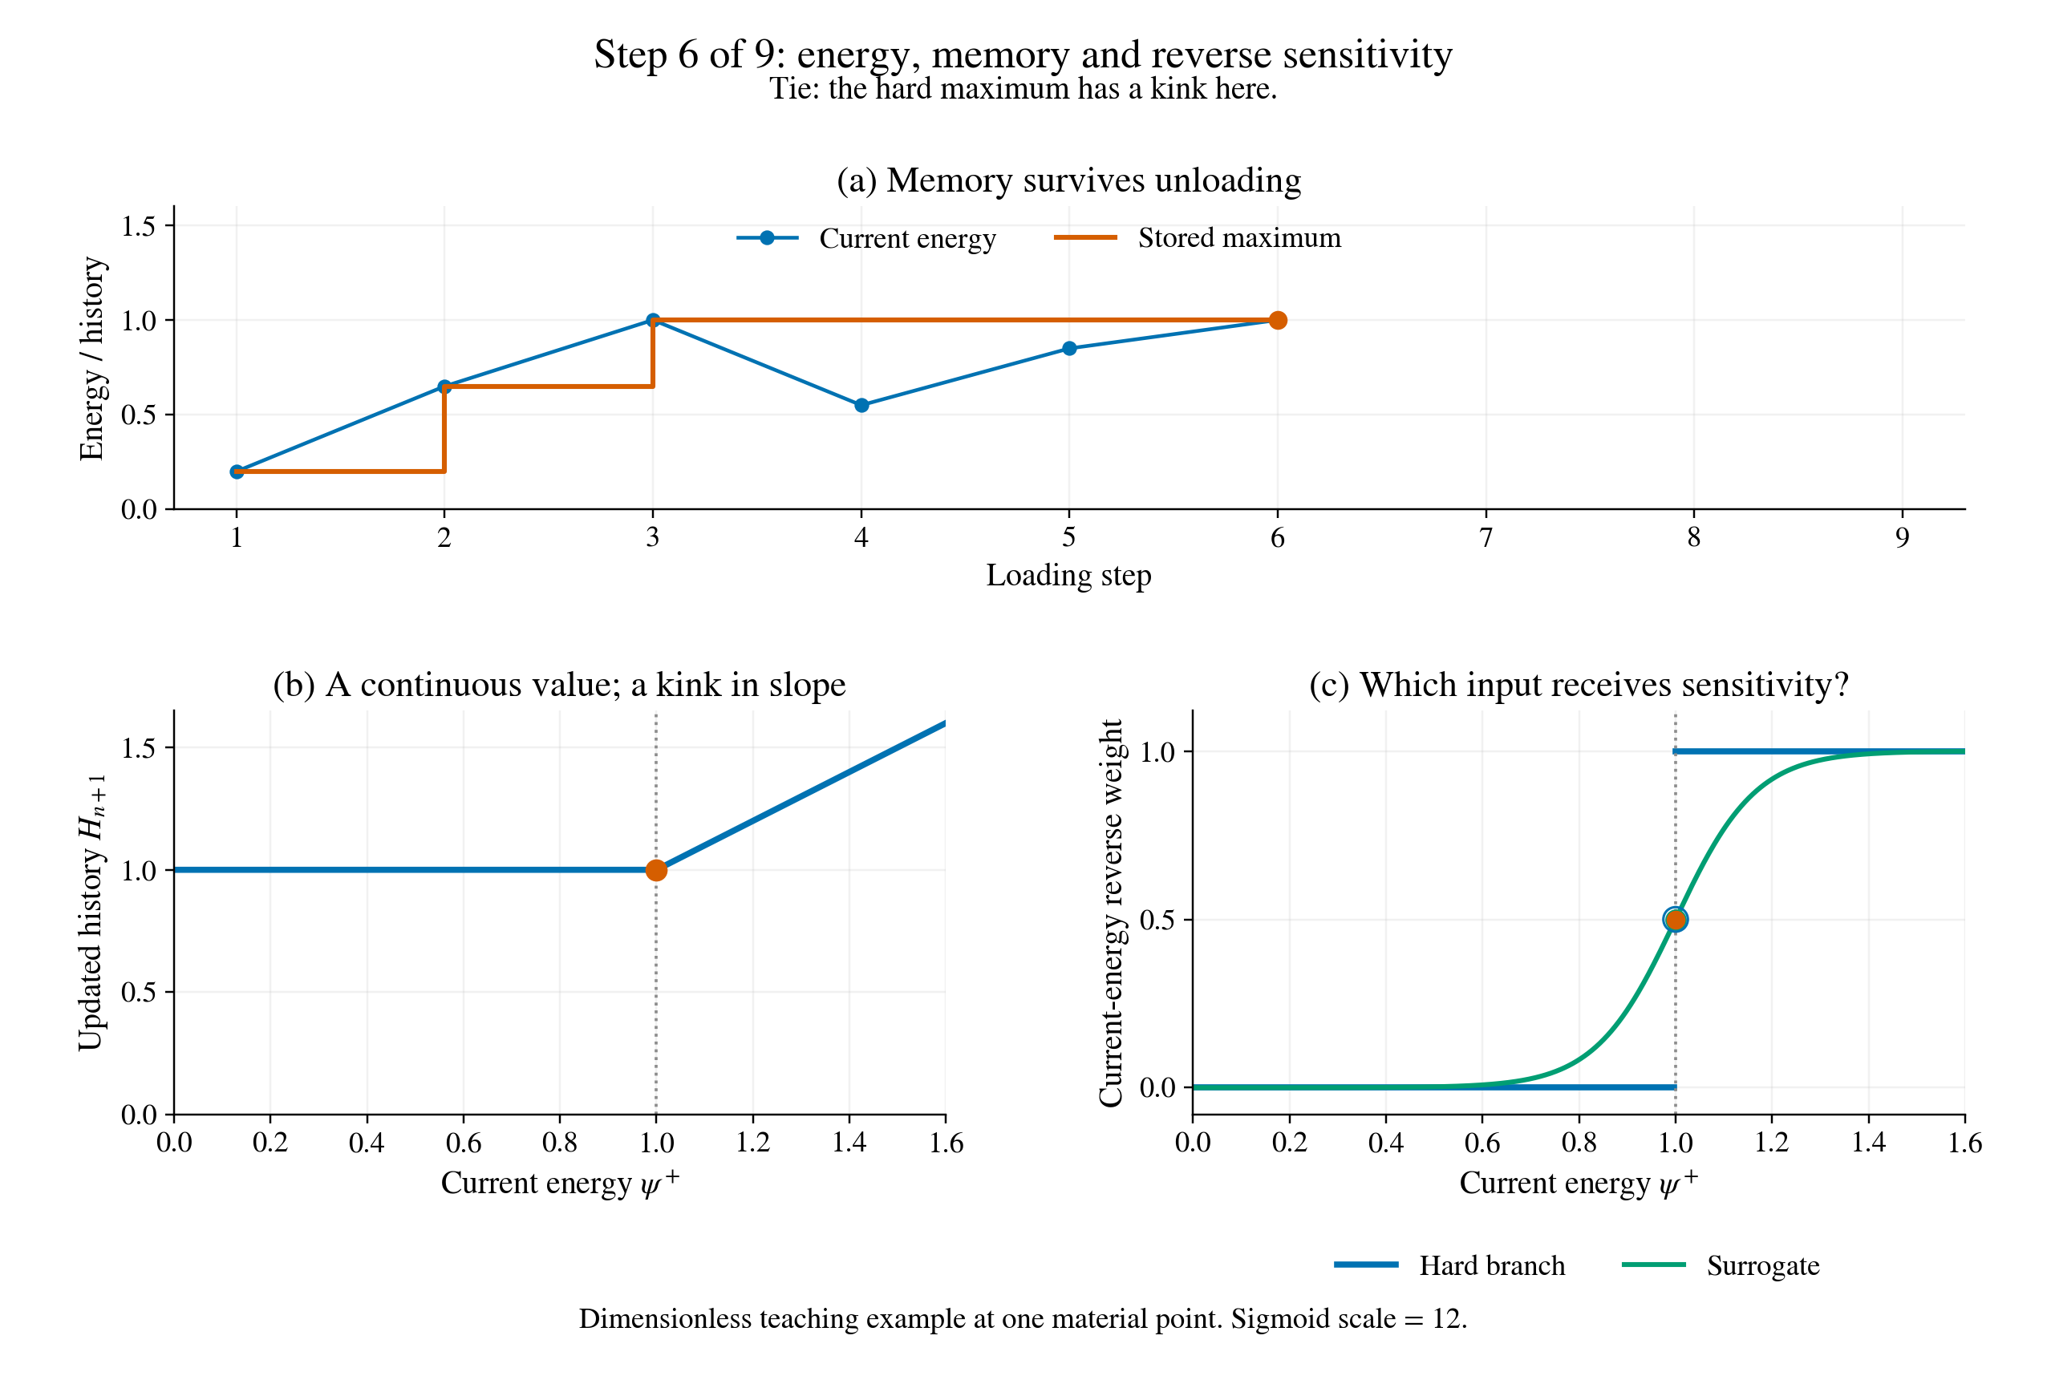
Stored history selects the active sensitivity
Observe
Energy can unload.
History retains its peak.
The active branch determines the local derivative.
At a tie, specify the derivative convention.
Click the figure to play or pause.
Dimensionless material-point teaching example. Green: surrogate reverse weights.
15
Notes:
L2 · 35–45 min. Dimensionless material-point teaching example. Green: surrogate reverse weights.
Play the 18-second clip. Pause around 10 seconds.
Ask: During unloading below the previous peak, which input receives the hard-history sensitivity?
Discussion: For H_new=max(H_old, psi), the old history receives the derivative when psi<H_old; the current energy receives it when psi>H_old. At equality the maximum is nonsmooth. The displayed 0.5 marker is a selected tie convention. The green sigmoid weights define a surrogate backward rule; they describe a different derivative rule from the hard maximum away from the branch transition as well.
Static fallback: media/history_switch_poster.png. Describe the same sequence from its poster.
Replay from the beginning after discussion. The clip is embedded in this deck and needs no network connection.
Original source: source/book/research/code/history_animation.py; history_lesson.py
Created by Allamaprabhu Ani, CEMS-Lab, for the UKACM Autumn School 2026. Presented by Sathiskumar A. Ponnusami, Queen Mary University of London.

Slide 16
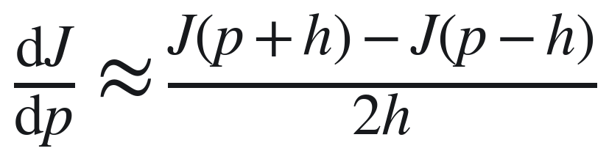
Check the derivative before using it
Automatic differentiation
Differentiate the implemented computation.
Independent check
Use an analytical expression or a hand-written adjoint.
Finite differences
Compare several spacings at the same physical state.
CEMS-Lab · UKACM Autumn School 2026
16
Notes:
Delivery placement: L2.
Compare automatic differentiation, an independent analytical or manual derivative and central finite differences at several spacings. Use float64 and a fixed discretisation. Interpret error through truncation and roundoff. For a quadratic, central differences are exact in real arithmetic. Inverse uniqueness depends on observation sensitivity and parameterisation.
Sources and provenance:
Course notebooks/02_degradation_autograd.ipynb; new diffusion draft; https://docs.pytorch.org/docs/stable/notes/autograd.html.
Course material created by Allamaprabhu Ani, CEMS-Lab, UKACM Autumn School 2026. Presented by Sathiskumar A. Ponnusami, Queen Mary University of London.

Slide 17
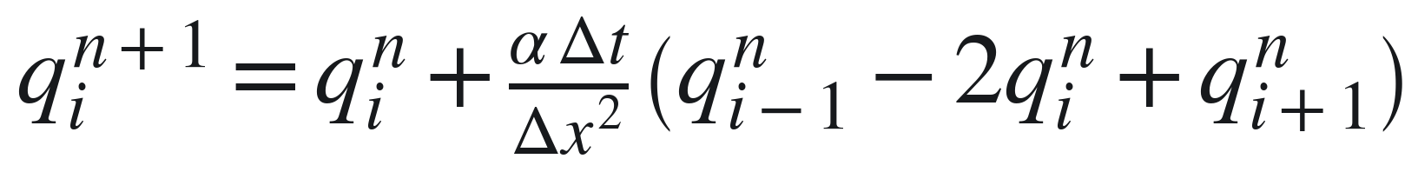
A small time-stepping notebook
Plot a forward trajectory.
Differentiate a terminal observation.
Compare AD, manual reverse mode and finite differences.
Recover a synthetic parameter.
One-dimensional diffusion provides a compact example of time-step differentiation.
CEMS-Lab · UKACM Autumn School 2026
17
Notes:
Delivery placement: L2.
The one-dimensional diffusion lesson makes shared-parameter accumulation explicit. Forward Euler with the central stencil requires alpha*dt/dx^2<=1/2. The bounded parameter interval and fixed time step respect this condition. Students read short update loops, compare derivatives and recover a diffusivity from a synthetic target.
Sources and provenance:
notebooks/drafts/06_differentiability_step_by_step.ipynb; original code. Cell sequencing inspired by Felix Köhler, hybridization-in-jax/first_data_assimilation.ipynb at61ee2629f5800d92fba64492a0f81efe3a6a7c39; no code copied.
Course material created by Allamaprabhu Ani, CEMS-Lab, UKACM Autumn School 2026. Presented by Sathiskumar A. Ponnusami, Queen Mary University of London.

Slide 18
What learning can contribute
Approximation
Represent a complex relation between inputs and physical responses.
Repeated queries
Amortise a training investment across many suitable predictions.
A learned component
Propose a material response or a correction inside a numerical method.
Compare data generation, training, prediction and correction costs separately.
CEMS-Lab · UKACM Autumn School 2026
18
Notes:
Delivery placement: L3 / practical bridge.
A learned relation can approximate a material response, supply a proposal or support repeated queries. Compare the complete cost of data generation, training, prediction and correction for the intended range of loads and geometries.
Sources and provenance:
Course source/book/06_learning_adapter.md; Physics-Based Deep Learning, https://physicsbaseddeeplearning.org/diffphys.html
Course material created by Allamaprabhu Ani, CEMS-Lab, UKACM Autumn School 2026. Presented by Sathiskumar A. Ponnusami, Queen Mary University of London.

Slide 19
What a prediction must satisfy
Physical conditions
Boundary conditions, balance laws and admissible material states.
Numerical accuracy
Discretisation error, solver tolerance and the chosen observation.
Use beyond training
Unseen loads, geometries and material parameters require evaluation.
Assess prediction accuracy and physical consistency separately.
CEMS-Lab · UKACM Autumn School 2026
19
Notes:
Delivery placement: L3 / practical bridge.
Separate approximation, discretisation and optimisation errors. A soft physics penalty enters the objective. Exact constraints enforce a relation by construction. Evaluate both approaches in the intended physical setting.
Sources and provenance:
Course source/book/06_learning_adapter.md.
Course material created by Allamaprabhu Ani, CEMS-Lab, UKACM Autumn School 2026. Presented by Sathiskumar A. Ponnusami, Queen Mary University of London.

Slide 20
Coupling a network and a solver
Prediction with a learned component
Physical state
Learned proposal
Solver + checks
Training through the numerical response
Model weights
Differentiable solve
Observation loss
Backward sensitivity: loss → solve → model weights
Blue: forward evaluation. Orange: backward sensitivity. Each interface has a contract.
CEMS-Lab · UKACM Autumn School 2026
20
Notes:
Delivery placement: L3 / practical bridge.
The first diagram shows inference through a compatible model interface. The second shows a training objective evaluated after a differentiable solve. Reverse-mode differentiation propagates the loss sensitivity through each intervening operation to the model weights. The classroom adapter uses a Helmholtz-type teaching equation.
Sources and provenance:
Original diagram; course source/book/06_learning_adapter.md; https://physicsbaseddeeplearning.org/diffphys.html
Course material created by Allamaprabhu Ani, CEMS-Lab, UKACM Autumn School 2026. Presented by Sathiskumar A. Ponnusami, Queen Mary University of London.

Slide 21
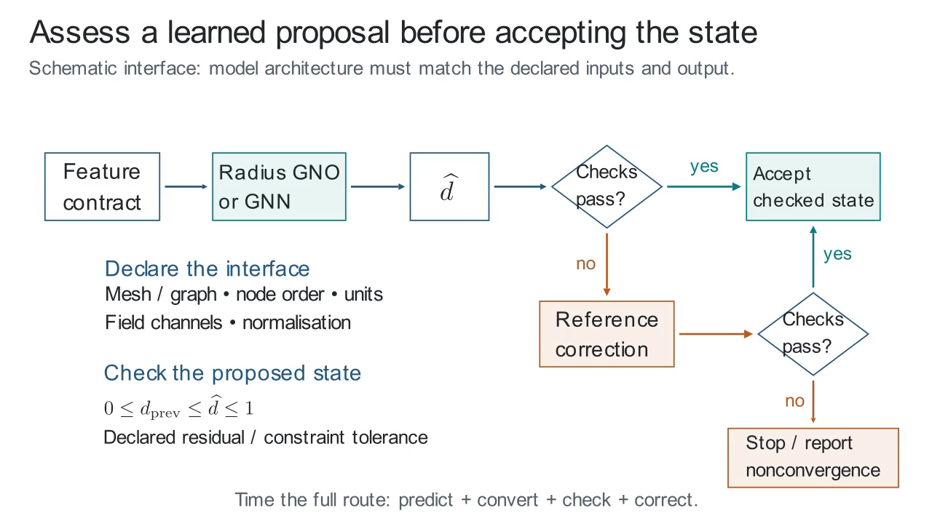
A learned field enters a checked interface
Observe
Declare features.
Propose a field.
Check and correct.
Recheck the result.
Click the figure to play or pause.
Interface schematic. Practical models: MLP/RBF on a Helmholtz-type teaching field.
21
Notes:
L3 · 32–45 min. Interface schematic. Practical models: MLP/RBF on a Helmholtz-type teaching field.
Play the 26.5-second clip. Pause around 15 seconds.
Ask: Which checks should a proposed damage field satisfy before the simulation accepts it?
Discussion: Check the declared node/graph ordering, units, normalisation and output location first. Check prescribed values, bounds, irreversibility and the declared residual tolerance. A corrected state is checked again. The graphic names Radius GNO/GNN as possible architecture contracts; the practical trains MLP/RBF models for a Helmholtz-type field problem. Total cost includes graph construction, prediction, conversion, checks and correction.
Static fallback: media/checked_learned_proposal_poster.png. Describe the same sequence from its poster.
Replay from the beginning after discussion. The clip is embedded in this deck and needs no network connection.
Original source: source/animations/learning_scenes.py: CheckedLearnedProposal
Created by Allamaprabhu Ani, CEMS-Lab, for the UKACM Autumn School 2026. Presented by Sathiskumar A. Ponnusami, Queen Mary University of London.

Slide 22
Keep a reproducible numerical experiment
Input specification
Geometry, connectivity, materials, boundary values and loading.
Numerical specification
Algorithm, precision, tolerances and failure conditions.
Saved evidence
Field arrays, response history, configuration and source revision.
Reload the saved data into fresh variables, then reproduce a plot.
CEMS-Lab · UKACM Autumn School 2026
22
Notes:
Delivery placement: L3 / practical bridge.
NPZ stores named arrays, JSON stores scalar metadata and histories, and PNG or PDF stores figures. A .pt model checkpoint additionally needs its feature and normalisation contract. The current forward archive contains nodes, elements, prescribed damage and damage snapshots. Explain how those fields support the plotted results.
Sources and provenance:
source/planning/PRACTICAL_SEQUENCE_AUDIT_20260909.md; notebooks/day2_helpers/course_tools.py.
Course material created by Allamaprabhu Ani, CEMS-Lab, UKACM Autumn School 2026. Presented by Sathiskumar A. Ponnusami, Queen Mary University of London.

Slide 23
The practical learning cycle
Predict
What should change, and in which direction?
Compute
Run one short, inspectable calculation.
Explain
Use a field, a response and an independent check.
Companion book, executable notebooks and worked solutions: CEMS-Lab autumn-school.
CEMS-Lab · UKACM Autumn School 2026
23
Notes:
Delivery placement: L3 / practical bridge.
Ask students to predict, run a small calculation and explain the result. Separate setup from numerical execution. Use the recorded outputs for discussion and the downloadable notebook for experimentation. The course computational budget is 300 seconds per task after setup.
Sources and provenance:
Ceyron notebook references: source/planning/CEYRON_NOTEBOOK_DESIGN.md; D2L and Physics-Based Deep Learning supplied by the user as pedagogical references.
Course material created by Allamaprabhu Ani, CEMS-Lab, UKACM Autumn School 2026. Presented by Sathiskumar A. Ponnusami, Queen Mary University of London.

