Slide 1

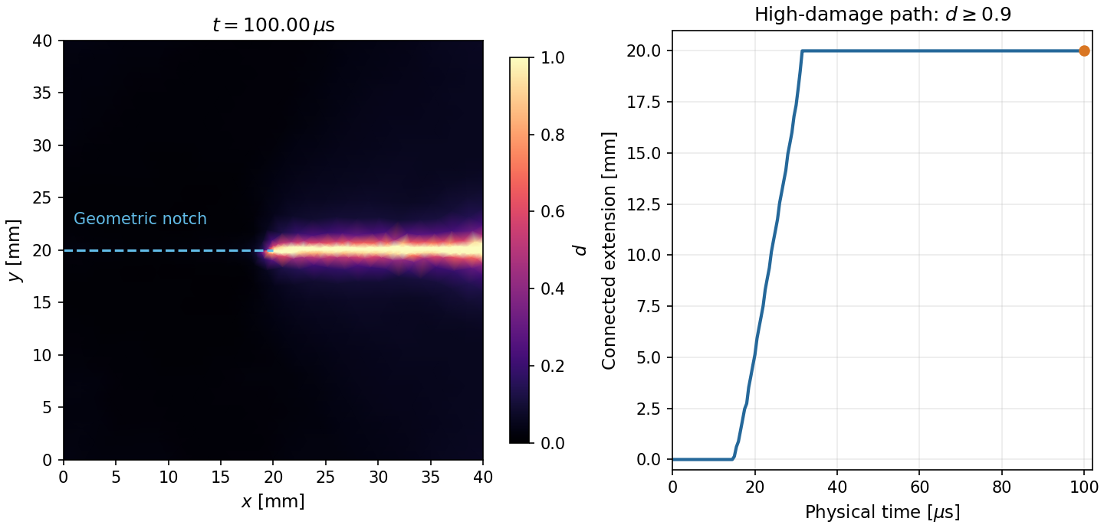
Phase-field fracture and differentiable simulation with PhAST
UKACM Autumn School 2026 · six-hour lecture and notebook sequence
Presented by
Sathiskumar A. Ponnusami
Queen Mary University of London · CEMS-Lab
Computed phase-field fracture trajectory
Prepared by Allamaprabhu Ani and Sathiskumar A. Ponnusami
CEMS-Lab · UKACM Autumn School 2026
1
Notes:
Presented by Sathiskumar A. Ponnusami, Queen Mary University of London. Prepared by Allamaprabhu Ani and Sathiskumar A. Ponnusami, CEMS-Lab.
Opening slide. Introduce the course as an applied route from fracture modelling to differentiable simulation and machine-learning interfaces.

Slide 2
One master deck, three connected sections
The extended scaffold and specialist modules remain available as insertable teaching resources.
01
02
03
Phase-field fracture
Differentiability
Learning interfaces
Energy, degradation, discretisation, and a compact dynamic run.
Forward evaluation, local sensitivities, reverse accumulation, and recovery.
Train, save, reload, audit, and couple a learned component.
CEMS-Lab · UKACM Autumn School 2026
2
Notes:
Presented by Sathiskumar A. Ponnusami, Queen Mary University of London. Prepared by Allamaprabhu Ani and Sathiskumar A. Ponnusami, CEMS-Lab.
Explain that this deck is the standard presentation entry point. The 90-slide outline provides the long-form delivery structure; short specialist decks provide selectable inserts.

Slide 3
SECTION 01
Phase-field fracture and the PhAST workflow
Represent fracture by a smooth damage field, then resolve coupled mechanics and damage.
CEMS-Lab · UKACM Autumn School 2026
3
Notes:
Presented by Sathiskumar A. Ponnusami, Queen Mary University of London. Prepared by Allamaprabhu Ani and Sathiskumar A. Ponnusami, CEMS-Lab.
Section divider. Ask students to predict where damage will extend before showing the next slide.

Slide 4
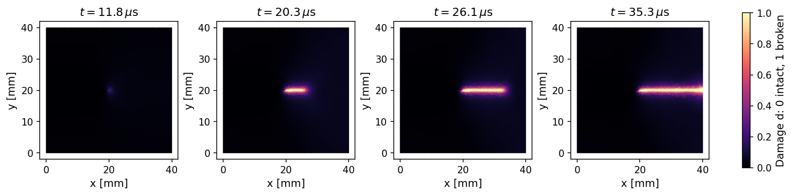
A compact dynamic plate produces a visible fracture trajectory
The visual shows a computed diffuse damage field; the bright core is highlighted without reinterpreting it as a sharp crack.
Damage field: d = 0 intact · d = 1 fractured · high-damage core shown at d ≥ 0.95
CEMS-Lab · UKACM Autumn School 2026
4
Notes:
Presented by Sathiskumar A. Ponnusami, Queen Mary University of London. Prepared by Allamaprabhu Ani and Sathiskumar A. Ponnusami, CEMS-Lab.
Walk left-to-right through the four snapshots. Damage is d=0 in intact material and d=1 in fully damaged material. The high-damage core is a display aid defined by d greater than or equal to 0.95.

Slide 5
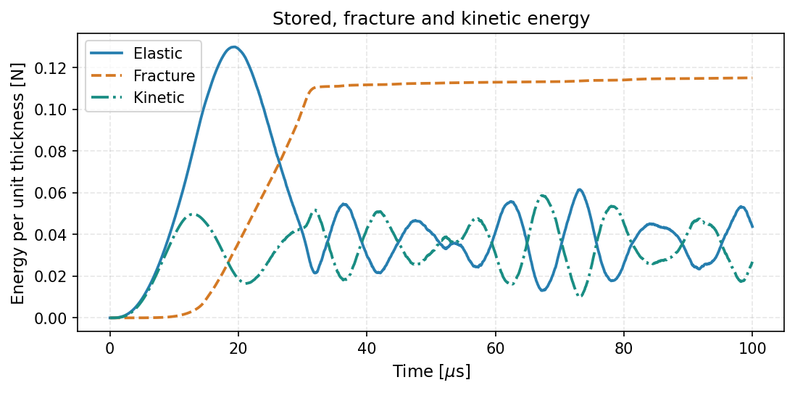
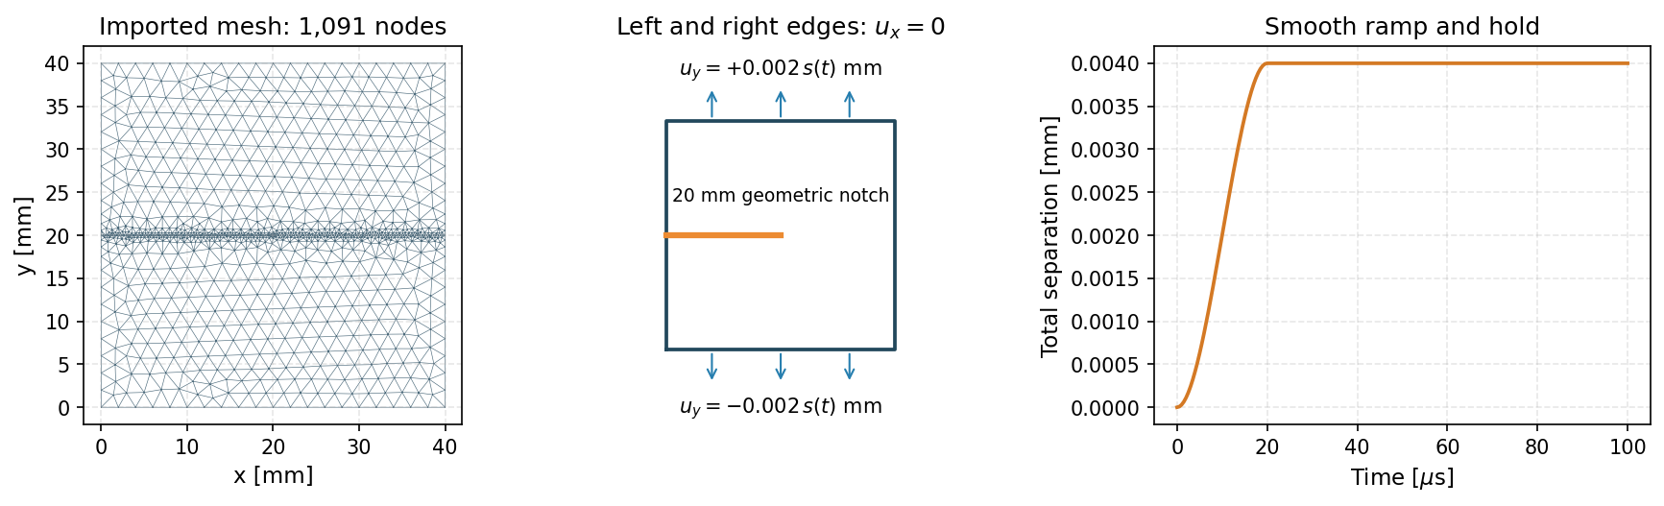
Fields, boundary conditions, and energy checks stay connected
Notebook 01 gives each setup action an immediately visible outcome.
CEMS-Lab · UKACM Autumn School 2026
5
Notes:
Presented by Sathiskumar A. Ponnusami, Queen Mary University of London. Prepared by Allamaprabhu Ani and Sathiskumar A. Ponnusami, CEMS-Lab.
Use the left panel to introduce geometry, notch, mesh, and boundary condition labels. Use the right panel to explain that results are interpreted using both fields and energy histories.

Slide 6
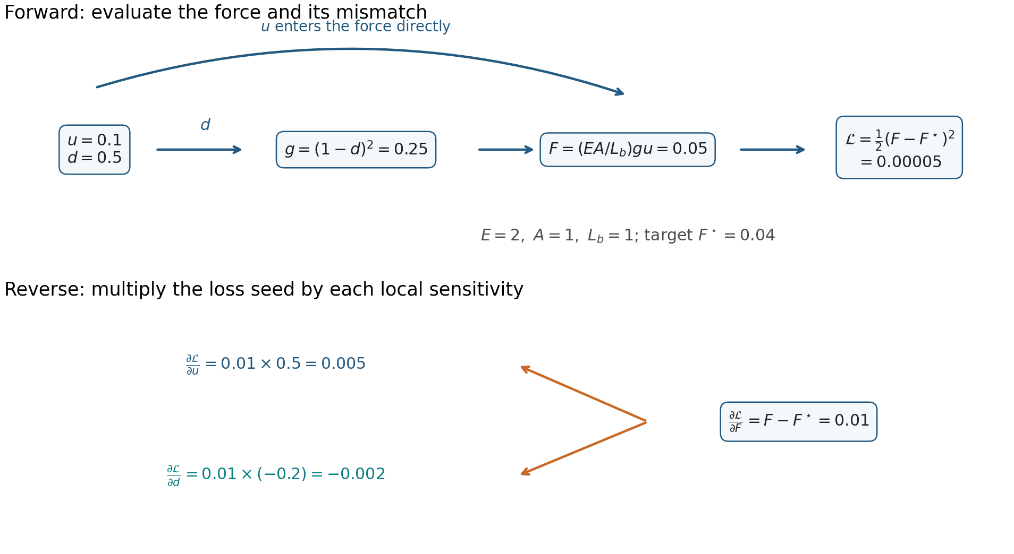
SECTION 02
Differentiability, sensitivities, and inverse questions
A scalar objective can send information back through tensor operations to the parameters that shaped the response.
CEMS-Lab · UKACM Autumn School 2026
6
Notes:
Presented by Sathiskumar A. Ponnusami, Queen Mary University of London. Prepared by Allamaprabhu Ani and Sathiskumar A. Ponnusami, CEMS-Lab.
Section divider. Emphasise that the section begins with a small damaged-bar example before returning to the solver-scale setting.

Slide 7
From a measured force mismatch to input gradients
The toy damaged bar keeps the chain rule visible before students encounter solver-scale tensors.
CEMS-Lab · UKACM Autumn School 2026
7
Notes:
Presented by Sathiskumar A. Ponnusami, Queen Mary University of London. Prepared by Allamaprabhu Ani and Sathiskumar A. Ponnusami, CEMS-Lab.
Read the forward path first: prescribed displacement and damage determine force and loss. Then read the reverse path: the scalar loss sends derivatives back to the shared inputs. This is the same computational principle used by PyTorch autograd in the solver.

Slide 8
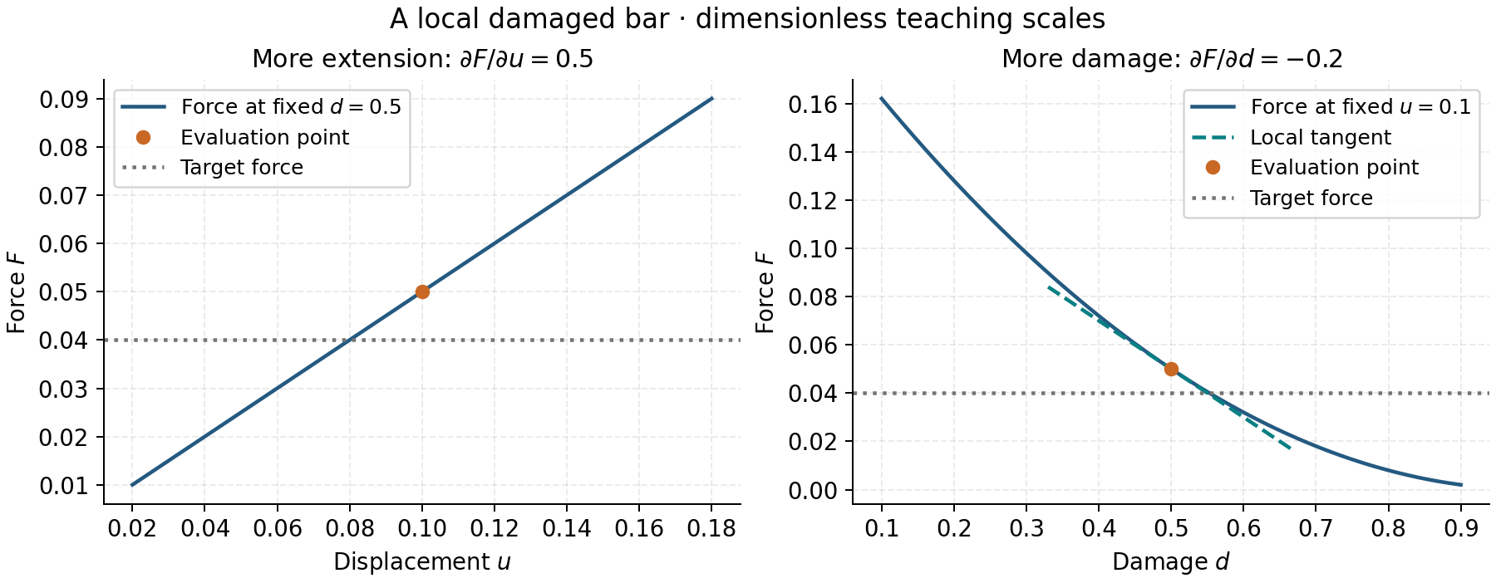
Local derivatives retain physical interpretation
At fixed damage, displacement raises force; at fixed displacement, damage lowers the retained stiffness and force.
CEMS-Lab · UKACM Autumn School 2026
8
Notes:
Presented by Sathiskumar A. Ponnusami, Queen Mary University of London. Prepared by Allamaprabhu Ani and Sathiskumar A. Ponnusami, CEMS-Lab.
Use this plot to interpret derivative signs before discussing numerical gradient checks and inverse recovery. The illustrated points are dimensionless teaching values, not a calibration result.

Slide 9
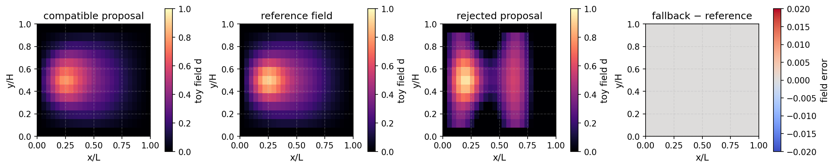
SECTION 03
Learning interfaces and hybrid simulation
A learned model can be inserted at a defined interface, trained against data, and audited against a physics-based reference.
CEMS-Lab · UKACM Autumn School 2026
9
Notes:
Presented by Sathiskumar A. Ponnusami, Queen Mary University of London. Prepared by Allamaprabhu Ani and Sathiskumar A. Ponnusami, CEMS-Lab.
Section divider. State that a learned component is an explicit proposal inside an auditable workflow, not a replacement for the problem definition.

Slide 10
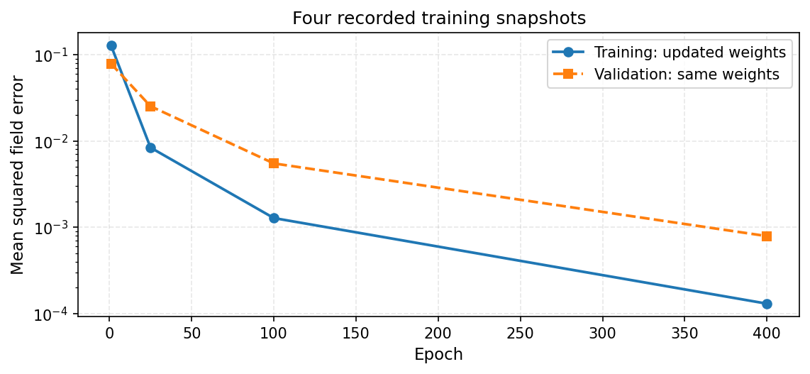
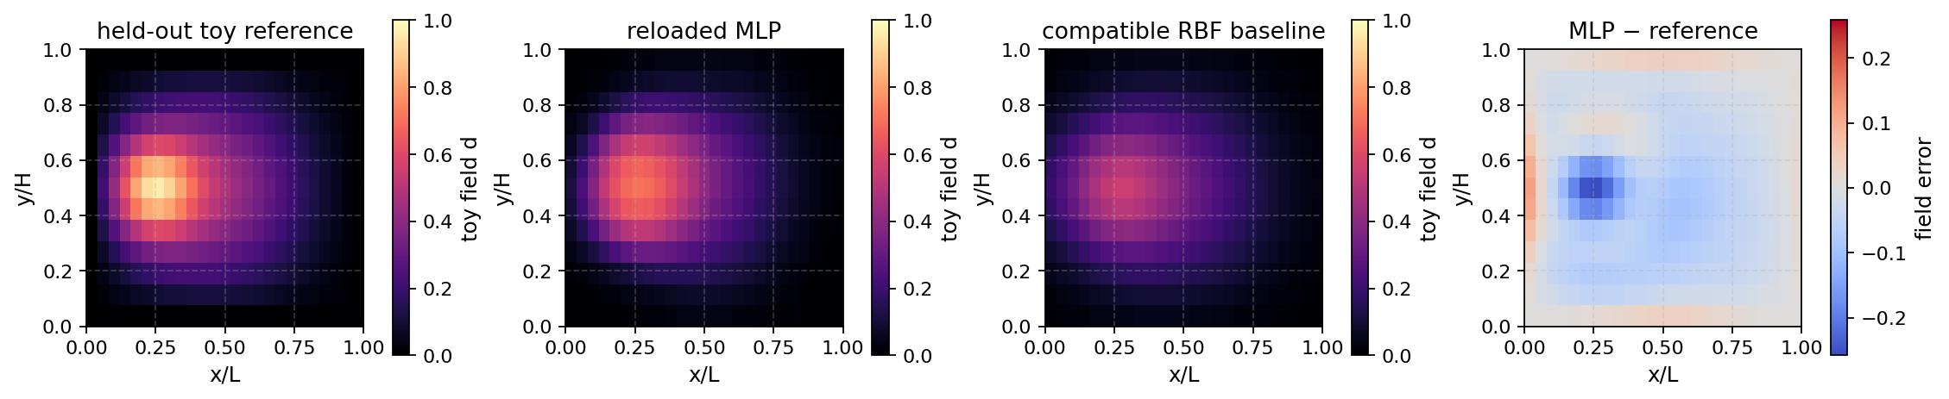
A learning workflow has a clear hand-off and a clear check
Notebook 03 trains a toy field predictor, reloads it, then evaluates the prediction against a reference.
Training history
Held-out reference, reloaded MLP, compatible baseline, and error
CEMS-Lab · UKACM Autumn School 2026
10
Notes:
Presented by Sathiskumar A. Ponnusami, Queen Mary University of London. Prepared by Allamaprabhu Ani and Sathiskumar A. Ponnusami, CEMS-Lab.
Use this as the bridge to model modularity. The notebook can be extended from the small MLP to an RBF model, GNN, GNO, or CNN provided the input-output interface and verification remain explicit.

Slide 11
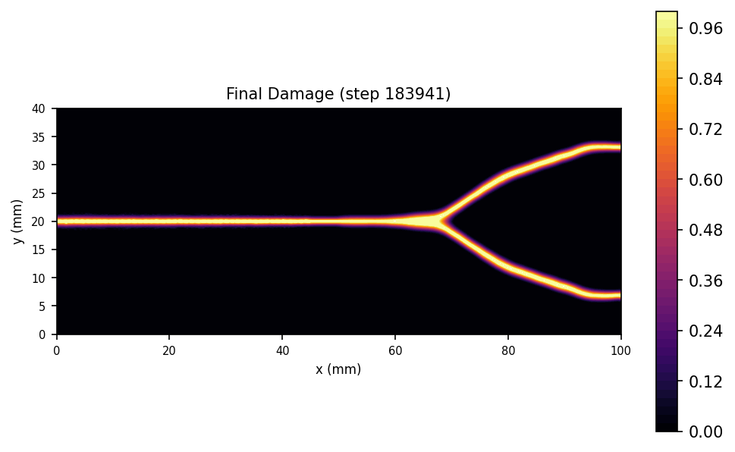
Dynamic branching is a recorded reference exhibit
A separate PhAST example illustrates branching; it is retained as a media insert rather than presented as a classroom runtime target.
Reference exhibit: dynamic crack branching · use MP4/GIF during delivery when supported
CEMS-Lab · UKACM Autumn School 2026
11
Notes:
Presented by Sathiskumar A. Ponnusami, Queen Mary University of London. Prepared by Allamaprabhu Ani and Sathiskumar A. Ponnusami, CEMS-Lab.
This slide distinguishes the two-minute classroom B3 run from the higher-complexity B7 branching reference. The B7 media originates from the pinned public PhAST example recorded in the asset source record.

Slide 12

Continue from a working course site and three short notebooks
The web edition carries the course narrative; notebooks provide the reproducible practical route.
• Phase field provides a regularised fracture representation.
• Tensor operations enable differentiation through a simulation workflow.
• Verified interfaces let learning components enter the workflow responsibly.
cems-lab.github.io/autumn-school
CEMS-Lab · UKACM Autumn School 2026
12
Notes:
Presented by Sathiskumar A. Ponnusami, Queen Mary University of London. Prepared by Allamaprabhu Ani and Sathiskumar A. Ponnusami, CEMS-Lab.
Closing slide. Invite students to use the live book, download the notebooks, and open an issue or discussion after the school. The QR code points to the public PhAST repository.

