Slide 1



Hardware Code Generation Techniques for Accelerating Python
Jackson P. Morgan, Todd S. Palmer, and Kyle E. Niemeyer
The Center for Exascale Monte Carlo Neutron Transport (CEMeNT)
Oregon State University
Annual Meeting of the American Nuclear Society, Anaheim, CA
June 16th, 2022
This work was supported by the Center for Exascale Monte-Carlo Neutron Transport (CEMeNT) a PSAAP-III project funded by the Department of Energy, grant number: DE-NA003967

Slide 2
Introduction

Slide 3
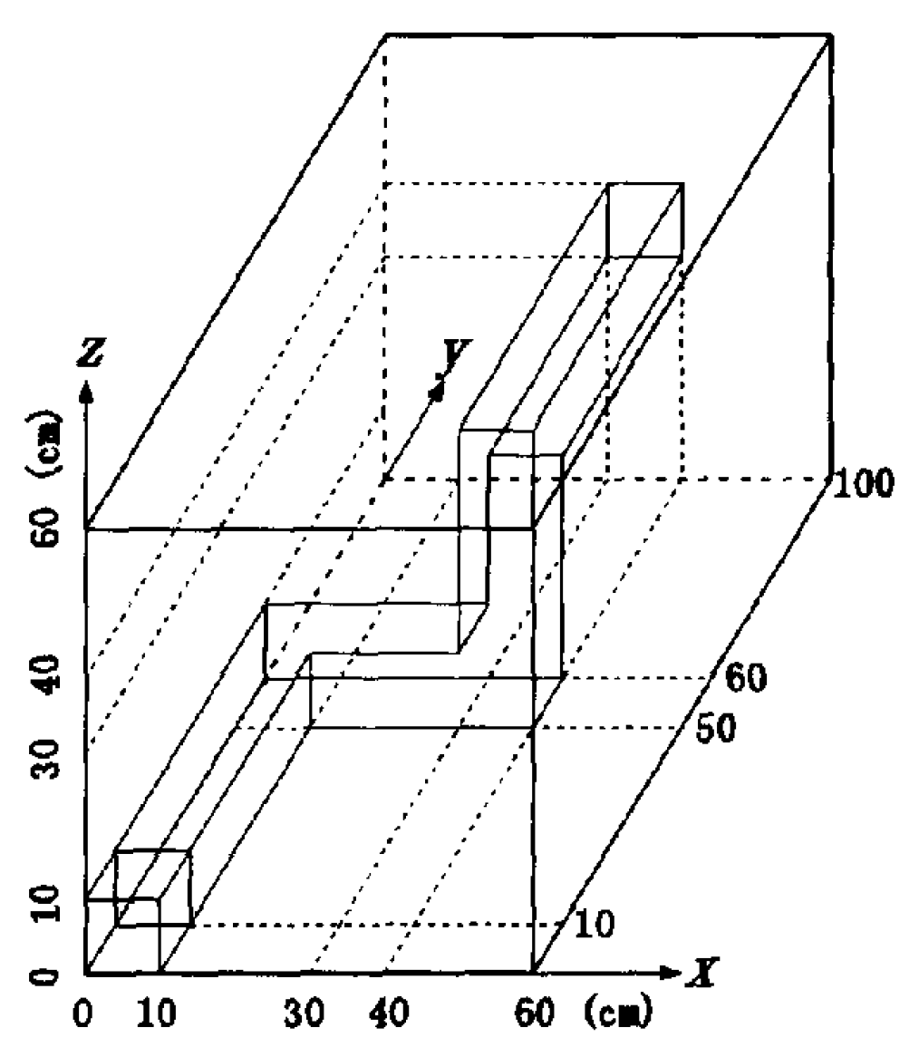
MC/DC: Monte Carlo / Dynamic Code
Dynamic neutron transport solver made for rapid methods exploration at high performance computing and exa-scale
Target various hardware architectures
Written in Python
Kobyashi Problem: Image courtesy Ilham Variansyah

Slide 4
MC/DC–TNT: Toy Neutronics Testbed
Mono-energetic, slab-geometry, transient tallies, fission, event-based, with surface tracking
Architecture targets: Nvidia GPUs and x86 CPUs
Validated with AZURV1 [1]
Vacuum
Vacuum
L = 40cm, ν = 2.3, Δx = 0.49cm Σ_{cap} = Σ_{scat} = Σ_{fis} = 1/3cm⁻¹

Slide 5
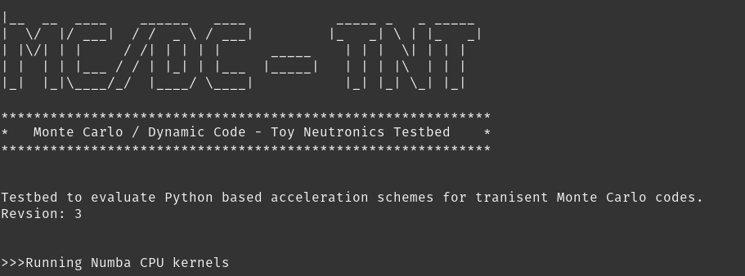
MC/DC–TNT
Modularity in mind
10 accelerated functions
Advance implemented on hardware target
.
└── mcdc_tnt
├── numba_kernels
│ ├── cpu
| ├── pyopenmp
│ └── cuda
├── pk_kernels
├── hcgl_kernels
└── pure_py_kernels

Slide 6
Methods of Acceleration

Slide 7
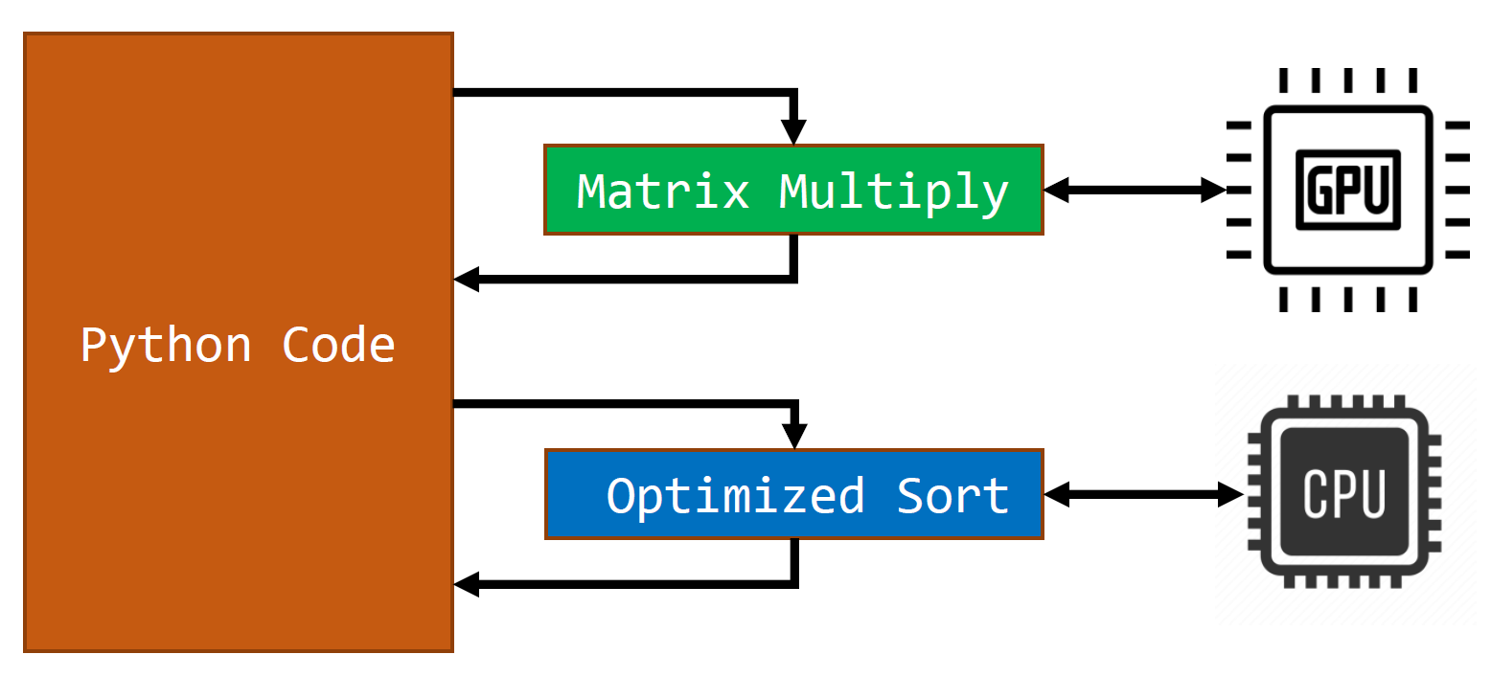
Heterogeneous Targeting: Python Glue
Python serves as glue code
Native Python modules used produce and just-in-time (JIT) schemes
Can target multiple architecture types

Slide 8
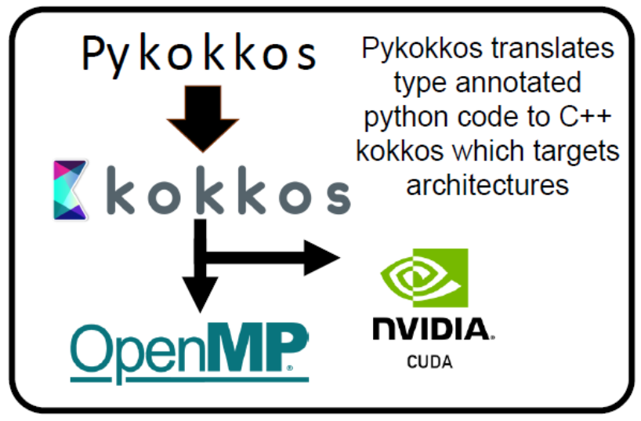
PyKokkos
Python library that implements parts of Kokkos Portability framework [2]
Brand new and under active development
Currently building out HIP functionality

Slide 9
Numba + CUDA
Converts Python code then implements the LLVM compiler [3]
Industry support and active development
Often operates on pure Python code
Experimental full implementation of OpenMP [4]

Slide 10
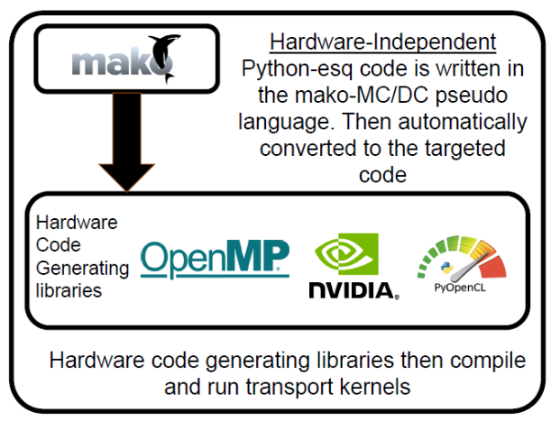
HCGL and Mako Templating Engine
Implemented on PyFR [5] at petascale [6]
Code-generating libraries to compile templated code
Our implementation plugs into PyCUDA and g++

Slide 11
Results

Slide 12
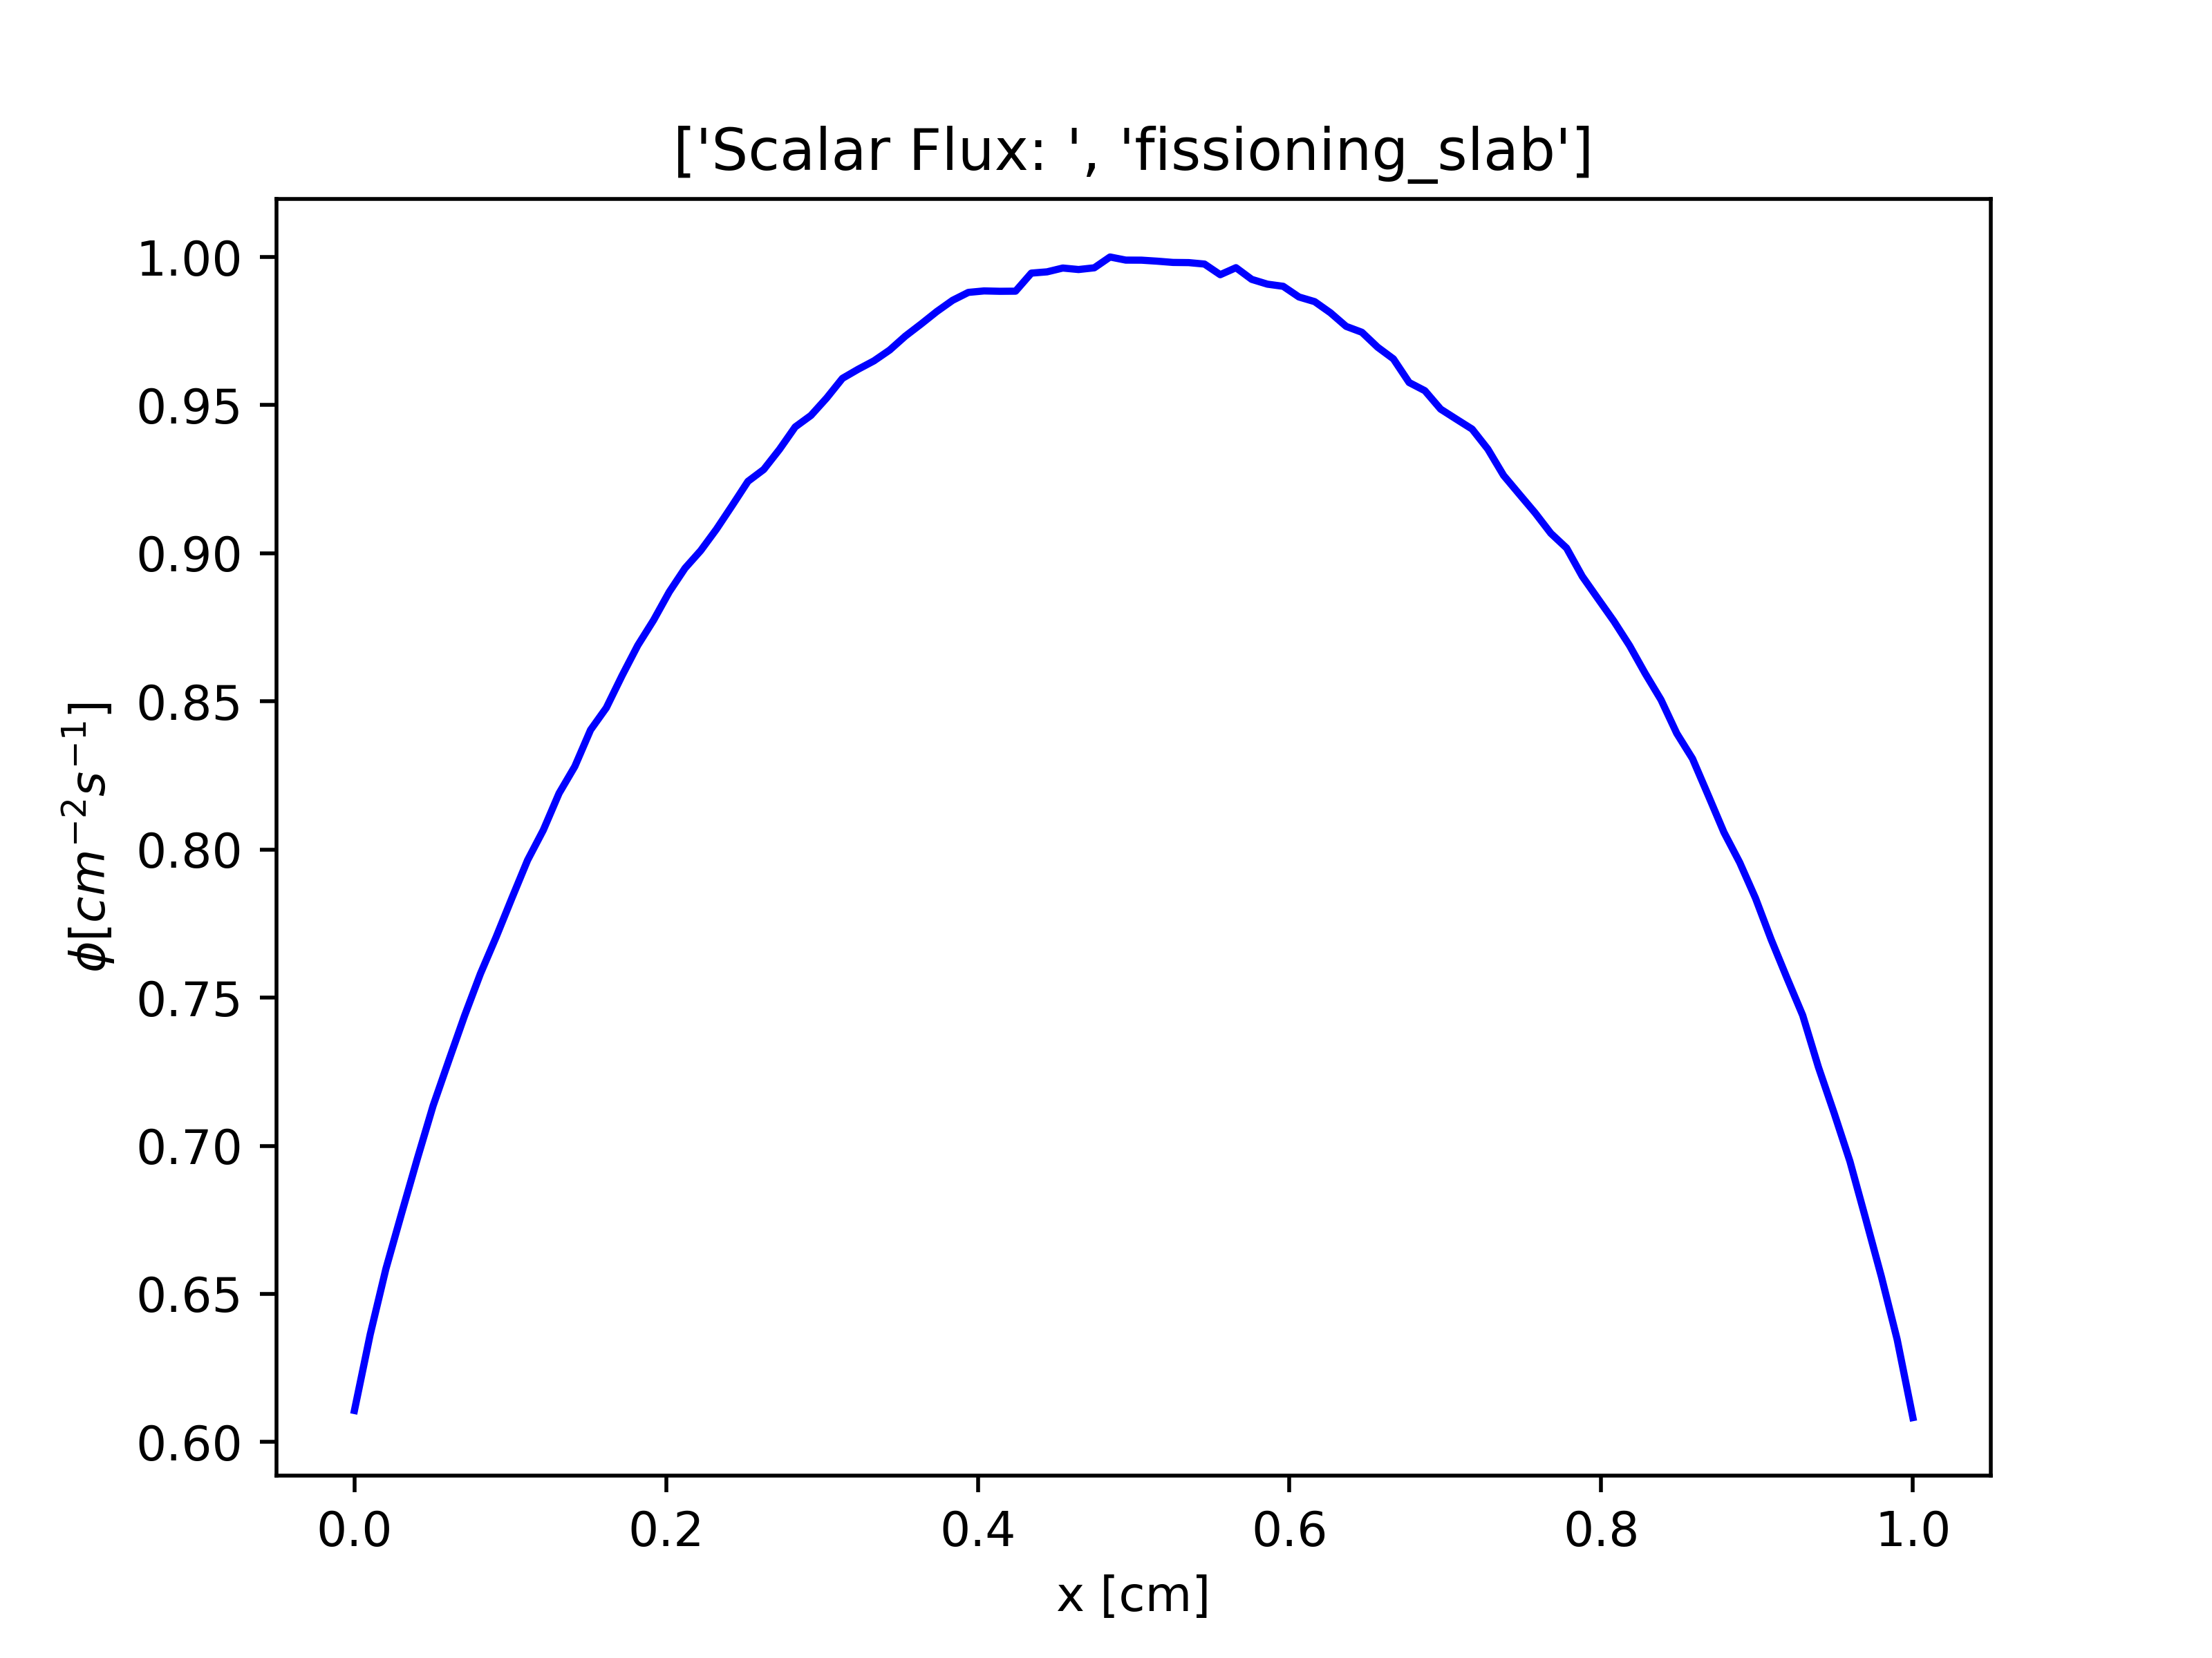
Runtime Test Problem
Sub-critical slab with initial population of 1×10⁸ particles
Validated with MC/DC
Follow particles till death
Vacuum
Vacuum
L = 1cm, ν = 2, Δx = 0.01cm Σ_{cap} = Σ_{scat} = Σ_{fis} = 1/3cm⁻¹

Slide 13
Performance: CPU
Integration test problem: L = 1cm, Δx = 0.01cm, Σ_{f} = Σ_{c} = Σ_{s} = 1/3 cm⁻¹, ν = 2, vacuum boundary conditions on LHS and RHS w/ 1 × 10⁸ Initial particles
Method of Implementation | Compile Time [s] | Run Time [s]
Pure Python* | N/A | 52970
Numba (Native threading) | 5.28 | 232.3
Numba PyOmp | 5.66 | 382.3
PyKokkos | 37.50 | 158.4
16 threads on an i7-10875H CPU
*one thread

Slide 14
Performance: GPU Implementation
Integration test problem: L = 1cm, Δx = 0.01cm, Σ_{f} = Σ_{c} = Σ_{s} = 1/3 cm⁻¹, ν = 2, vacuum boundary conditions on LHS and RHS w/ 1 × 10⁸ Initial particles
Method of Implementation | Compile Time [s] | Run Time [s]
Numba | 6.25 | 179.36
PyKokkos | 39.72 | 385.24
HCGL (PyCUDA) | 2.45 | 160.53
1 single GPU (NVIDIA TeslaV100 at 1530MHz w/ 16GB) on 1 Lassen node

Slide 15
Conclusions and Future Work

Slide 16


Difficulty of Implementation
Numba is simple
Pykokkos is more difficult
HCGL is very difficult but more performant

Slide 17
Performance
Ease of use inversely proportional to max performance
Every method is very performant! (relative to Python)
Diminishing returns for more difficult implementations

Slide 18
Future Work
Complete transient tally implementation for all methods
Test deployment on new hardware
Implement testbed in C++
Implement Numba on MC/DC to accelerate pure Python code and gain fine grain parallelism

Slide 19
Acknowledgments
Special thanks to:
Ilham Variansyah
Aaron Reynolds
CEMeNT Team and Associated Folks!

Slide 20
Citations
[1] Ganapol B.D., Baker, R. S., Dahl, J. A., & Alcouffe, R. E. (2001). Homogeneous Infinite Media Time-Dependent Analytical Benchmarks. International Meeting on Mathematical Methods for Nuclear Applications, 836(December), 1–4.
[2] Awar, N. Al, Zhu, S., Biros, G., & Gligoric, M. (2021). A performance portability framework for python. Proceedings of the International Conference on Supercomputing, 467–478. https://doi.org/10.1145/3447818.3460376
[3] Lam, S. K., Pitrou, A., & Seibert, S. (2015). Numba: A LLVM-Based Python JIT Compiler. Proceedings of the Second Workshop on the LLVM Compiler Infrastructure in HPC. https://doi.org/10.1145/2833157.2833162
[4] T. G. Mattson, T. A. Anderson, G. Georgakoudis, K. Hinsen, and A. Dubey, “PyOMP: Multithreaded Parallel Programming in Python,” Comput. Sci. Eng., vol. 23, no. 6, pp. 77–80, Nov. 2021, doi: 10.1109/MCSE.2021.3128806.
[5] Witherden, F. D., Farrington, A. M., & Vincent, P. E. (2014). PyFR: An open source framework for solving advection-diffusion type problems on streaming architectures using the flux reconstruction approach. Computer Physics Communications, 185(11), 3028–3040. https://doi.org/10.1016/j.cpc.2014.07.011
[6] Witherden, F. (2021). Python at petascale with PyFR or: how I learned to stop worrying and love the snake. Computing in Science & Engineering, 9615(c), 1–1. https://doi.org/10.1109/mcse.2021.3080126

Slide 21
Backmatter Slides

Slide 22
Event-Based MC Transport Flow Chart
Advance till collision (surface tracking)
Still in space and time?
Sample event
Event Type
Scatter
Add fissions
Capture
Population control
Cleanup

Slide 23
Other Acceleration Techniques in Python
Cython (able to use C++ standard parallelism)
PyCUDA and PyOpenCL (used but not directly)
MPI4Py (Does not accelerate code, only runs more of it)
Python CUDA
Pure Numba / SciPy implementations (C under the hood)
Build your own!

Slide 24
Planed Explorations within MC/DC
Fully transient Monte Carlo
Intrusive UQ
Dynamic Quasi Monte Carlo
Dynamic Weight Windows
Population Control Methods
Python Based Parallelization
Asynchronous GPU scheduling
Machine Learning MPI scheduling

Slide 25
Future Development Path of MC/DC
Address Numba issues in MC/DC
Replace JITClass with Numba structured array
Runtime and memory profiling
Write event-based MC/DC (pure Python + MPI4Py)
Reuse and exploit existing MC/DC (history-based) modules with Python decorator
Integrate findings from MC/DC-TNT
PyKokkos, Numba, PyOMP, Mako templating

Slide 26
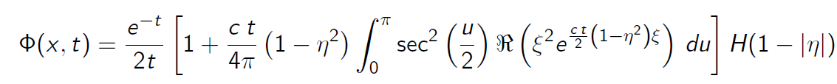
AVURV Benchmark Descirption
We can simulate fission by having c>1
NTE with initial source

Slide 27
Science Python & HPC: Bigger Picture
Enables rapid methods development for complex systems [7]
Off the shelf codes for science applications available [8]
There is a trade off in performance in benchmarks [9]
A rich environment or high productivity in science [10]
Allows nuclear folks to better interface with other fields!
Can alleviate the need for C++ testbeds as initial performance analysis of methods can be examined
[7] Barba, L. A., Klockner, A., Ramachandran, P., & Thomas, R. (2021). Scientific Computing With Python on High-Performance Heterogeneous Systems. Computing in Science & Engineering. https://doi.org/10.1109/MCSE.2021.3088549
[8] Bogdan Opanchuk, Daniel Ringwalt, Lev E. Givon, & SyamGadde. (2021). Reikna(0.7.4). http://reikna.publicfields.net/en/latest/
[9] Oden, L. (2020). Lessons learned from comparing C-CUDA and Python-Numbafor GPU-Computing. Proceedings -2020 28th Euromicro International Conference on Parallel, Distributed and Network-Based Processing, PDP 2020, 216–223. https://doi.org/10.1109/PDP50117.2020.00041
[10] L. A. Barba, "The Python/Jupyter Ecosystem: Today’s Problem-Solving Environment for Computational Science," in Computing in Science & Engineering, vol. 23, no. 3, pp. 5-9, 1 May-June 2021, doi: 10.1109/MCSE.2021.3074693.

