Slide 1



Python Development Schemes for Monte Carlo Neutronics on High Performance Computing
Jackson P. Morgan & Kyle E. Niemeyer
The Center for Exascale Monte Carlo Neutron Transport (CEMeNT)
Oregon State University
SciPy 2022
Austin, TX
July 17th, 2022
This work was supported by the Center for Exascale Monte-Carlo Neutron Transport (CEMeNT) a PSAAP-III project funded by the Department of Energy, grant number: DE-NA003967

Slide 2
Introduction

Slide 3
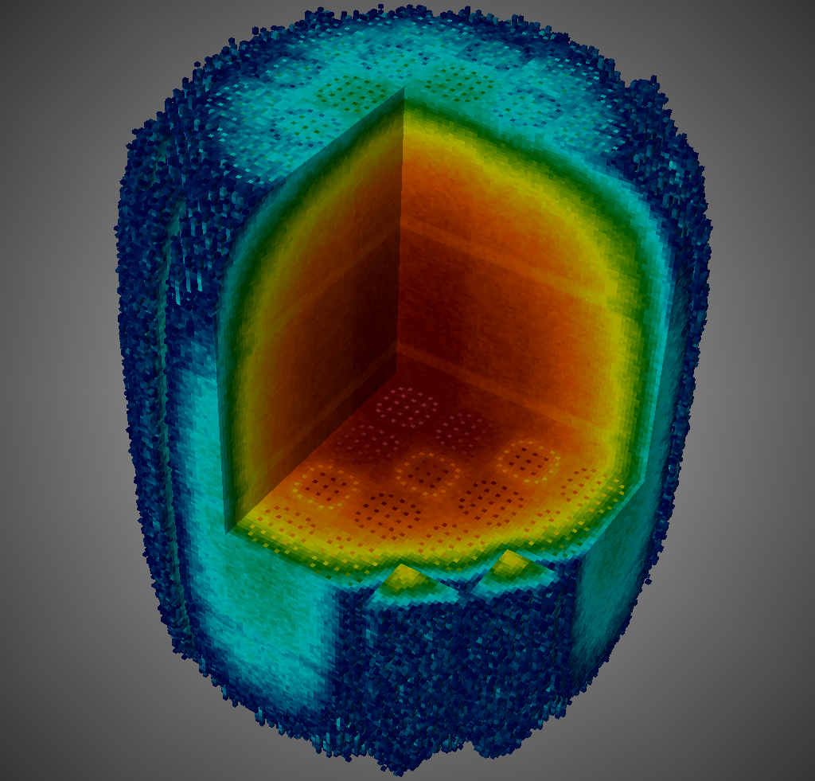
Neutron Transport
Trying to answer when how and when neutrons interact with a domain
Applications:
Cancer radio therapy development
Power reactor
Other governmental implementations

Slide 4
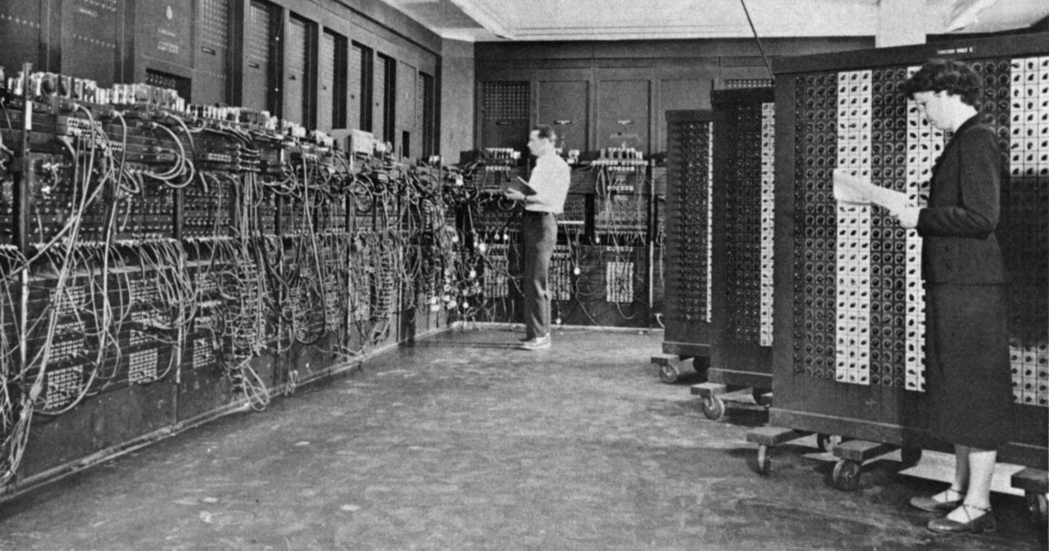
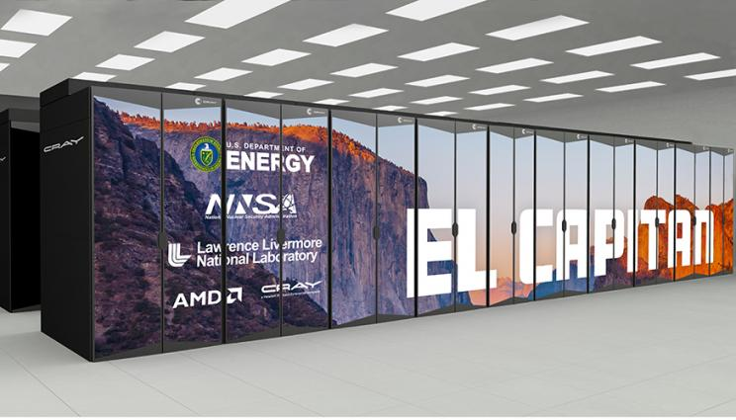
Neutron Transport and HPC
There at the beginning…
There now
ENIAC – 1946
First general programable computer circa 1946
El Capitan – 2023
Heterogeneous exa-scale machine

Slide 5
Monte Carlo Methods
Can we use statistics and event rates to model a system?
Traditional numerical methods (deterministic methods) get an exact solution to an estimated problem
Monte Carlo gives an estimated solution to an exact problem

Slide 6

Monte Carlo Neutronics
Are we safe?
Σ_{scat} = ½ [cm⁻¹]
Σ_{cap} = ½ [cm⁻¹]
Σ_{total} = 1 [cm⁻¹]

Slide 7

Monte Carlo Neutronics
Material Data (statistical likelihoods)
Equations where can relate a distance to a probability
List of events that could possible happen (scatter, absorption, transmission)
$$\text{S}\text{ = −}\frac{\text{ln}\text{(}\text{ξ}\text{)}}{{\text{Σ}}_{\text{t}}}$$
ξ: random number [0,1]
Σ_{t}: total cross section

Slide 8
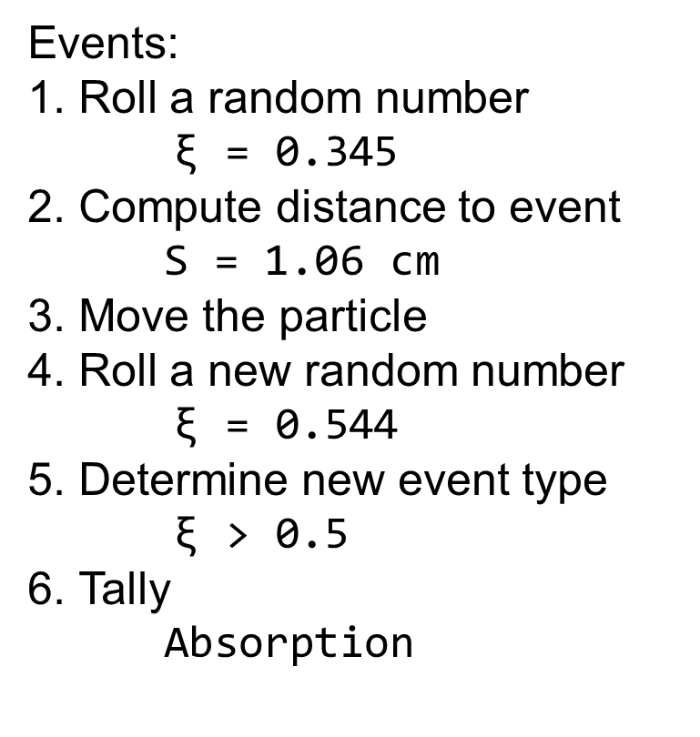
Monte Carlo Neutronics: Round 1
Events:
Roll a random number $\text{ξ}$ = 0.345
Compute distance to event S = 1.06 cm
Move the particle
Roll a new random number $\text{ξ}$ = 0.544
Determine new event type $\text{ξ}$ > 0.5
Tally Absorption
n
Σ_{scat} = ½ [cm⁻¹]
Σ_{cap} = ½ [cm⁻¹]
Σ_{total} = 1 [cm⁻¹]

Slide 9
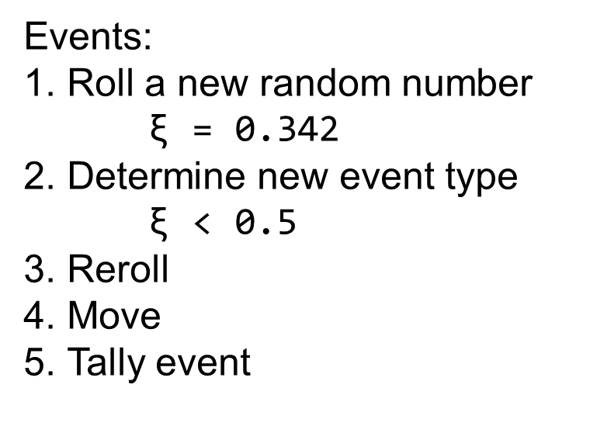
Monte Carlo Neutronics Round 2
Events:
Roll a new random number $\text{ξ}$ = 0.342
Determine new event type $\text{ξ}$ < 0.5
Reroll
Move
Tally event
n
Σ_{scat} = ½ [cm⁻¹]
Σ_{cap} = ½ [cm⁻¹]
Σ_{total} = 1 [cm⁻¹]

Slide 10
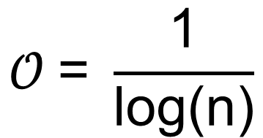
Monte Carlo is Dirt Slow!
To get a decent solution we will need to do this over
and over…
and over…
and over…
and over…
and over…
and over…
…
…
$$𝒪 \text{= }\frac{\text{1}}{\text{log}\text{(}\text{n}\text{)}}$$

Slide 11
Adding Complexity
Other events we can add
Scattering
Fissions
Other physics we can capture
Delayed neutron production
Change of material
Change of time step
Variance reduction mechanisms

Slide 12
MC/DC

Slide 13
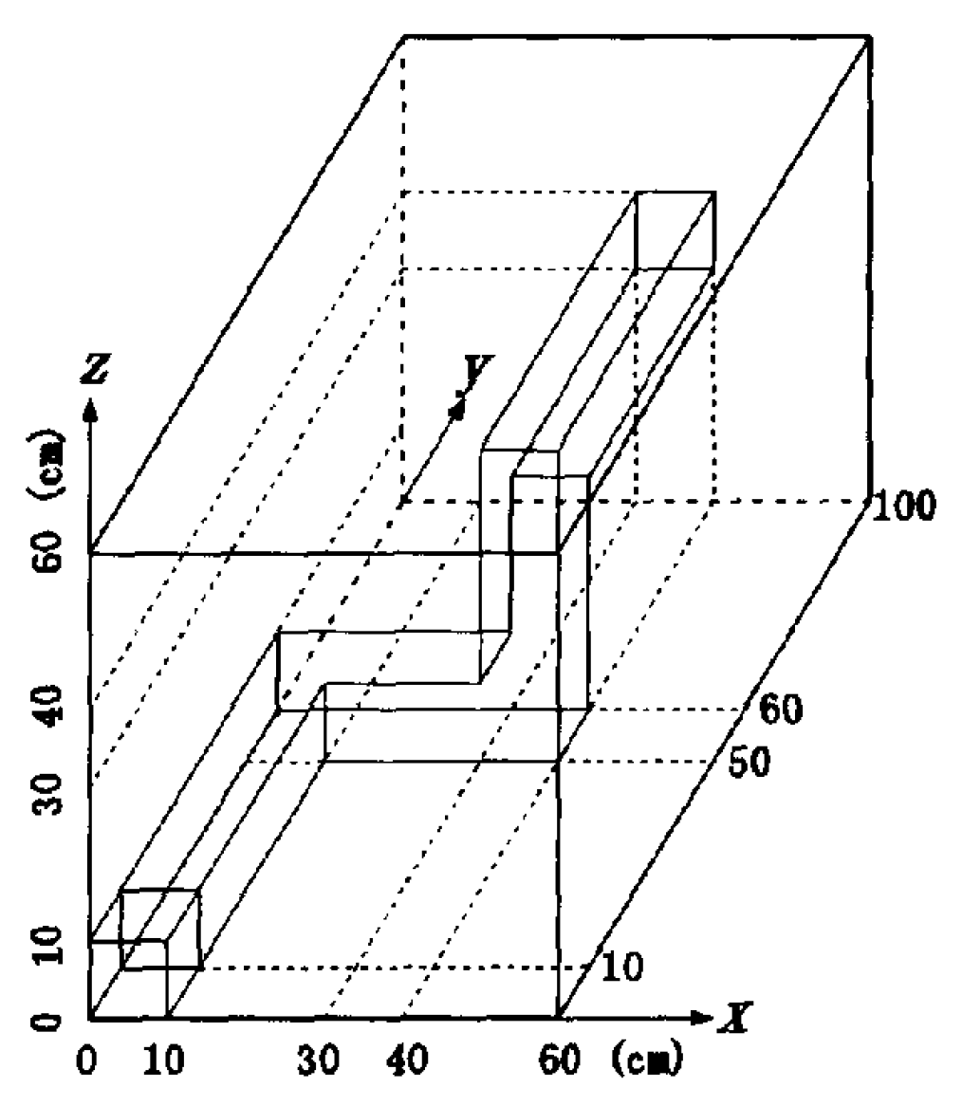
MC/DC: Monte Carlo / Dynamic Code
Dynamic neutron transport solver made for rapid methods exploration at high performance computing and exa-scale
Target various hardware architectures
Written in Python
Kobyashi Problem: Image courtesy Ilham Variansyah

Slide 14
MC/DC–TNT: Toy Neutronics Testbed
Mono-energetic, slab-geometry, transient tallies, fission, event-based, with surface tracking
Architecture targets: Nvidia GPUs and x86 CPUs
Validated with analytic solutions [1]
Vacuum
Vacuum
L = 40cm, ν = 2.3, Δx = 0.49cm Σ_{cap} = Σ_{scat} = Σ_{fis} = 1/3cm⁻¹

Slide 15
MC/DC–TNT
Modularity in mind
10 accelerated functions
Advance implemented on hardware target
User aware kernel production (nothing off the shelf)
.
└── mcdc_tnt
├── numba_kernels
│ ├── cpu
| ├── pyopenmp
│ └── cuda
├── pk_kernels
├── hcgl_kernels
└── pure_py_kernels

Slide 16
Event-Based MC Transport Flow Chart
Advance till collision (tallying in appropriate bins)
Still in space and time?
Sample event
Event Type
Scatter
Add fissions
Capture
Population control
Cleanup

Slide 17
Methods of Acceleration

Slide 18
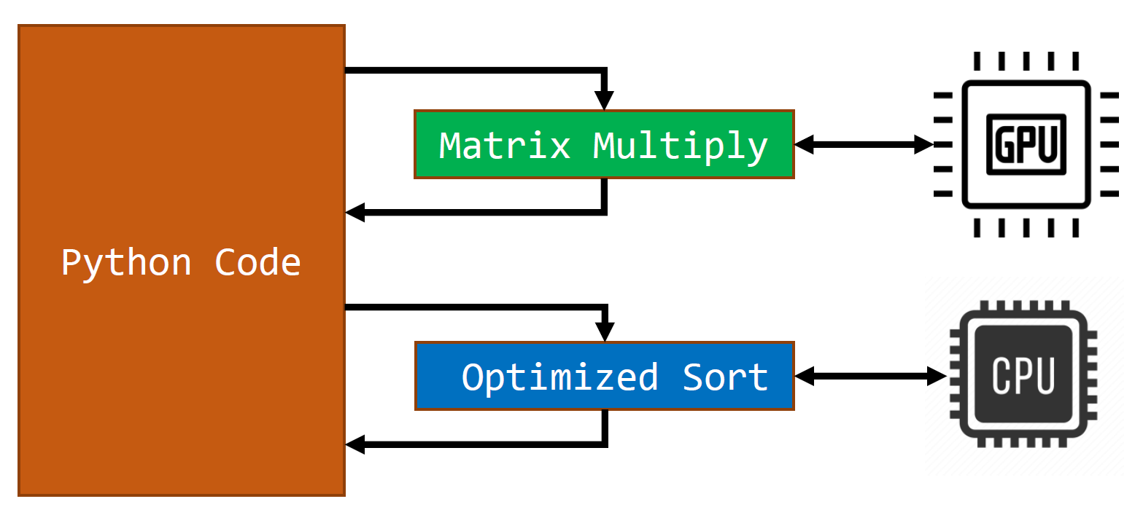
Heterogeneous Targeting: Python Glue
Python serves as glue code
Native Python modules used produce and just-in-time (JIT) schemes
Can target multiple architecture types

Slide 19
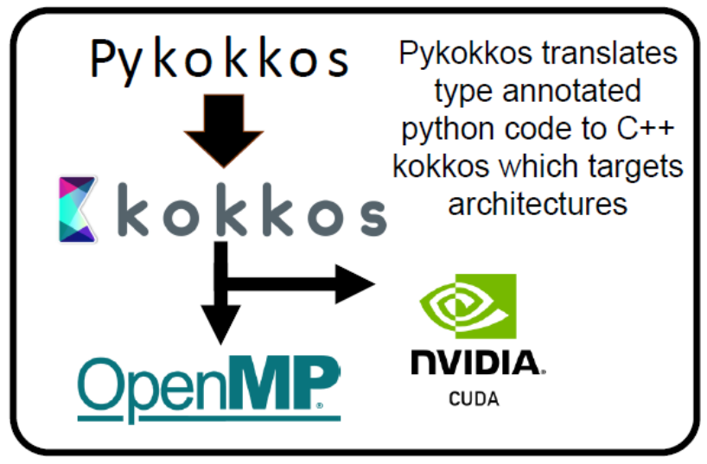
PyKokkos
Python library that implements parts of Kokkos Portability framework [2]
Brand new and under active development
Currently building out HIP functionality

Slide 20
Numba + CUDA
Converts Python code then implements the LLVM compiler [3]
Industry support and active development
Often operates on pure Python code
Experimental full implementation of OpenMP [4]

Slide 21
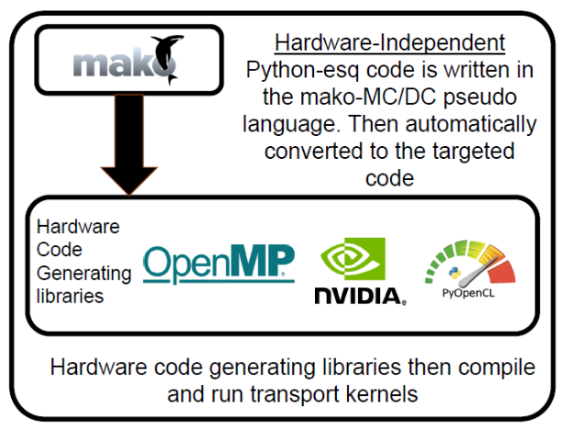
HCGL and Mako Templating Engine
Implemented on PyFR [5] at petascale [6]
Code-generating libraries to compile templated code
Our implementation plugs into PyCUDA and g++

Slide 22
Results

Slide 23
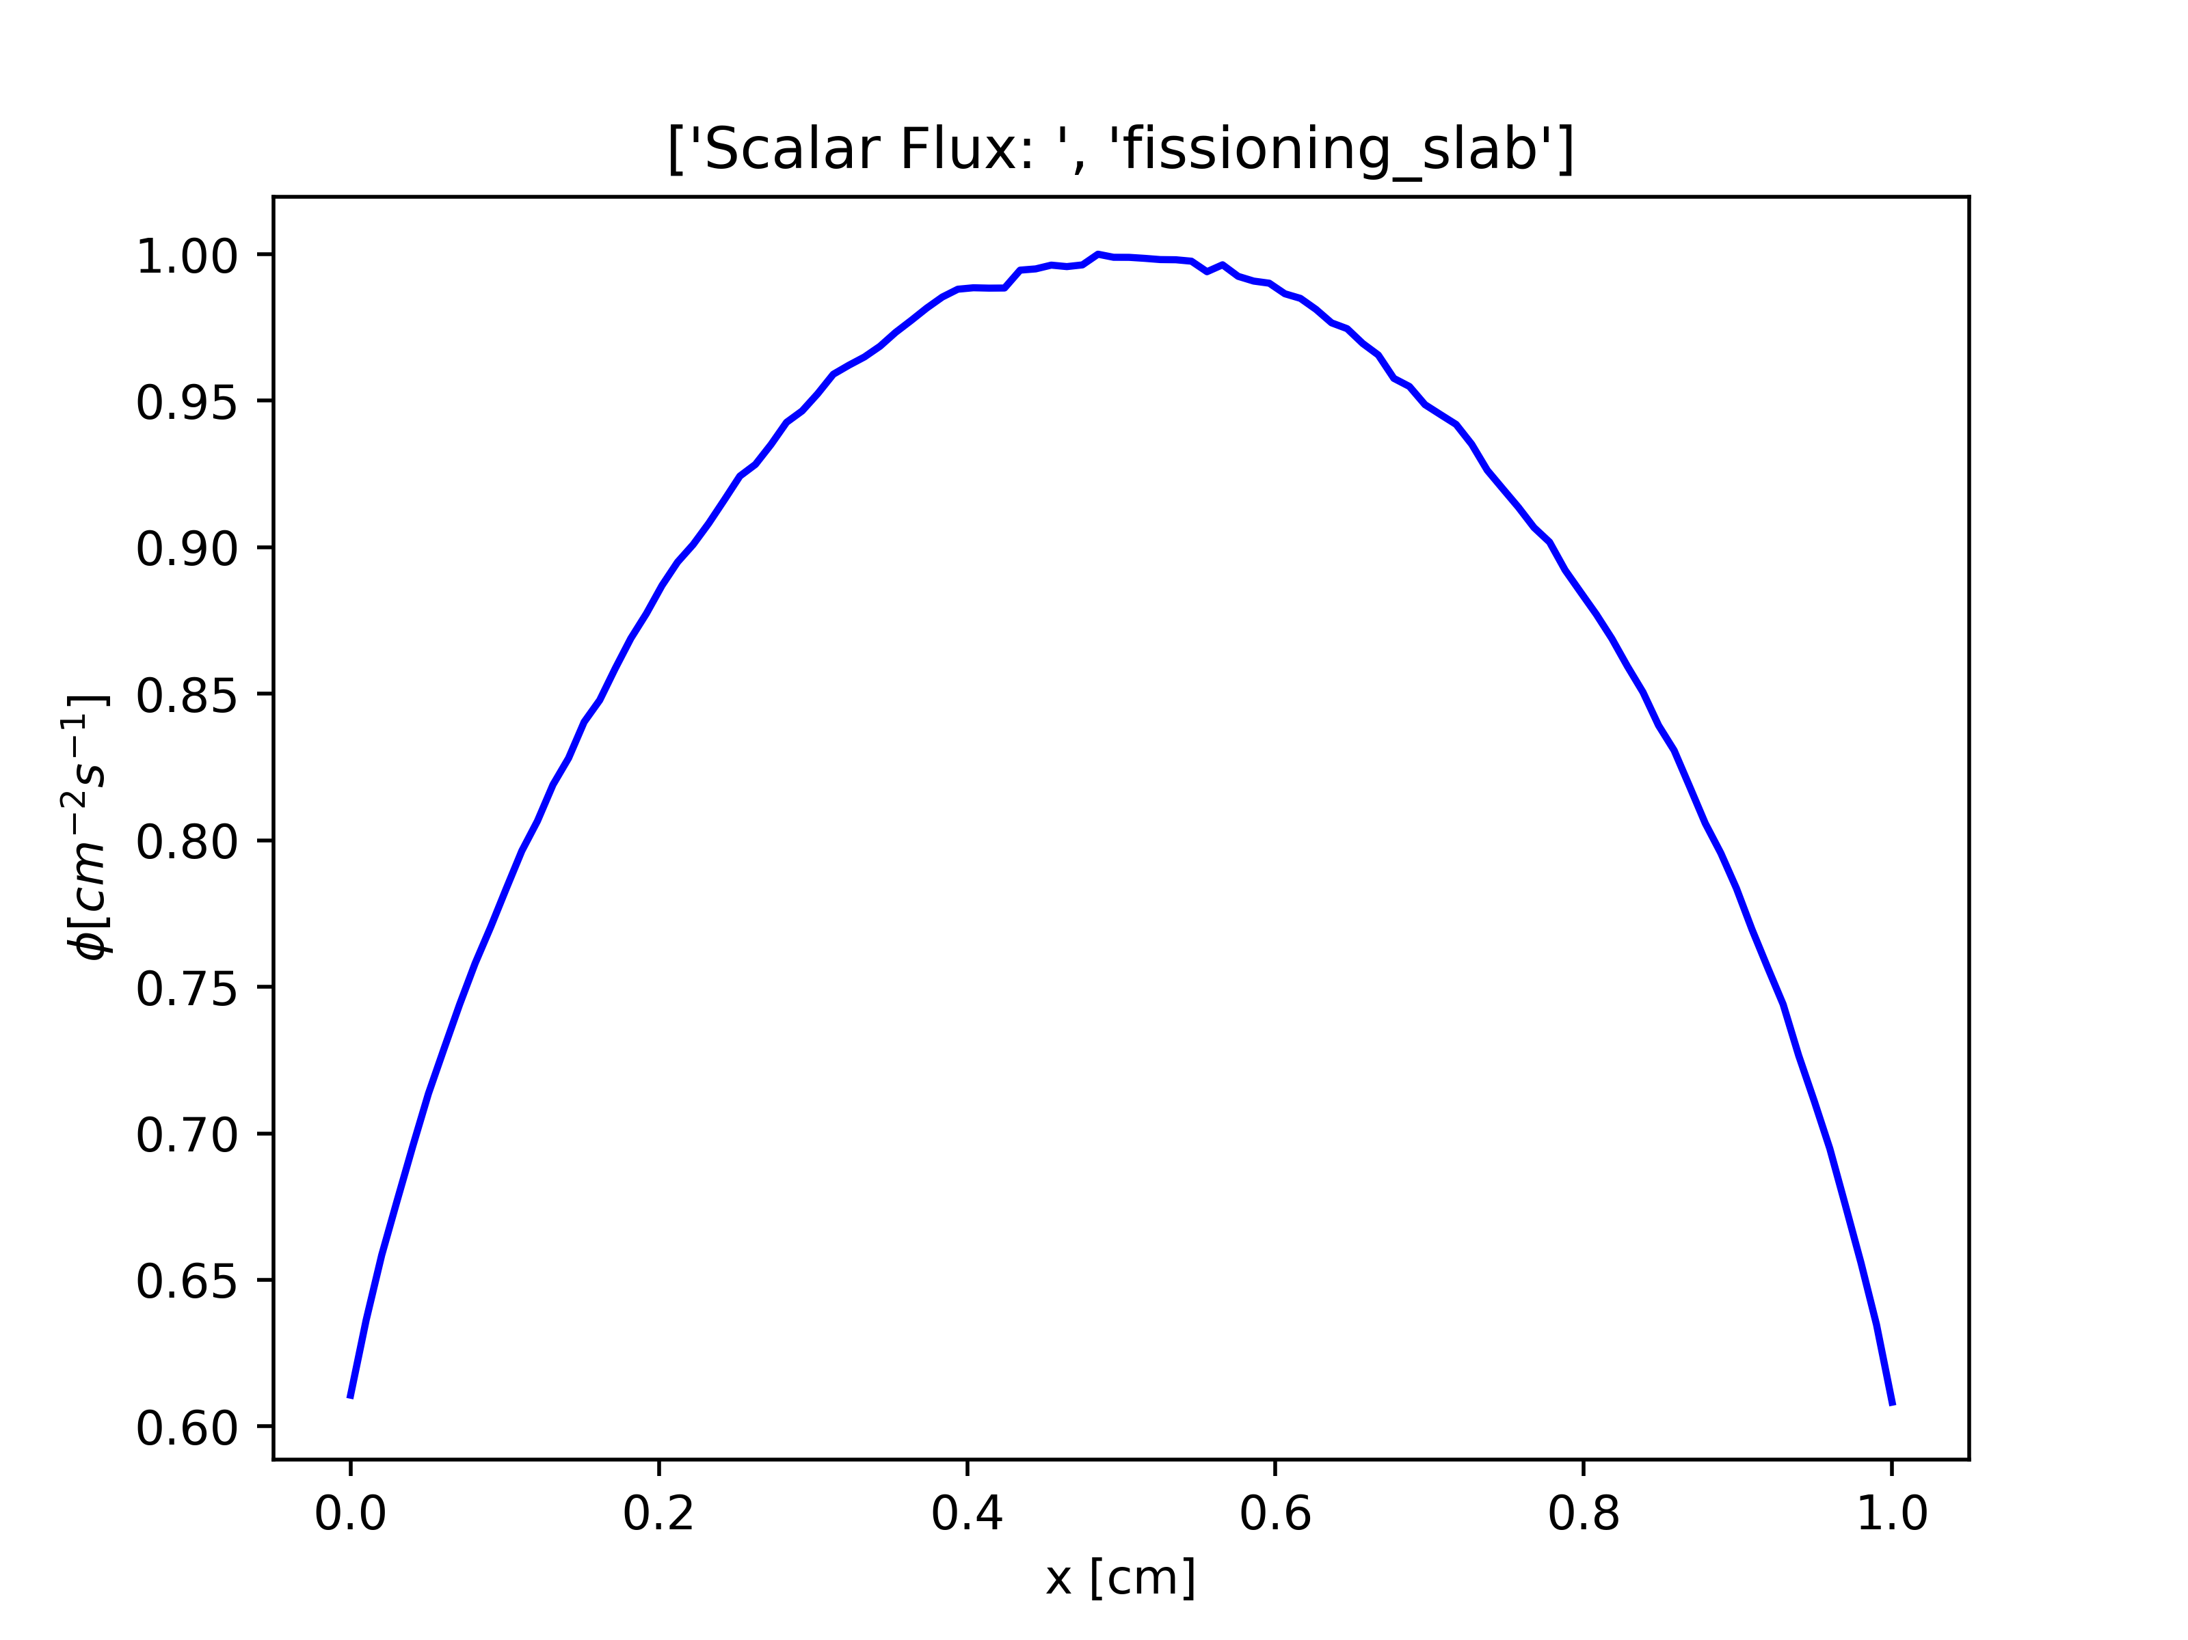
Runtime Test Problem
Sub-critical slab with initial population of 1×10⁸ particles
Validated with MC/DC
Follow particles till death
Vacuum
Vacuum
L = 1cm, ν = 2, Δx = 0.01cm Σ_{cap} = Σ_{scat} = Σ_{fis} = 1/3cm⁻¹

Slide 24
Performance: CPU
Integration test problem: L = 1cm, Δx = 0.01cm, Σ_{f} = Σ_{c} = Σ_{s} = 1/3 cm⁻¹, ν = 2, vacuum boundary conditions on LHS and RHS w/ 1 × 10⁸ Initial particles
Method of Implementation | Compile Time [s] | Run Time [s]
Pure Python* | N/A | 52970
Numba (Native threading) | 5.28 | 232.3
Numba PyOmp | 5.66 | 382.3
PyKokkos | 37.50 | 158.4
16 threads on an i7-10875H CPU
*one thread

Slide 25
Performance: GPU Implementation
Integration test problem: L = 1cm, Δx = 0.01cm, Σ_{f} = Σ_{c} = Σ_{s} = 1/3 cm⁻¹, ν = 2, vacuum boundary conditions on LHS and RHS w/ 1 × 10⁸ Initial particles
Method of Implementation | Compile Time [s] | Run Time [s]
Numba | 6.25 | 179.36
PyKokkos | 39.72 | 385.24
HCGL (PyCUDA) | 2.45 | 160.53
1 single GPU (NVIDIA TeslaV100 at 1530MHz w/ 16GB) on 1 Lassen node

Slide 26
Conclusions and Future Work

Slide 27


Difficulty of Implementation
Numba is simple
Pykokkos is more difficult
HCGL is very difficult but more performant

Slide 28
Performance
Ease of use inversely proportional to max performance
Every method is very performant! (relative to non-accelerated Python)
Diminishing returns for more difficult implementations

Slide 29
Future Work
Complete transient tally implementation for all methods
Test deployment on new hardware
Implement testbed in C++
Implement Numba on MC/DC to accelerate pure Python code and gain fine grain parallelism

Slide 30
Acknowledgments
Special thanks to:
Ilham Variansyah
Aaron Reynolds
CEMeNT Team and Associated Folks!

Slide 31
Citations
[neu] https://ieeexplore.ieee.org/document/6880250
[1] Ganapol B.D., Baker, R. S., Dahl, J. A., & Alcouffe, R. E. (2001). Homogeneous Infinite Media Time-Dependent Analytical Benchmarks. International Meeting on Mathematical Methods for Nuclear Applications, 836(December), 1–4.
[2] Awar, N. Al, Zhu, S., Biros, G., & Gligoric, M. (2021). A performance portability framework for python. Proceedings of the International Conference on Supercomputing, 467–478. https://doi.org/10.1145/3447818.3460376
[3] Lam, S. K., Pitrou, A., & Seibert, S. (2015). Numba: A LLVM-Based Python JIT Compiler. Proceedings of the Second Workshop on the LLVM Compiler Infrastructure in HPC. https://doi.org/10.1145/2833157.2833162
[4] T. G. Mattson, T. A. Anderson, G. Georgakoudis, K. Hinsen, and A. Dubey, “PyOMP: Multithreaded Parallel Programming in Python,” Comput. Sci. Eng., vol. 23, no. 6, pp. 77–80, Nov. 2021, doi: 10.1109/MCSE.2021.3128806.
[5] Witherden, F. D., Farrington, A. M., & Vincent, P. E. (2014). PyFR: An open source framework for solving advection-diffusion type problems on streaming architectures using the flux reconstruction approach. Computer Physics Communications, 185(11), 3028–3040. https://doi.org/10.1016/j.cpc.2014.07.011
[6] Witherden, F. (2021). Python at petascale with PyFR or: how I learned to stop worrying and love the snake. Computing in Science & Engineering, 9615(c), 1–1. https://doi.org/10.1109/mcse.2021.3080126

Slide 32
Backmatter Slides

Slide 33
Code Sample
Vectorized Multiplication in Each Method

Slide 34
Other Acceleration Techniques in Python
Cython (able to use C++ standard parallelism)
PyCUDA and PyOpenCL (used but not directly)
MPI4Py (Does not accelerate code, only runs more of it)
Python CUDA
Pure Numba / SciPy implementations (C under the hood)
Build your own!

Slide 35
Planed Explorations within MC/DC
Fully transient Monte Carlo
Intrusive UQ
Dynamic Quasi Monte Carlo
Dynamic Weight Windows
Population Control Methods
Python Based Parallelization
Asynchronous GPU scheduling
Machine Learning MPI scheduling

Slide 36
Future Development Path of MC/DC
Address Numba issues in MC/DC
Replace JITClass with Numba structured array
Runtime and memory profiling
Write event-based MC/DC (pure Python + MPI4Py)
Reuse and exploit existing MC/DC (history-based) modules with Python decorator
Integrate findings from MC/DC-TNT
PyKokkos, Numba, PyOMP, Mako templating

Slide 37
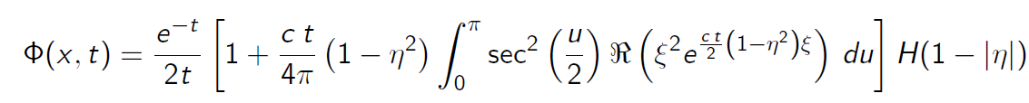
AVURV Benchmark Descirption
We can simulate fission by having c>1
NTE with initial source

Slide 38
Science Python & HPC: Bigger Picture
Enables rapid methods development for complex systems [7]
Off the shelf codes for science applications available [8]
There is a trade off in performance in benchmarks [9]
A rich environment or high productivity in science [10]
Allows nuclear folks to better interface with other fields!
Can alleviate the need for C++ testbeds as initial performance analysis of methods can be examined
[7] Barba, L. A., Klockner, A., Ramachandran, P., & Thomas, R. (2021). Scientific Computing With Python on High-Performance Heterogeneous Systems. Computing in Science & Engineering. https://doi.org/10.1109/MCSE.2021.3088549
[8] Bogdan Opanchuk, Daniel Ringwalt, Lev E. Givon, & SyamGadde. (2021). Reikna(0.7.4). http://reikna.publicfields.net/en/latest/
[9] Oden, L. (2020). Lessons learned from comparing C-CUDA and Python-Numbafor GPU-Computing. Proceedings -2020 28th Euromicro International Conference on Parallel, Distributed and Network-Based Processing, PDP 2020, 216–223. https://doi.org/10.1109/PDP50117.2020.00041
[10] L. A. Barba, "The Python/Jupyter Ecosystem: Today’s Problem-Solving Environment for Computational Science," in Computing in Science & Engineering, vol. 23, no. 3, pp. 5-9, 1 May-June 2021, doi: 10.1109/MCSE.2021.3074693.

