Slide 1
The Freelancers Campus Snapshots
URL: http://lamp.cse.fau.edu/~cen4010fal19_g04/CampusSnapshot/

Slide 2
What is Campus Snapshots?
Campus Snapshots is a web system that people can access and inform users about issues and events around campus.
Campus Snapshots is made with the intention of allowing campuses to more easily communicate items in an instantaneous fashion throughout the area.

Slide 3
Why Campus Snapshots?
It can be used to report events happening on campus such as games, concerts, activities, etc.
It is a way to send out notifications about specific problems that cannot be solved at that current moment.
It is, in a sense, a one stop shop to know any major developments within a campus.

Slide 4
Advantages
Student to administrator ratio is about 22:1. With more eyes, more issues can be reported quickly.
With the ability to upload photos of the reported issues, it will allow for issues to be validated and for there to be no false reporting.
Students can host their own events; they can add that event to the site for other students to join if they are interested.

Slide 5
Major functionalities
Students can create accounts if they do not already have one (Administrators are preregistered)
Users can login to their account
Users can create markers (events/issues)
Users can attach photos to created markers
Users can add comments to an event
Users can report markers
Administrators can update status of issues
Administrators can remove markers
Students can sort events by location or most recent

Slide 6
Languages and Tools
PHP
JavaScript
HTML/CSS
Bootstrap
MySQL
PHP MyAdmin

Slide 7
Future Features
User’s will have more sorting options (By time, by oldest, etc.)
User’s will have the ability to report comments
User’s can see history of markers they created.
User’s will be able to remove events they created.

Slide 8
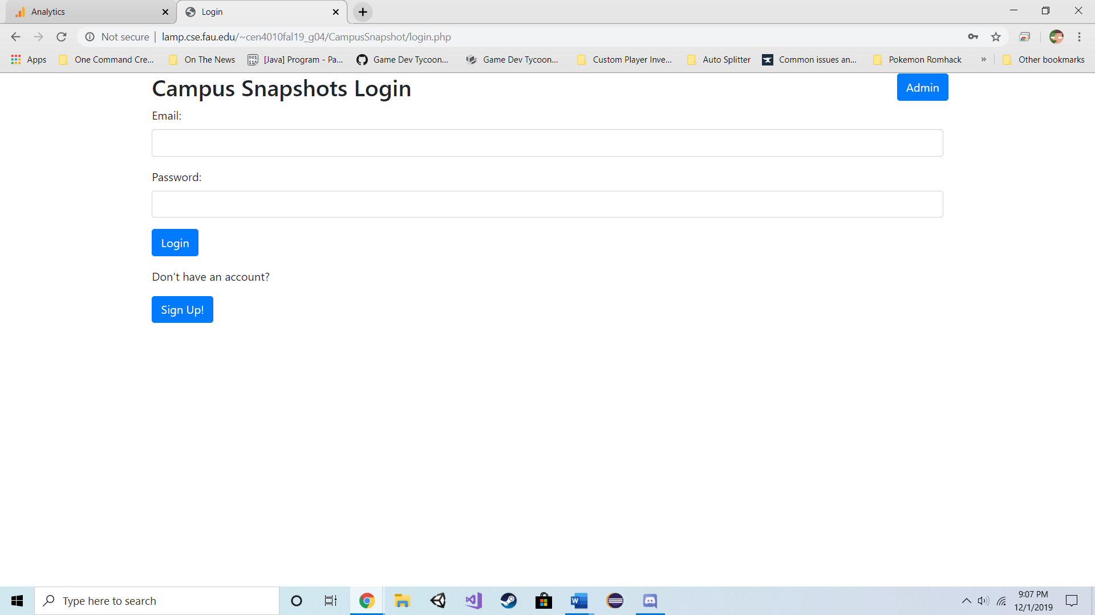
Student Portal: Login

Slide 9
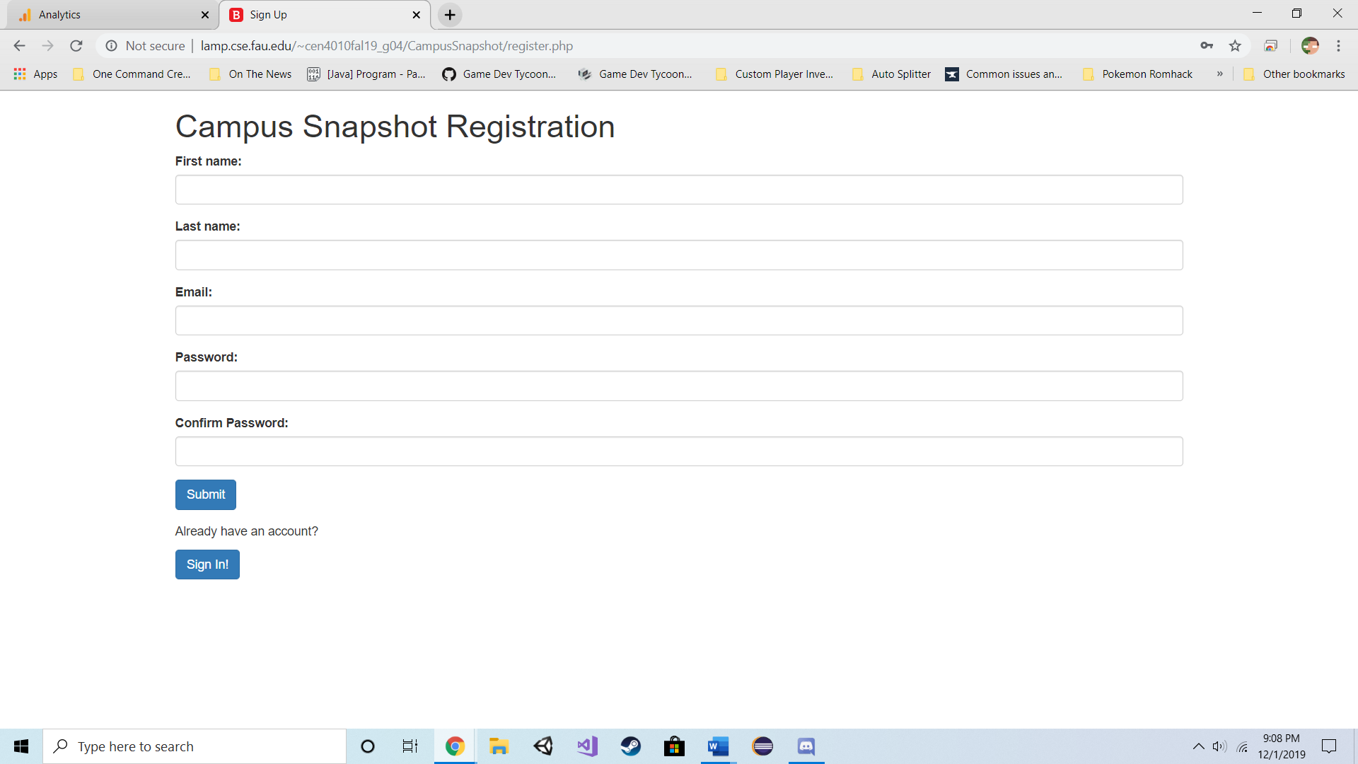
Student Portal: Registration

Slide 10
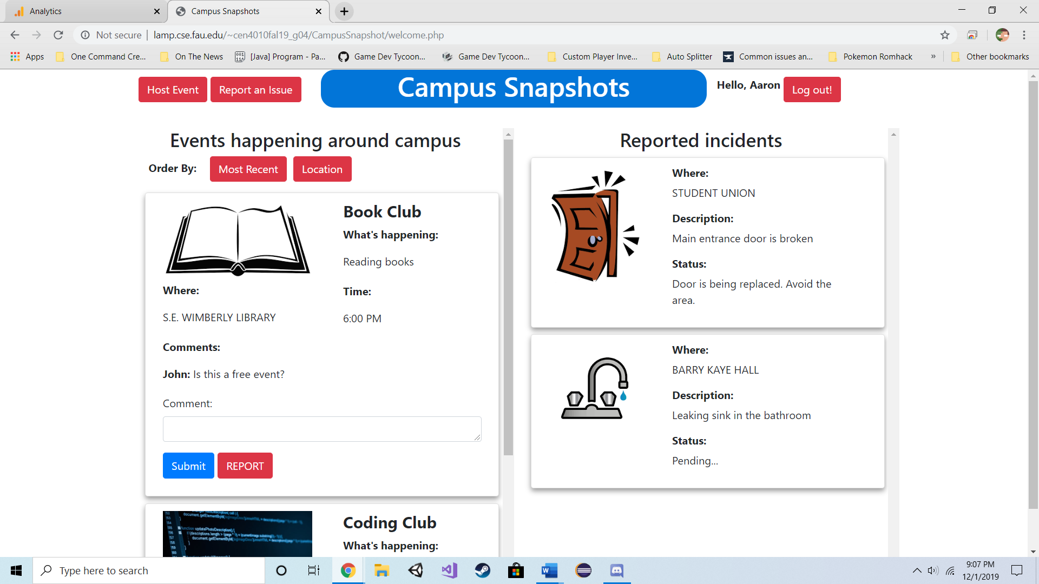
Student Portal: Home

Slide 11
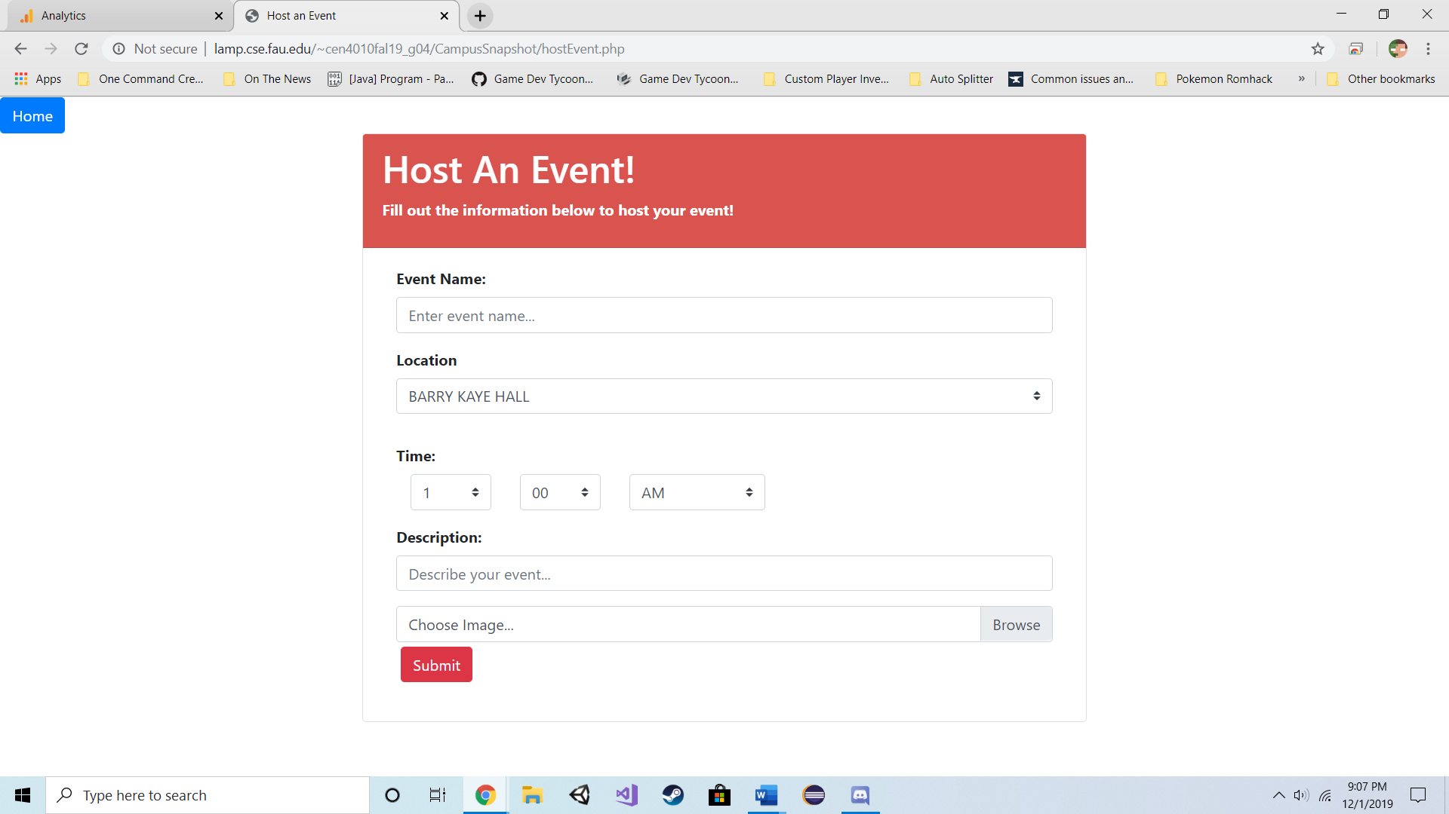
Student Portal: Host an Event

Slide 12
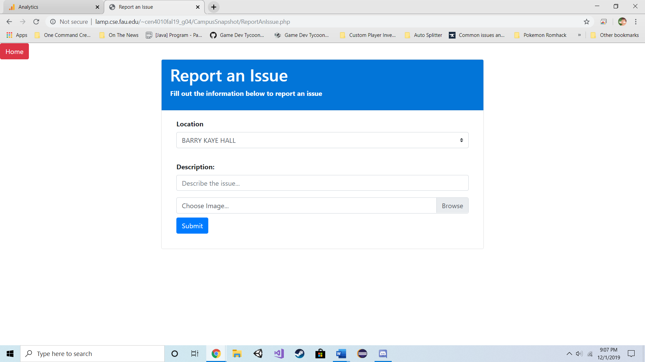
Student Portal: Report an Issue

Slide 13
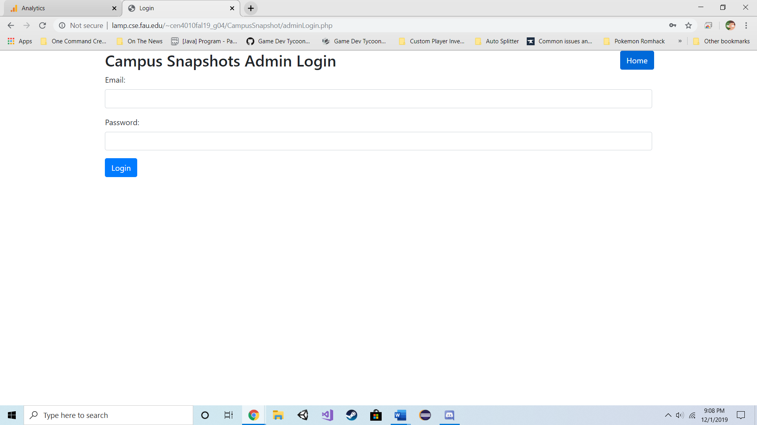
Admin Portal: Login

Slide 14
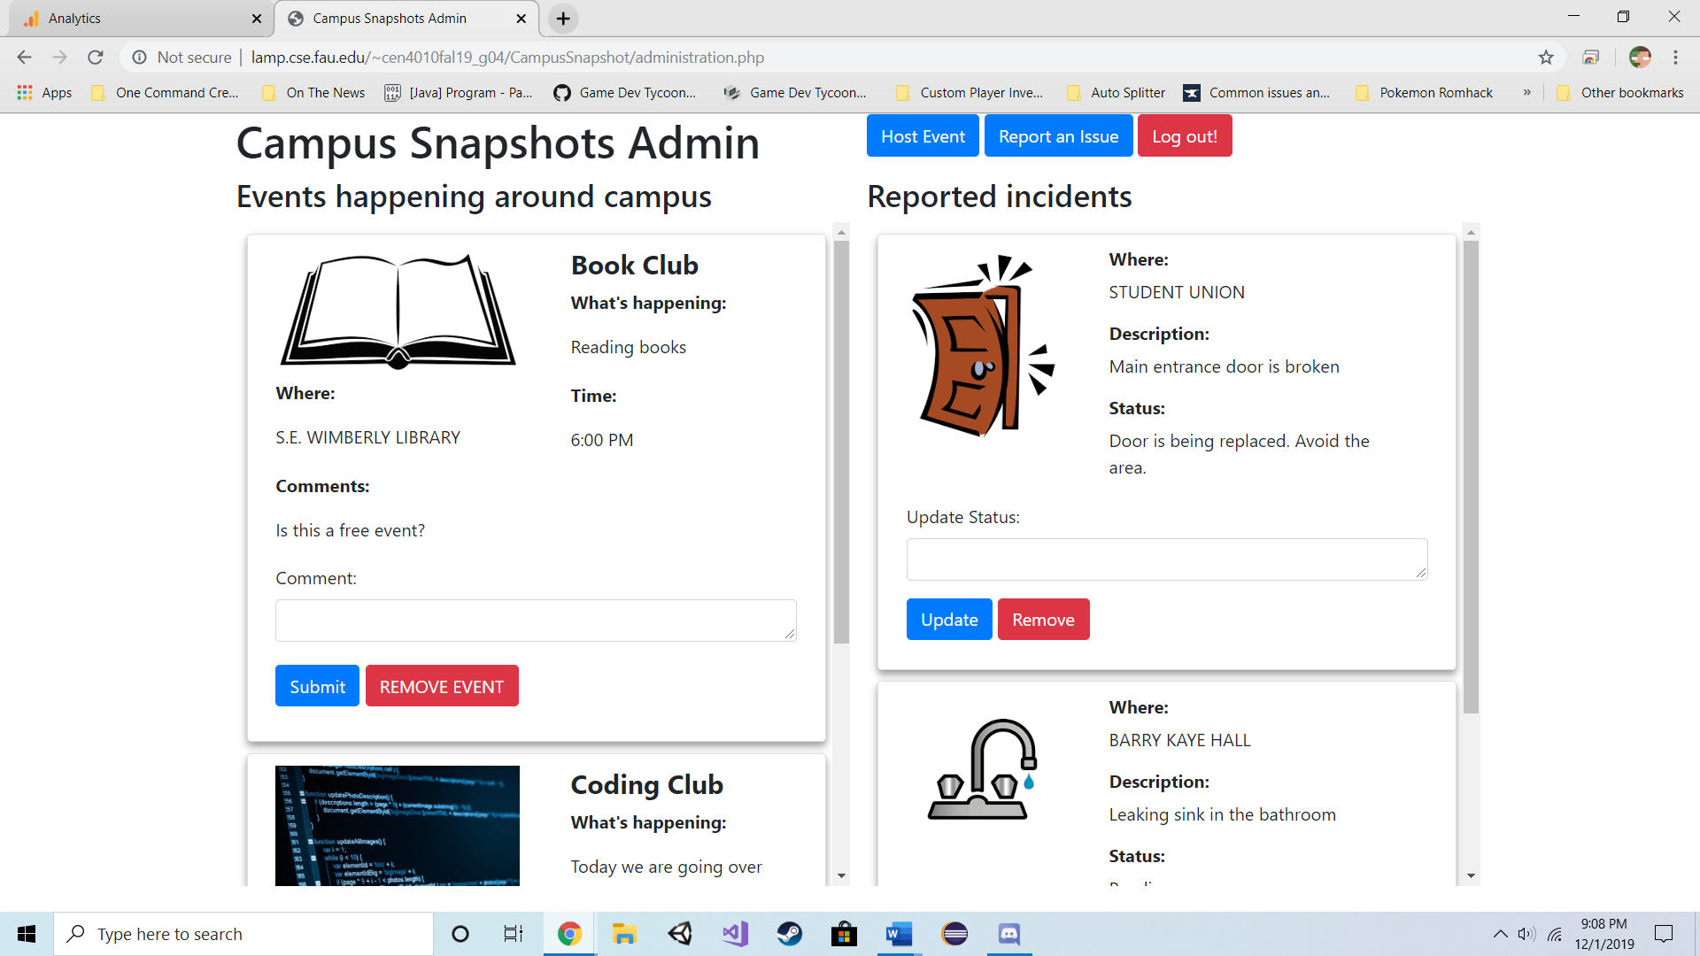
Admin Portal: Home

Slide 15
The Team
Aaron Haim (Scrum Master) – ahaim2016@fau.edu
Daniel Fradlin (Front End Lead) – dfradlin2017@fau.edu
Richard Urena (Back End Lead) – urenar2016@fau.edu
Yiyang Liu (Product Owner) – yliu2015@fau.edu

