Slide 1
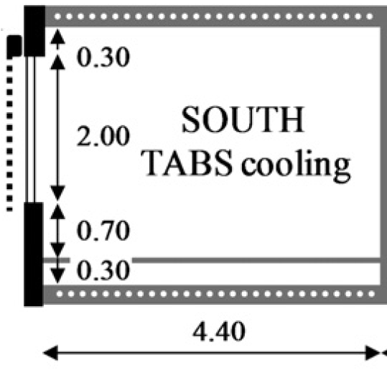
Low-energy office
NORTH
TABS heating
(depth: 2.7m)
SOUTH
TABS heating
(depth: 2.7m)

Slide 2
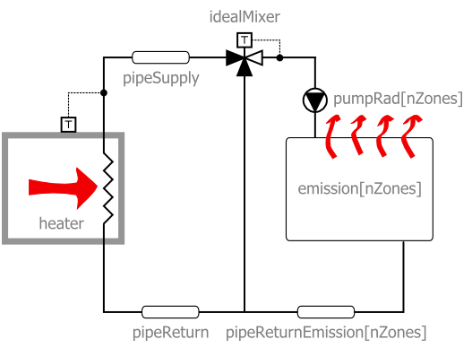
Low-energy office

