Slide 1

UNIVERSITY OF MASSACHUSETTS
Dept. of Electrical & Computer Engineering
Digital Computer Arithmetic
ECE 666
Part 6b
High-Speed Multiplication - II
Israel Koren
Spring 2008

Slide 2
Accumulating the Partial Products
After generating partial products either directly or using smaller multipliers
Accumulate these to obtain final product
  A fast multi-operand adder
Should take advantage of particular form of partial products - reduce hardware complexity
They have fewer bits than final product, and must be aligned before added
Expect many columns that include fewer bits than total number of partial products - requiring simpler counters

Slide 3
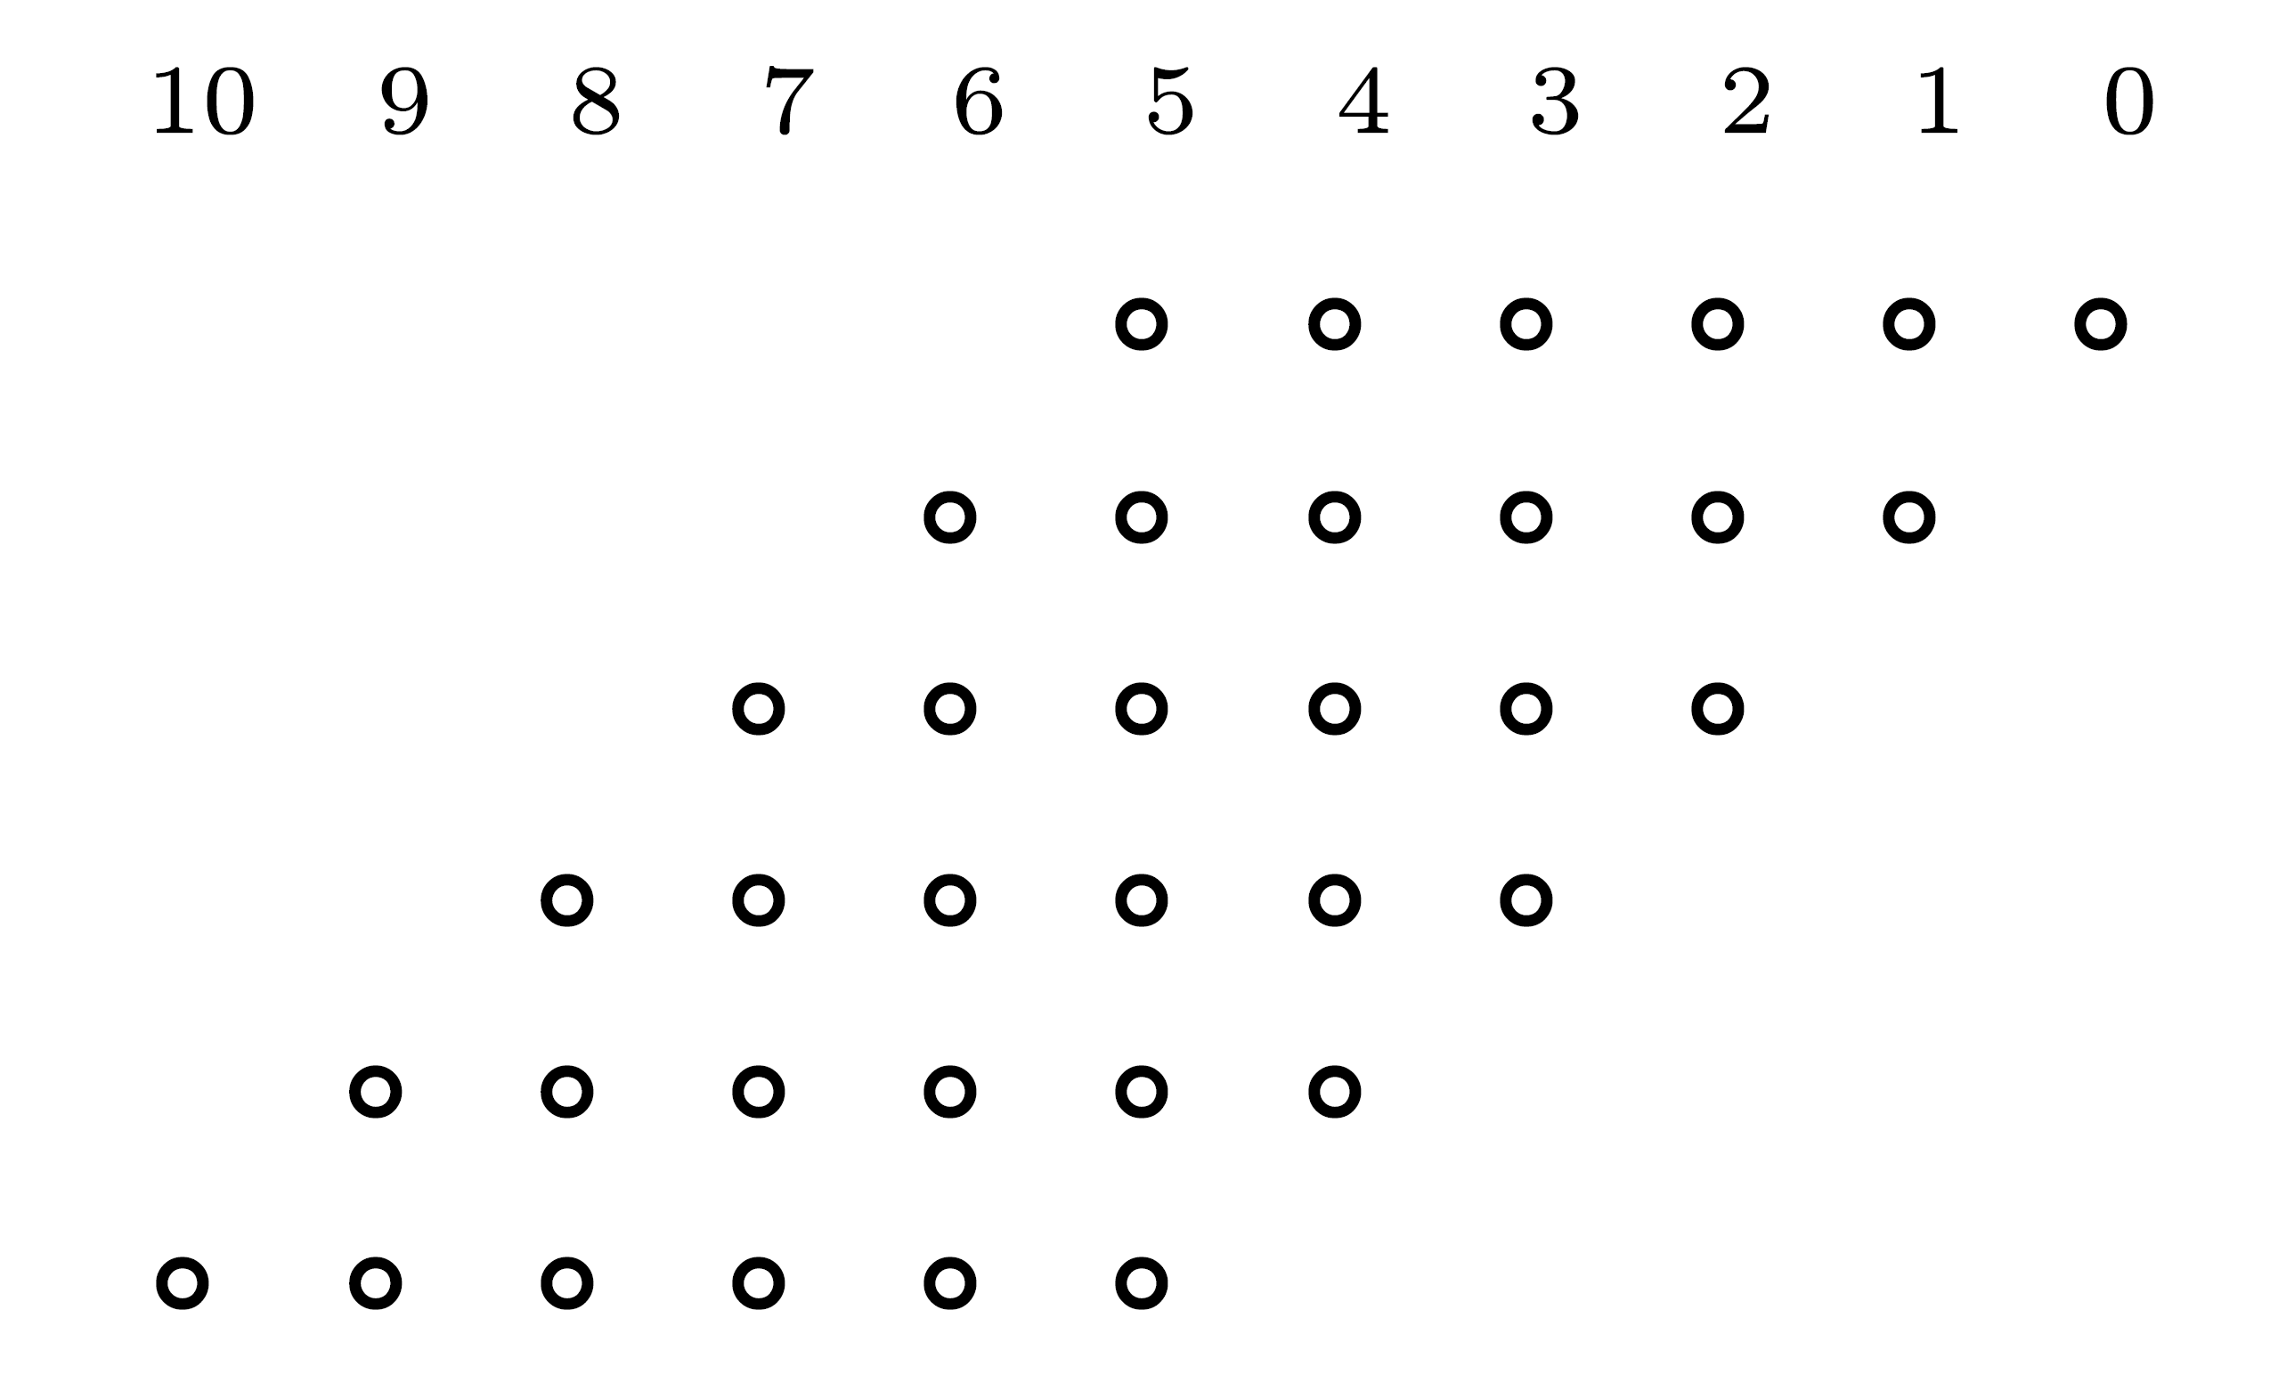
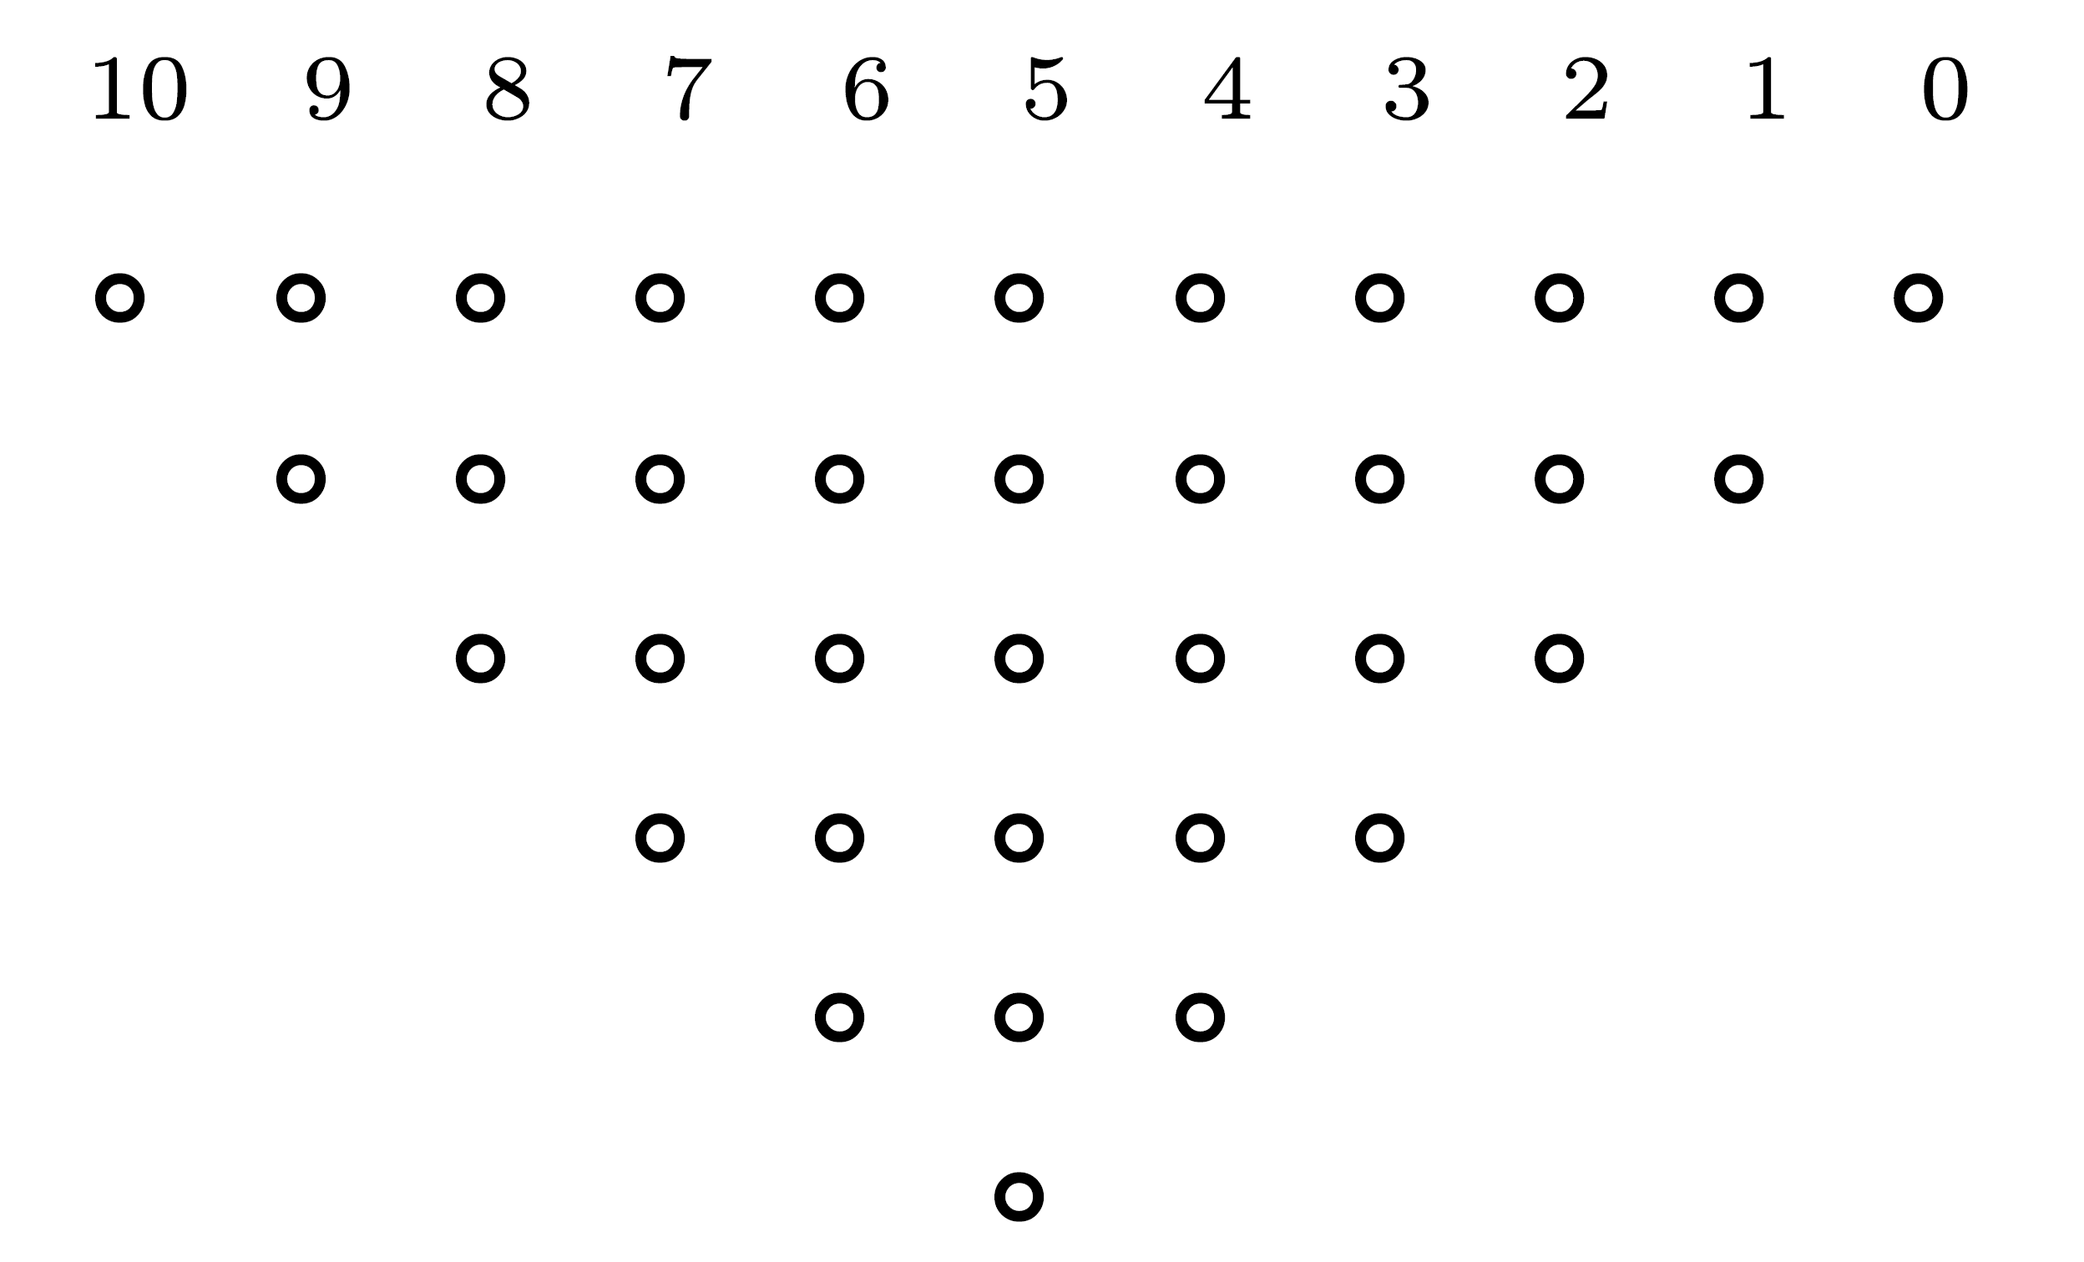
Example - Six Partial Products
Generated when multiplying unsigned 6-bit operands using one-bit-at-a-time algorithm
6 operands can be added using 3-level carry-save tree
Number of (3,2) counters can be substantially reduced by taking advantage of the fact that all columns but 1 contain fewer than 6 bits
Deciding how many counters needed - redraw matrix of bits to be added:

Slide 4
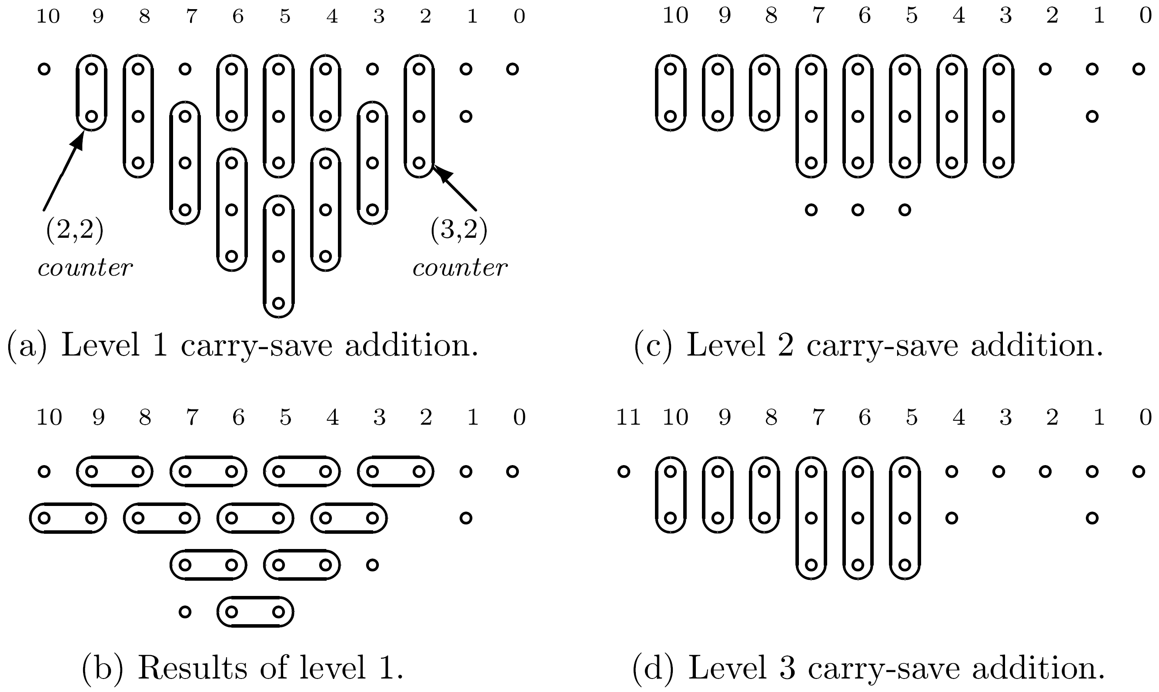
Reduce Complexity - Use (2,2) Counters (HAs)
Number of levels still 3, but fewer counters

Slide 5
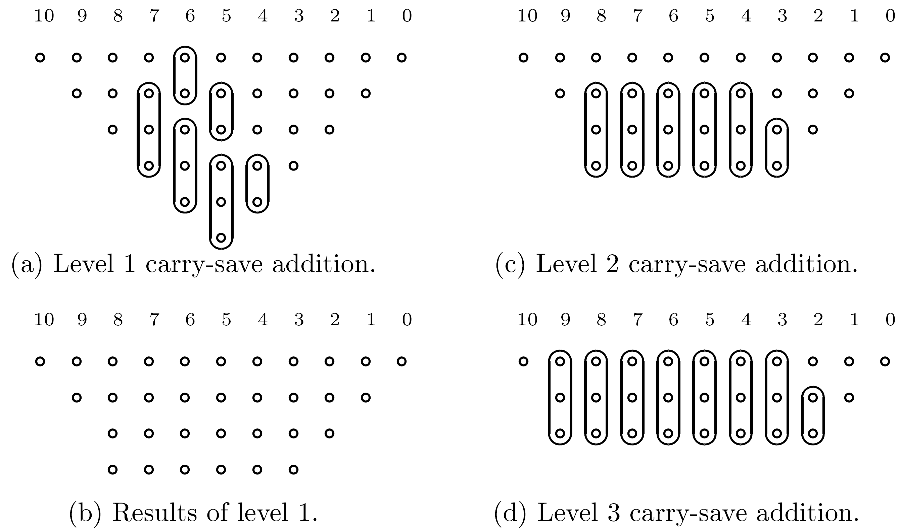
Further reduction in number of counters
Reduce # of bits to closest element of 3,4,6,9,13,19,…
15 (3,2) and 5 (2,2) vs. 16 (3,2) and 9 (2,2) counters

Slide 6
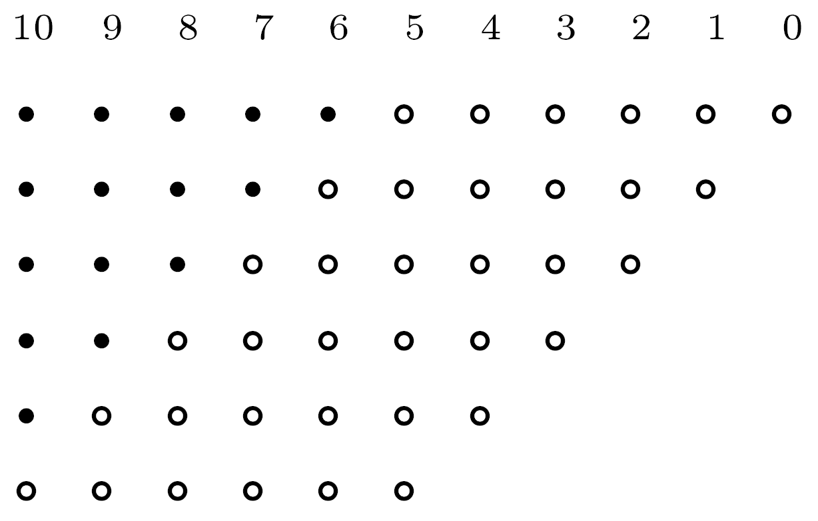
Modified Matrix for Negative Numbers
Sign bits must be properly extended
In row 1: 11 instead of 6 bits, and so on
Increases complexity of multi-operand adder
If two's complement obtained through one's complement - matrix increased even further

Slide 7
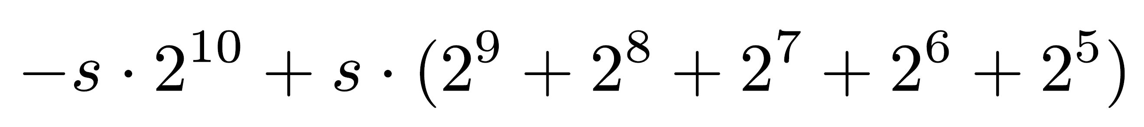
Reduce Complexity Increase
Two's complement number s s s s s s z4 z3 z2 z1 z0 with value
Replaced by 0 0 0 0 0 (-s) z4 z3 z2 z1 z0
since

Slide 8
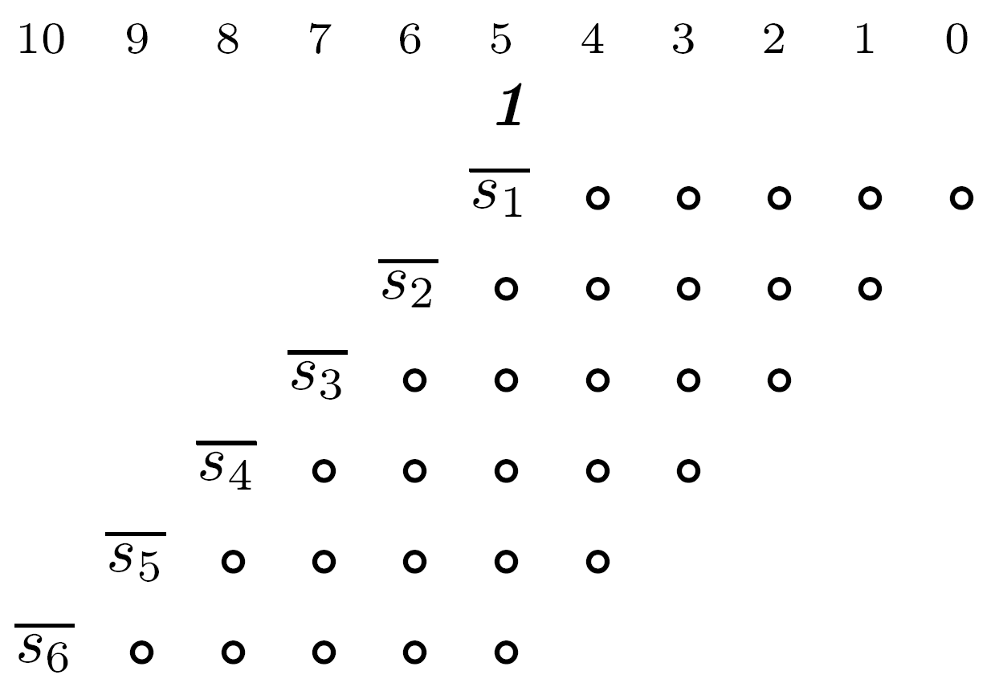
New Bit Matrix
To get -s in column 5 - complement original s to (1-s) and add 1
  Carry of 1 into column 6 serves as the extra 1 needed for sign bit of second partial product
New matrix has fewer bits but higher maximum height (7 instead of 6)

Slide 9
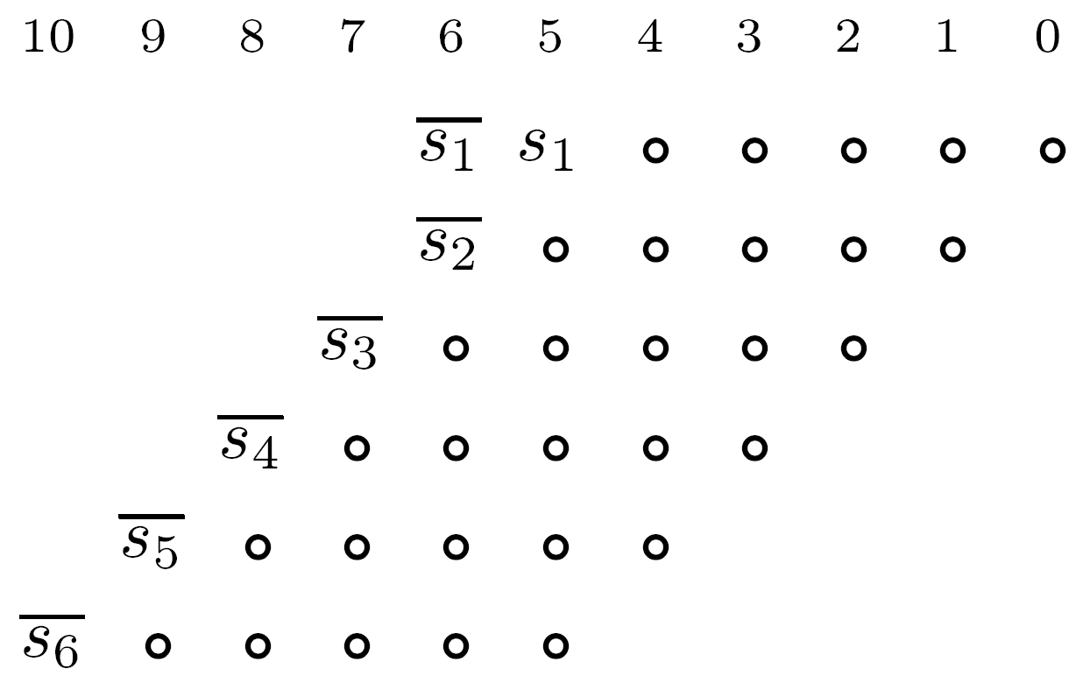
Eliminating Extra 1 in Column 5
Place two sign bits s1 and s2 in same column
(1-s1)+(1-s2) = 2 -s1 -s2
2 is carry out to next column
Achieved by first extending sign bit s1

Slide 10
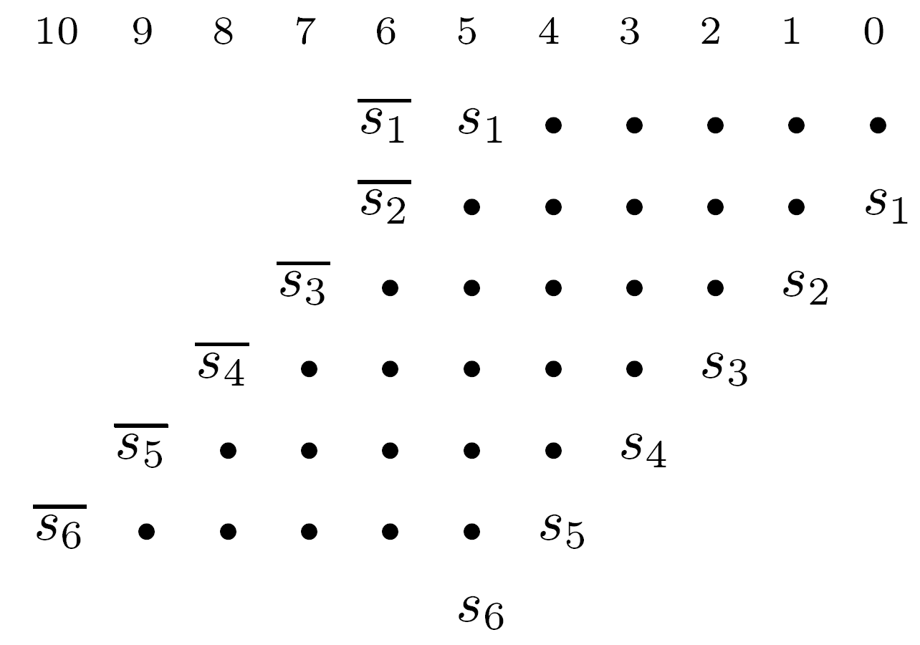
Using One’s Complement and Carry
Add extra carries to matrix
Full circles - complements of corresponding bits are taken whenever si=1
Extra s6 in column 5 increases maximum column height to 7
If last partial product is always positive (i.e., multiplier is positive) - s6 can be eliminated

Slide 11
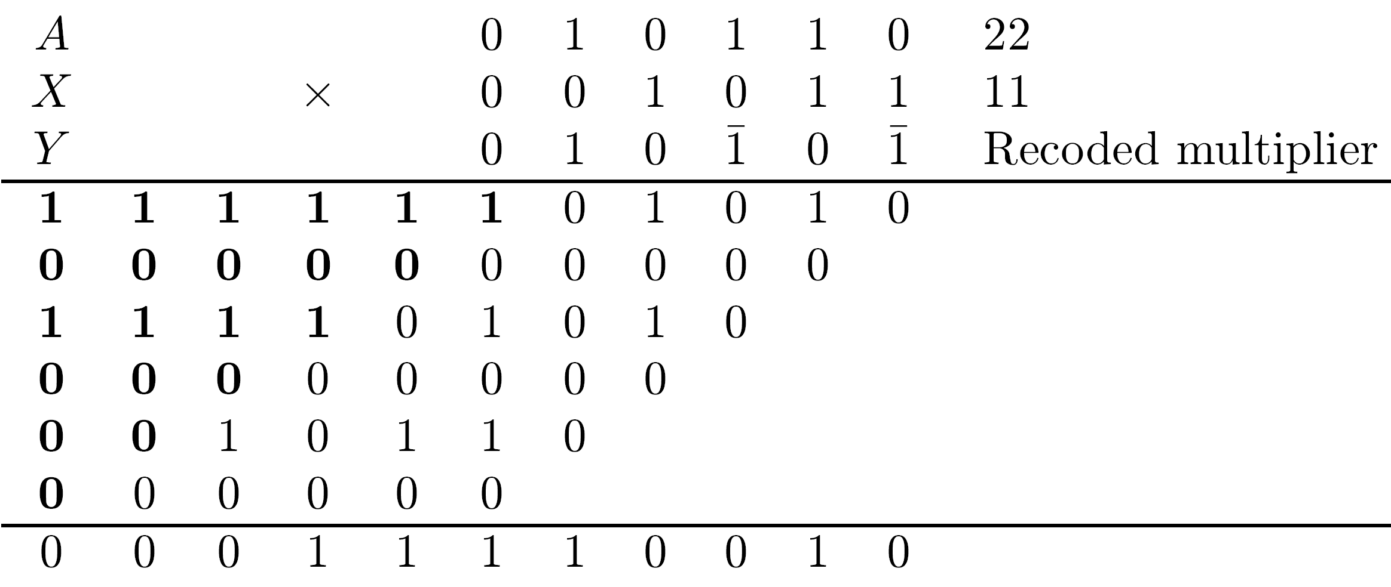
Example
Recoded multiplier using canonical recoding

Slide 12
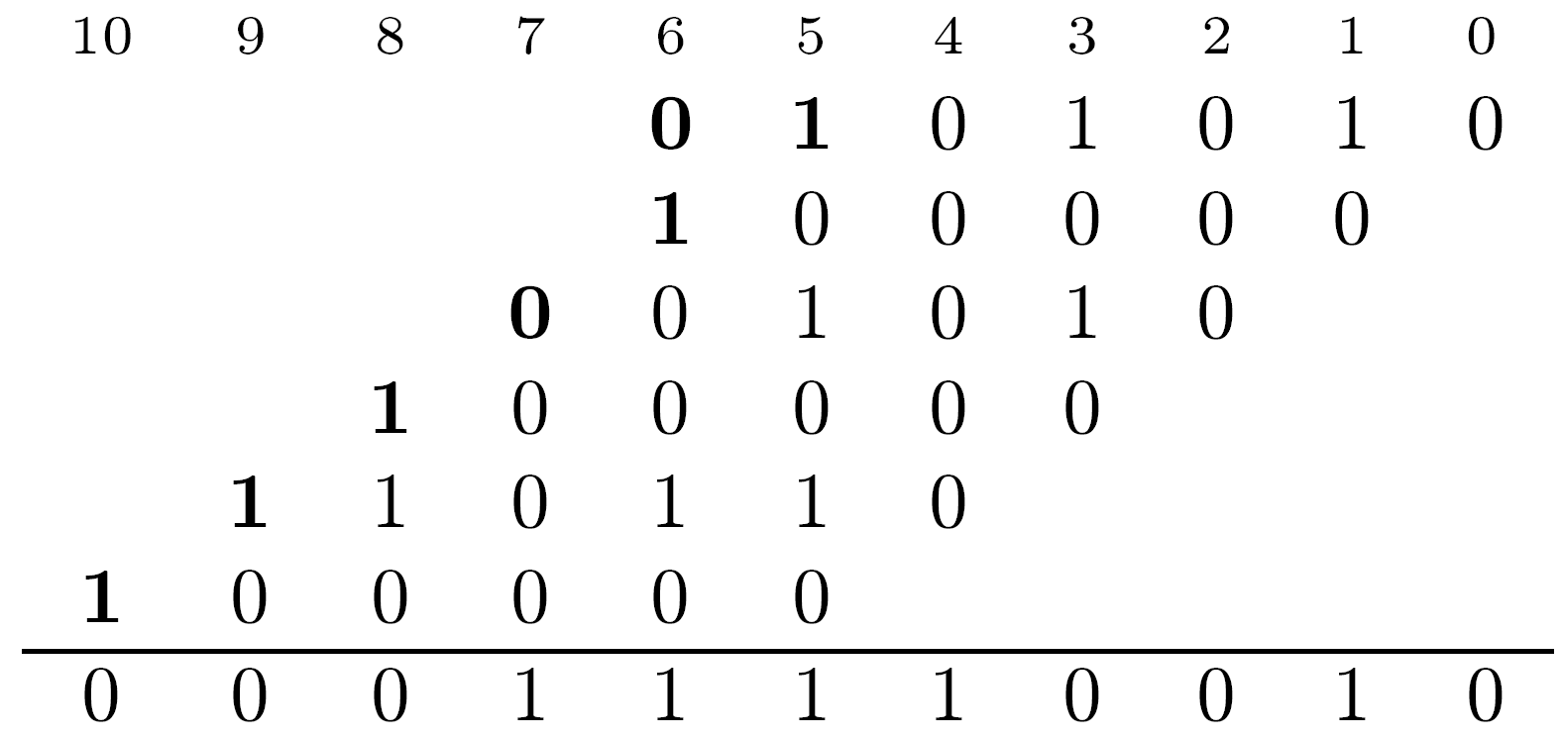
Smaller Matrix for the Example

Slide 13
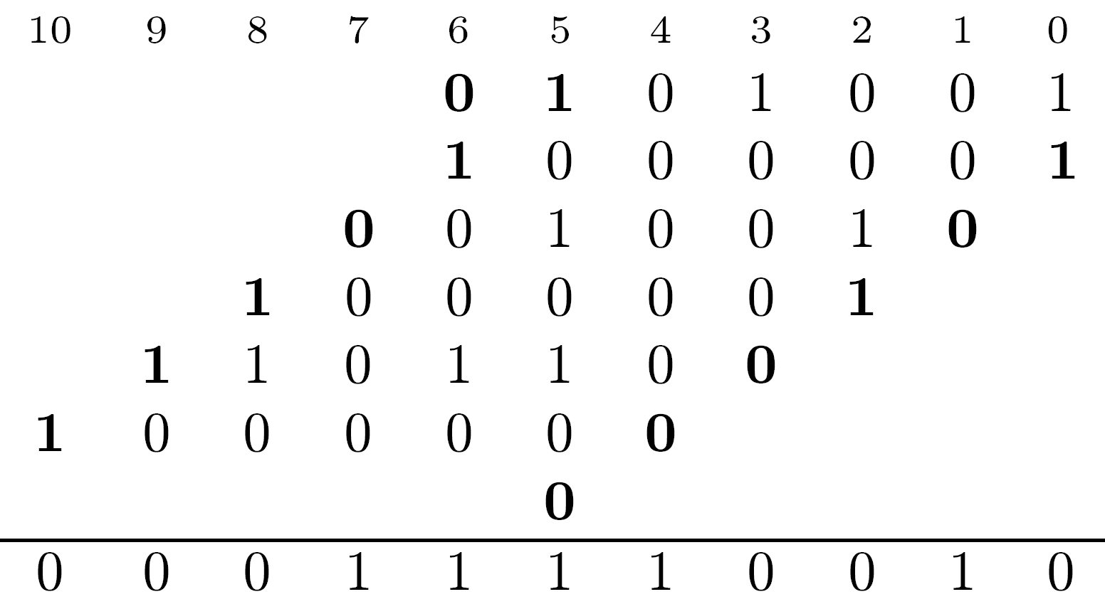
Using One’s Complement and Carry

Slide 14
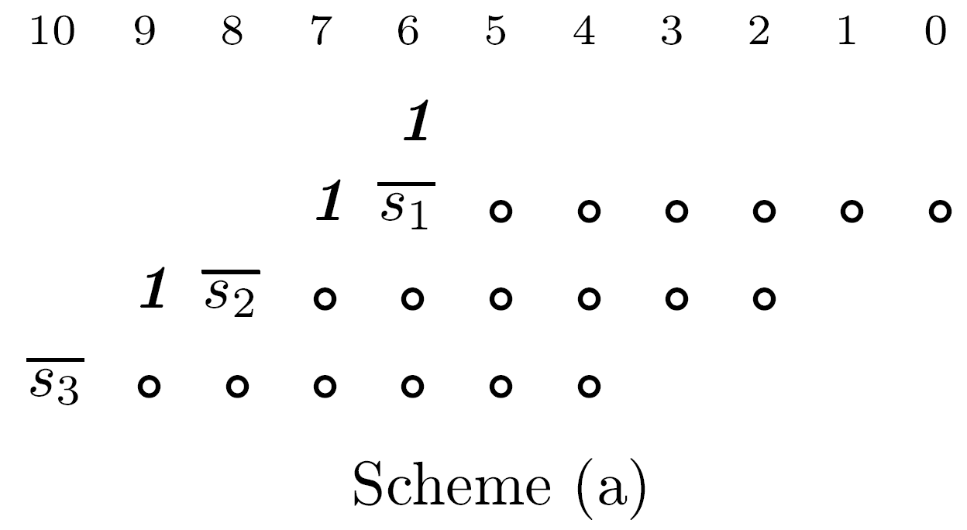
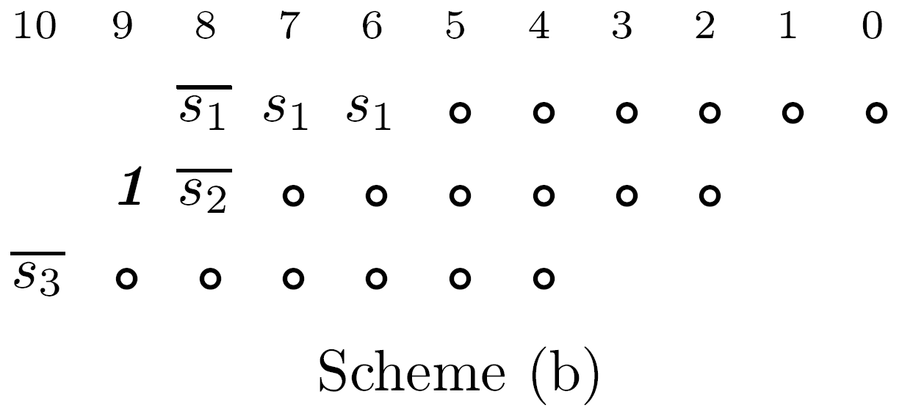
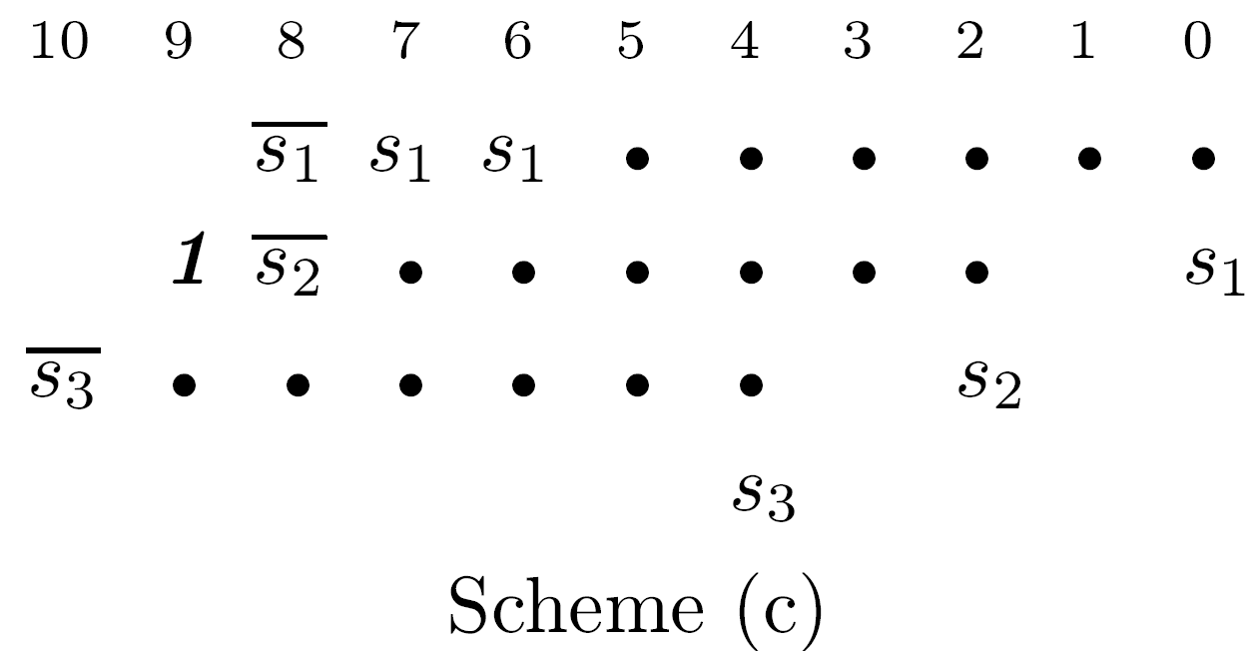
Use Modified Radix-4 Booth Algorithm

Slide 15
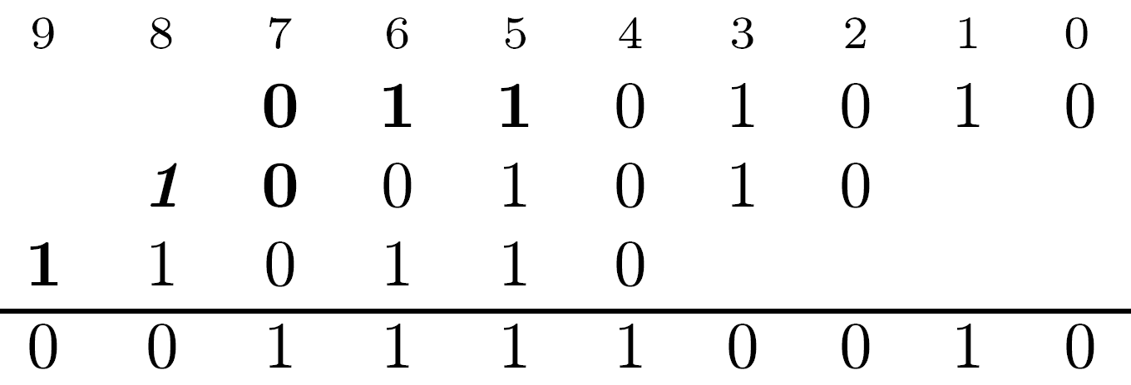
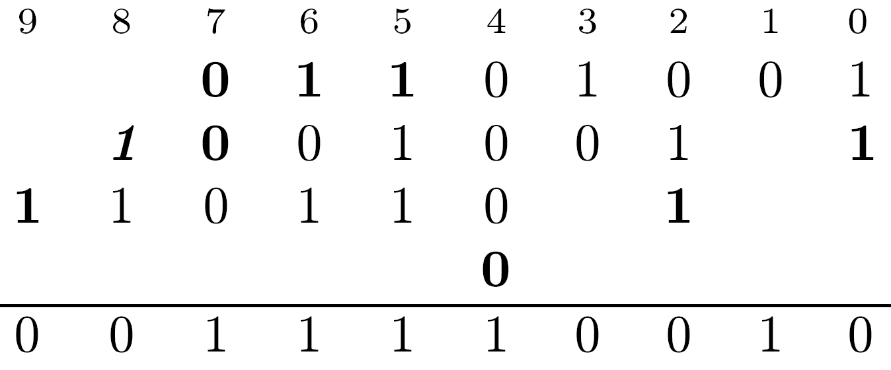
Example 2: Using radix-4 modified Booth's
Same recoded multiplier 010101

Slide 16
Alternative Techniques for Partial Product Accumulation
Reducing number of levels in tree - speeding up accumulation
Achieving more regular design
Tree structures usually have irregular interconnects
  Irregularity complicates implementation- area-inefficient layouts
Number of tree levels can be lowered by using reduction rate higher than 3:2
Achieve 2:1 reduction rate by using SD adders
  SD adder also generates sum in constant time
  Number of levels in SD adder tree is smaller
  Tree produces a single result rather than two for CSA tree

Slide 17
Final Result of SD Tree
In most cases, conversion to two's complement needed
Conversion done by forming two sequences:
First - Z - created by replacing each negative digit of SD number by 0
Second - Z - replaces each negative digit with its absolute value, and each positive digit by 0
Difference Z - Z - found by adding two's complement of Z to Z using a CPA
Final stage of a CPA needed as in CSA tree
+
-
+
-
-
+

Slide 18
SD Adder Tree vs. CSA Tree
SD - no need for a sign bit extension when negative partial products - no separate sign bit
Design of SD adder more complex - more gates and larger chip area - each signed digit requires two ordinary bits (or multiple-valued logic)
Comparison between the two must be made for specific technology
Example:
  32x32 Multiplier based on radix-4 modified Booth's algorithm - 16 partial products
  CSA tree with 6 levels, SD adder tree with 4 levels
  Sophisticated logic design techniques and layout schemes result in less area-consuming implementations

Slide 19
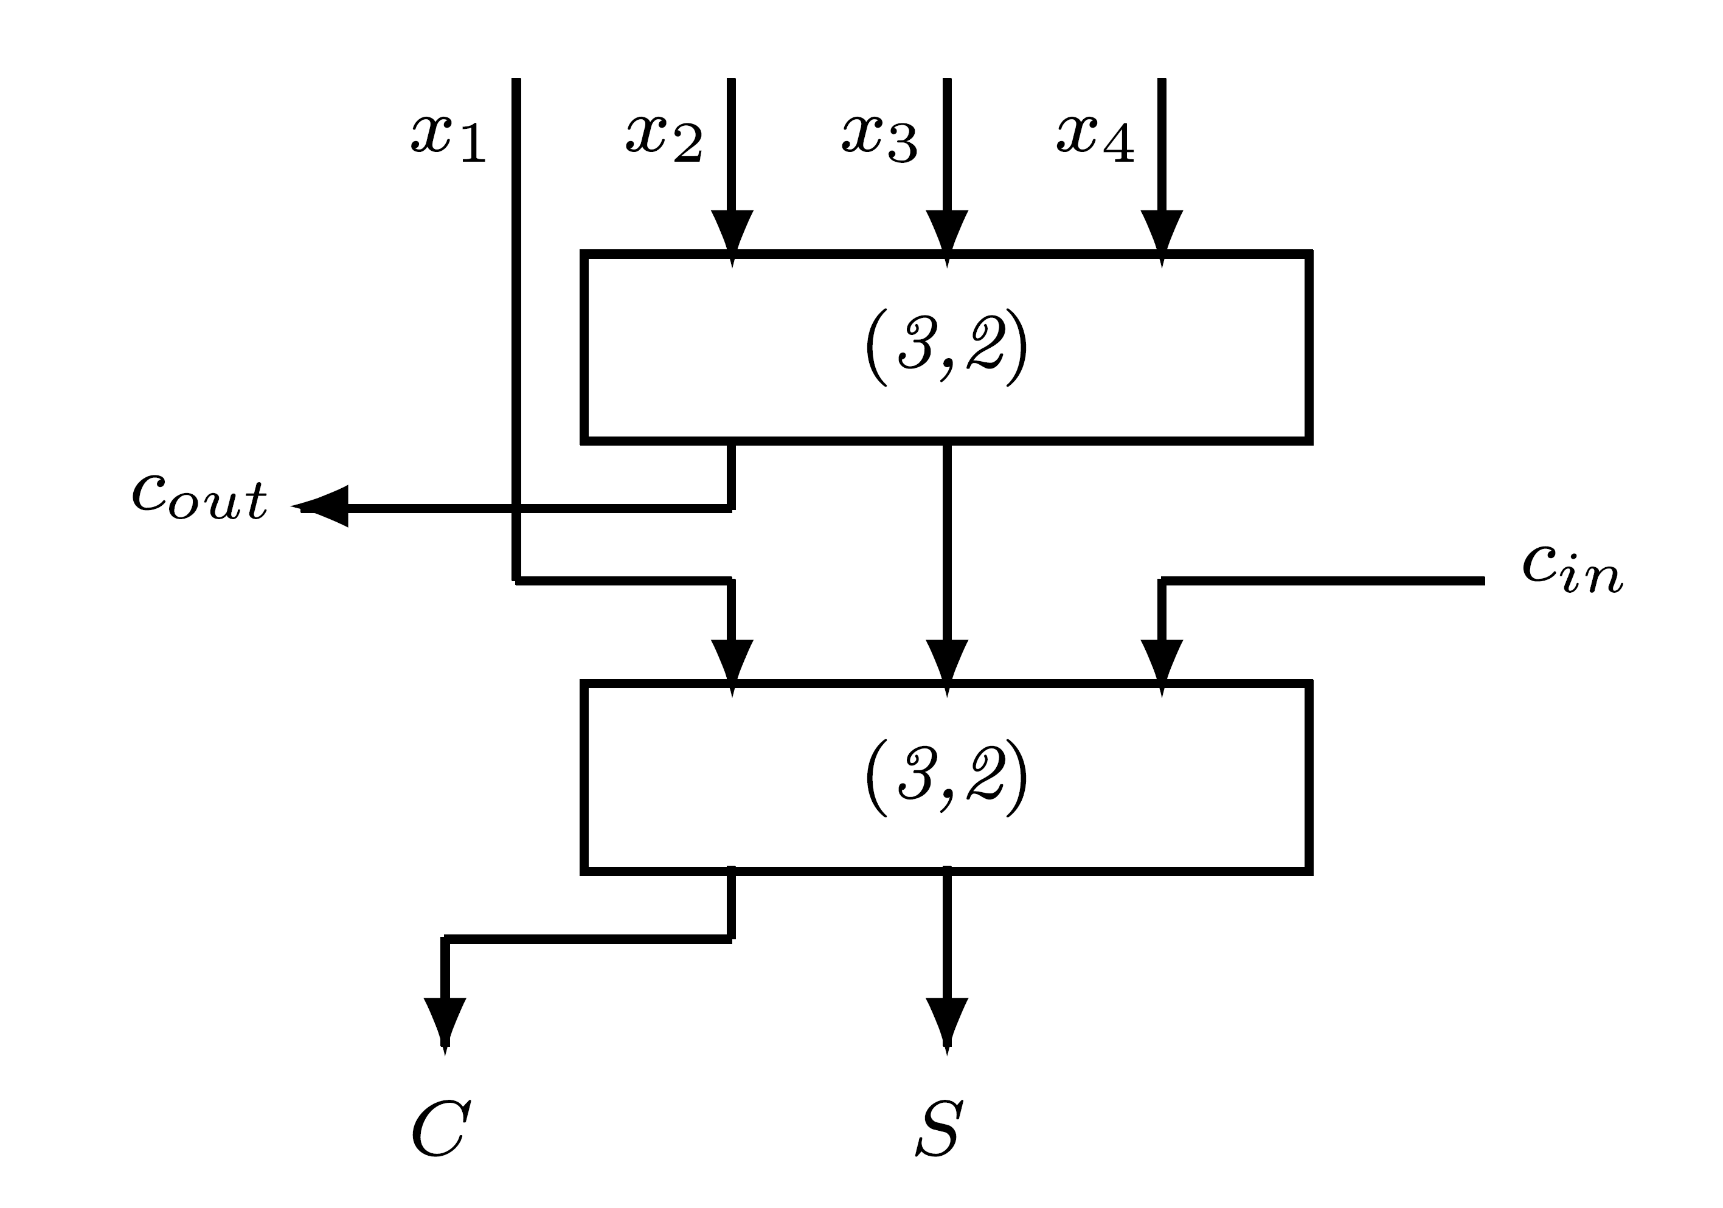
(4;2) Compressors
Same reduction rate of 2:1 achieved without SD representations by using (4;2) compressors
Designed so that cout is not a function of cin to avoid a ripple-carry effect
(4;2) compressor may be implemented as a multi-level circuit with a smaller overall delay compared to implementation based on 2 (3,2) counters

Slide 20
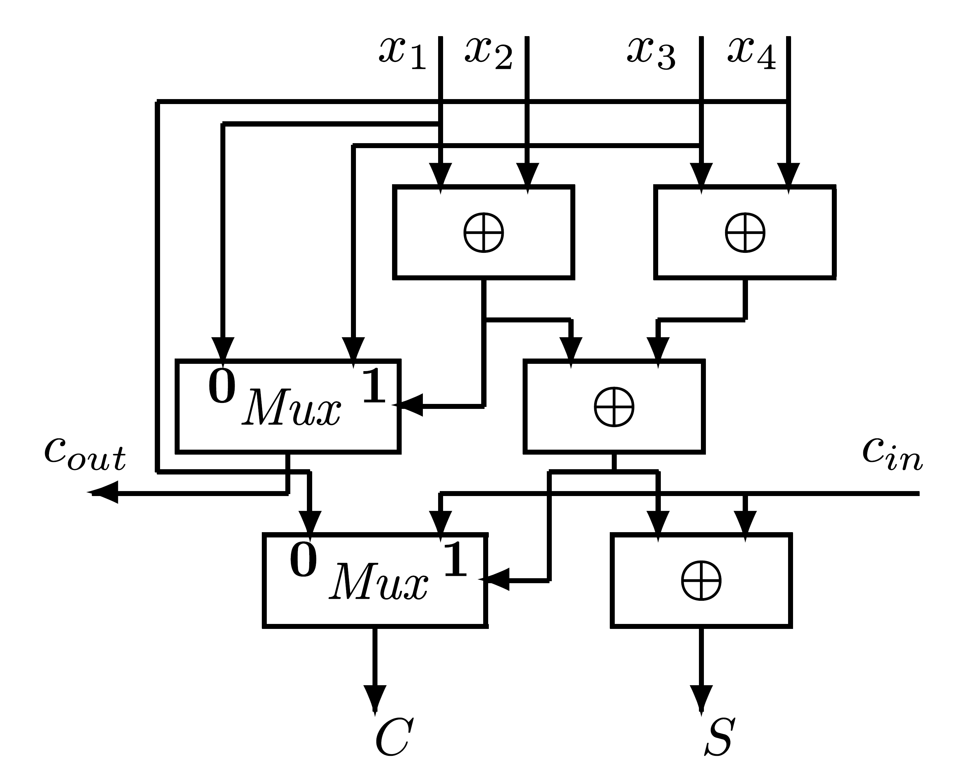
Example Implementation
Delay of 3 exclusive-or gates to output S vs. delay of 4 exclusive-or gates
  25% lower delay

Slide 21
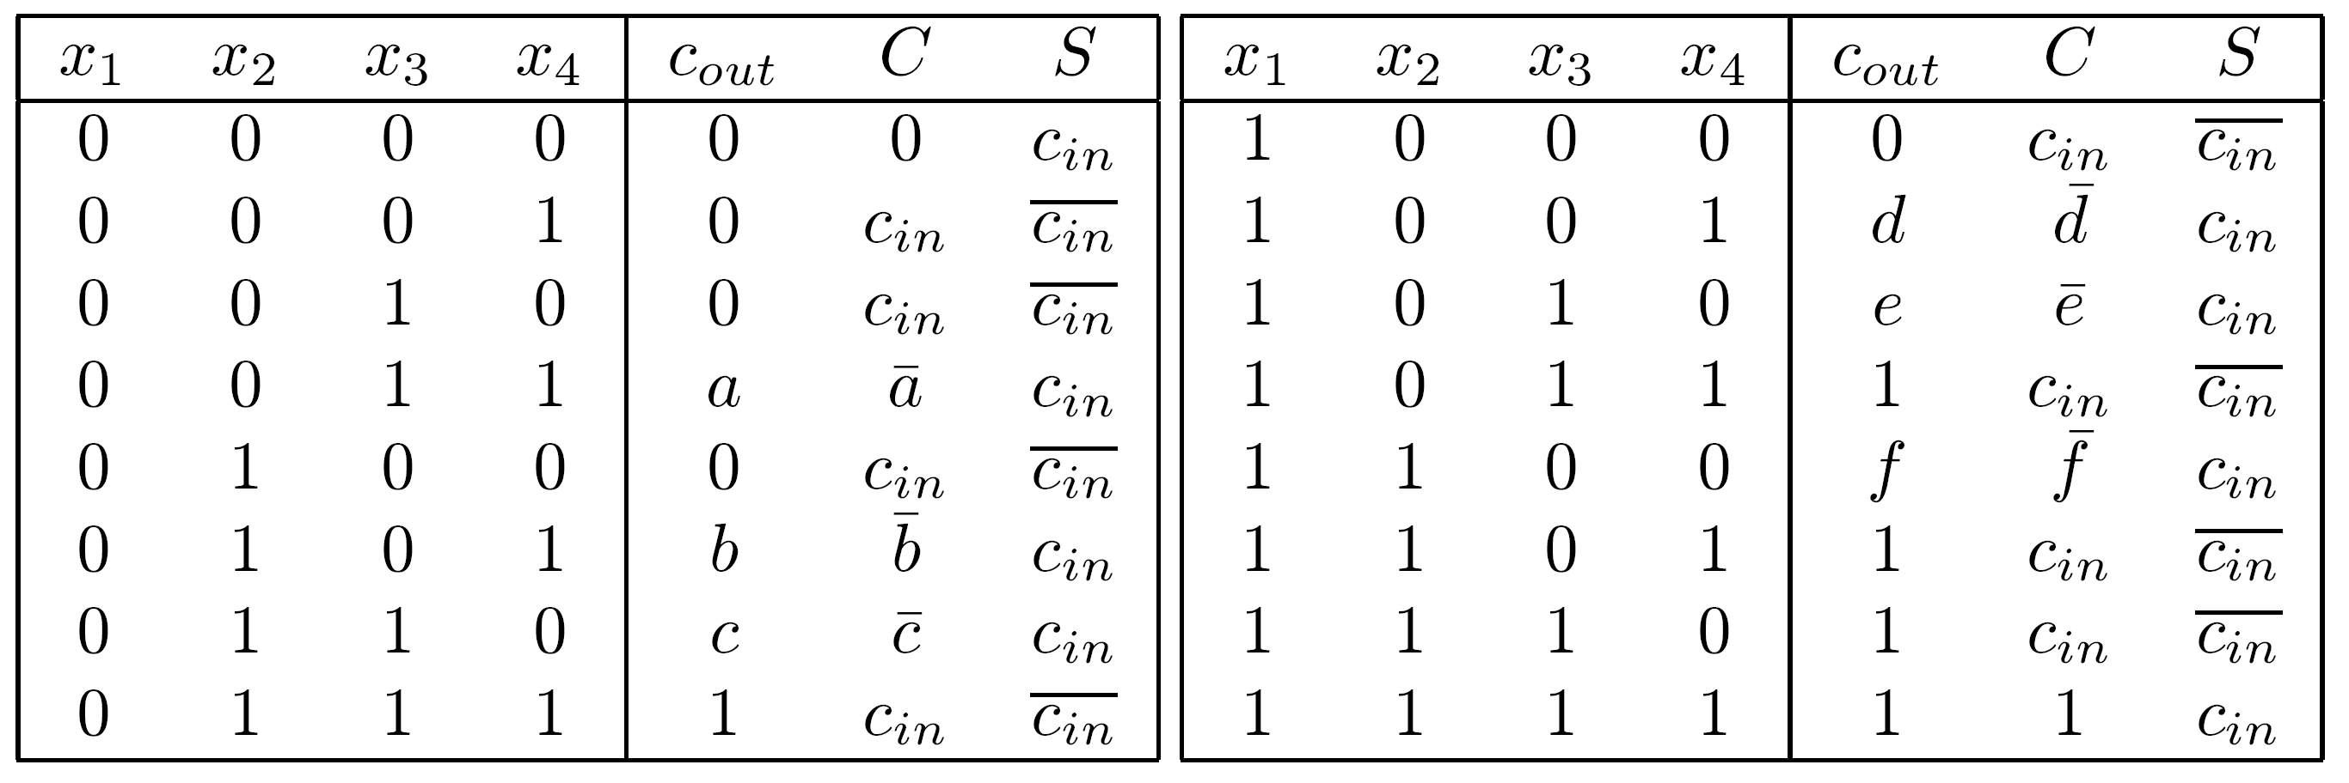
Other Multi-Level Implementations of a (4;2) Compressor
All implementations must satisfy
cout should not depend on cin to avoid horizontal rippling of carries
Truth table : (a,b,c,d,e,f - Boolean variables)
Previous implementation - a=b=c=1, d=e=f=0

Slide 22
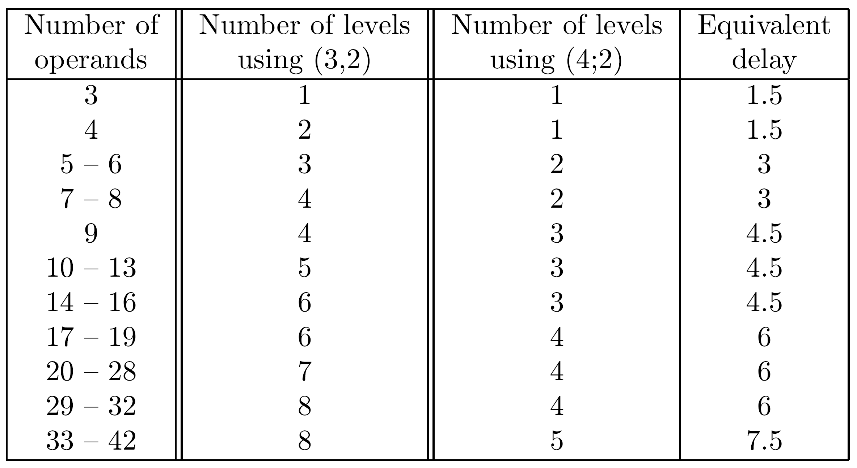
Comparing Delay of Trees

Slide 23
Other Implementations
Other counters and compressors can be used: e.g., (7,3) counters
Other techniques suggested to modify CSA trees which use (3,2) counters to achieve a more regular and less area-consuming layout
Such modified tree structures may require a somewhat larger number of CSA levels with a larger overall delay
Two such techniques are:
  Balanced delay trees
  Overturned-stairs trees

Slide 24
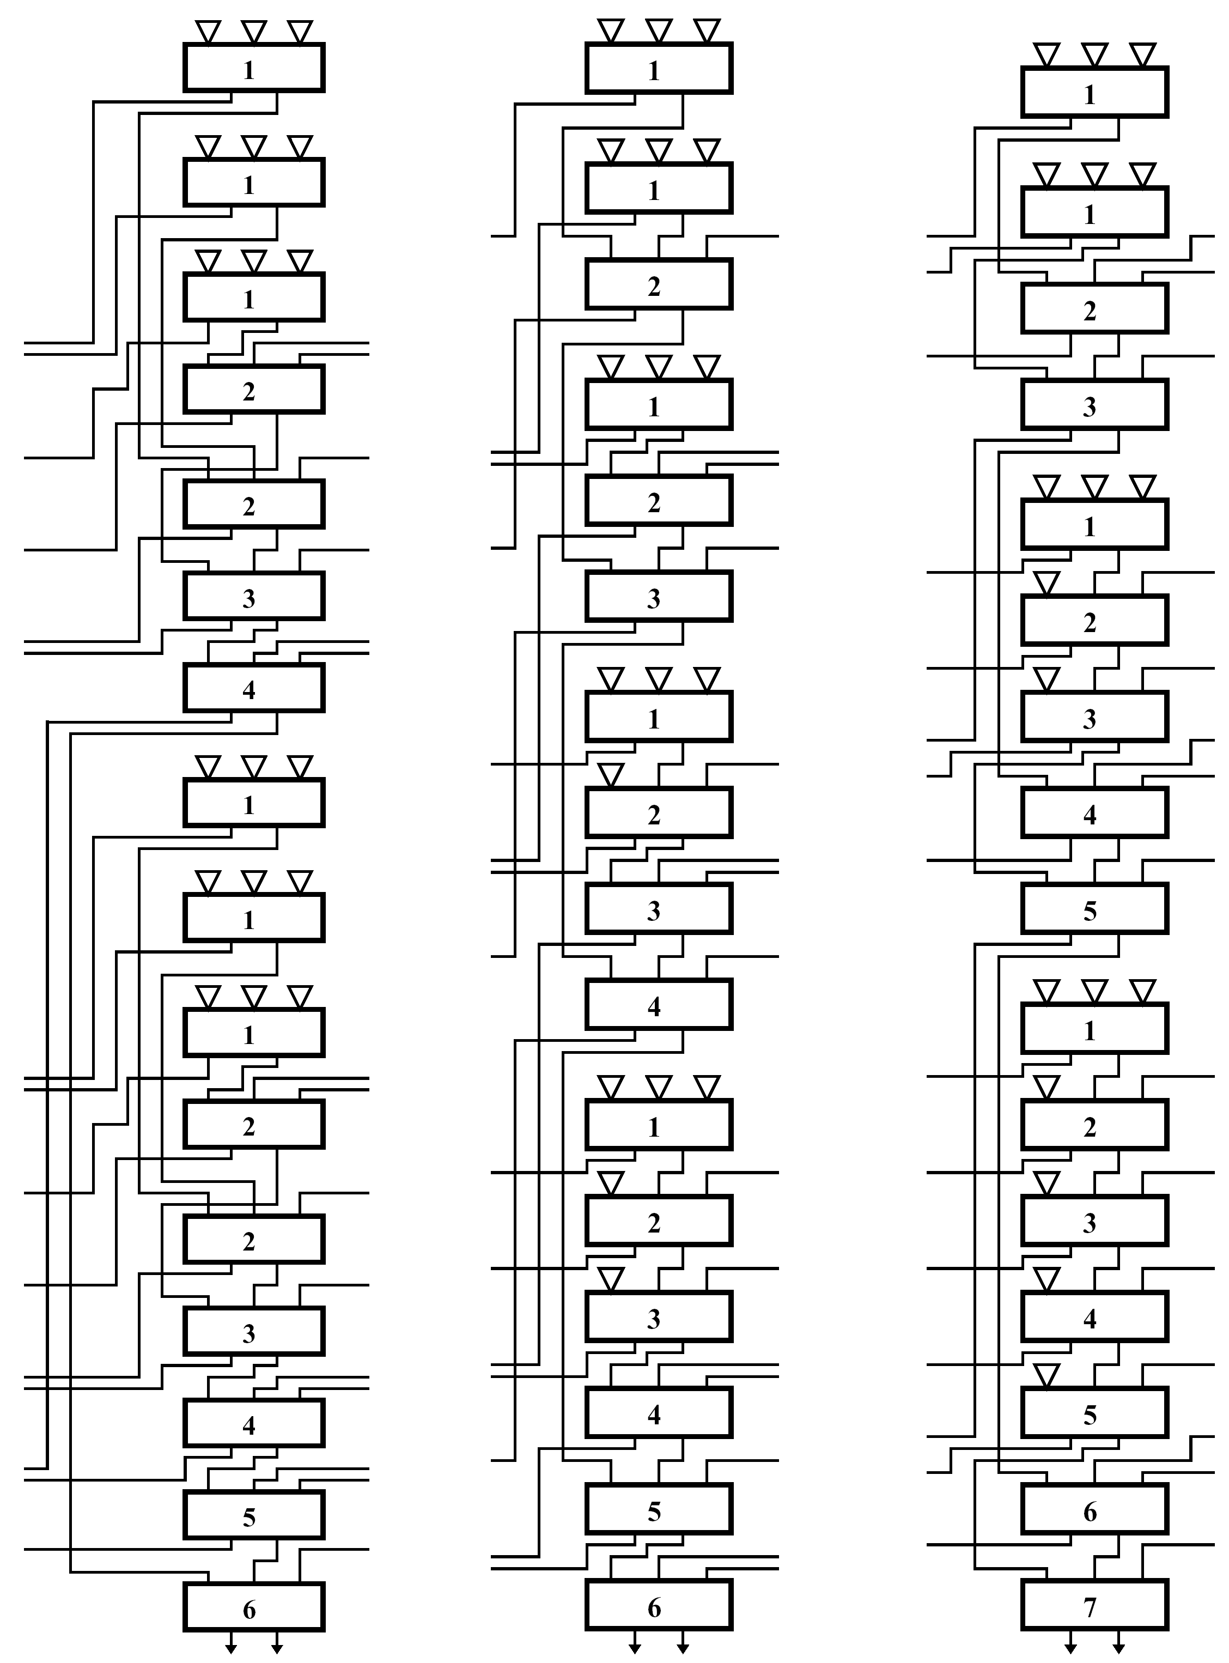
Bit-Slices for Three Techniques
* 18 operands * radix-4 modified Booth
* Triangles - multiplexers * Rectangles -(3,2) counters
* 15 outgoing & incoming carries aligned * adjacent bit-slices abut
Wallace
Over-turned
Balanced
7ΔFA

Slide 25
Comparing the Three Trees
Incoming carries routed so that all inputs to a counter are valid before or at necessary time
Only for balanced tree - all 15 incoming carries generated exactly when required - all paths balanced
In other 2 - there are counters for which not all incoming carries are generated simultaneously
  For example, bottom counter in overturned-stairs - incoming carries with delays of 4ΔFA and 5ΔFA
Number of wiring tracks between adjacent bit-slices (affect layout area)
  Wallace tree requires 6; overturned-stairs 3; balanced tree 2 tracks
Tradeoff between size and speed
  Wallace : lowest delay but highest number of wiring tracks
  Balanced: smallest number of wiring tracks but highest delay

Slide 26
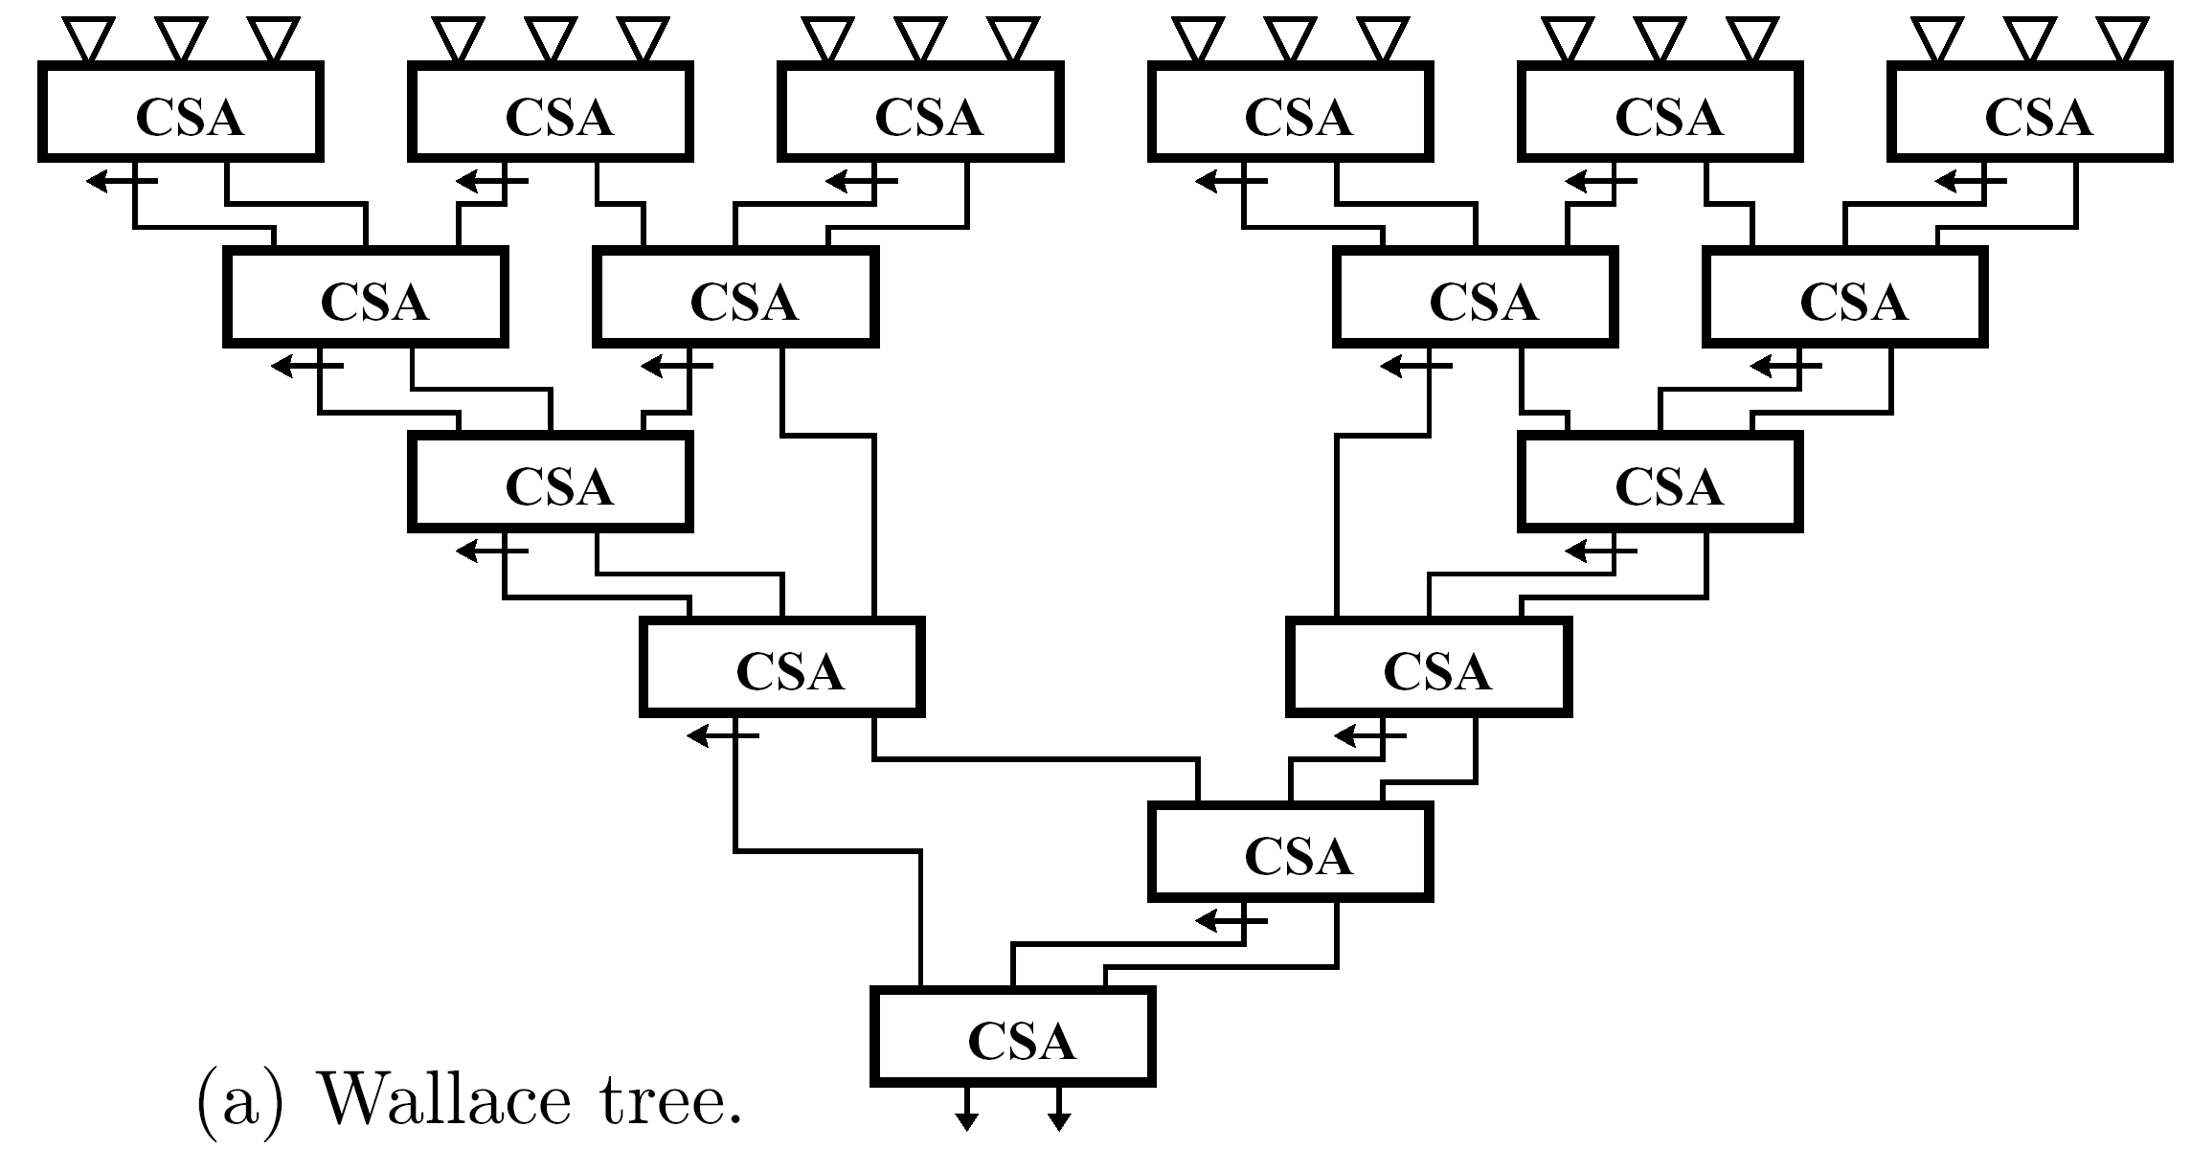
Complete Structure of Wallace Tree
Balanced and overturned-stairs have regular structure - can be designed in a systematic way

Slide 27
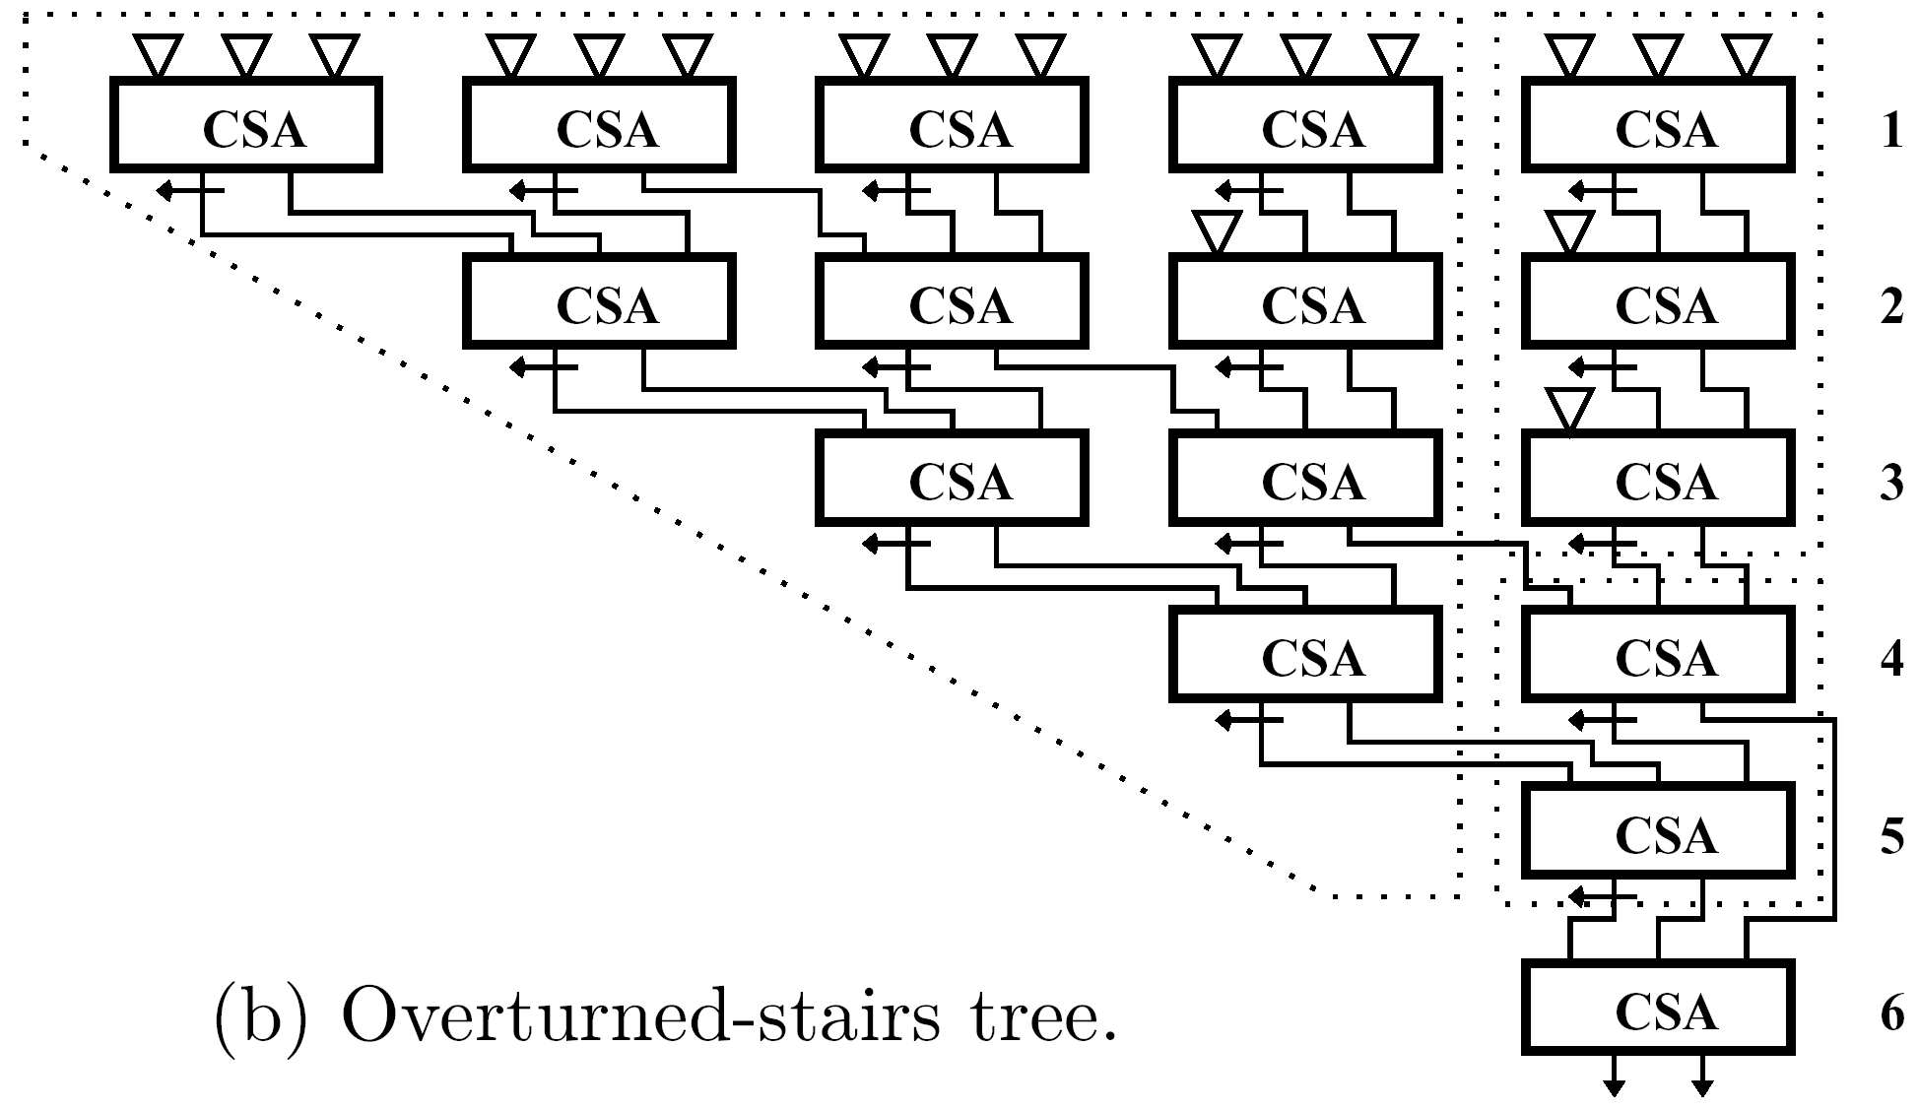
Complete Structure of Over-turned Tree
Building blocks indicated with dotted lines

Slide 28
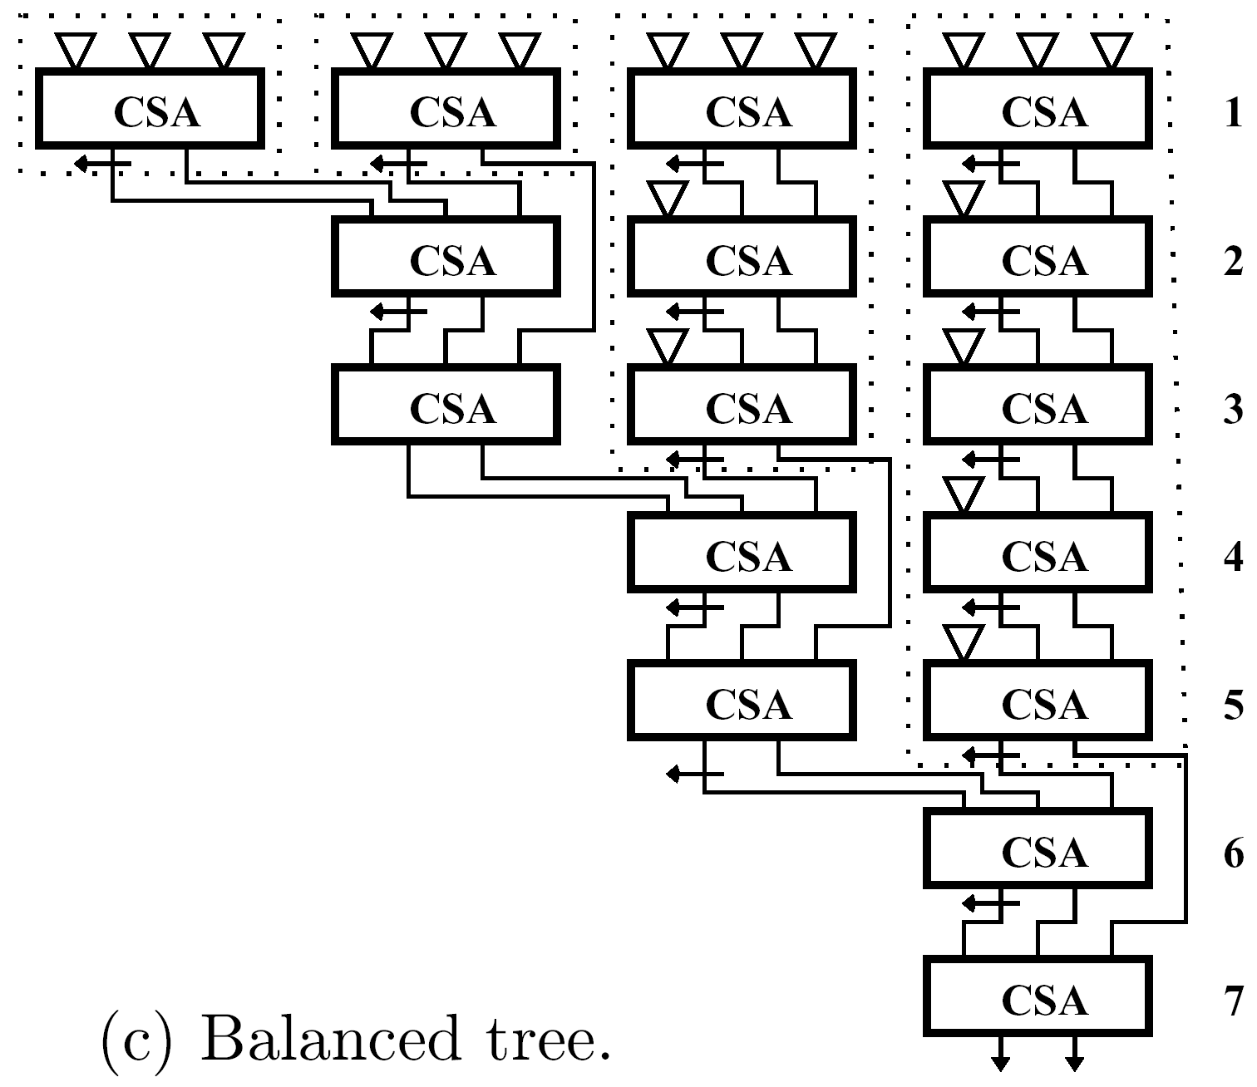
Complete Structure of Balanced Tree
Building blocks indicated with dotted lines

Slide 29
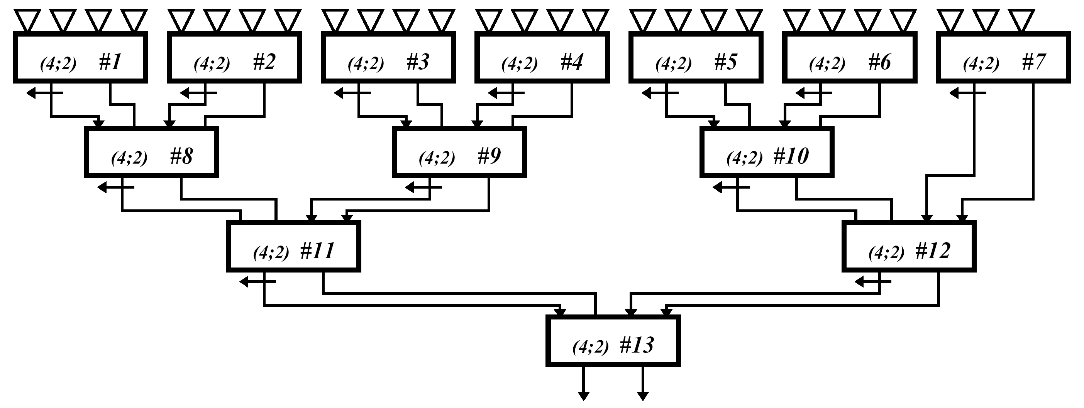
Layout of CSA Tree
Wires connecting carry-save adders should have roughly same length for balanced paths
CSA tree for 27 operands constructed of (4;2) compressors

Slide 30
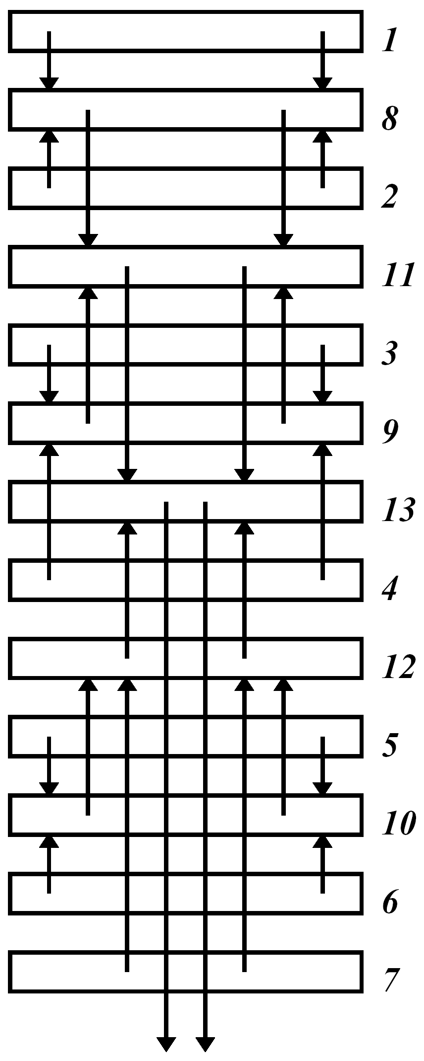
Layout of CSA Tree
Bottom compressor (#13) is located in middle so that compressors #11 and #12 are roughly at same distance from it
Compressor #11 has equal length wires from #8 and #9

Slide 31
Fused Multiply-Add Unit
Performs A x B followed by adding C
  A x B + C done as single and indivisible operation
Multiply only: set C=0; add (subtract) only: set B=1
  Can reduce overall execution time of chained multiply and then add/subtract operations
Example: Evaluation of a polynomial anx +an-1x +…+a0 through [(anx+an-1)x+an-2]x + …
Independent multiply and add operations can not be performed in parallel
Another advantage for floating-point operations - rounding performed only once for A x B+C rather then twice for multiply and add
  Rounding introduces computation errors - reducing number of roundings reduces overall error
n
n-1

Slide 32
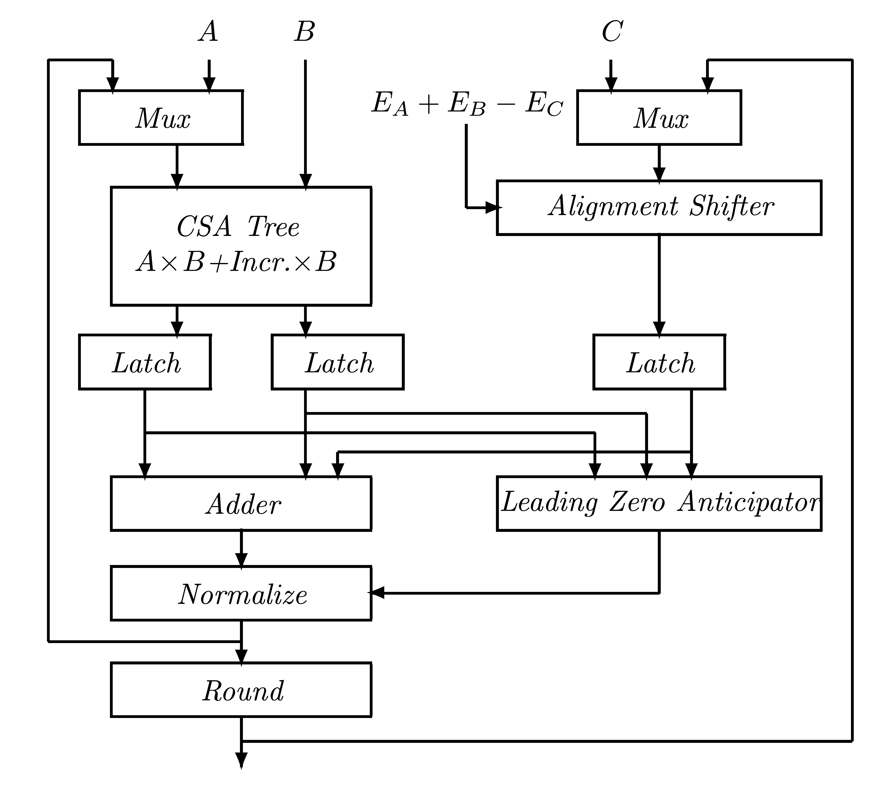
Implementating Fused Multiply-Add Unit
A,B,C - significands; EA,EB,EC - exponents of operands
CSA tree generates partial products and performs carry- save accumulation to produce 2 results which are added with properly aligned C
Adder gets 3 operands - first reduces to 2 ((3,2) counters), then performs carry-propagate addition
Post-normalization and rounding executed next

Slide 33
Two Techniques to reduce Execution Time
First: leading zero anticipator circuit uses propagate and generate signals produced by adder to predict type of shift needed in post-normalization step
It operates in parallel to addition so that the delay of normalization step is shorter
Second (more important): alignment of significand C in EA+EB-EC done in parallel to multiplication
Normally, align significand of smaller operand (smaller exponent)
Implying: if AxB smaller than C, have to shift product after generation - additional delay

Slide 34
Instead - Always align C
Even if larger than AxB - allow shift to be performed in parallel to multiplication
Must allow C to shift either to right (traditional) or left
Direction - EA+EB-EC is positive or negative
If C shifted to left - must increase total number of bits in adder

Slide 35
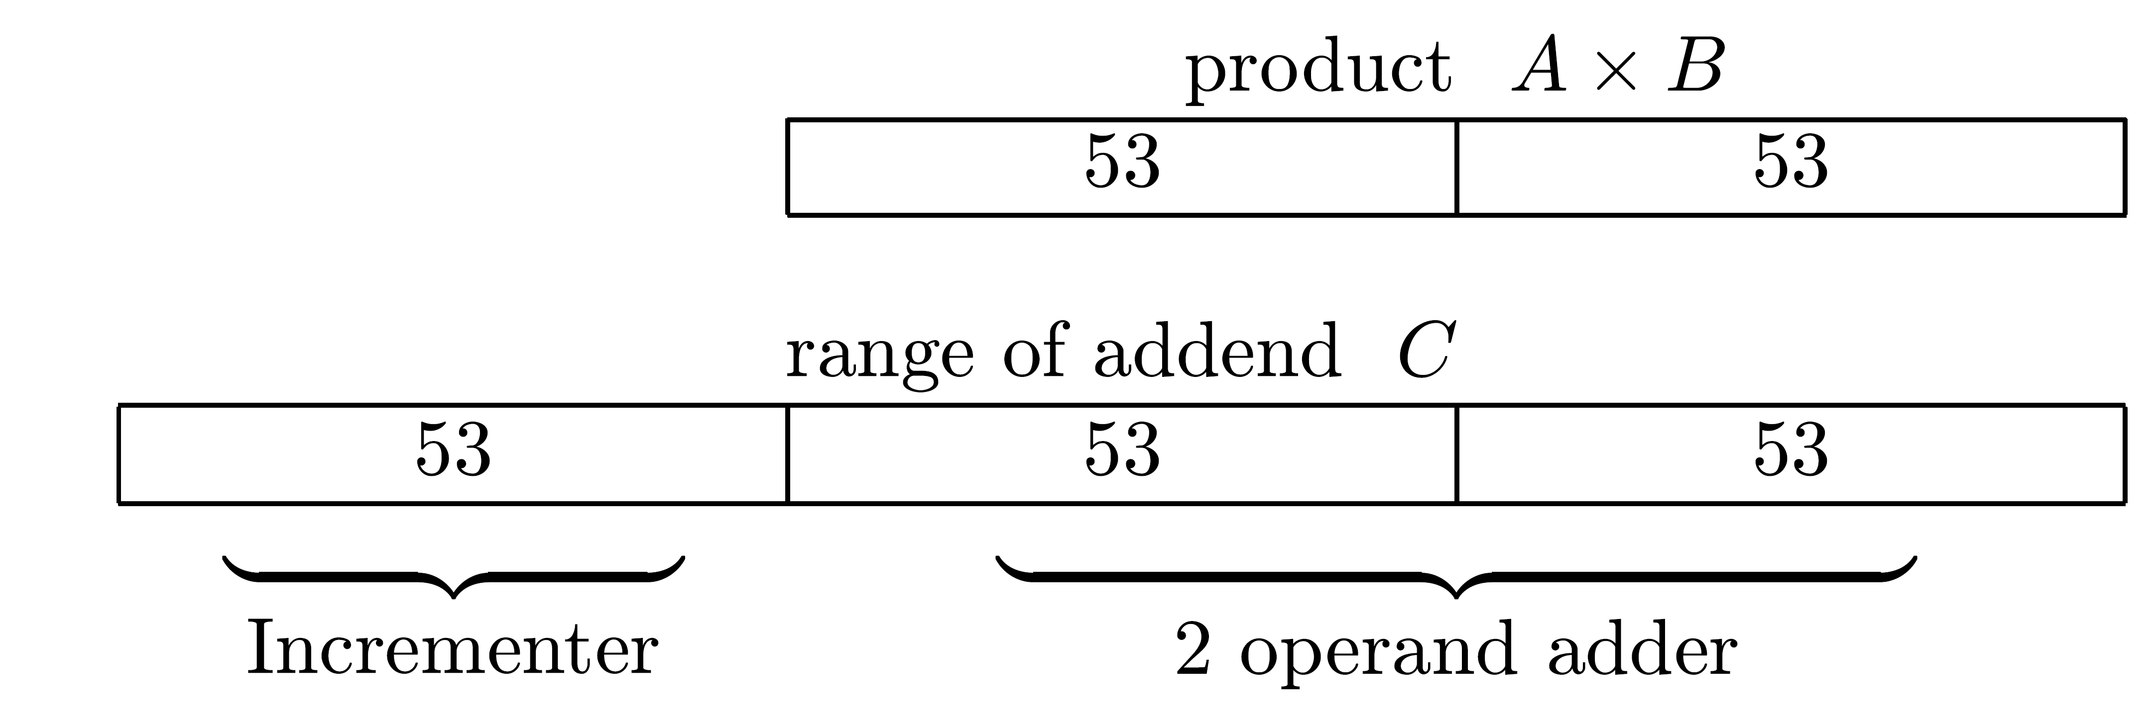
Example
Long IEEE operands - possible range of C relative to AxB:
53 ≥ EA+EB-EC ≥ -53
If EA+EB-EC ≥ 54, bits of C shifted further to right will be replaced by a sticky bit, and if EA+EB-EC ≤ -54, all bits of AxB replaced by sticky bit
Overall penalty - 50% increase in width of adder - increasing execution time
Top 53 bits of adder need only be capable of incrementing if a carry propagates from lower 106 bits

Slide 36
Additional Computation Paths
Path from Round to multiplexer on right used for (XxY+Z)+AxB
Path from Normalize to multiplexer on left used for (X x Y+Z) x B +C
Rounding step for (X x Y+Z) is performed at same time as multiplication by B, by adding partial product Incr.x B to CSA tree

