Slide 1
Booth Encoded Wallace Tree Multiplier
Ruida Yun
Nahid Rahman

Slide 2
Importance
Booth encoding is an effective method for multiplication of both positive and negative numbers.
Wallace tree reduces the number of partial products to be added into 2 final intermediate results.
Carry Look-ahead Adder used to add these results to generate the final output.

Slide 3
Background of our work…

Slide 4
Multiplication of unsigned (+ve ) numbers
Multiplicand 0110 (=6)
Multiplier x 1011 (=11)
-----------
0110 0110
0000
0110
-----------
01000010 (=66)
Logically can be expressed as AND operation:
if MR=1 assign MD
if MR=0 assign all zeros

Slide 5
In a 4-bit 2’s complement number system…..
Multiplicand 0110 (=6)
Multiplier x 1011 (=-5, signed number)
-----------
0110 0110
0000
0110
-----------
01000010 (=66)
Therefore, 8-bit result cannot be generated from 2 4- bit inputs in a signed number system.

Slide 6
Standard Multiplier Method
Multiplicand 00000110 (=6)
Multiplier x 11111011 (=-5, signed number)
---------------
00000110
00000110
00000000
00000110
00000110
00000110
00000110
------------------------
11100010 (=-30)

Slide 7
Booth’s Algorithm
Introduces a new symbol: í indicating multiplication by -1.
Multiplier is recoded in terms of 1, 0 & í.
Example: 1011 is recoded as: í10 í
AND operation changes as:
if MR=1 assign MD
if MR=0 assign all zeros
if MR= í assign -MD

Slide 8
Our MR now becomes 4-bit again..
Multiplicand 0110 (=6)
Multiplier x í10 í (=-5)
---------------
11111010 (-MD, sign extended) 00000000 (All zeros) 00000110 (MD, sign extended)
11111010 (-MD, sign extended)
----------------
11100010 (=-30 , 8 bits of LSB)

Slide 9
Generating í
Not possible to implement in hardware.
Therefore, done by inspecting a multiplier bit and its previous bit and generating 2 control signals x and z.
Whether the MR is í, 1 or 0, depends on these signals according to:
Recoded MR | M[i] | M[i-1] | x | z
0 | 0 | 0 | 0 | 0
1 | 0 | 1 | 0 | 1
í | 1 | 0 | 1 | 1
0 | 1 | 1 | 0 | 0

Slide 10
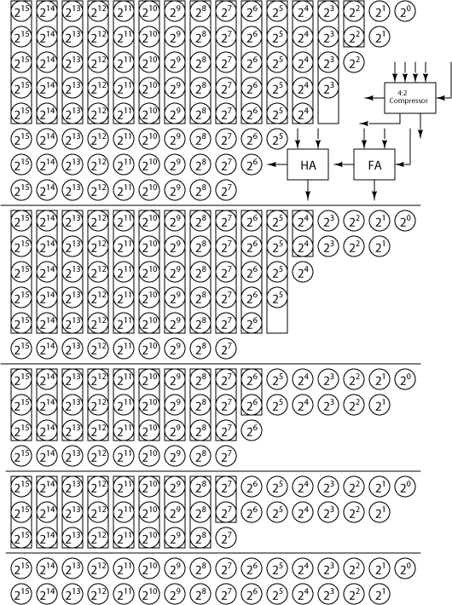
Wallace Tree

Slide 11
Tasks in Project
Generating 2’s complement of MD for –MD.
Recoding MR/generating x and z.
Generating partial products.
Sign extension.
Compressing the partial products.
Adding the final 2 operands for multiplication result.

Slide 12
Team Management
Nahid:
Booth Encoder
Partial Product Generator
Ruida:
Wallace Tree
Carry Look-ahead Adder
(Smaller modules generated and tested as necessary
Website: http://www.eecs.tufts.edu/~ryun01/vlsi)

Slide 13
Modules in our project…..

Slide 14
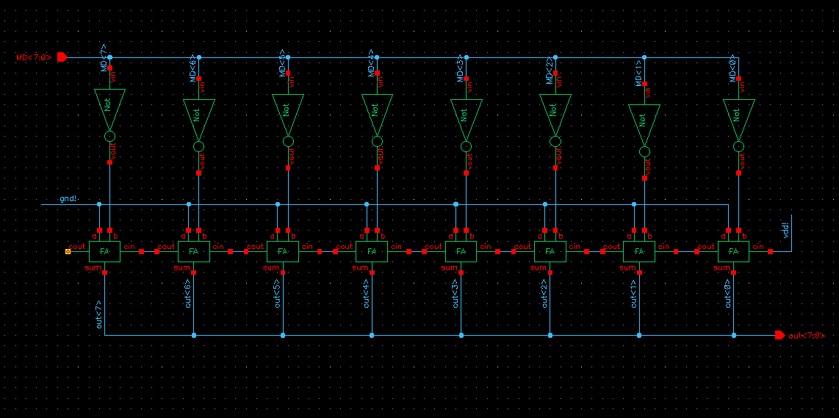
2’s Complement Generator

Slide 15
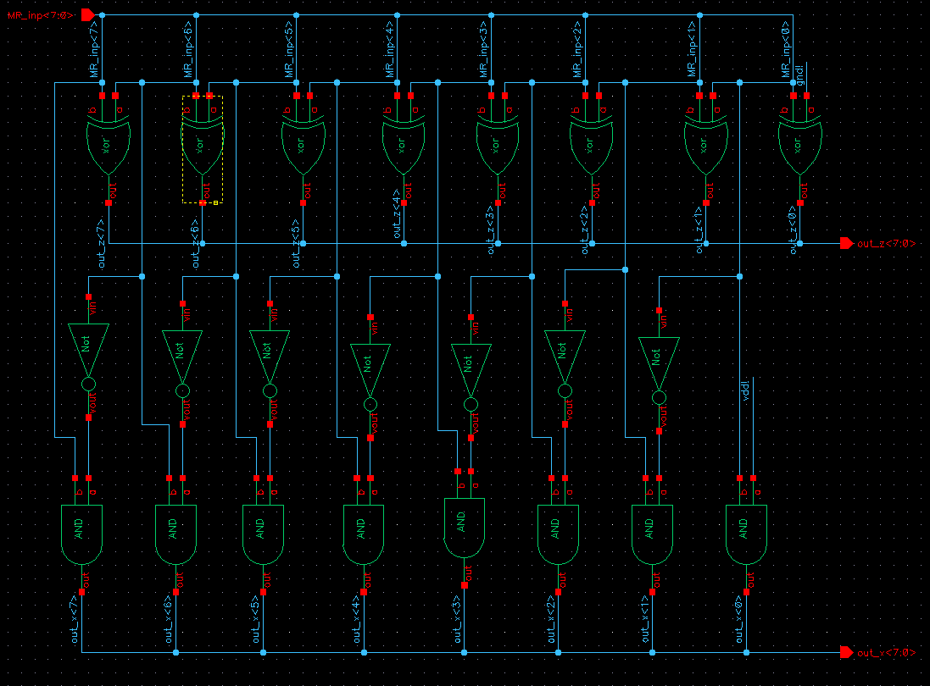
Booth Encoder

Slide 16
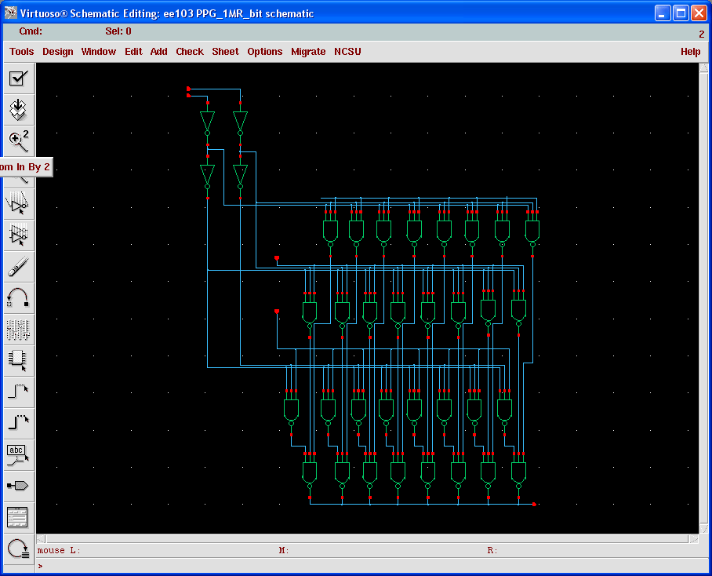
Partial Product Generator (a)

Slide 17
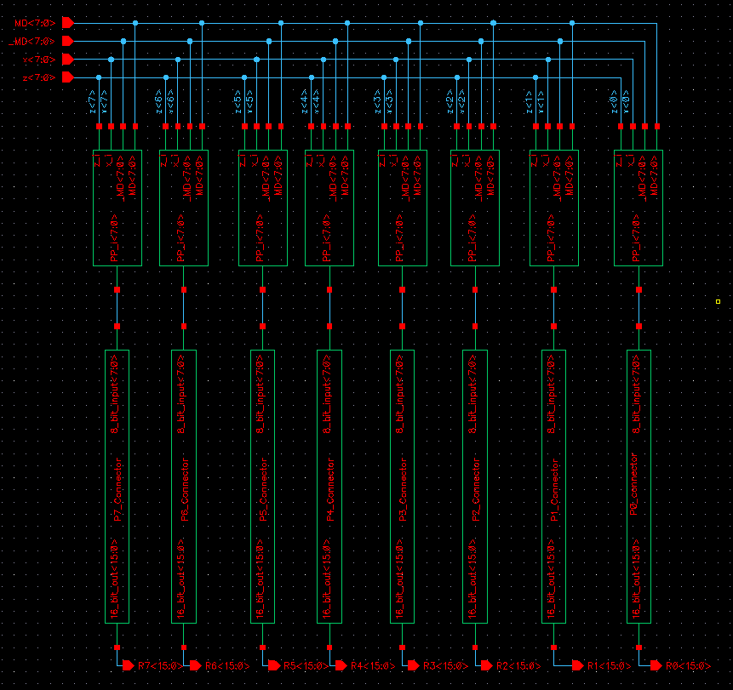
Partial Product generator

Slide 18
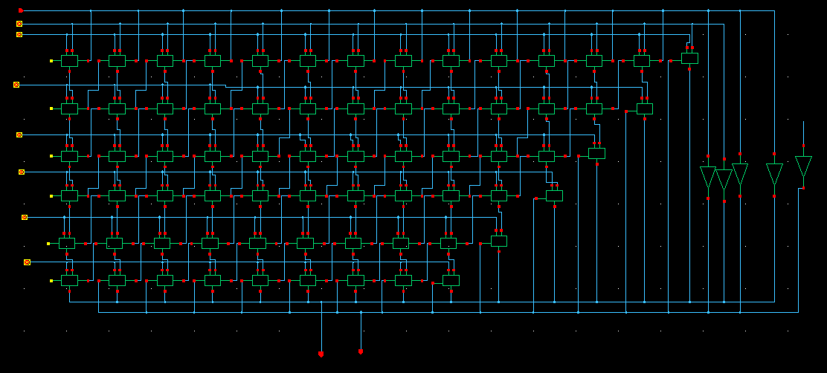
Wallace Tree

Slide 19
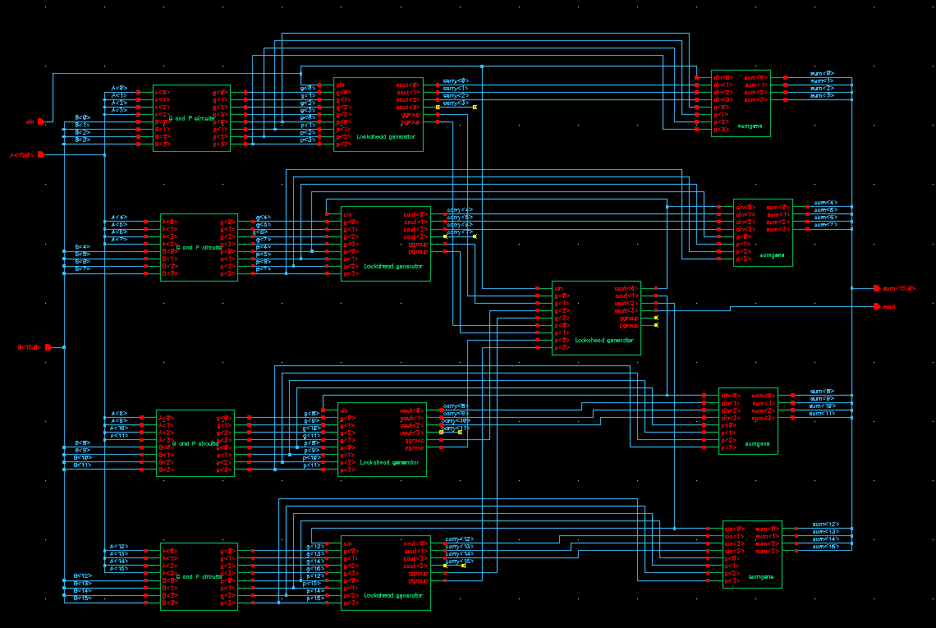
Carry Look-ahead Adder

Slide 20
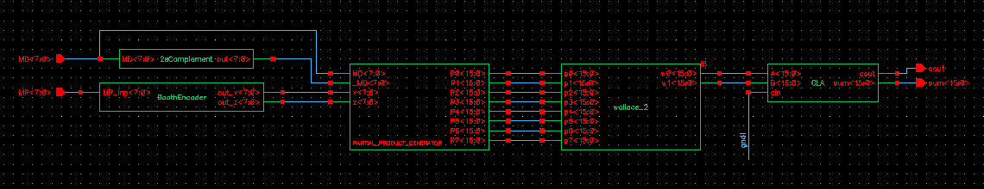
Multiplier

Slide 21
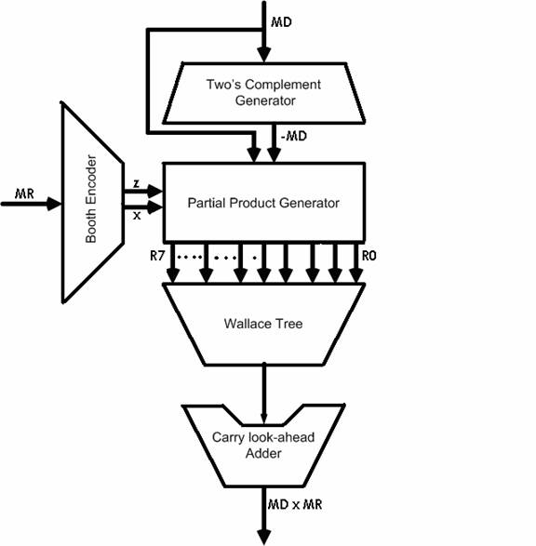
Chip Architecture

Slide 22
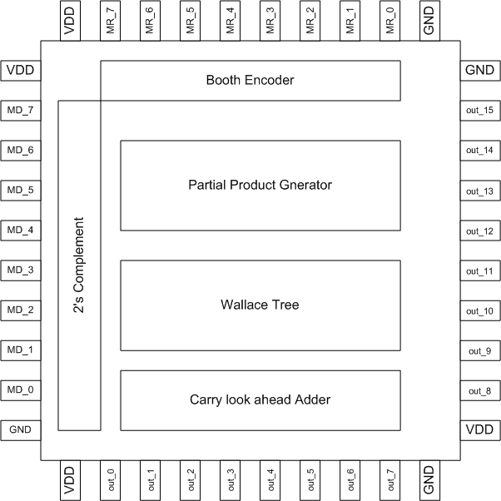
Floor plan

Slide 23
Final Layout
No, it’s not a gun…

Slide 24
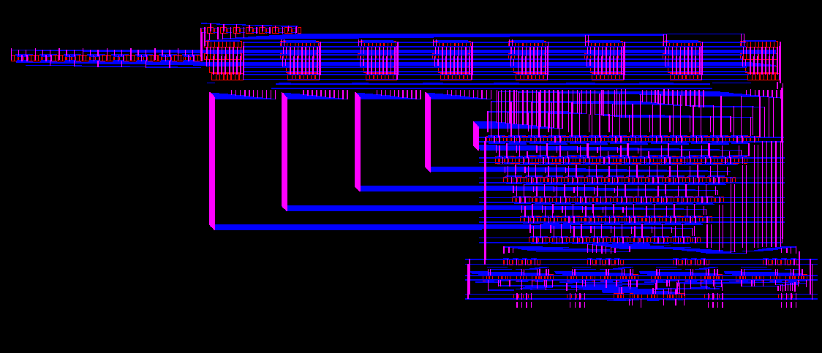

Slide 25
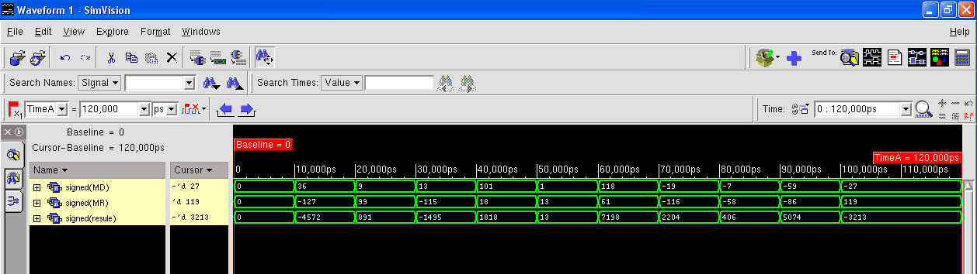
Verilog Simulation Results

Slide 26
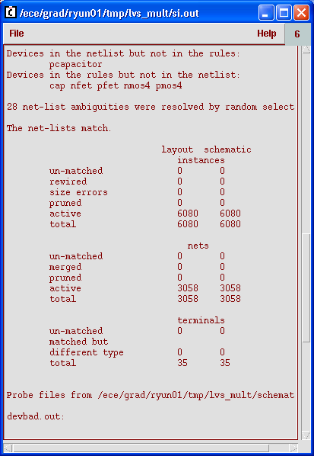
LVS for Final Chip

Slide 27
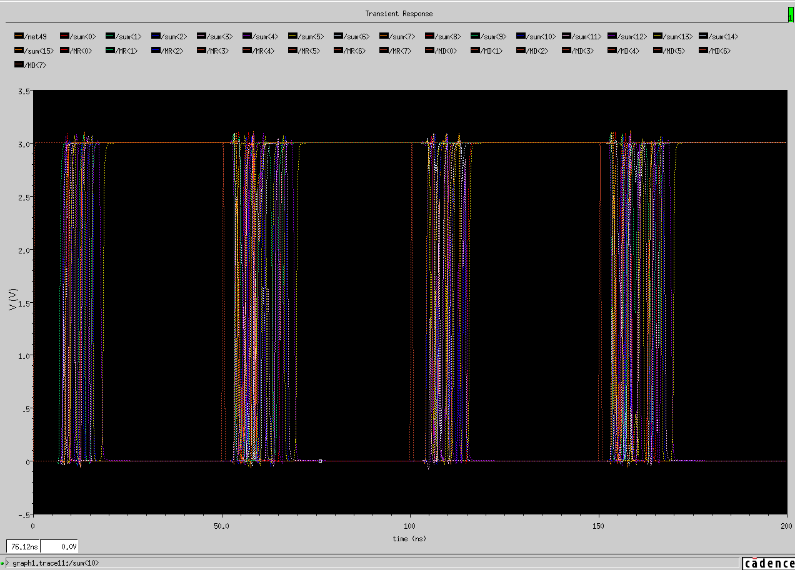
Spectre_S Simulation for Final Chip

Slide 28
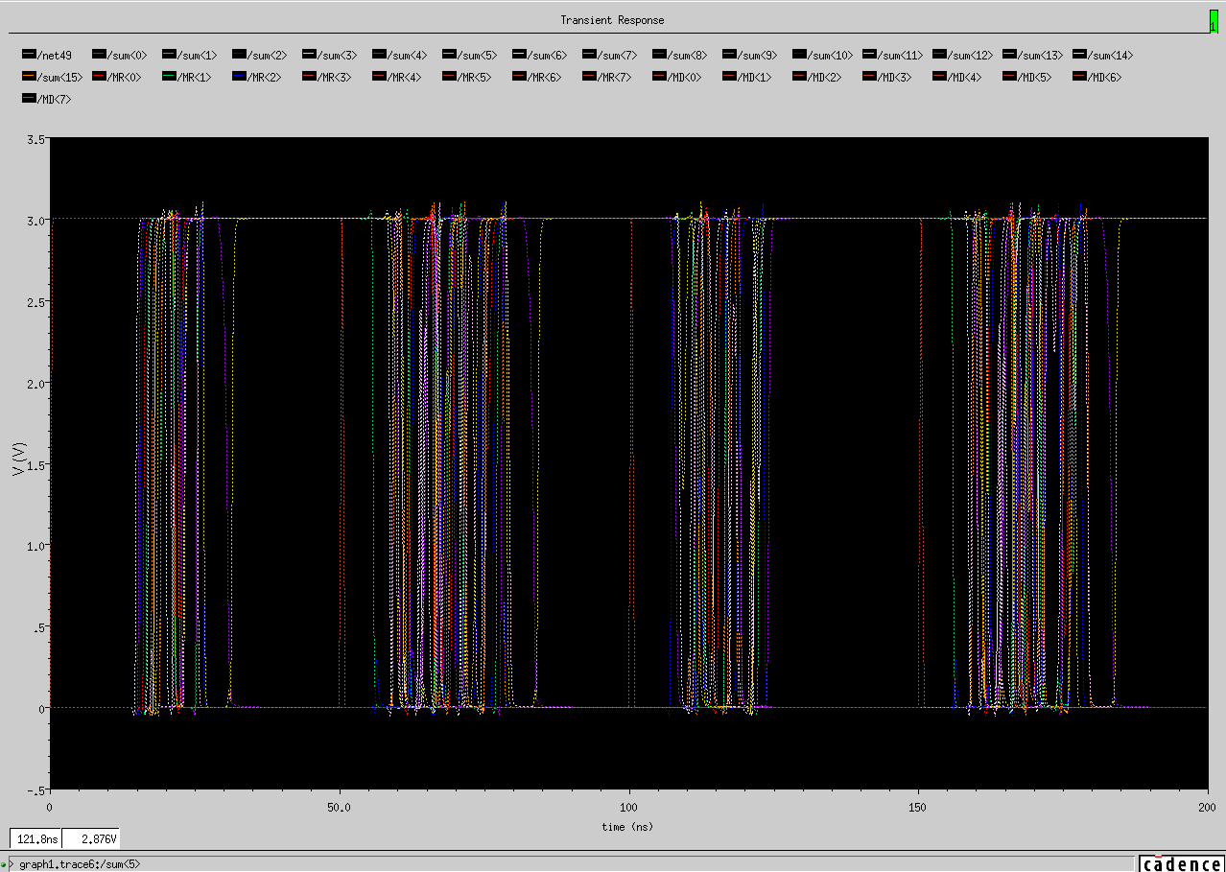
Post-Layout Simulation for Final Chip

Slide 30
Full Chip Implementation Details
Fabrication Process: AMI 0.6u C5N
Final Chip Area: 4.2mm*1.5mm
Number of PMOS: 3040
Number of NMOS: 3040
Total number of transistors: 6080
Speed: 20 MHz
Power Dissipation: 15.14 mW

Slide 31
Drawbacks
Original Booth’s algorithm used where modified radix-4 algorithm could be used.
Ripple Carry Adder used in 2’s Complement Generator.
Area and time not optimized; very slow chip.

Slide 32
Goals Achieved
As novice cadence users, our primary goal for this project was more of an academic nature:
We have been able to achieve completeness and overall functional accuracy in our work.
The project was foundational and served as a great learning experience.
It also provided us with valuable experience in effective collaboration, work ethics, and a very enjoyable ongoing intercommunication between different project groups.

Slide 33
Acknowledgements
Our research advisor Prof. Valencia Joyner for all her support.
All our new friends at the ECE department.

Slide 34
Thank you…..
~Ruida,
Nahid.

