Slide 2
Embedded Software
Training Day
Fundamentals of embedded software, how it operates in CeNTI and small challenge.
2025

Slide 3

Fundamentals of embedded software
Who are we;
Where is embedded software situated;
What is embedded software;
What we do in our team;
Typical challenges we face;
Tools of the trade.

Slide 4
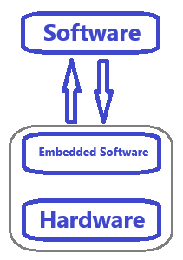
Fundamentals of embedded software
Who we are
We are a team of 10 elements;
The majority has a degree in electronics or similar;
Young team with ages between 24 and 30 years old.
Where is embedded software situated
Embedded software is situated between hardware and software;
In CeNTI, we use embedded software to control hardware and sometimes communicate with an external software.

Slide 5
Fundamentals of embedded software
What is embedded software
Embedded software, also known as firmware is specialized computer code that is directly integrated with the hardware;
Unlike the standard software, embedded software is highly dependent of the hardware that is controlling, and it is used to perform specific tasks efficiently and reliably;
“It is like writing software with a diet – limited resources”;
Where embedded software is present: smartwatch, car systems, gadget, medical devices, industrial robots, sensors, smart home devices, etc.

Slide 6
Fundamentals of embedded software
What we do in our team
Interaction with hardware and sometimes with software;
Drivers;
Sensing and system control;
Power management;
Updating devices (OTA updates);
Real-time systems;
Memory management.

Slide 7
Fundamentals of embedded software
Typical challenges we face
Create firmware from scratch;
Interpret datasheets to develop drivers;
Constant search for new technologies;
Limited resources: memory, low power, real-time, safety, budget;
Hardware understanding;
Problem solving;
Timming constraints.

Slide 8
Fundamentals of embedded software
Tools of the trade
Programming languages: C (majority), python, C++;
Debugging: Oscilloscope, JTAG, logic analyzer;
IDE: VS Code, STM32CubeIDE, MPLab, Simplicity studio, Code Composer Studio;
Microcontrollers: PIC18, PIC32, STM32, ATSAM, ATTiny, NRF, EFM32, MSP;
Wired communication protocols: UART, SPI, I2C, CAN, LIN, one-wire, RS485, RS232, modbus, ethernet;
Wireless communication protocols: BLE, Wi-Fi, Wi-Sun, Zigbee, NFC, LTE, UWB;
Outputs: Display, LED, motor, actuator, etc.;
Inputs: Sensors, capacitive touch, buttons, sliders, encoders, etc..

Slide 9
Fundamentals of embedded software
Questions?

Slide 10
Small challenge
Challenge introduction;
IDE and firmware resources;
Hardware resources;
First part of the challenge;
Second part of the challenge.

Slide 11
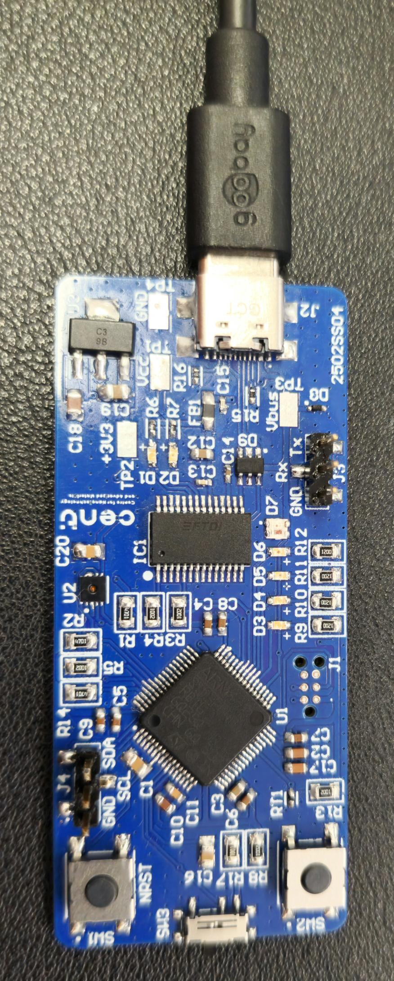
Small challenge
Challenge introduction
The challenge consists in create firmware code for a custom PCB made on CeNTI;
The main goal for this challenge is to simulate part of the work that the embedded software team must do;
The challenge is divided in two parts. The first one is to control the LEDs using a button and the second one is to communicate with the temperature and humidity sensor and print the values and control the LEDs according the temperature.
Github link

Slide 12
Small challenge
IDE and firmware resources
To perform the challenge, it is recommended to install the STM32CubeIDE version 1.15 or higher;
For this challenge will be necessary to use the following peripherals: UART, GPIO, and I2C;
UART: Used for debug and to print the temperature and humidity values;
GPIO: To control the LEDs and receive the button and switch inputs;
I2C: To communicate with the SHT31 sensor (temperature and humidity sensor).
To program your code, you will need to use a SEGGER j-link debug probe and a 6-pin needle cable.

Slide 13
Small challenge
Hardware resources
1
2
3
4
5
1 – USB power and UART output;
2 – Debug UART;
3 – LEDs;
4 – Programming pads;
5 – User button;
6 – User switch;
7 – Reset button;
8 – Debug I2C;
9 – SHT31 sensor.
6
9
8
7

Slide 14





Small challenge
First part of the challenge
Control LEDs based on button press time
This challenge will be used to introduce to the hardware and the peripherals.
The idea is to turn each LED on, one at a time, for each second that passes with the button being pressed. If the button is no longer being pressed, each LED, one at a time but in reverse order, should be turned off for each 0.5 seconds that passes with being pressed.
Use the UART to help debug the code and to understand the actual system state.
Button pressed
0 seconds
1 seconds
2 seconds
3 seconds
4 seconds
Button released
0 seconds
0.5 seconds
1 seconds
1.5 seconds
2 seconds

Slide 15
Small challenge
Second part of the challenge
Control LEDs based on temperature
For this challenge you will need to implement the switch to allow swap between the first and second challenge.
For this challenge you will need the to acquire frequently the temperature from the SHT31 sensor, and if the temperature reaches some levels, the LEDs should indicate it.
For that, use initially a standard temperature (e.g., 24°C) and if the user button is pressed, update the base temperature to the actual temperature.
Use the UART to help understand the system state and the actual temperature and humidity values.
Compared with the defined base temperature
-1°C
+0.5°C
+1 °C
+1.5 °C

