Slide 1
Array jobs

Slide 2
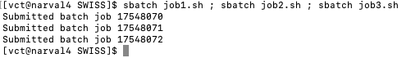
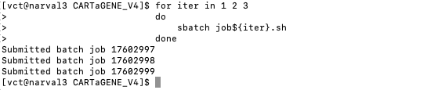
Parallel jobs – Launching multiple Jobs
To run jobs in parallel you could launch them all successively:
Example
Or even in a for loop :
If unfamiliar see next slide for a refresher.
In extreme cases (a lot of jobs), it is limiting because :
1) you have to write each script
2) compute Canada Might block you (for spamming)
Did you know:
while $ is the bash way of calling a variable,
{} : separates what is a variable form not a variable i.e. $aba is not ${ab}a it is not necessary in all context but also helps readability

Slide 3
For loop (Refresher)
For loops, in many (if not all) coding language, a for loop refers to a loop with a predefine number or iteration (i.e. a pass)
Breaking down the example
The general form
For X in {the value that X need to be applied} do {bash syntax} Execution ${X} 1) execute once per value specified 2) ${} calls the variable inside (this case X) done {closing}

Slide 4
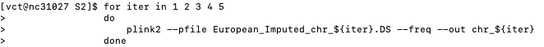
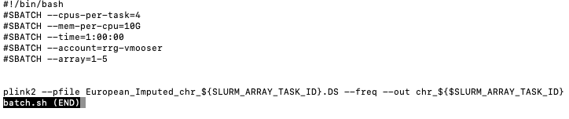
Parallel jobs – Array
Similarly, to for loop, the goal is to make a variable, $SLURM_ARRAY_JOB_ID take a different value in jobs executed in parallel.
This not parallelized for loop code (which computes variant frequency for chromosome 1 to 5 separately) :
Can be parallelize by summitting (i.e. sbatch) this script :
Same as a regular sbatch submission
Array specification

Slide 5
Parallel jobs – Array
#SBATCH array accepts :
Only Numbers are accepted
Dash (i.e. -) to signify everything in between
Example 1-10 -> $SLURM_ARRAY_JOB_ID (or ${SLURM_ARRAY_JOB_ID}) will take the value of 1 2 3 4 5 6 7 8 9 10 in different parallel instances.
Comma (i.e. ,) to signify nothing in between
Example 1,10 -> $SLURM_ARRAY_JOB_ID (or ${SLURM_ARRAY_JOB_ID}) will take the value of 1 and 10 in different parallel instances.
Colon (i.e. : ) to signify steps (i.e. iterate skipping x value)
Example 1-10:2 -> $SLURM_ARRAY_JOB_ID (or ${SLURM_ARRAY_JOB_ID}) will take the value of 1 3 5 7 9 in different parallel instances.
modulo (i.e. % ) to limit the number of job that can be active at any given time
Example 1-10%4 -> If job 1 2 3 and 4 are running, the system will wait until one is finished to start 5 and so on.

