Slide 1
High Performance Computing (HPC) Cluster
Compute Canada (aka Digital Research Alliance of Canada)

Slide 2
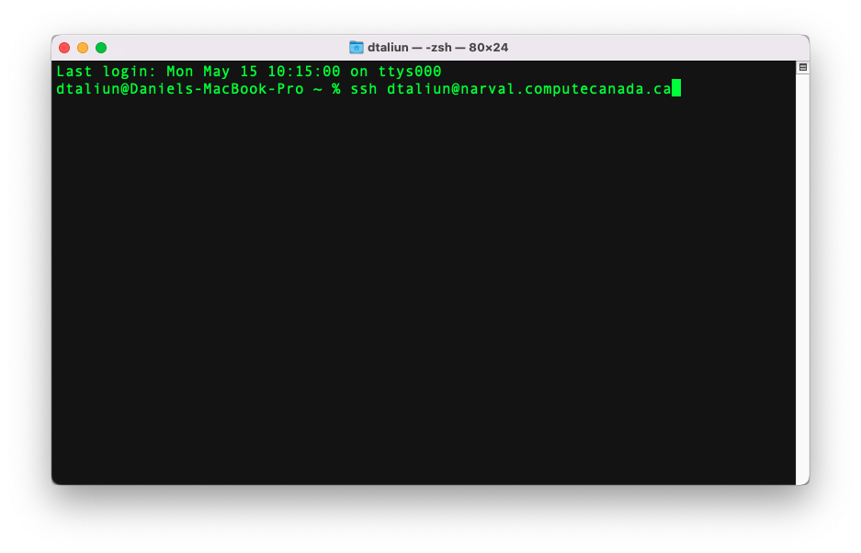
How do you log in?
ssh <your username>@narval.computecanada.ca

Slide 3
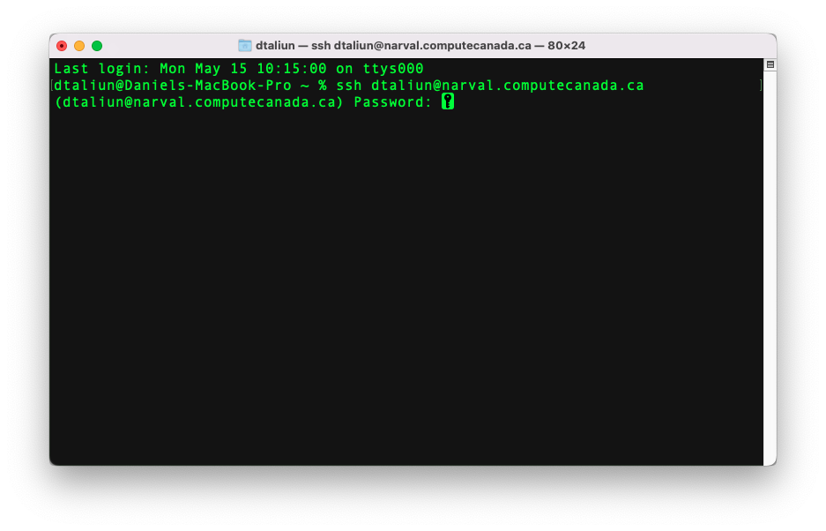
How do you log in?
Enter your password

Slide 4
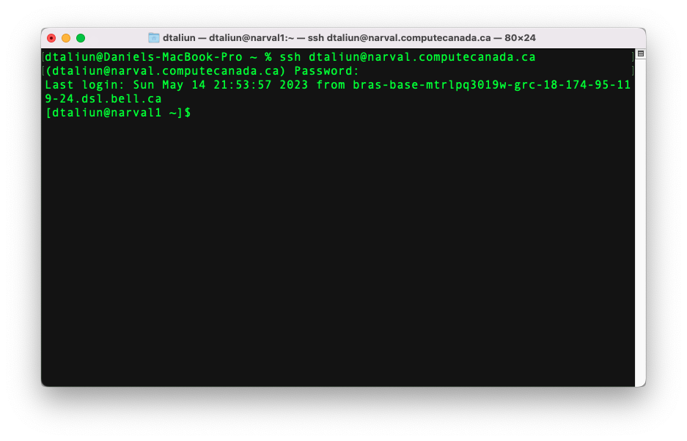
How do you log in?
It will take a few seconds to connect
your username
narval1 – name of the machine you are connected to

Slide 5
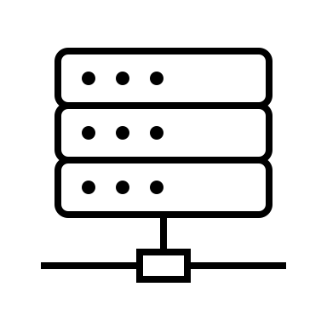

You are automatically connected to one of the available Login Nodes
Login node – narval1
ssh <your username>@narval.computecanada.ca

Slide 6
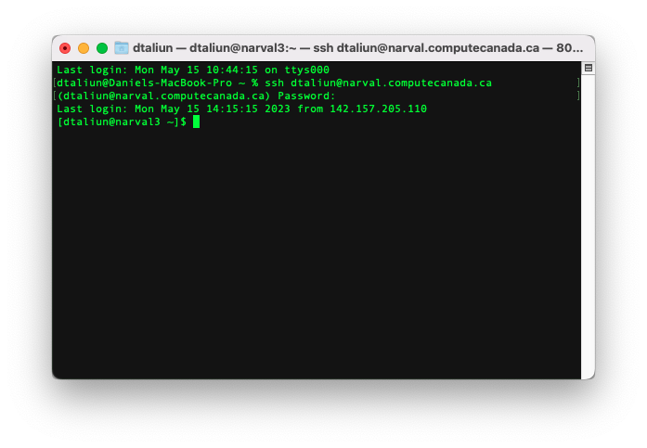
There are multiple login nodes: each time you log in, you can get different one
narval3 – name of the machine you are connected to

Slide 7
You can explicitly specify a login node
narval1
narval2
narval3
narval4
ssh <your username>@narval2.computecanada.ca

Slide 8
Login Nodes
Use only for short/small interactive work/jobs e.g. code development, visualizations, simple file manipulations
You can use maximum 8GB of memory (RAM)
Use of multi-threading is very limited
Has connection to internet i.e. use login nodes to download external files to HPC cluster

Slide 9


Overview
Storage ~/projects/ ~/scratch/
~/home/
Login Nodes
WWW (Internet)
ssh

Slide 10
How do you run many heavy computational jobs?

Slide 11
Compute nodes
Compute Nodes
Storage ~/projects/ ~/scratch/
~/home/
Login Nodes
WWW (Internet)
ssh

Slide 12
You can’t directly connect to compute nodes
Compute Nodes
Storage ~/projects/ ~/scratch/
~/home/
ssh
Login Nodes
WWW (Internet)

Slide 13
Compute nodes are not connected to internet
Compute Nodes
Storage ~/projects/ ~/scratch/
~/home/
Login Nodes
WWW (Internet)
ssh

Slide 14
How do you run computations on compute nodes?
Compute Nodes
Storage ~/projects/ ~/scratch/
~/home/
Login Nodes
WWW (Internet)
ssh

Slide 15
Use SLURM job scheduler installed on login nodes
Compute Nodes
Storage ~/projects/ ~/scratch/
~/home/
SLURM (sbatch, squeue, scontrol, srun)
Login Nodes
WWW (Internet)
ssh

Slide 16
What happens when you use JupyterHub?

Slide 17
1) JupyterHub asks SLURM to reserve a compute node
Compute Nodes
Storage ~/projects/ ~/scratch/
~/home/
SLURM (sbatch)
https://jupyterhub.narval.computecanada.ca

Slide 18

2) Wait until a compute node is available

Slide 19

3) You get access to a compute node through a secure channel
Compute Nodes
Storage ~/projects/ ~/scratch/
~/home/
https://jupyterhub.narval.computecanada.ca

Slide 20
Good luck!

