Slide 1
Version control
Introduction to GitHub

Slide 2
Version control system
Version control system – tracks and manages the modifications to the project’s source code and related files
Git (or GitHub) – is the only one, most wide-spread, example of such system
It ensures that your project’s changes are never lost and you can go back to any version you want at any time
It allows multiple people to work on the same project’s code simultaneously

Slide 3
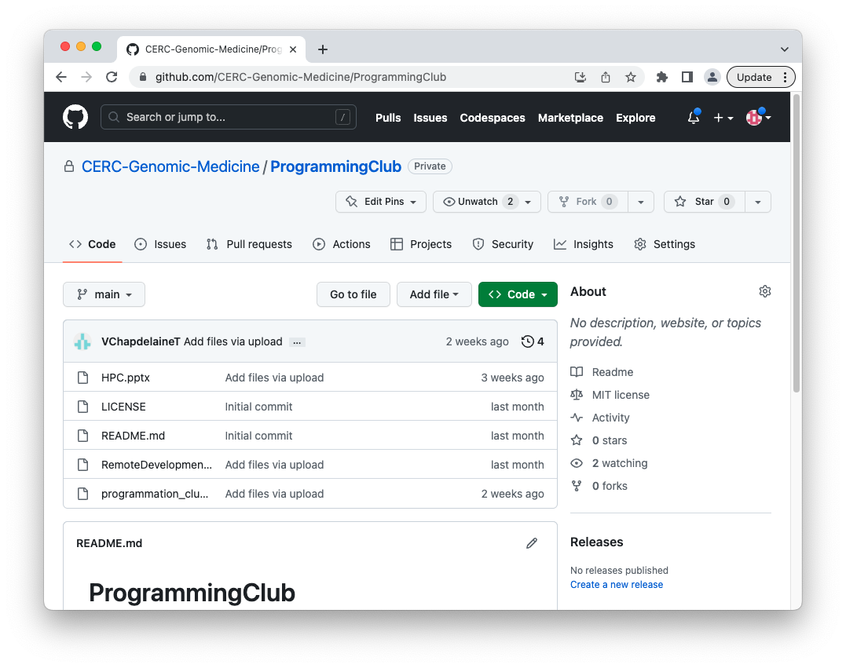
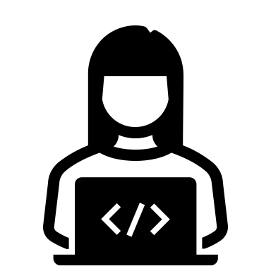
GitHub remote repository
Remote repository – central repository containing source code and all relevant files for a project.
The remote repository is accessible through https://github.com/.
Remote repository at github.com

Slide 4
GitHub remote repository allows collaborations
Multiple developers can access and work with remote repositories at the same time.
Remote repository at github.com

Slide 5
Modifying files in a remote repository
You can modify files in a remote repository directly from the Web browser at https://github.com
Examples:
Editing README files or other documentation
Uploading/deleting/renaming files
But you can’t run and debug your code at https://github.com

Slide 6
GitHub local repository
To perform more complex work on a project’s remote repository (e.g. programming and testing), you need to copy it to the machine you are working on.
The copy of the remote repository on your machine is called the local repository.
Local
repository
Remote repository at github.com
copy

Slide 7
GitHub clone
Use `git clone` command to copy the remote repository
Local
repository
Remote repository at github.com
git clone

Slide 8
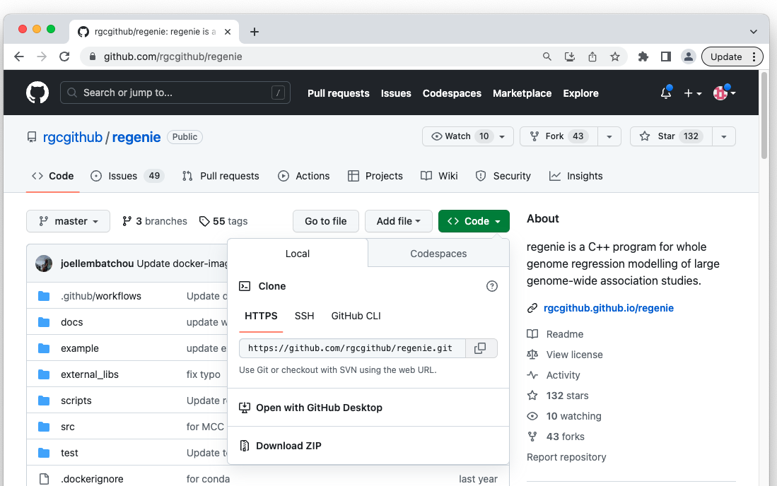
Example: clone Regenie repository to Compute Canada server (1/3)
(1) Open the remote directory in your browser
(2) Click on “Code”
(3) Copy HTTPS link

Slide 9
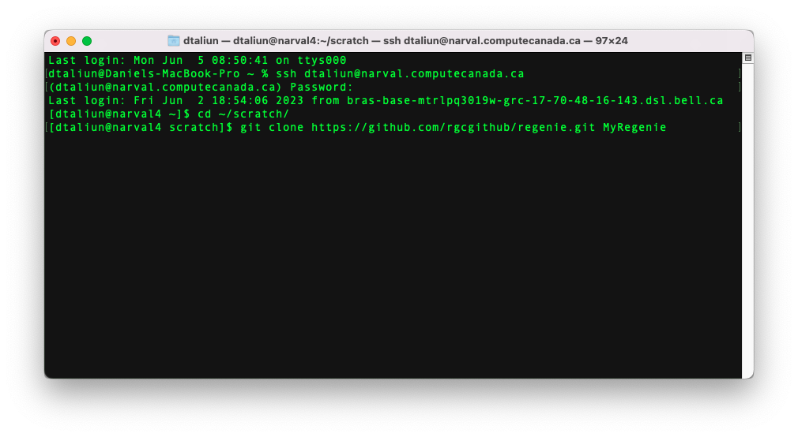
Example: clone Regenie repository to Compute Canada server (2/3)
(1) Login to the Compute Canada node
(2) Change to the directory you want
HTTPS link to the remote repository
New directory name where to store local repository
(3) Type `git clone` command

Slide 10
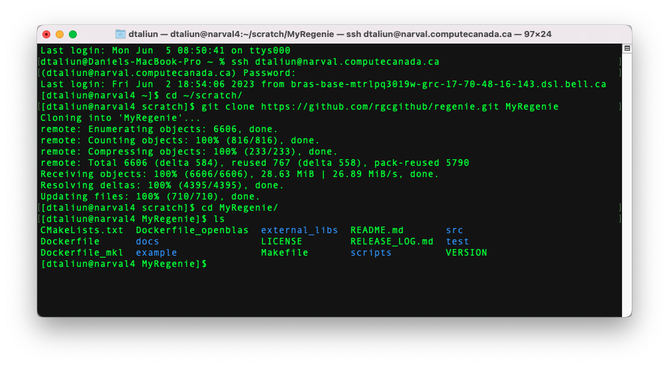
Example: clone Regenie repository to Compute Canada server (3/3)
When done, MyRegenie directory will have exactly the same content as the remote repository

Slide 11
No limit on the number of local repositories
You can have many local repositories
Compute Canada
Local repository at ~/scratch/MyRepo2
Local repository at ~/scratch/MyRepo1
Laptop/Desktop
Remote repository at github.com
Local repository at /Documents/MyRepo

Slide 12
Working directory
Working directory - the directory on your machine where you cloned the remote repository.
Working directory

Slide 13
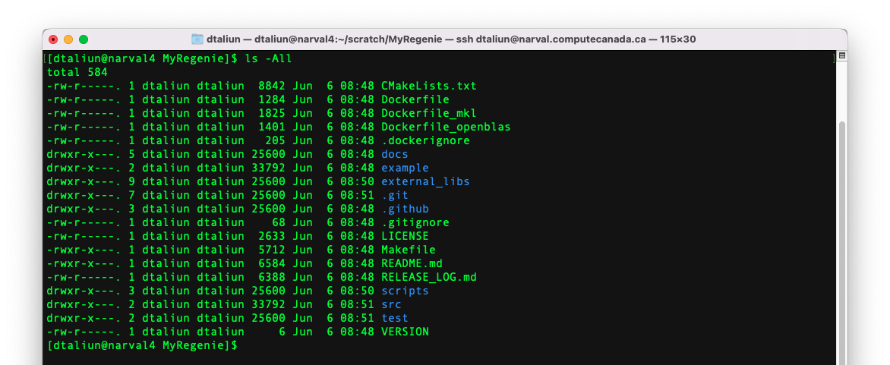
Local repository is hidden
The local repository files are maintained by Git and are hidden from your eyes in a hidden folder `.git` inside the working directory.
Inside working directory
Hidden files of local repository
Never alter files inside the hidden `.git` directory yourself!

Slide 14
Editing files inside working directory
Inside your working directory, you can:
Edit all files (except .git) inside the working directory
Create new files/directories or delete existing ones (except .git)
But any changes that you make in the working directory are not saved to the local repository!
Thus, at any time, you can undo changes in the working directory and start over

Slide 15
How do you save your changes to remote repository?

Slide 16
First step - commit
Use `git commit` command to save changes in the working directory to the local repository
Working directory
Local repository
Remote repository at github.com
git commit

Slide 17
Second step – push
Use `git push` command to update the remote repository with your changes
Working directory
Local repository
Remote repository at github.com
git commit
git push

Slide 18
Commit/push summary
You can do multiple `git commit` commands before the `git push`.
Until you do `git commit`, you can undo changes in the working directory.
Until you do `git push,` nobody else but you can see the changes.
Until you do `git push,` you are still at risk of losing all your changes if something happens to your machine.
After you do `git push,` everybody will be able to see your changes.

Slide 19
How do you get the latest changes from the remote repository?

Slide 20
Simplest way - pull
Use `git pull` to update your local repository and working directory with the latest changes from the remote repository
git pull
Working directory
Local repository
Remote repository at github.com

Slide 21
GitHub restrictions
Store only your source code and documentation. (Note: you can store genetic data from public studies such as 1000 Genomes Project, HGDP, and etc)
Don’t store any individual-level information in our studies:
Individual IDs
Phenotypic values
Genotypic values
Don’t store large files e.g. >100 Mb.

Slide 22
Important concepts to remember
Remote repository
Local repository
Working directory
Commit
Push
Pull

Slide 23
Good luck!

