Slide 1
Remote Development
Setting up your development environment

Slide 2
Remote vs local development
Local development | Remote development
You can edit and run code from your local computer | You can edit and run code from your local computer
Code resides on your local computer | Code resides on the remote server
Code is run on your local computer | Code is run on the remote server
Input and output files must be located on your local computer | Input and output files must be located on the remote server
All necessary software libraries and packages must be installed on your local computer | All necessary software libraries and packages must be installed on the remote server

Slide 3
Disadvantages of local development
Installing and maintaining all necessary software libraries and packages on your local computer may be time-consuming.
To deploy and run your code on the remote server, you must manually copy it and ensure all library versions are compatible between local and remote machines.
Input data may be too large to be on the local computer or under privacy regulations.
Your local computer may not meet required computational requirements.

Slide 4
Disadvantages of remote development
To experience full benefits, it requires specialized integrated development environments (IDE) and other tools

Slide 5


Examples remote development tools you may know
Rstudio
Jupyter Notebook
Both are available on Compute Canada through JupyterHub at https://jupyterhub.narval.computecanada.ca/ or https://jupyterhub.beluga.computecanada.ca/

Slide 6
The simplest way to remotely write Python code
Use SSH terminal to connect to the remote server
Then, use command line editors (nano, vim) to write the code

Slide 7
The simplest way to remotely write Python code
Use SSH terminal to connect to the remote server
Then, use command line editors (nano, vim) to write the code
This is not ideal because of the limited amount of features that command-line editors can provide and steep learning curve

Slide 8
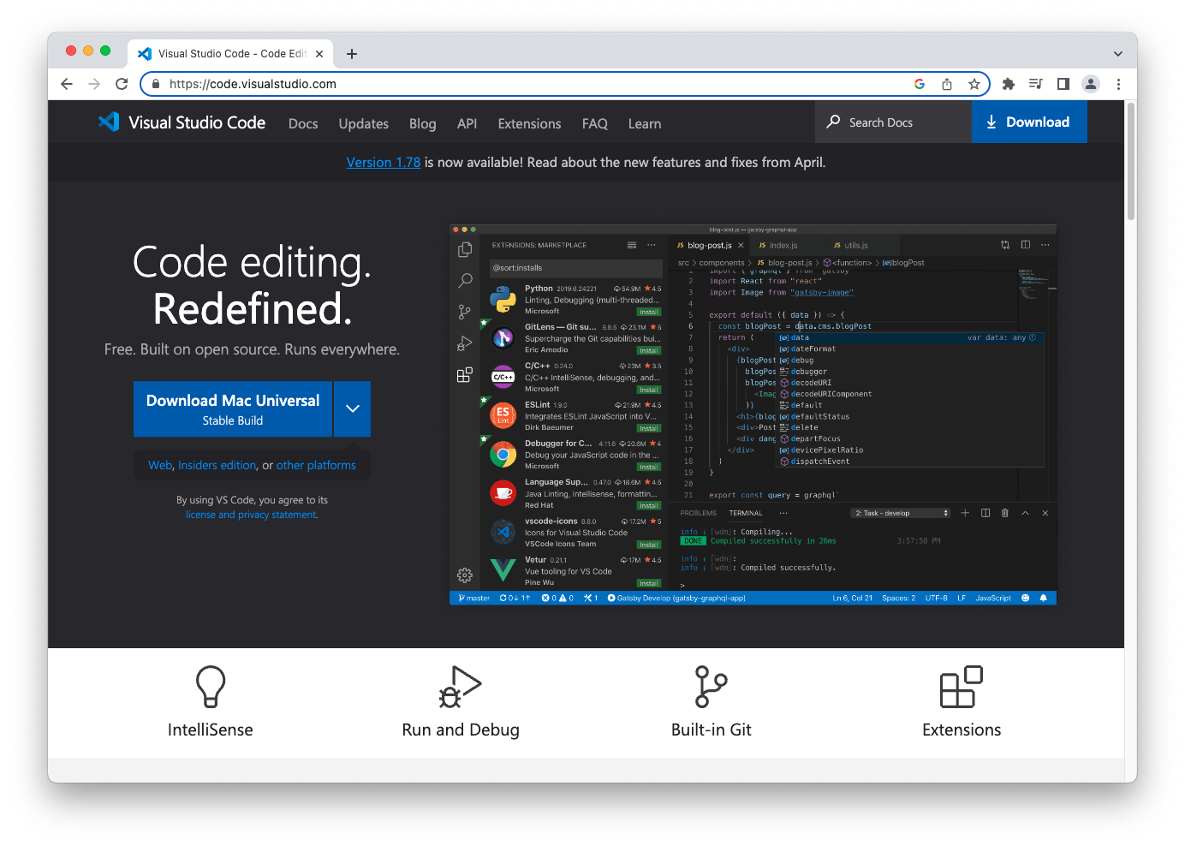
Visual Studio Code – is a free IDE allowing the remote development
https://code.visualstudio.com/

Slide 9
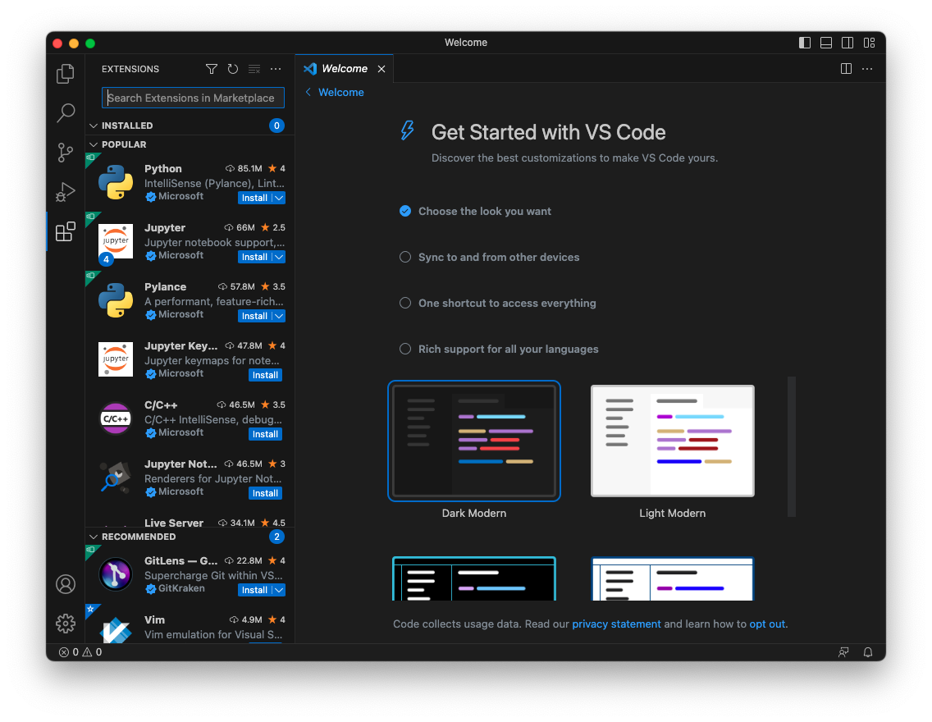
1. Open “Extensions”

Slide 10
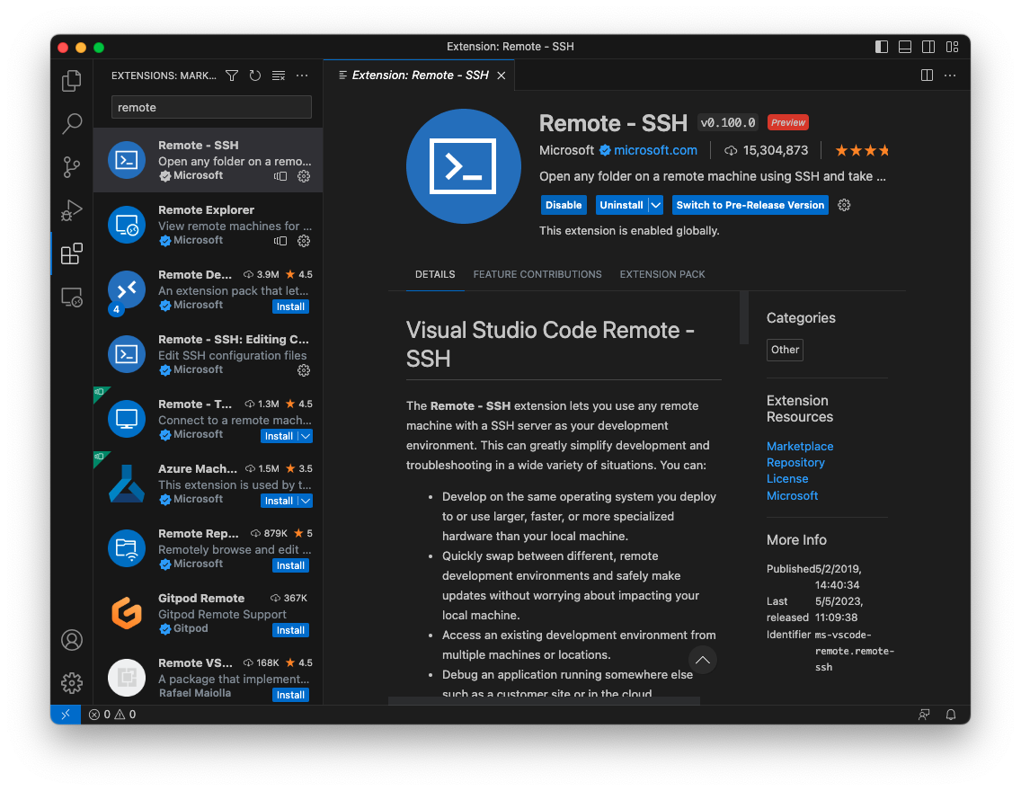

2. Find and install the “Remote– SSH” extension

Slide 11
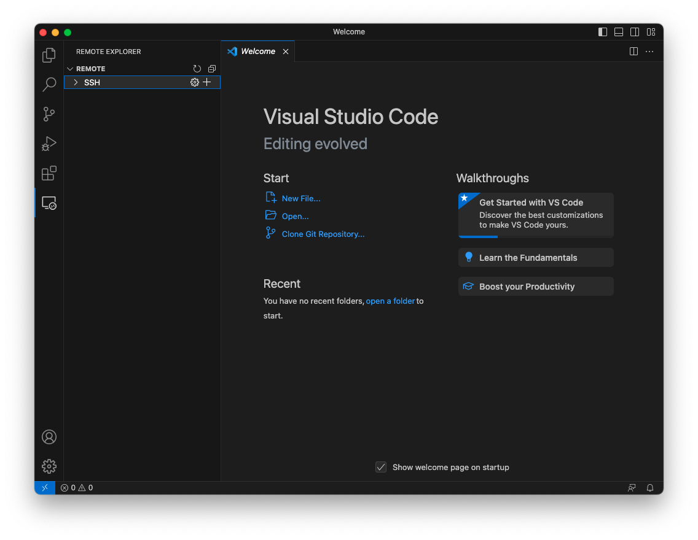

3. Open “Remote Explorer”

Slide 12
4. Click on “New remote” near “SSH”

Slide 13
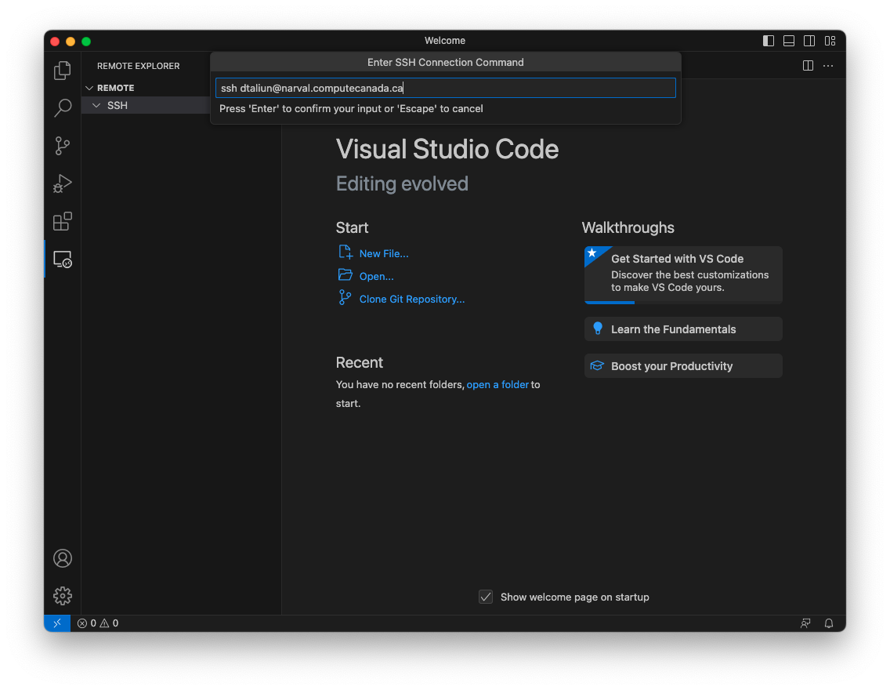

5. Enter SSH login command
* The template for the SSH command: ssh <your username>@narval.computecanada.ca

Slide 14
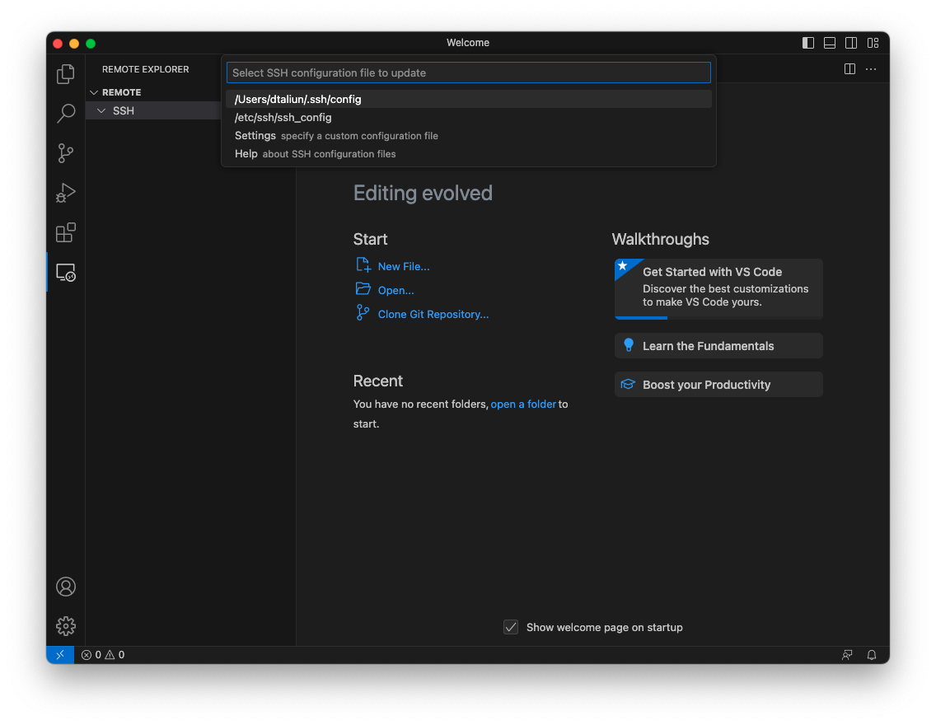

6. Choose the first SSH configuration file from the list
* The name of the SSH configuration can slightly differ between users and machines

Slide 15
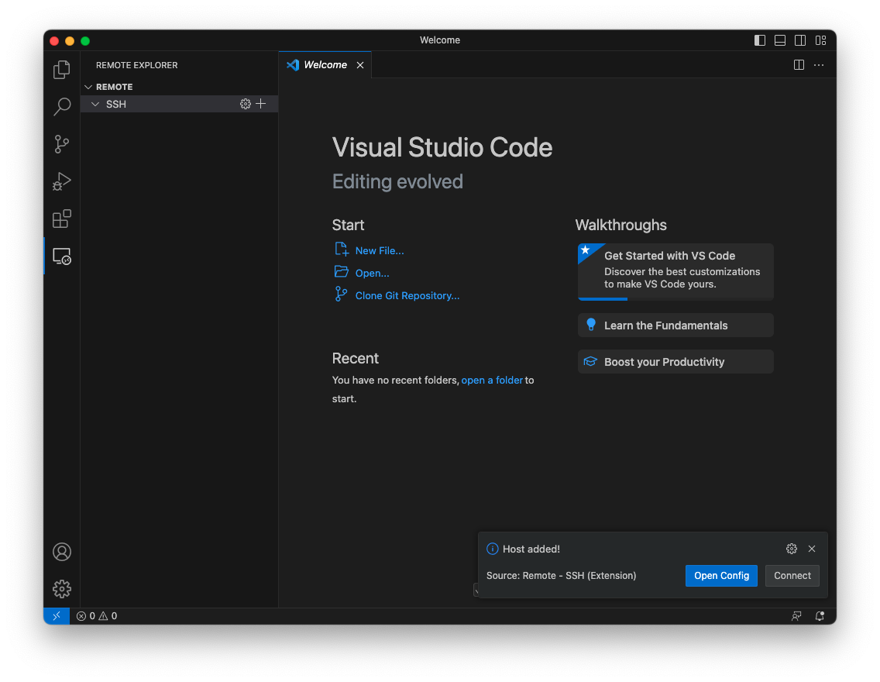

7. Click “Connect”

Slide 16
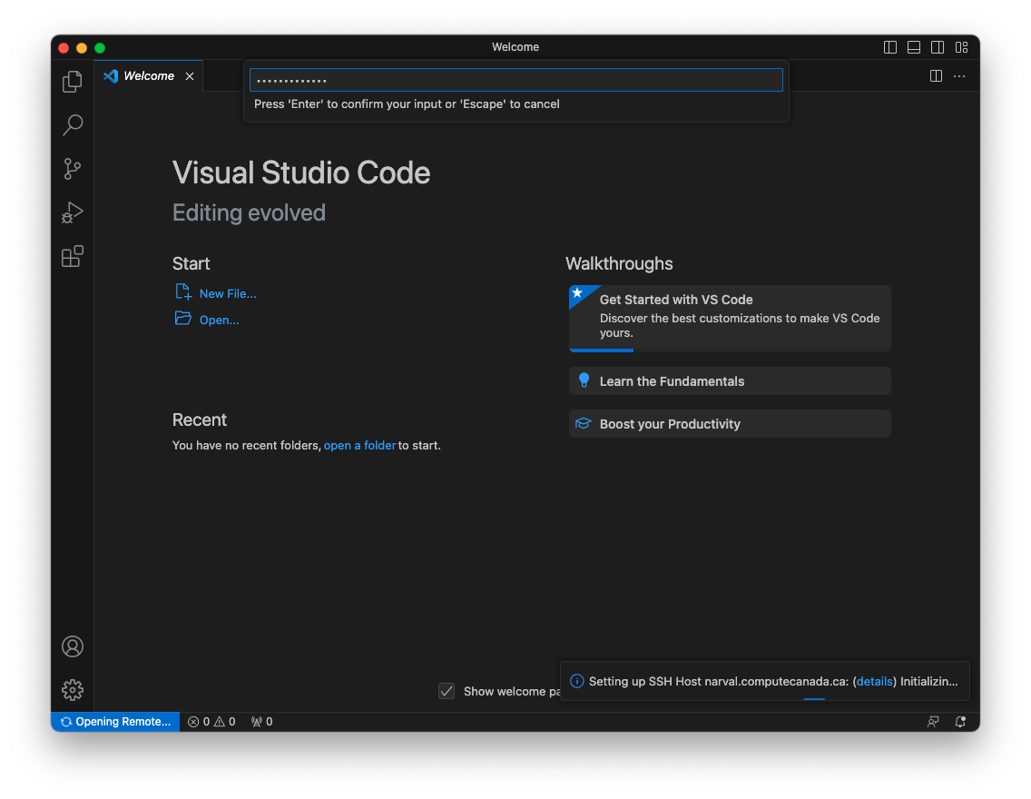

8. In a new window, enter your password again

Slide 17
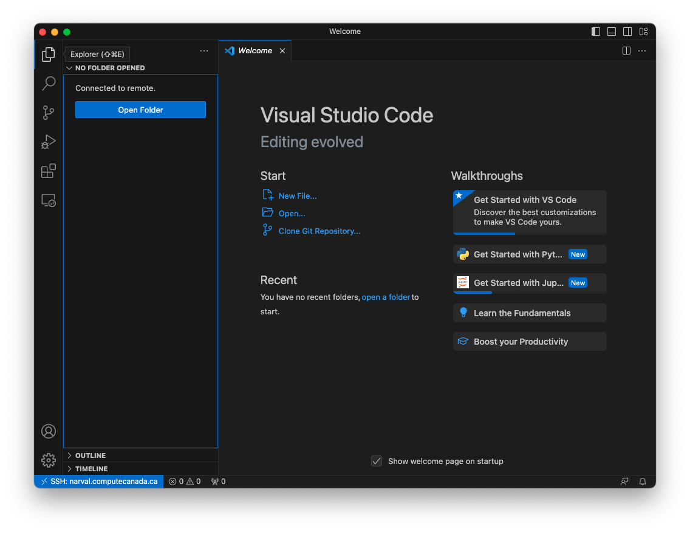
9. You are connected to the remote server! Open “Explorer” to start browsing remote files.

Slide 18
9. Click “Open Folder” to go to the specific remote directory

Slide 19
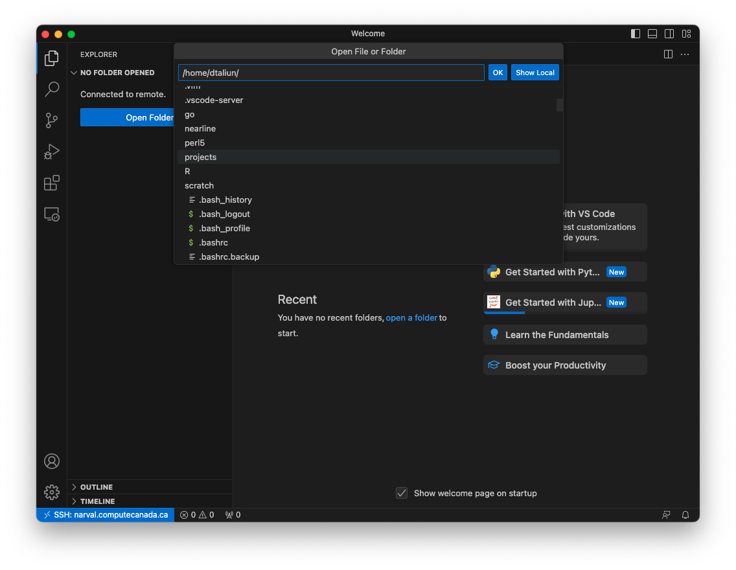

10. You can see all your directories on the server

Slide 20
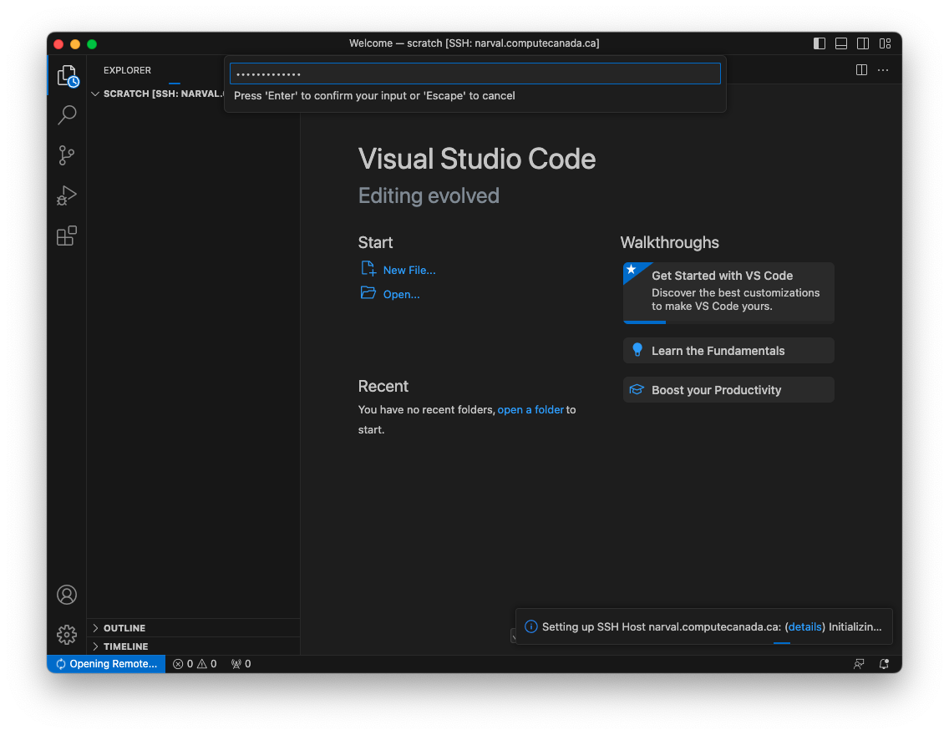

11. Once you selected the remote directory, enter your password once again

Slide 21
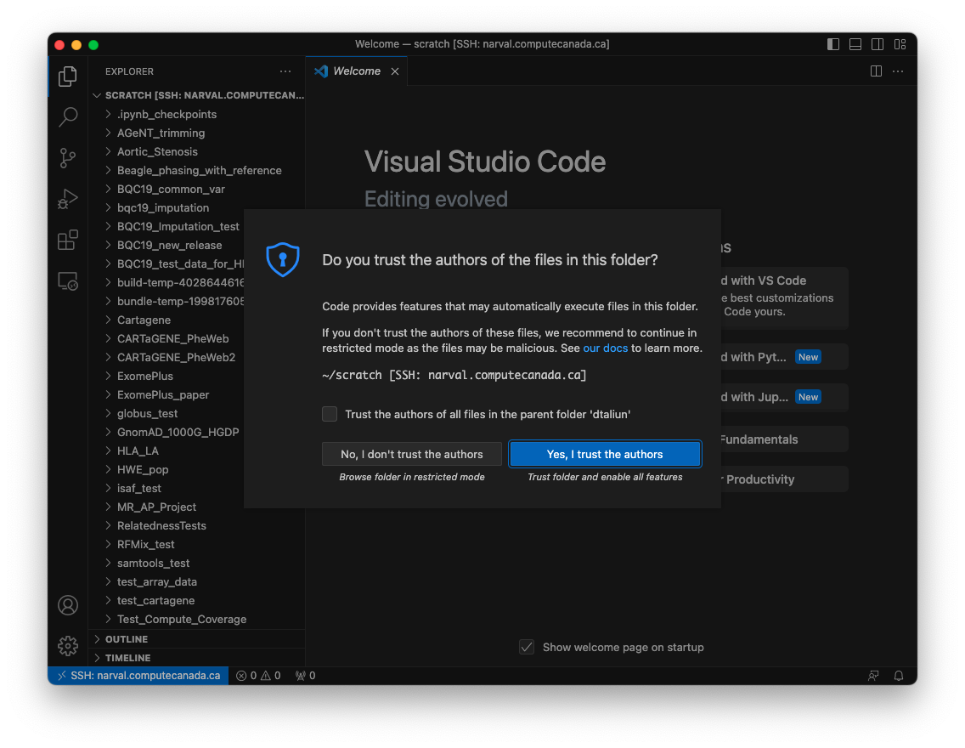

12. Confirm that you trust all files on the remote server

Slide 22
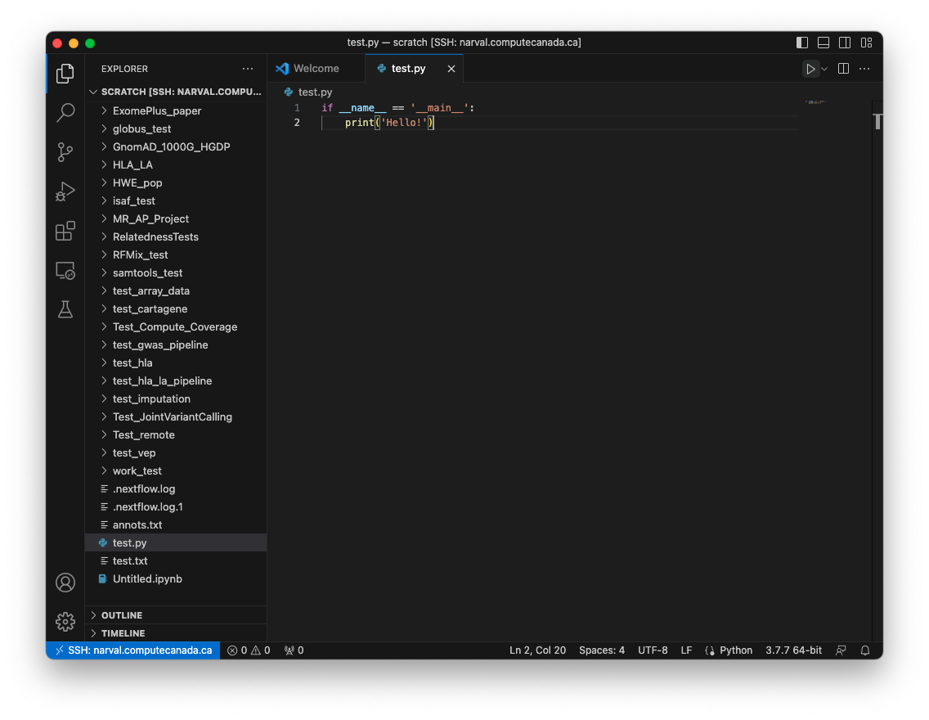
13. You can start creating and editing your code remotely!

Slide 23
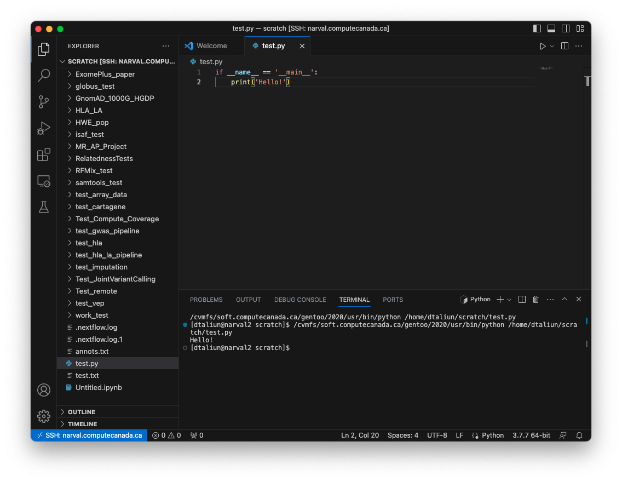

14. You can run your code remotely

Slide 24
Good luck!

