Slide 1

Rizal’s Life:Family, Childhood and Early Education

Slide 2
Word of the day:
Resilience

Slide 3
The Hero’s First Teacher:
The early education of Pepe began with his mother serving as his first teacher. As Rizal grew older, private tutors were hired, including Maestro Celestino and Lucas Padua. Later, an elderly man named Leon Monroy became his tutor. Subsequently, Rizal’s parent decided to enroll him in a private school in Biñan.

Slide 4
Jose Goes to Biñan:
On June 1869, Pepe left Calamba for Biñan with his brother Paciano. They rode in a carromata, and reached Biñan after 1 and a half hour. They proceeded to their Aunt’s house where Pepe will stay for the rest of his schooling.

Slide 5
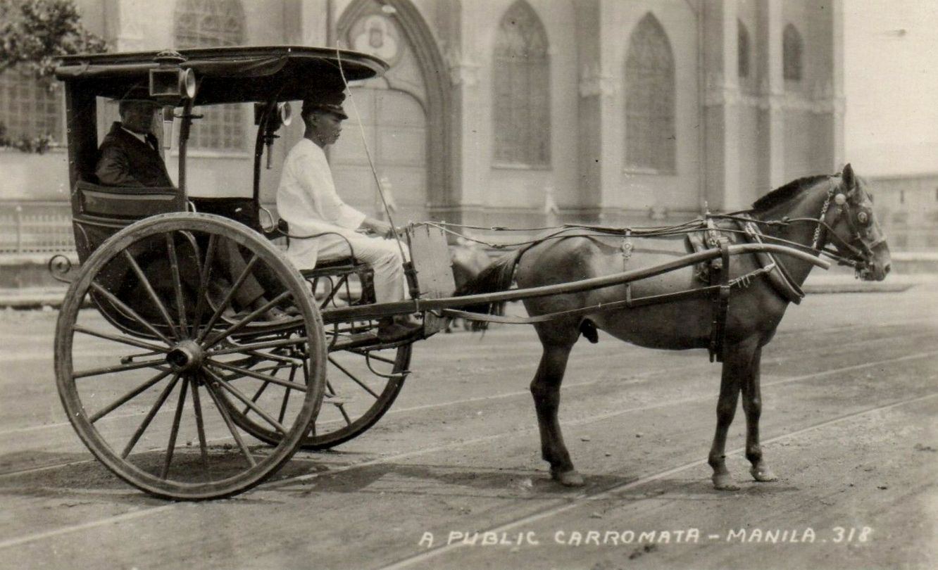

Slide 6
First Day In Biñan School:
The next morning, Paciano took his younger brother to he school of Maestro Justiniaino Aquino Cruz. He introduced Pepe to his former teacher and left for Calamba.

Slide 7
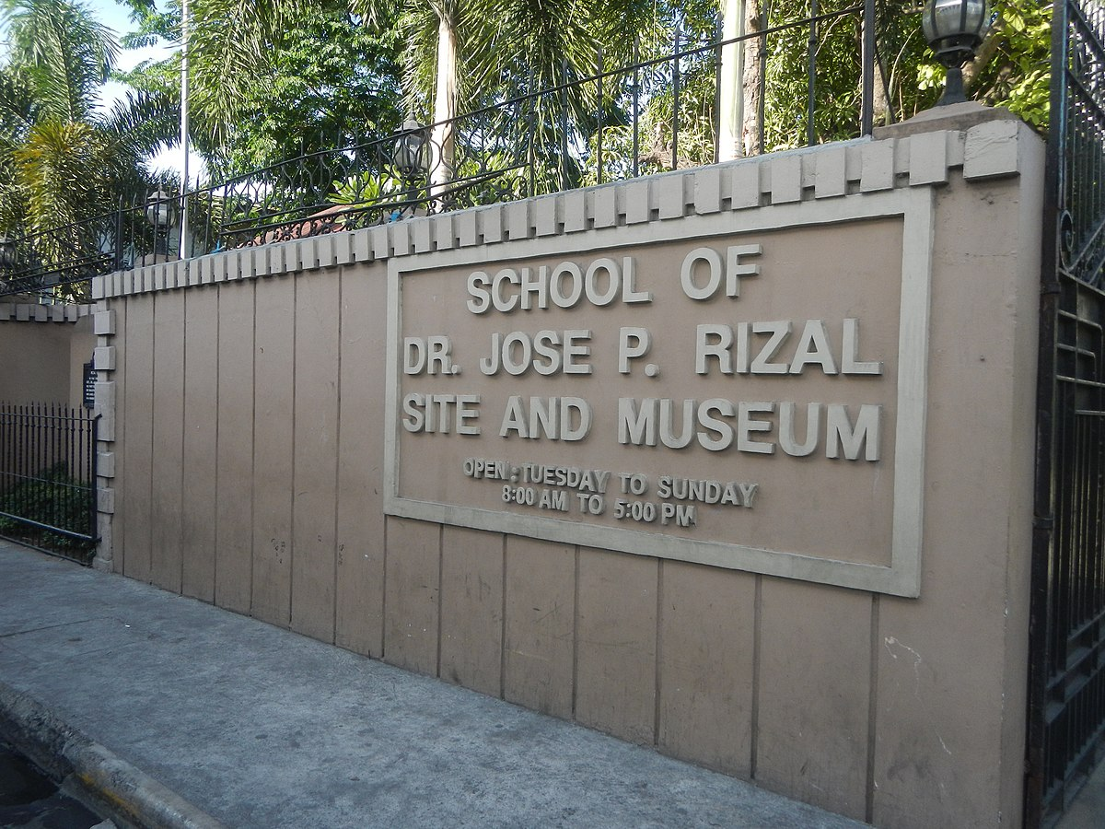

Slide 8
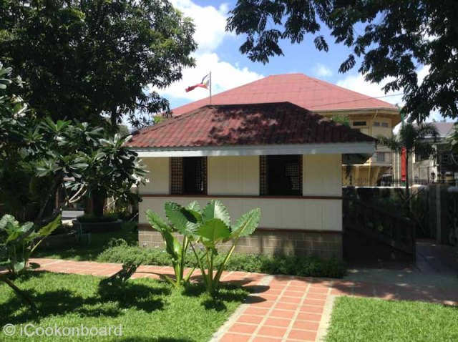

Slide 9
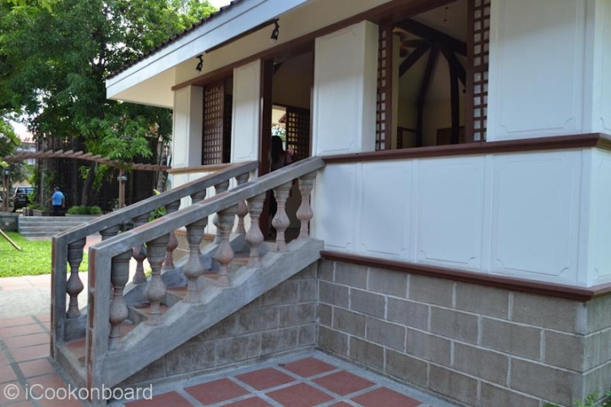

Slide 10
First School Brawl:
On his first afternoon at school, Jose Rizal encountered a bully named Pedro who had mocked him earlier in the day. Pepe, still upset challenged Pedro to a fight, which Pedro readily accepted.

Slide 11
Painting Lessons in Binan:
Near the school was the house of an old painter, called Juancho, who was the father-in-law of the school teacher. Jose, lured by his love for painting, spent many leisure hours at the painter’s studio. Old Juancho freely gave him lessons in drawing and painting. He was impressed by the artistic talent of the Calamba lad.

Slide 12
Daily Life in Biñan:
Jose led in methodical life in Binan, almost Spartan in simplicity. Such a life contributed much to his future development. It strengthened his body and soul

Slide 13
Best Student in School:
Pepe excelled in academic studies, surpassing all boys in Biñan in subjects like Spanish, Latin, and others. However, some older classmates harbored jealousy towards his intellectual superiority.

Slide 14
Ending of Biñan Schooling:
Before Christmas in 1870, Jose Rizal received a letter from his sister Saturnina, announcing the arrival of the streamer Talim that would transpost him from Biñan to Calamba.

Slide 15
