Slide 1

Rizal’s Life:Family, Childhood and Early Education

Slide 2
At the end of the lesson, the students should be able to:
Analyze the family, childhood, and early education of Rizal;
Evaluate the people and events and their influence on Rizal’s early life

Slide 3
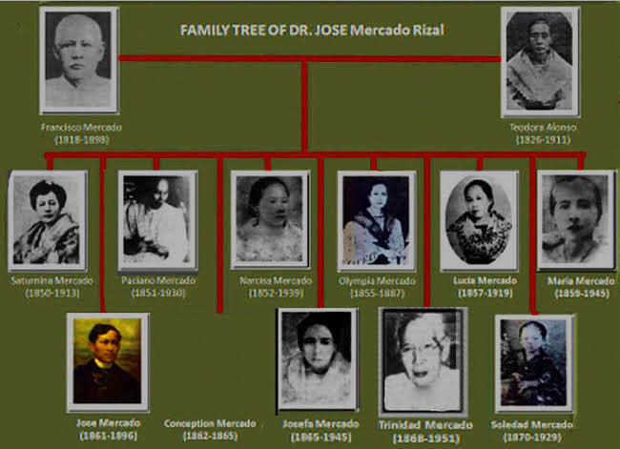

Slide 4
Rizal’s Childhood and Early Education
Name: Jose Protacio Rizal Mercado Y Alonzo Realonda
Nickname: Pepe
Birthdate: June 19, 1861
Birthplace: Calamba, Laguna
Baptized by: Father Rufino Collantes
God Father: Pedro Casañas

Slide 5
Rizal’s Childhood and Early Education
Sa Aking mga Kababata – Rizal’s first poem.
Uncle Manuel Alberto – teaches Rizal Physical skills
Uncle Jose – taught Rizal to love the Nature
Uncle Gregorio – instilled in Rizal’s mind the the love for Education.

Slide 6
Rizal’s Childhood and Early Education
Famous Novels: Noli Me Tangere and El Filibusterismo
Animals named after Rizal: Draco Rizali, Apogania Rizali, Rhacophorus Rizali
Animal Pet of Rizal: Big black dog, and Pony

Slide 7
To My Fellow Children
Whenever people of a country truly love The language, which by heaven they were taught to use That country also surely liberty pursue As does the bird which soars to freer space above. For language is the final judge and referee Upon the people in the land where it holds sway; In truth our human race resembles this way The other living beings born in liberty.

Slide 8
Whoever knows not how to love his native tongue Is worse than any beast or evil smelling fish. To make our language richer ought to be our wish The same as any mother loves to feed her young. Tagalog and the Latin language are the same And English and Castilian and the angel’s tongue; And God, whose watchful care o’er all is flung, Has given us His blessing in the speech we claim.

Slide 9
Our mother tongue, like all the highest that we know Had alphabet and letters of its very own; But these were lost – by furious waves were overthrown Like bancas in the stormy sea, long years ago.

Slide 10
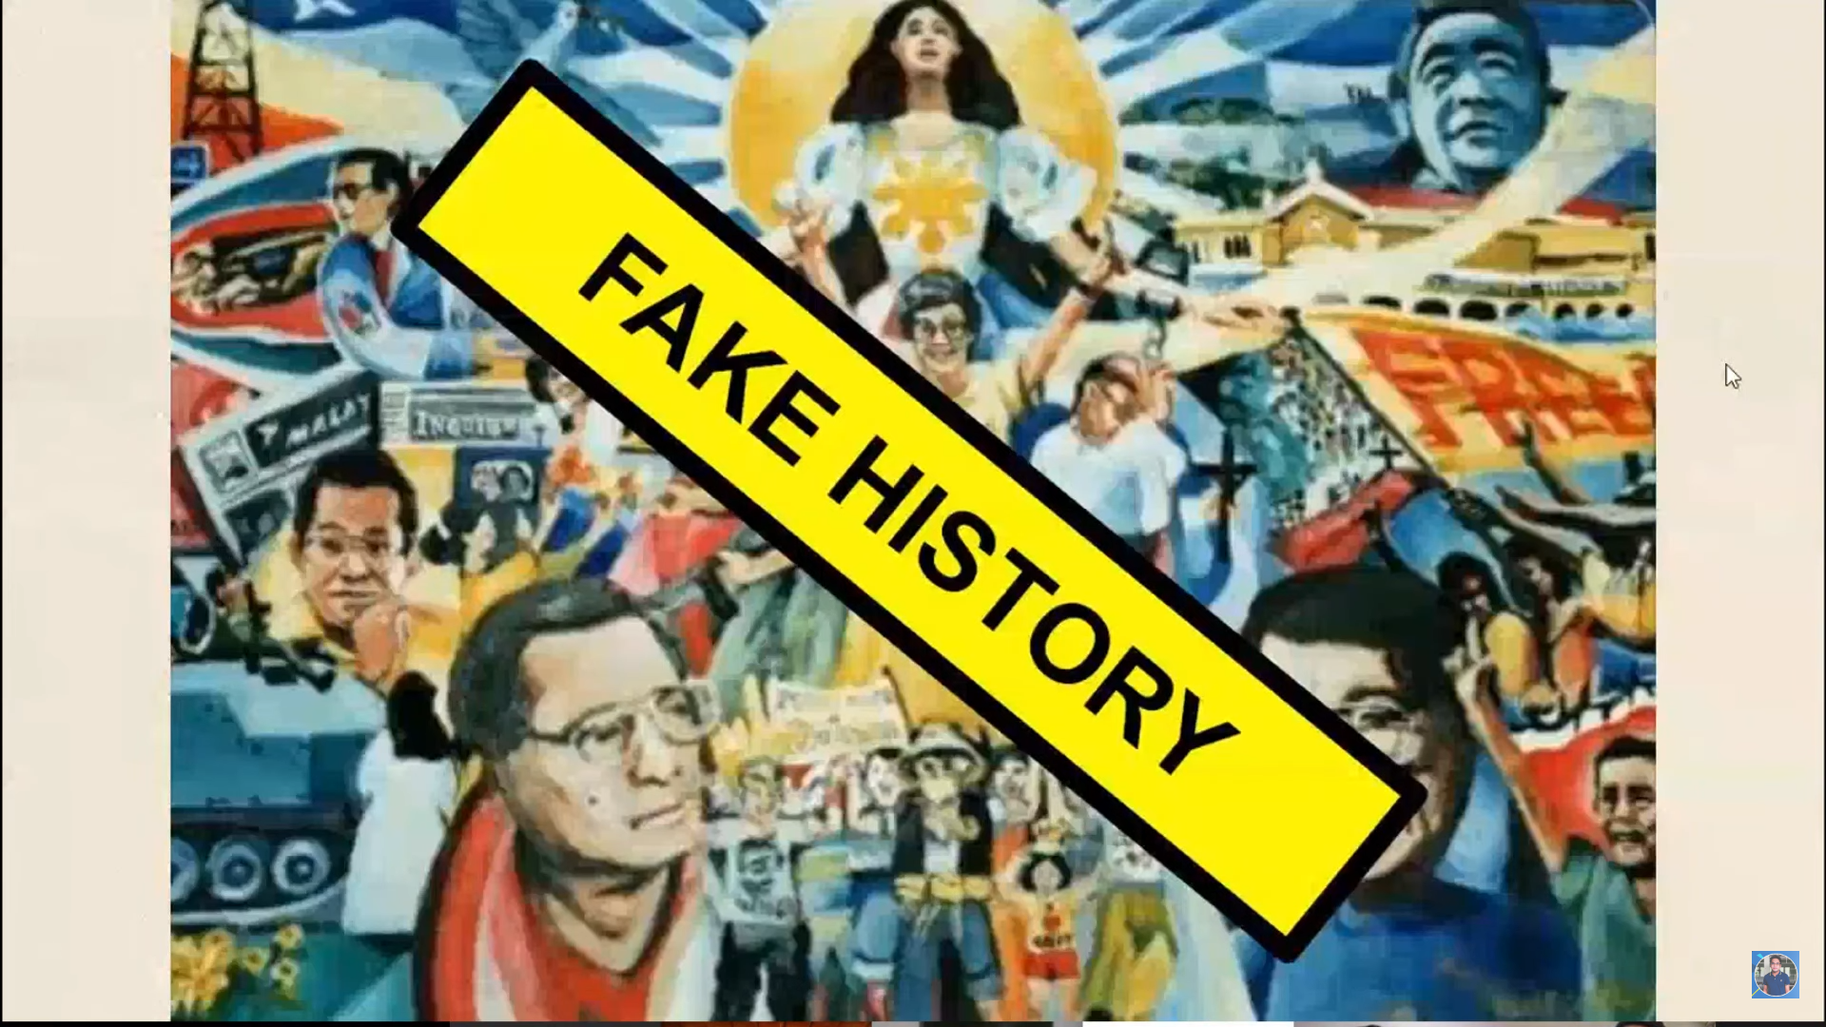
Our mother tongue, like all the highest that we know Had alphabet and letters of its very own; But these were lost – by furious waves were overthrown Like bancas in the stormy sea, long years ago.

